Slide 1
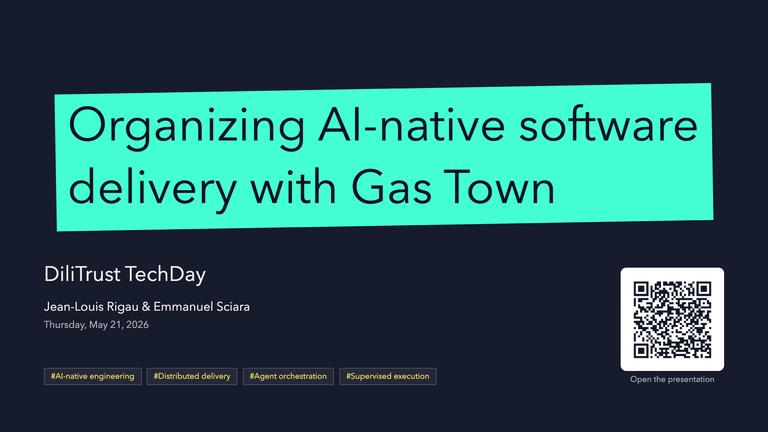
Notes:
Open on the model, not the tooling.
This is not "AI coding faster"; it is how delivery gets organized when AI workers become part of the engineering system.

Slide 2
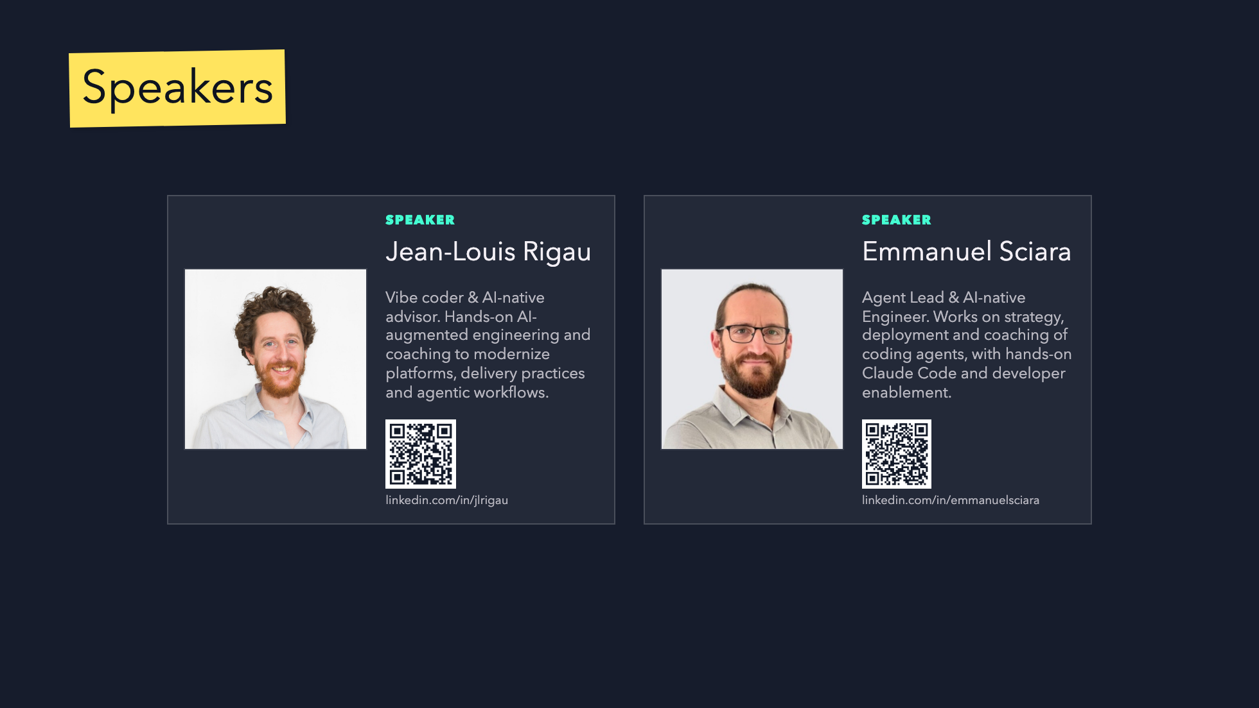
Notes:
Introduce the two presenters before moving into the AI practice evolution.
Keep the slide simple: names, photos, and the angle each speaker brings to the story.

Slide 3
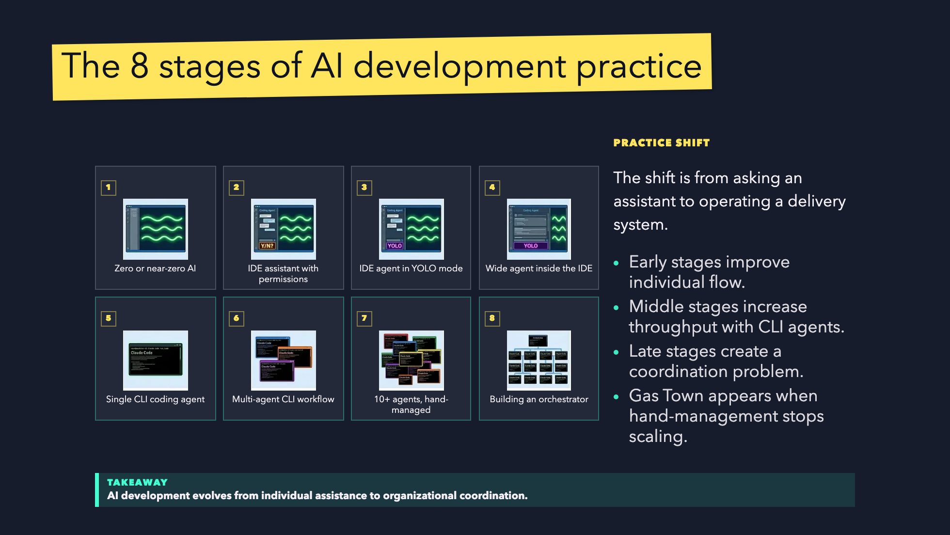
Notes:
Inspired by Steve Yegge's "The 8 Stages of Dev Evolution To AI" framing.
Use this as the bridge from personal AI practice to organizational orchestration.

Slide 4
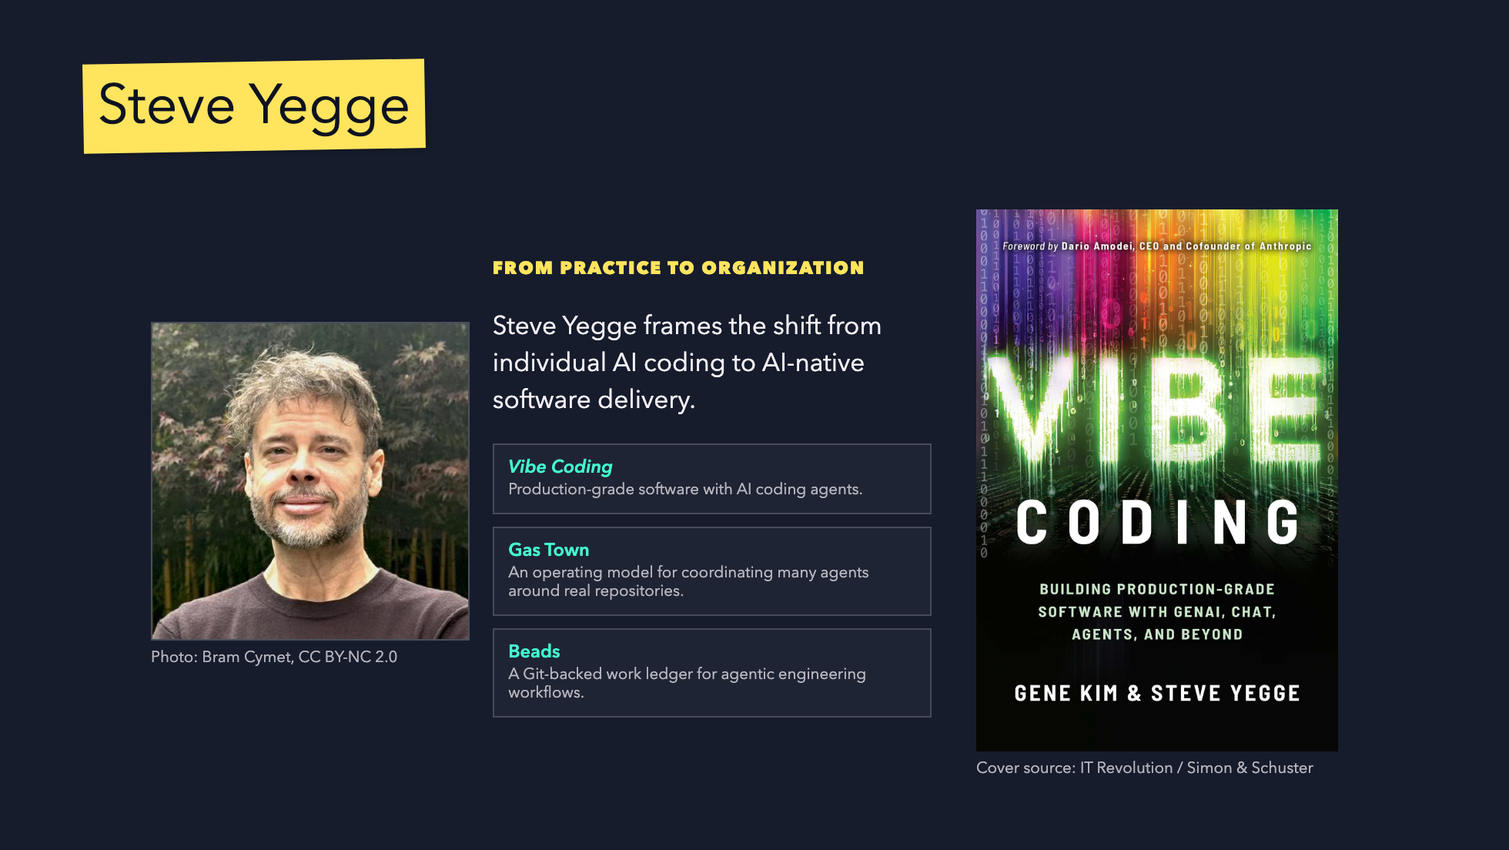
Notes:
Use this slide to ground the story in Steve Yegge's work before introducing the delivery problem.
Keep it short: creator, book, why it matters for the model.

Slide 5
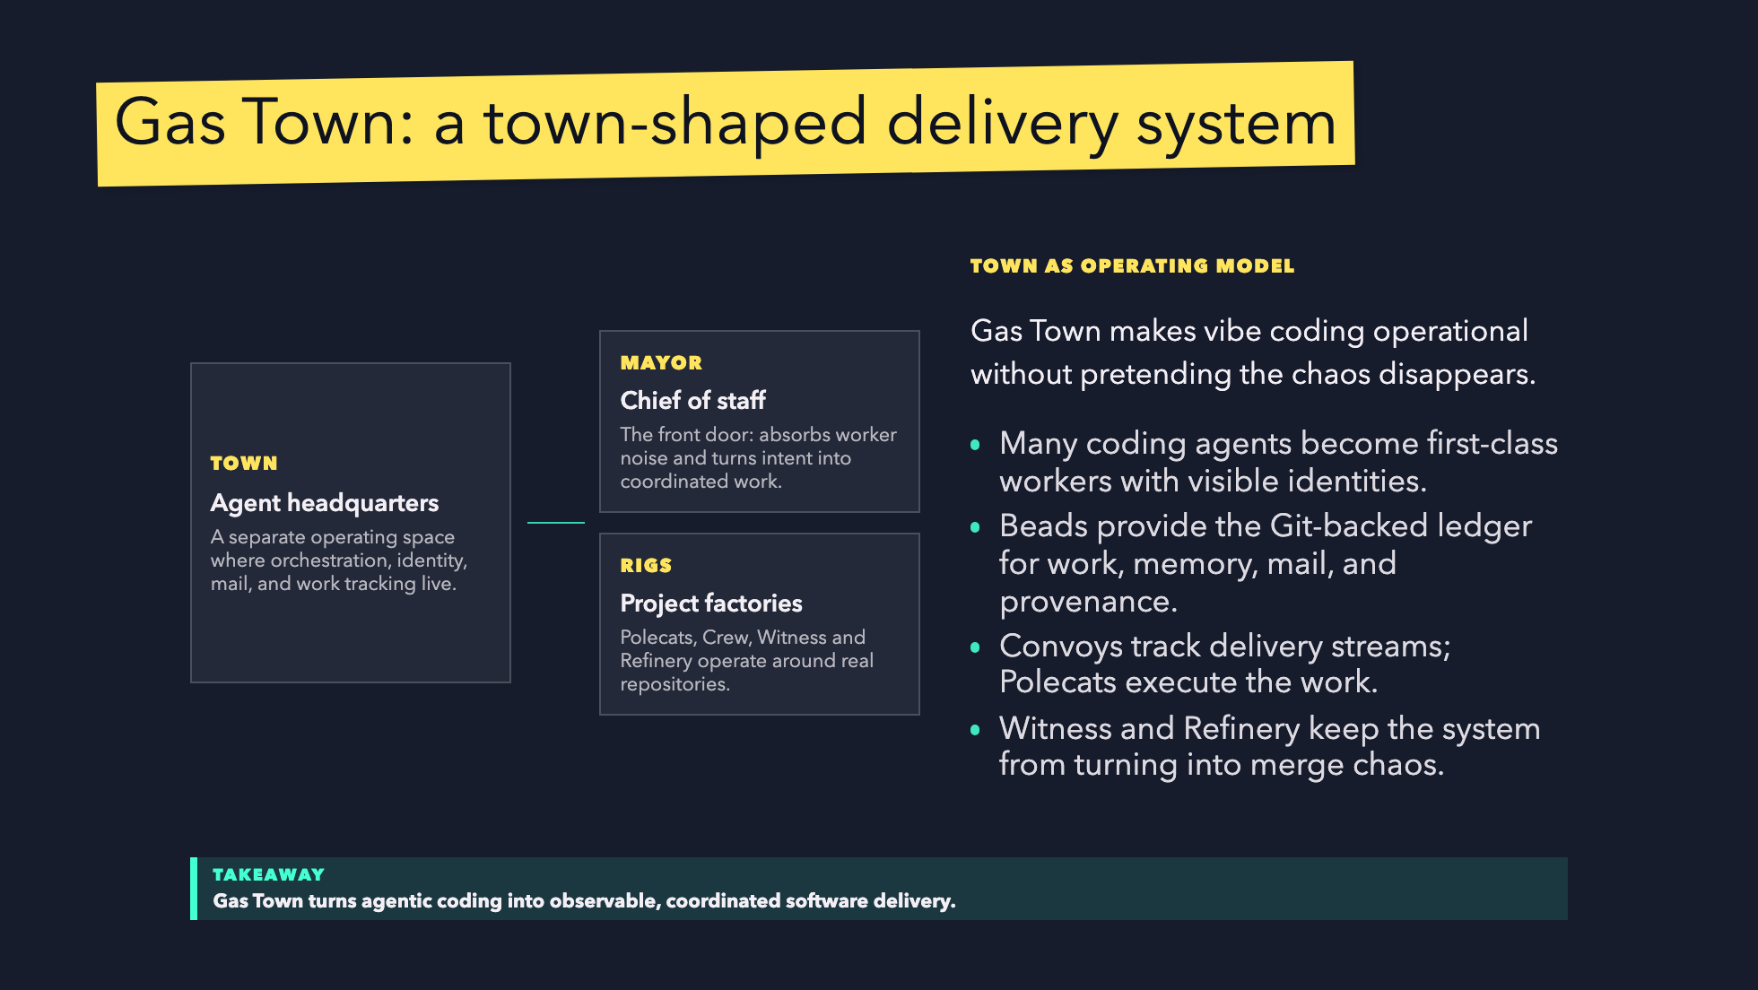
Notes:
Use this slide as the atmosphere and vocabulary bridge before the problem slide.
The story: Gas Town starts from vibe-coding chaos, then adds city-like operating roles so delivery can be supervised.

Slide 6
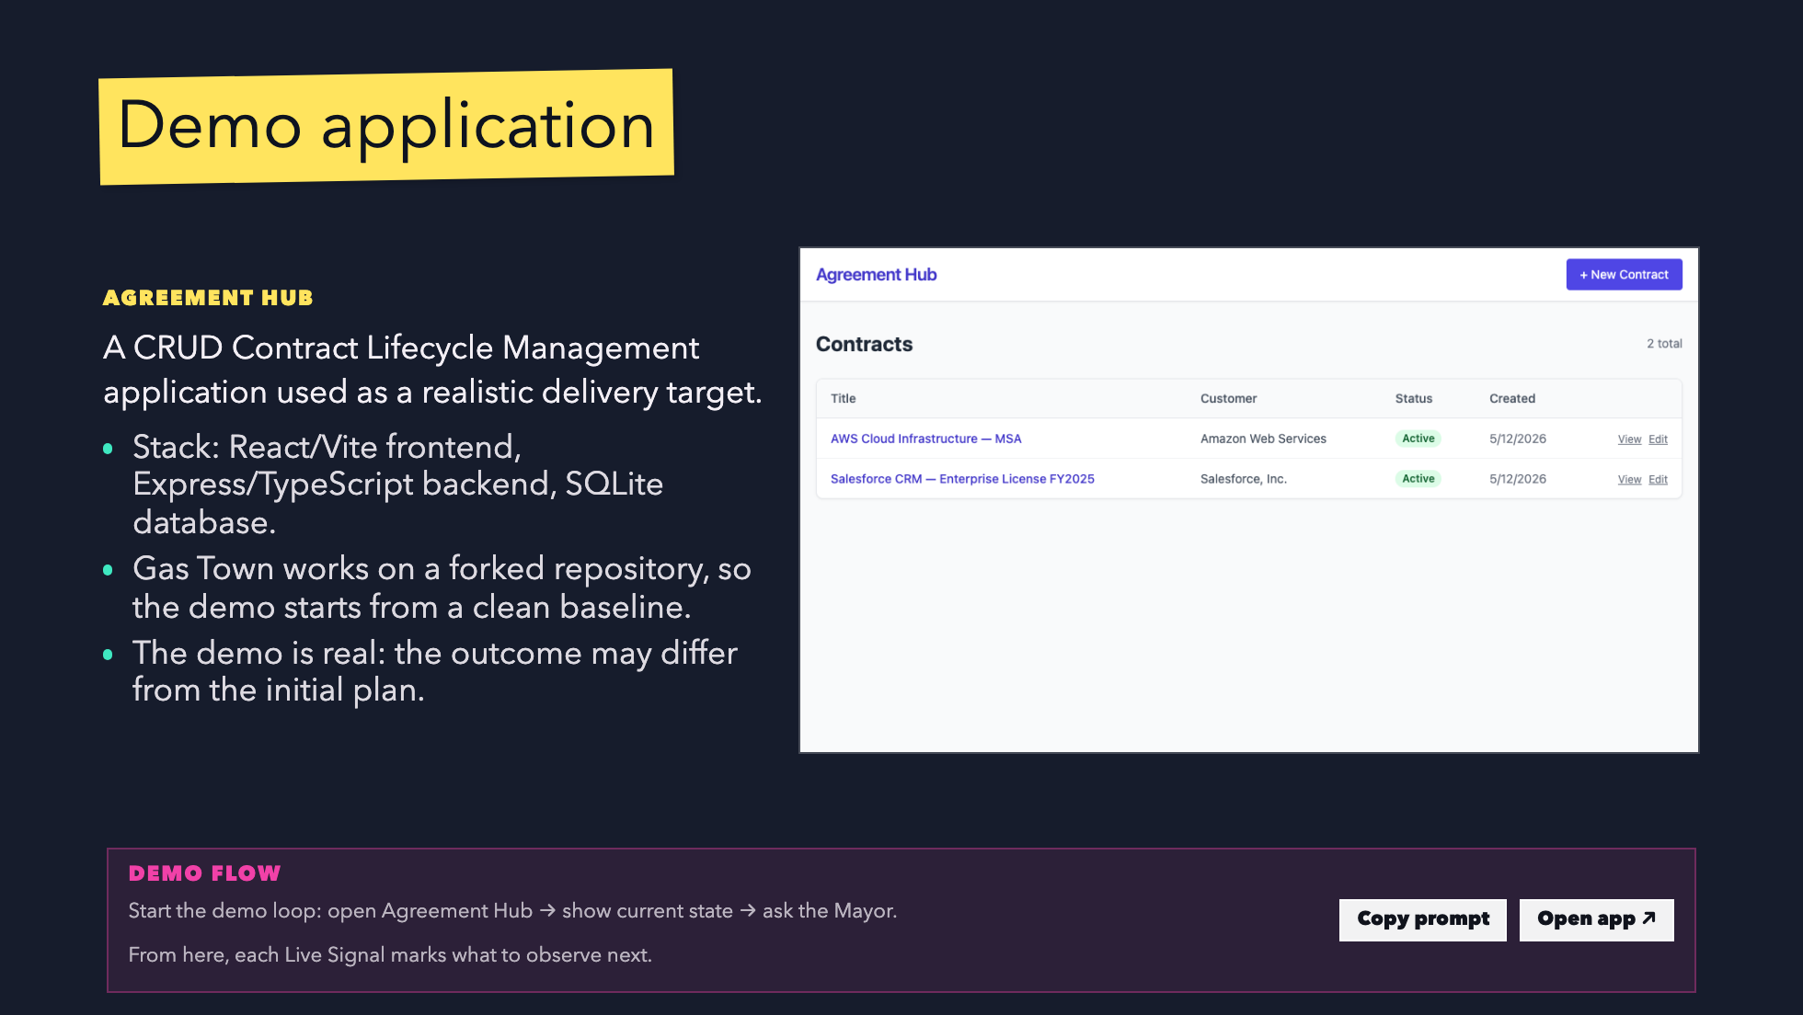
Notes:
LIVE START:
- Launch Gas Town.
- Present Agreement Hub in the browser.
- Ask the Mayor for the first implementation step.
Contract: the deck explains, the terminal works, the app proves.

Slide 7
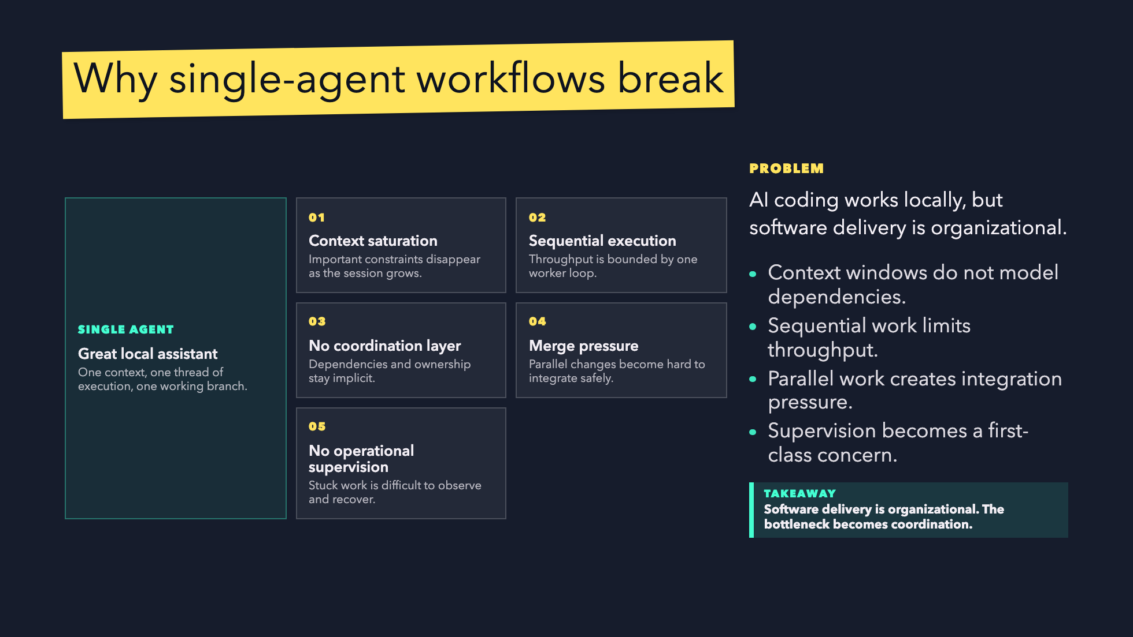
Notes:
The audience should understand why Gas Town exists before we introduce roles.
The bottleneck is not just model intelligence; it is coordination.

Slide 8
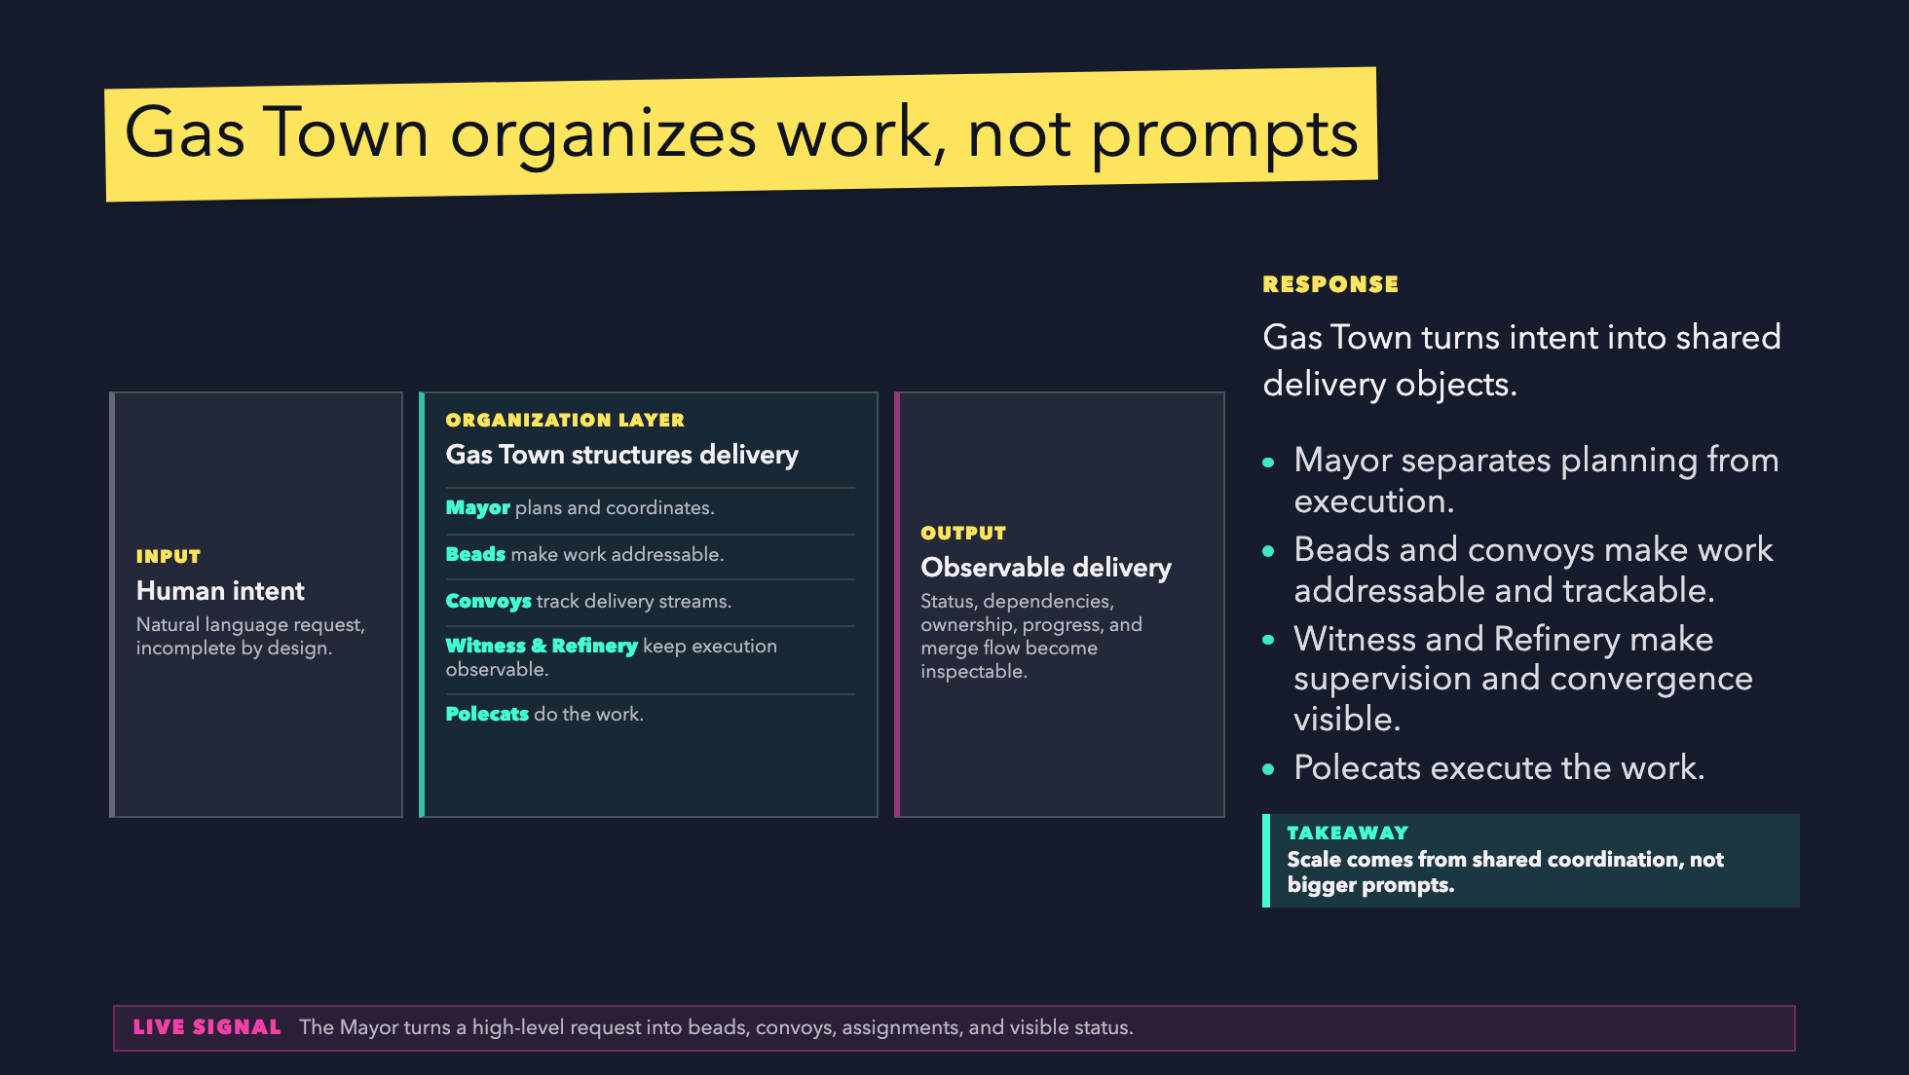
Notes:
Use this slide to position Gas Town as an AI-native delivery organization.
Avoid tool tour language.

Slide 9
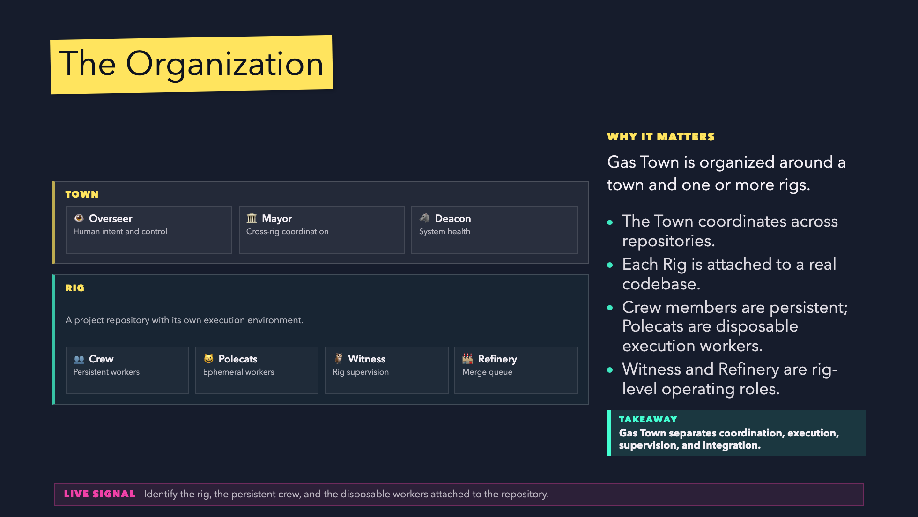
Notes:
This is a central slide. The key line is:
The Mayor coordinates work. Polecats execute it.

Slide 10
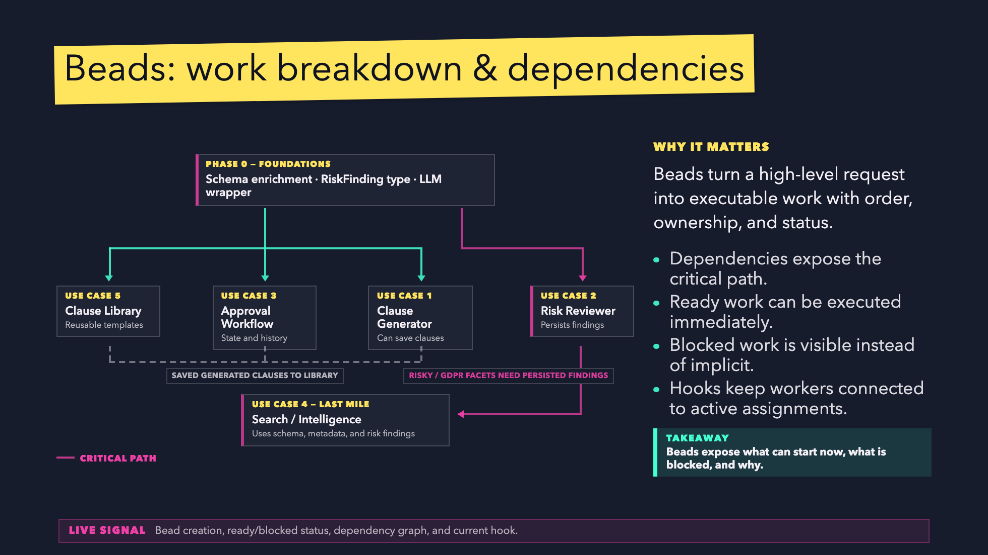
Notes:
Use this slide to explain why dependency management matters.
The important point: work becomes executable and inspectable.

Slide 11
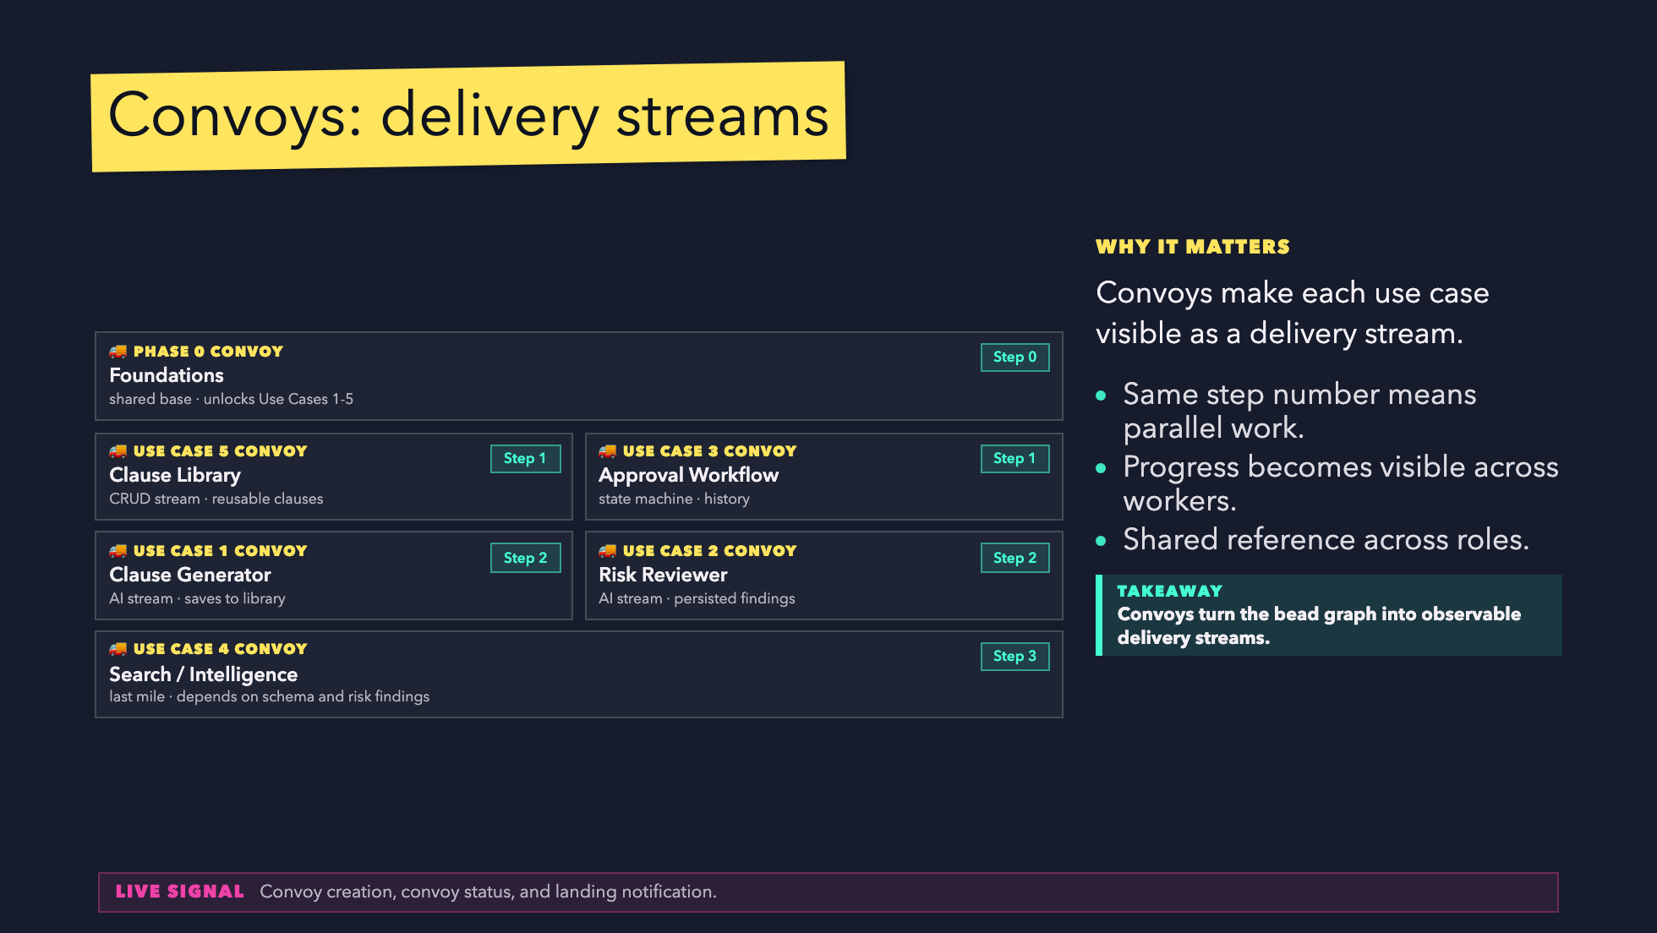
Notes:
Convoys should feel operational, not decorative.
They are the shared handle for distributed delivery.

Slide 12
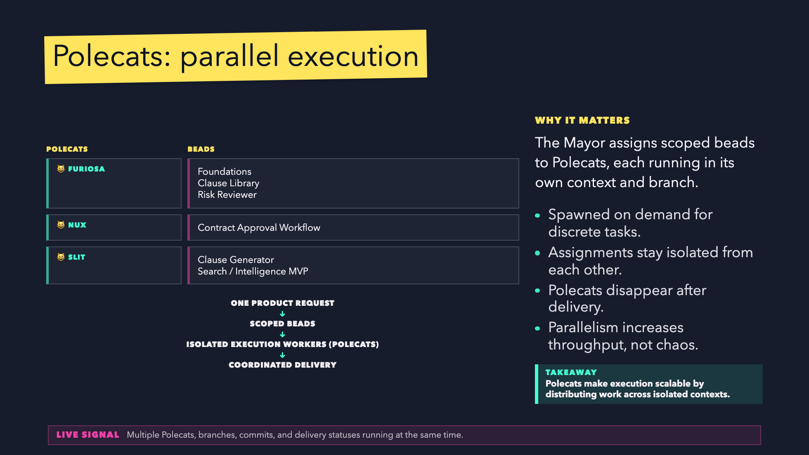
Notes:
This is the "wow" moment, but keep it engineering-oriented.
The claim is throughput through isolated execution.

Slide 13
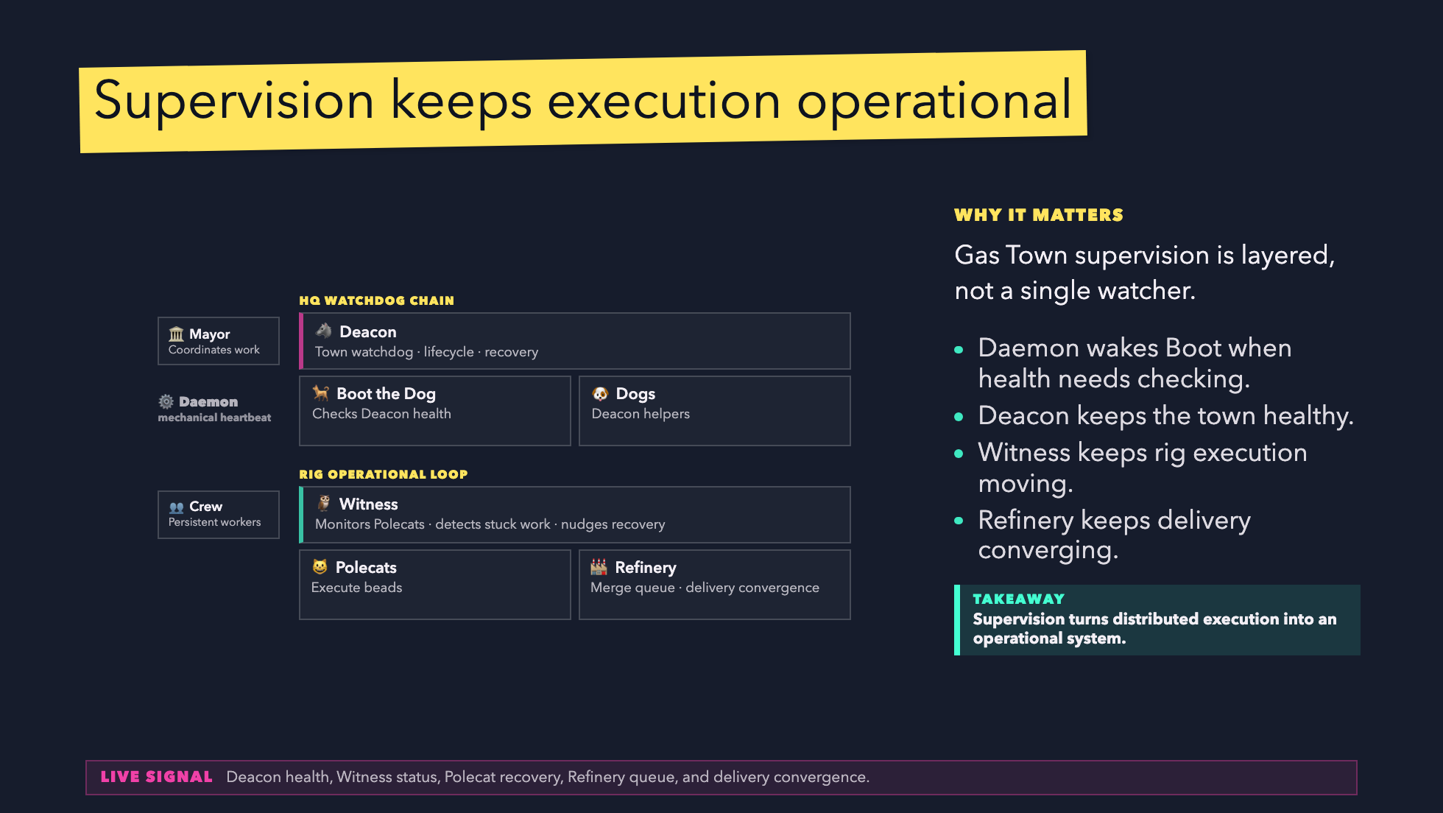
Notes:
Important for DiliTrust: supervision and control are not optional.
This slide turns distributed execution into an operational system.

Slide 14
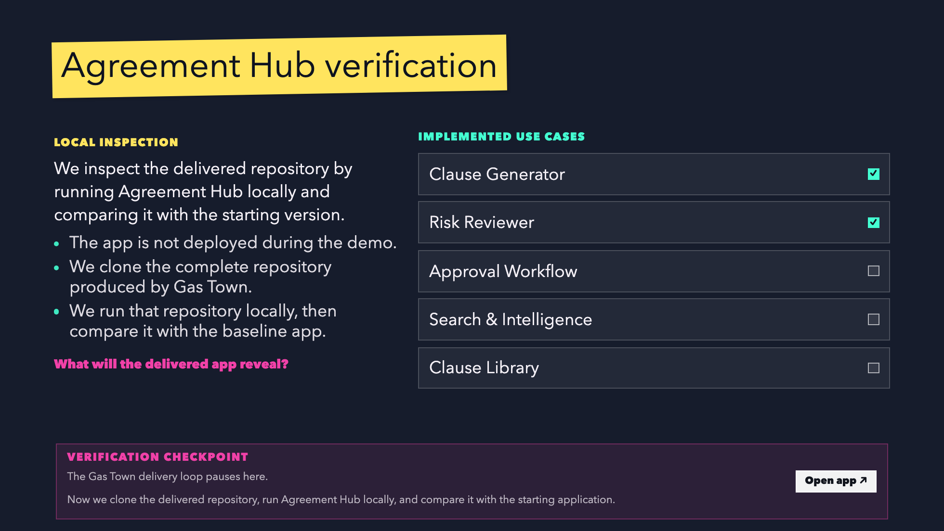
Notes:
Switch to the browser and slow down.
The audience must see that Agreement Hub changed because Gas Town delivered code.

Slide 15
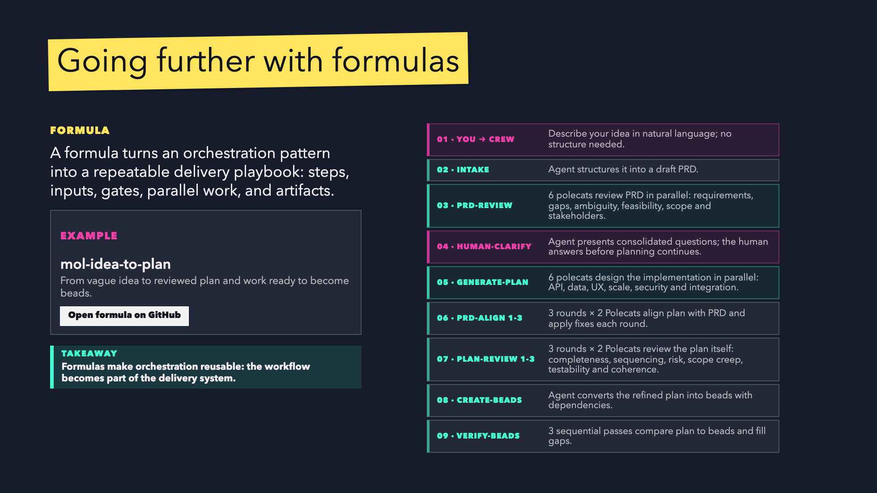
Notes:
Use this slide after the live proof to show how the model can become reusable.
The mol-idea-to-plan formula is the concrete example: vague idea to reviewed plan to beads.

Slide 16
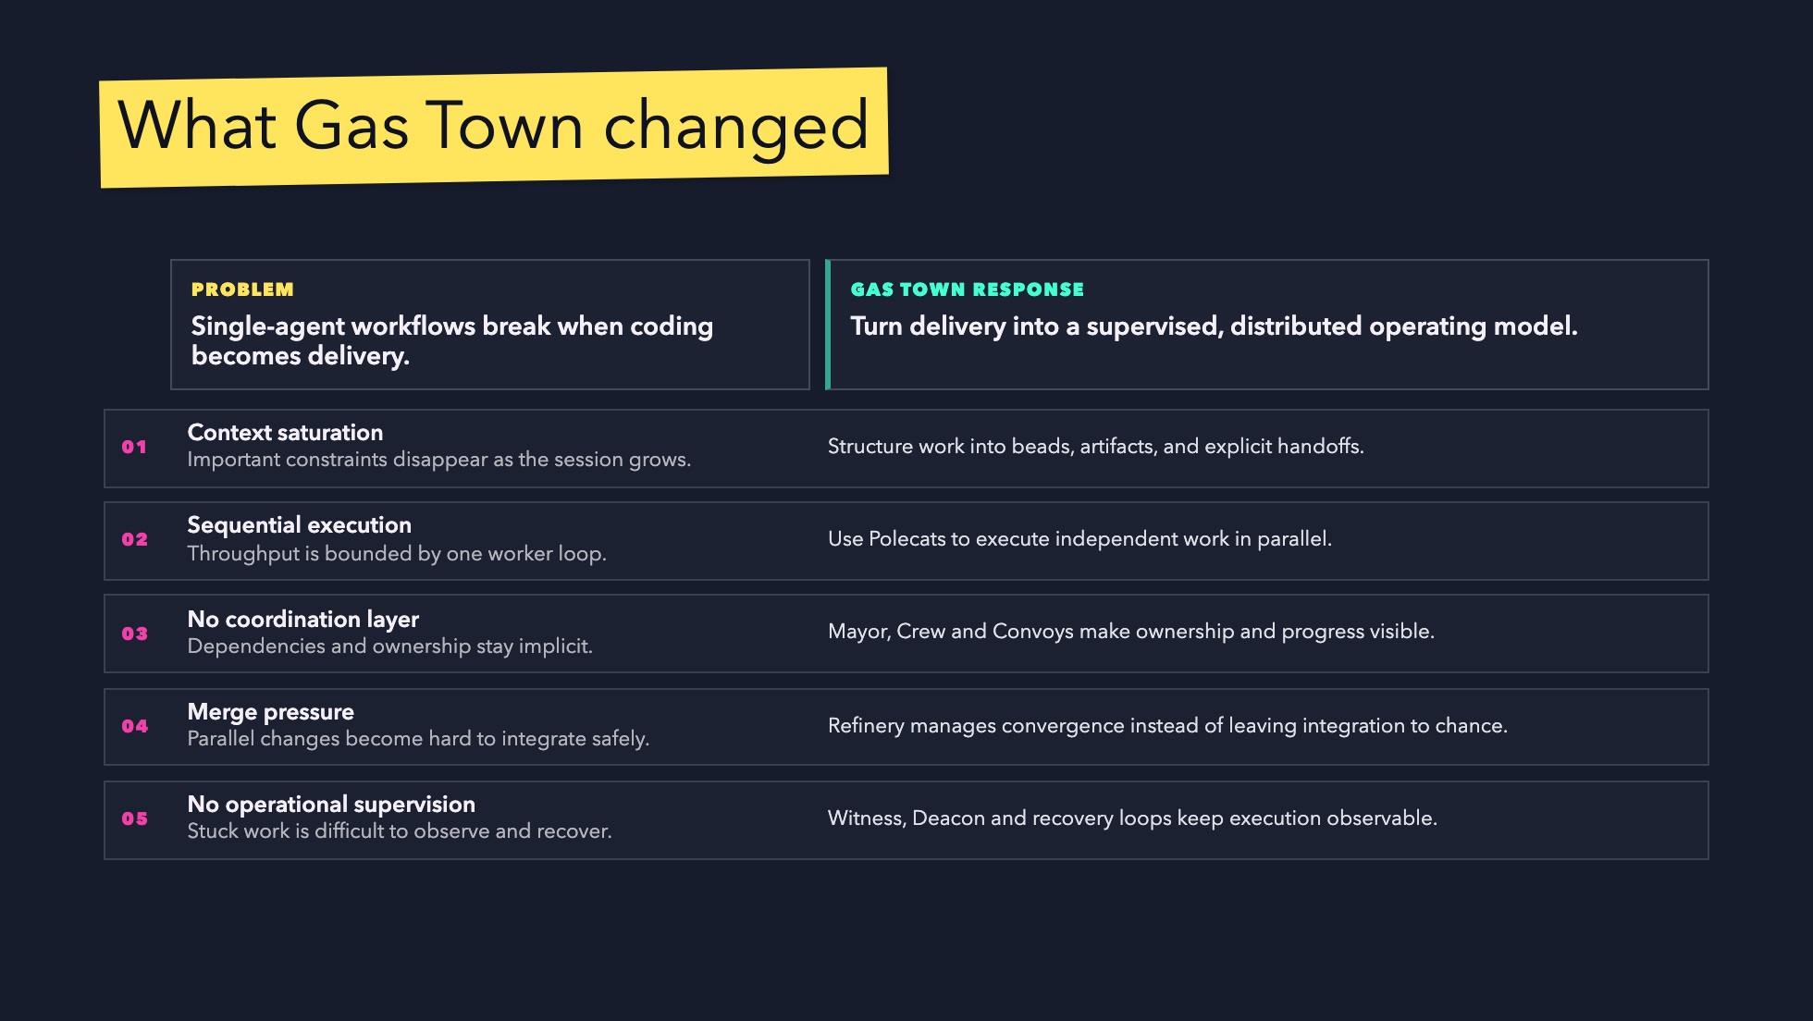
Notes:
This closes the conceptual loop with the exact five problems introduced earlier.

Slide 17
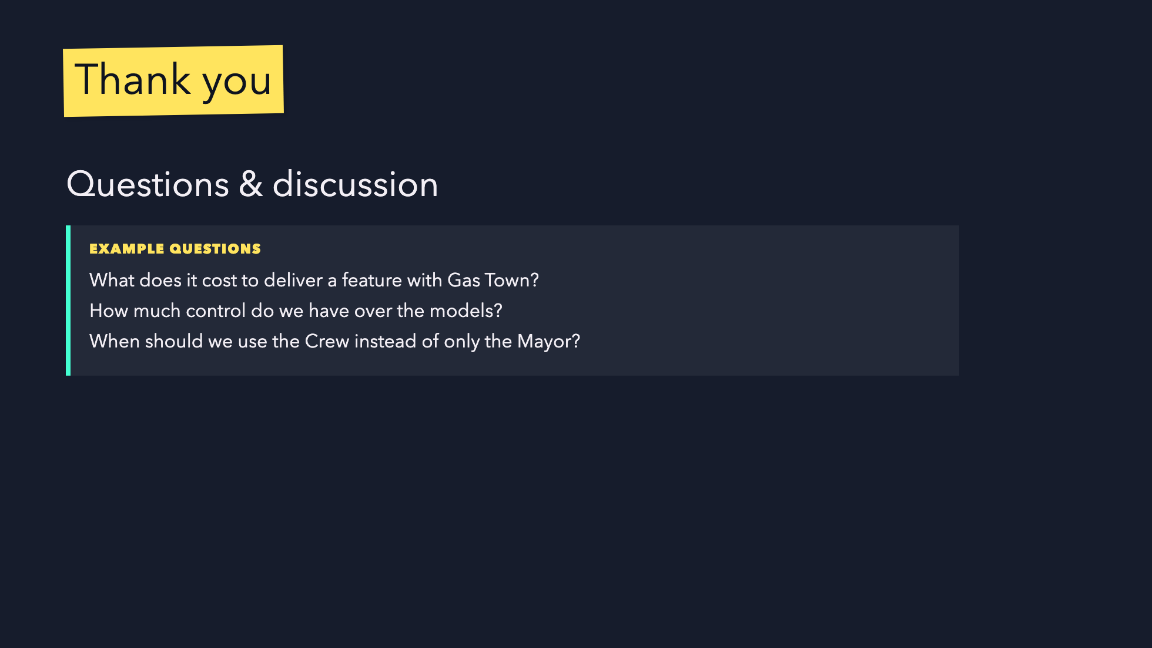
Notes:
Final slide for Q&A.
Keep it quiet. Do not add new concepts.

