Slide 1
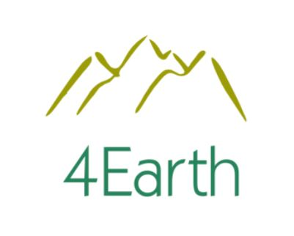


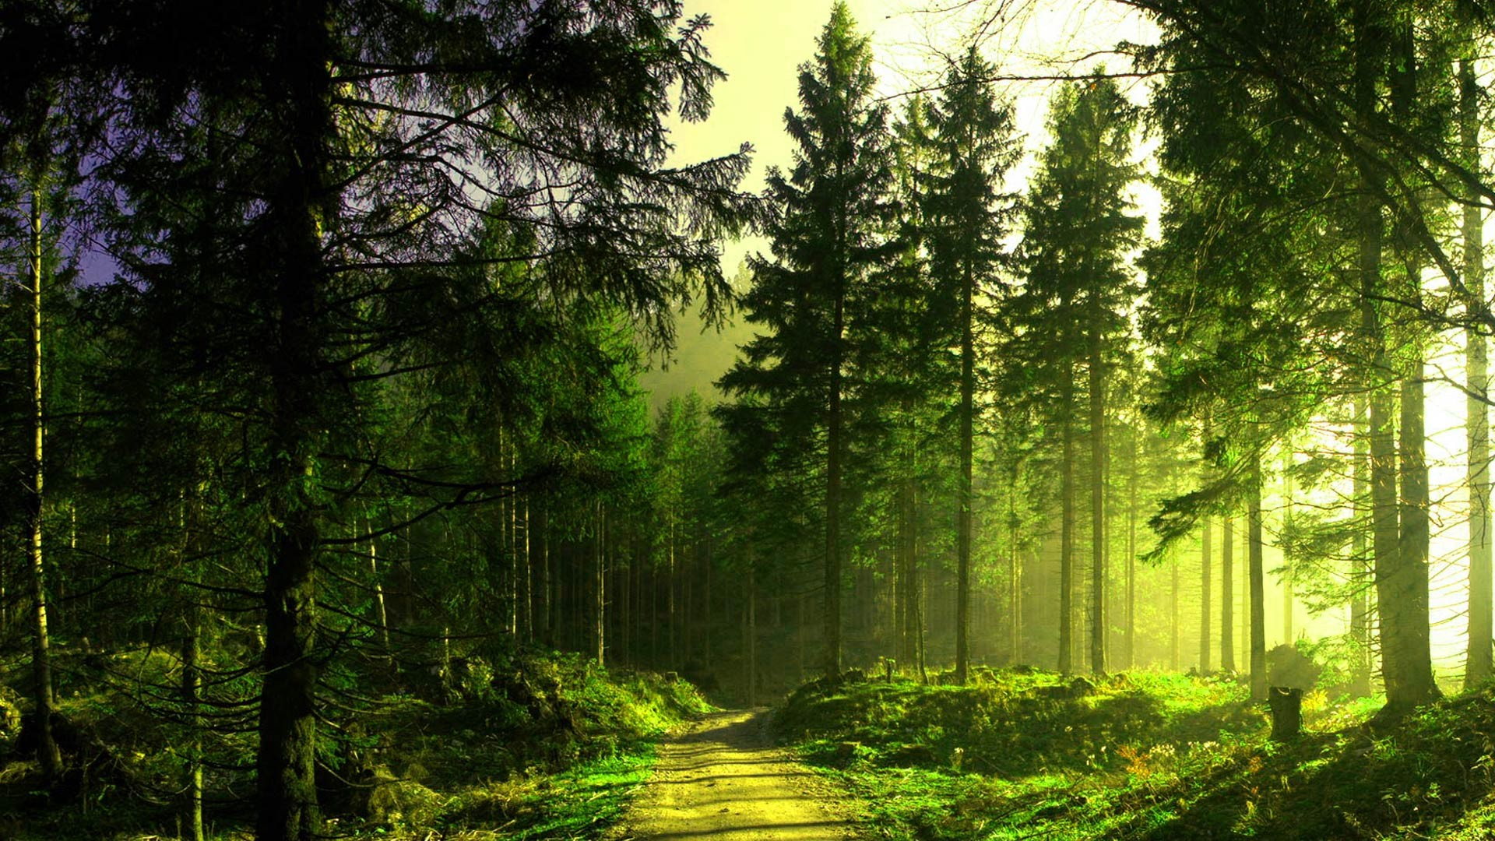
Ever wanted to be Green?
With 4Earth, it’s easier than ever

Slide 2

Sign in to continue to 4Earth
Forgot Email and Username?
Email or Username

Slide 3
Welcome to 4Earth
Forgot Password?
Enter your Password

Slide 4

Create your Account
To continue to 4Earth
You can use just letters and numbers
Mix a minimun of 8 chars or numbers
First name
Last name
Username
Password
Confirm Password

Slide 5

Welcome to 4Earth
We’ll use this info to keep your account safe
Your birthday
Phone Number
City, Country
Recovery Email address
Month
Day
Year

Slide 6


Privacy and Terms
I agree
License and privacy terms

Slide 7




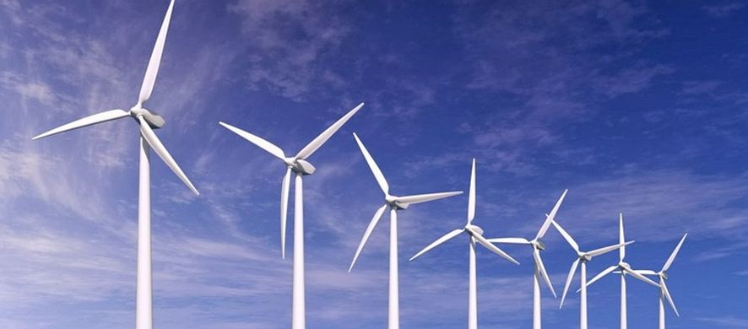
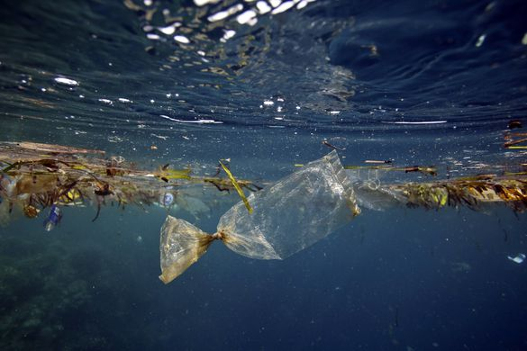
News
Events
Most searched
Eco World
“Portugal reached for the first time on it’s history, one month of eco friendly energy”
Vegan World
News
“In 2050 there will be more plastic than fish in the oceans”

Slide 8
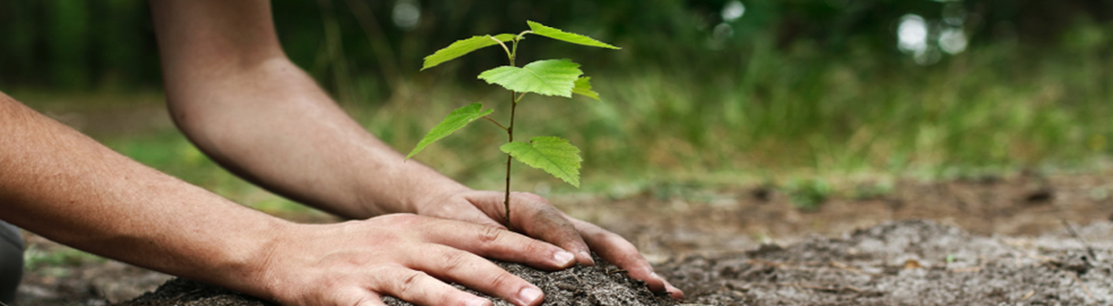
News
Events
Most searched
Eco World
“Portugal reached for the first time on it’s history, one month of eco friendly energy”
Vegan World
Events
“Two hundred thousand trees will make a greener Sierra Nevada (Spain)”
“In 2050 there will be more plastic than fish in the oceans”

Slide 9
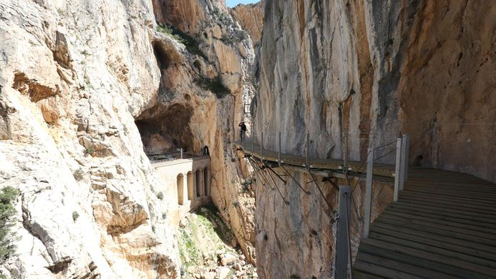
News
Events
Most searched
Eco World
“Portugal reached for the first time on it’s history, one month of eco friendly energy”
Vegan World
Most searched
“Two hundred thousand trees will make a greener Sierra Nevada (Spain)”
“It is said that “King’s road” is the most dangerous hiking in south of Europe (Málaga, Spain)”
“In 2050 there will be more plastic than fish in the oceans”

Slide 10
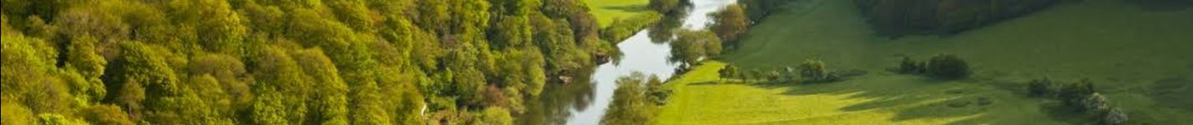
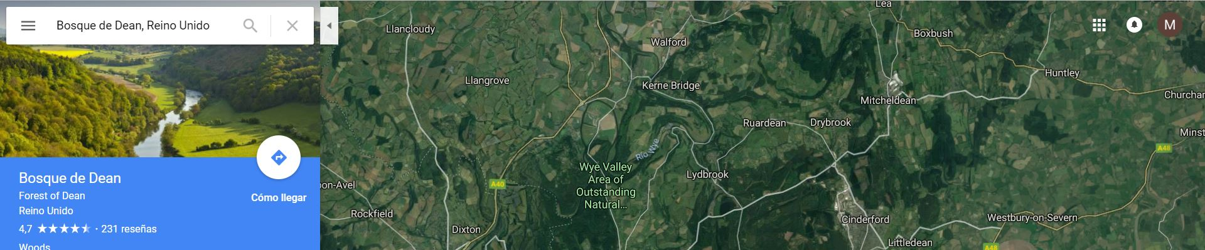
News
Events
Most searched
Why turning green?
Activities
Eco World
Vegan World
Big Projects
Daily tips
“It is said that “King’s road” is the most dangerous hiking in south of Europe (Spain)”
“In 2050 there will be more plastic than fish in the oceans”

Slide 11
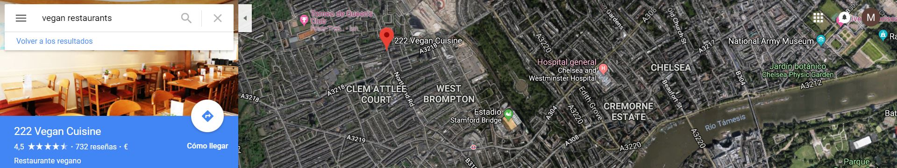
News
Events
Most searched
Why turning vegan?
Recipes
Eco World
Vegan World
Restaurants
Markets
“It is said that “King’s road” is the most dangerous hiking in south of Europe (Spain)”
“In 2050 there will be more plastic than fish in the oceans”

Slide 12
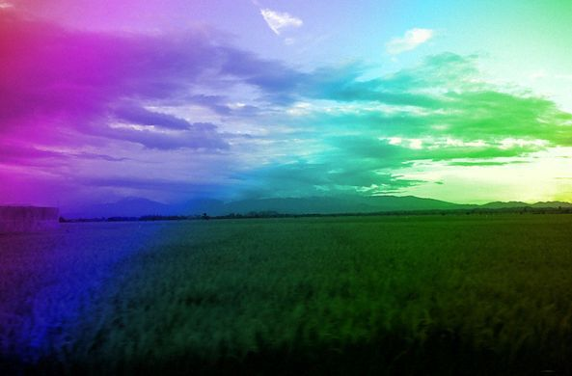

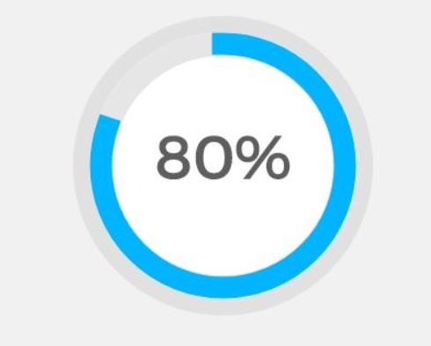

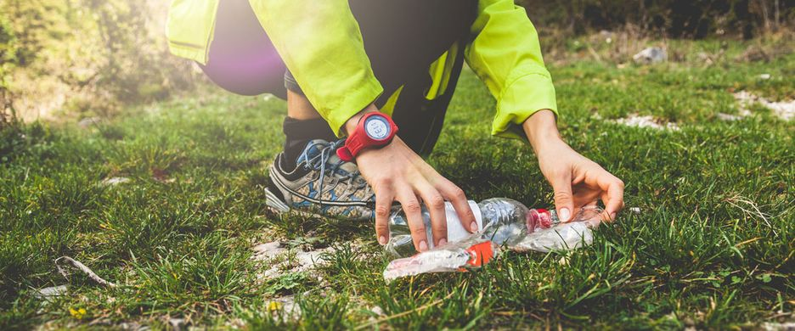

Level 5
Biography
Information
Friends
Recipes
Activities
Projects
Photos
Message
Posts section
Plogging, la nueva moda del fitness
Type something here ...
El plogging es una modalidad nueva en el mundo del running que combina ...
“It is said that “King’s road” is the most dangerous hiking in south of Europe (Spain)”
“In 2050 there will be more plastic than fish in the oceans”
Write post
Leer más

Slide 13
Users
Recipes
Matt Owens
Melted chocolate with muffins
Molly Perkins
Level 5
Activities
Projects
Marathon of Boston
Creation of Mt. Santa Helena as National Park
News
Events
More and more ice is melting in the antartic pole
Meeting the elks in their natural enviroment
“It is said that “King’s road” is the most dangerous hiking in south of Europe (Spain)”
“In 2050 there will be more plastic than fish in the oceans”

