Slide 1
Data Analysis: Sales Prospects from Home Mortgage Data

Slide 2
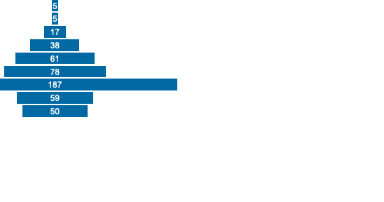
Loan to Value Ratio analysis:
The above plot shows the number of people present is a given LTV ratio range, here we can see that most of the people that are obtaining loan are having the LTV ratio in the range of 70-80.
That means we need to be concentrating more on the people with LTV ratio 40+.
The data given is normally distributed, so the analysis that we performed using the data will show similar results in larger dataset.

Slide 3
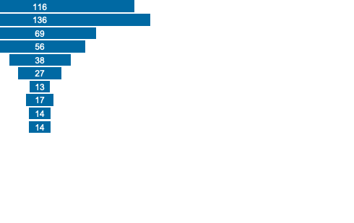
% Minority in local area analysis
The above plot shows the number of people present is a given % minorities in the area range, here we can see that most of the people that are obtaining loan are having the % minorities in the area range of 10-20.
That means we need to be concentrating more on the people with % minorities in the area range 0-60 to capture more number of people taking loans from the organization, if we are thinking of to increase support to those communities, then we need to focus on the range 60+.
The data given is normally distributed, so the analysis that we performed using the data will show similar results in larger dataset.

Slide 4
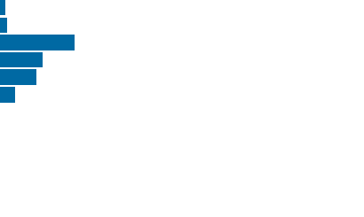
Analysis on different combined features.
Using the above plots, we can see the number of people in with annual income, the value of home and, also the distribution of the people according to their age groups.
As we can see all the data plotted is normally distributed, which means that the analysis that we are performing can be implemented on large dataset.

Slide 5
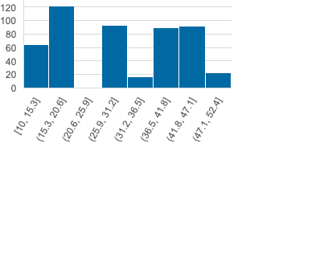
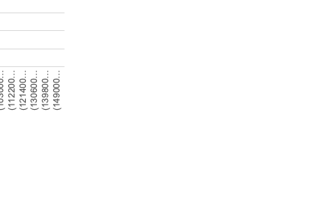
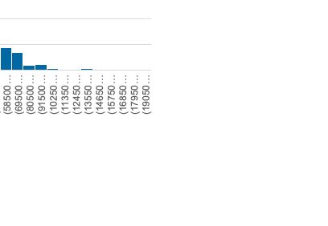
Analyzing the threshold values for Annual Income of borrower and Home value.
The threshold value of the home value can be considered as 695000, where we need to consider all the observations whose house value is below the threshold value, this will also help in increase in the support for the people coming from higher percentage of minority people living areas.
The threshold value of the annual income can be considered as 400000, where we need to consider all the observations whose annual income value is below the threshold value, this will also help in increase in the support for the people coming from higher percentage of minority people living areas.

Slide 6
Observations and Key Insights
All the features given in the dataset are normally distributed, which means that the analysis that we performed on this data will be reflecting same on the large dataset we sampled from.
The threshold value of the home value can be considered as 695000, where we need to consider all the observations whose house value is below the threshold value.
The threshold value of the annual income can be considered as 400000, where we need to consider all the observations whose annual income value is below the threshold value.

