Slide 1
Process Improvement Opportunity: 1- Minute Loan approval check.
Target Stakeholder Group: Senior Leaders.

Slide 2
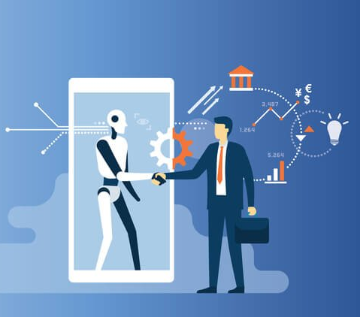
Problem: The manual review of loan documents is time-consuming and prone to errors, leading to delays in loan approval.
Impact of the problem:
Dissatisfied customers, lost business opportunities, and increased costs.
Solution:
Using AI to review and process loan documents with intelligent automation.
AI checking if you are approved to get Loan.

Slide 3
How can AI help? And What can AI do?
AI can take all the details about the borrower and predict whether the borrower is good or bad, just like a classification problem. Good means grant the loan, bad means loan rejected. And we can also include the AI to tell why.
AI can transform the loan approval process with faster processing times and increased accuracy.
Benefits of using AI, such as reducing costs, improving efficiency, and enhancing customer experience.
Using AI, we will get increase in the borrowers due to easy access to the services at home.
We can get the data, which is important, and which can be used in the further improvements in different processes.

Slide 4
Summary
We can see increase in number of customers, improved customer satisfaction, reduced time processing.
It will also provide easy access to the customers, by implementing it online.
Will help in attracting the customers, who can't make time to go to banks and go through the whole screening process.
We can decrease the manual work done by the employees and reduce the number of employees working on that position.

