Slide 1

Predictive Modelling

Slide 2
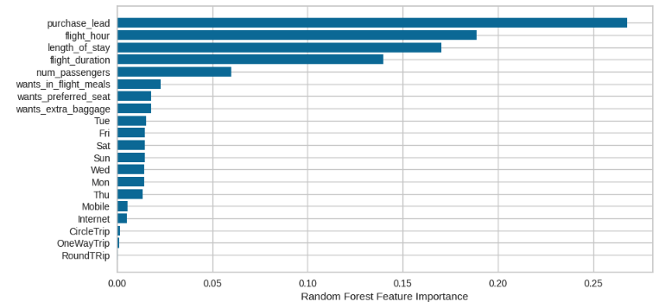
PREDICTIVE MODELLING ANALYSIS
PERFORMANCE METRICES | TRAINING DATA | TEST DATA
ACCURACY | 93 | 85
PRECISION | 100 | 46
F-1 SCORE | 70 | 7
Problem:
Solution:
Due to the presence of imbalanced data, that is the percentage of class-A data is 85% and percentage of class-B data is 15%. This imbalance in the data led to low performance of the prediction model.
We can over come this problem by either gathering more data on class-B or perform up-sampling or down-sampling on the dataset.

