Slide 1
A Study on Machine Learning Algorithms for Dynamic Pricing
Presented By:
Harideepak Marthati (20810029)

Slide 2
Prior literature on Dynamic Pricing
The problem of solving Dynamic Pricing (DP) under uncertain/unknown demand constraint was first tackled in the paper titled paper titled "A partially observed Markov decision process for dynamic pricing." by Aviv, Yossi, and Amit Pazgal (2005)
Assumption: Demand Function comes from a parametric family with unknown parameters.
A prior distribution is applied on the unknown parameters and posteriors are obtained through the application of Bayes theorem.
Objective: Discounted Revenue Maximization over an infinite horizon.
The first attempt at creating a non-myopic policy for dynamic pricing, when the actual demand function is unknown was explored in the paper titled “Dynamic Optimization and Learning: How Should a manager set Prices when the Demand Function is Unknown?” by Alexandre Xavier Carvalho and Martin Puterman (January 2005)
They proposed a variation of the one-step lookahead policy which maximizes revenue for the next two steps, instead of the next step.
An innovative exploration-exploitation approach was first crafted by Besbes, Omar, and Assaf Zeevi in their paper "Dynamic pricing without knowing the demand function: Risk bounds and near-optimal algorithms.“ (2009)
Exploration: Many price-points were experimented with; and the demand function was estimated at these price points.
Exploitation: optimal price point is obtained by leveraging a revenue maximization approach.
In a The paper titled “Online Network Revenue Management using Thompson Sampling”, authored by Kris Johnson Ferreira, David Simchi-Levi and He Wang (2016)
A Thompson-Sampling based solution to maximize revenue for multiple items in a finite horizon, given an unknown demand function and inventory constraints; was provided.

Slide 3
Problem Statement
Modern e-commerce stores have a need to set item prices on an appropriate basis to maximize profitability and manage inventory in a better fashion.
Customers who shop on e-commerce stores buy certain items together -- All items purchased by a customer constitutes a shopping basket/basket.
Pricing items in a basket is very critical for e-commerce stores as it affects their day-to-day profitability.
This creates a need for dynamic pricing systems, which can forecast revenues over a future time horizon.
This project relates to the aspect of how machine learning algorithms can be leveraged to improve dynamic pricing systems.
The specific algorithm which we will explore in detail here is a bandit algorithm which leverages Thompson Sampling to develop an effective dynamic pricing system.

Slide 4
How does a typical Dynamic Pricing System look like?
Collect historical data about price and demand across a time-period
Develop a parametric model where demand can be expressed as a function of price
Using the demand function, optimize a pre-decided metric like ‘overall revenue of a basket’
Apply the optimal prices obtained to set price points of items in a basket

Slide 5
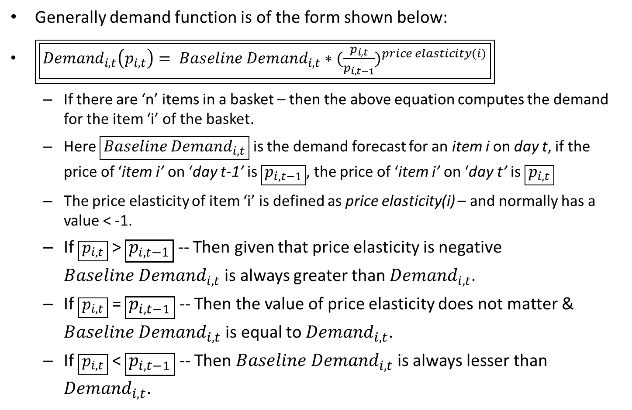
General form of a Demand Function
Generally demand function is of the form shown below:
$\boxed{\boxed{{Demand}_{i,t}\left(p_{i,t}\right)= {Baseline Demand}_{i,t}∗{(\frac{p_{i,t}}{p_{i,t−1}})}^{price elasticity(i)}}}$
If there are ‘n’ items in a basket – then the above equation computes the demand for the item ‘i’ of the basket.
Here $\boxed{{Baseline Demand}_{i,t}}$ is the demand forecast for an item i on day t, if the price of ‘item i’ on ‘day t-1’ is $\boxed{p_{i,t−1}}$, the price of ‘item i’ on ‘day t’ is $\boxed{p_{i,t}}$
The price elasticity of item ‘i’ is defined as price elasticity(i) – and normally has a value < -1.
If $\boxed{p_{i,t}}$ > $\boxed{p_{i,t−1}}$ -- Then given that price elasticity is negative ${Baseline Demand}_{i,t}$ is always greater than ${Demand}_{i,t}$.
If $\boxed{p_{i,t}}$ = $\boxed{p_{i,t−1}}$ -- Then the value of price elasticity does not matter & ${Baseline Demand}_{i,t}$ is equal to ${Demand}_{i,t}$.
If $\boxed{p_{i,t}}$ < $\boxed{p_{i,t−1}}$ -- Then ${Baseline Demand}_{i,t}$ is always lesser than ${Demand}_{i,t}$.

Slide 6
Project Objectives
The major objectives of the project are listed below:
Build a passive Max-Rev Optimization algorithm which uses historical forecasting techniques like ARIMA to forecast future elasticities and prices.
Build an active Max-Rev Optimization algorithm which uses Thomson Sampling to update the elasticity vector and solve for the revenue maximizing price across the shopping basket.
Perform graphical comparison of the two algorithms, to assess their performance vis-à-vis one-another.

Slide 7
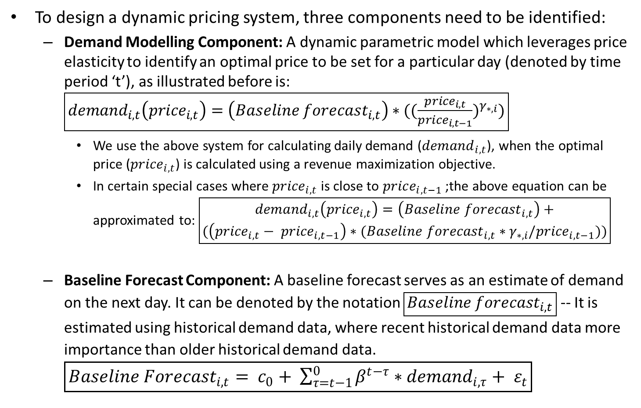
Designing a Dynamic Pricing System
To design a dynamic pricing system, three components need to be identified:
Demand Modelling Component: A dynamic parametric model which leverages price elasticity to identify an optimal price to be set for a particular day (denoted by time period ‘t’), as illustrated before is: $\boxed{{demand}_{i,t}\left({price}_{i,t}\right)=\left({Baseline forecast}_{i,t}\right)∗({(\frac{{price}_{i,t}}{{price}_{i,t−1}})}^{γ_{∗,i}})}$
We use the above system for calculating daily demand (${demand}_{i,t}$), when the optimal price (${price}_{i,t}$) is calculated using a revenue maximization objective.
In certain special cases where ${price}_{i,t}$ is close to ${price}_{i,t−1}$ ;the above equation can be approximated to: $\boxed{\begin{aligned}{demand}_{i,t}\left({price}_{i,t}\right)=\left({Baseline forecast}_{i,t}\right)+ \\ (\left({price}_{i,t}− {price}_{i,t−1}\right)∗({Baseline forecast}_{i,t}∗γ_{∗,i}/{price}_{i,t−1}))\end{aligned}}$
Baseline Forecast Component: A baseline forecast serves as an estimate of demand on the next day. It can be denoted by the notation $\boxed{{Baseline forecast}_{i,t}}$ -- It is estimated using historical demand data, where recent historical demand data more importance than older historical demand data. $\boxed{{Baseline Forecast}_{i,t}= c_{0}+ \sum_{τ=t−1}^{0}{β^{t−τ}∗{demand}_{i,τ}}+ ε_{t}}$

Slide 8
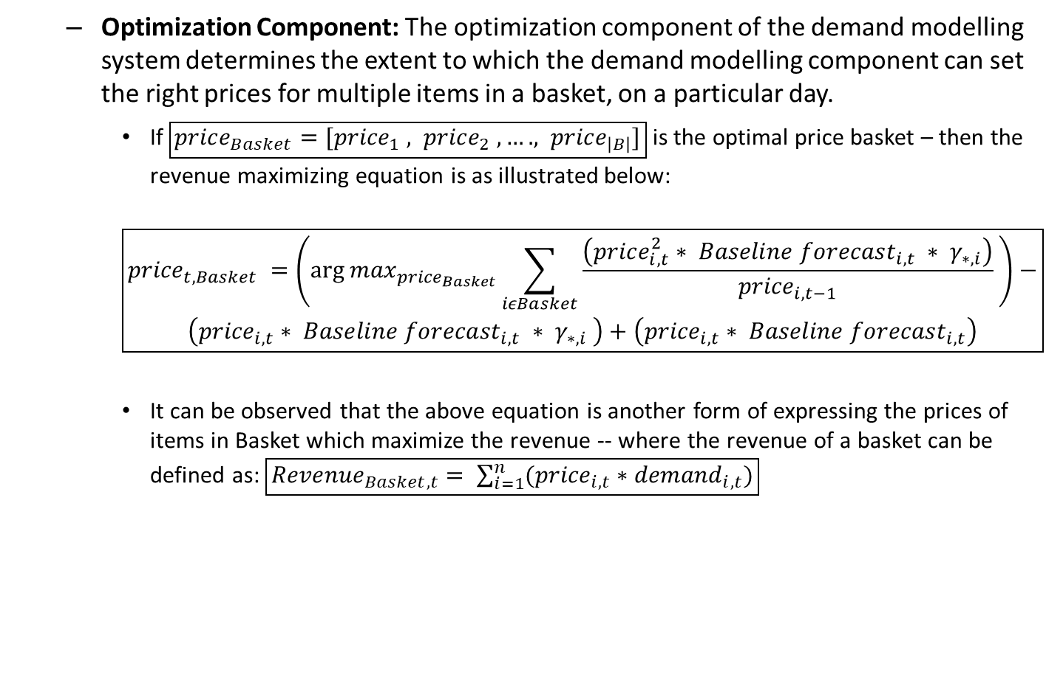
Designing a Dynamic Pricing System (contd.)
Optimization Component: The optimization component of the demand modelling system determines the extent to which the demand modelling component can set the right prices for multiple items in a basket, on a particular day.
If $\boxed{{price}_{Basket}=[{price}_{1} , {price}_{2} , …. , {price}_{\left|B\right|}]}$ is the optimal price basket – then the revenue maximizing equation is as illustrated below:
$$\boxed{\begin{aligned}{price}_{t,Basket} =\left({\arg{max}}_{{price}_{Basket}}\sum_{iεBasket}{\frac{\left({price}_{i,t}^{2}∗ {Baseline forecast}_{i,t} ∗ γ_{∗,i}\right)}{{price}_{i,t−1}}} \right)− \\ \left({price}_{i,t}∗ {Baseline forecast}_{i,t} ∗ γ_{∗,i} \right)+\left({price}_{i,t}∗ {Baseline forecast}_{i,t}\right)\end{aligned}}$$
It can be observed that the above equation is another form of expressing the prices of items in Basket which maximize the revenue -- where the revenue of a basket can be defined as: $\boxed{{Revenue}_{Basket,t}= \sum_{i=1}^{n}{({price}_{i,t}∗{demand}_{i,t})}}$

Slide 9
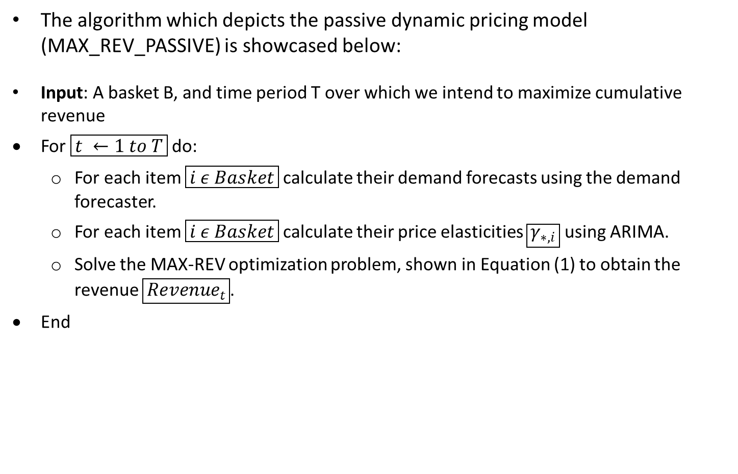
Passive Algorithm (Myopic) for DP
The algorithm which depicts the passive dynamic pricing model (MAX_REV_PASSIVE) is showcased below:
Input: A basket B, and time period T over which we intend to maximize cumulative revenue
For $\boxed{t ←1 to T}$do:
For each item $\boxed{i ε Basket}$calculate their demand forecasts using the demand forecaster.
For each item $\boxed{i ε Basket}$calculate their price elasticities $\boxed{γ_{∗,i}}$ using ARIMA.
Solve the MAX-REV optimization problem, shown in Equation (1) to obtain the revenue $\boxed{{Revenue}_{t}}$.
End

Slide 10
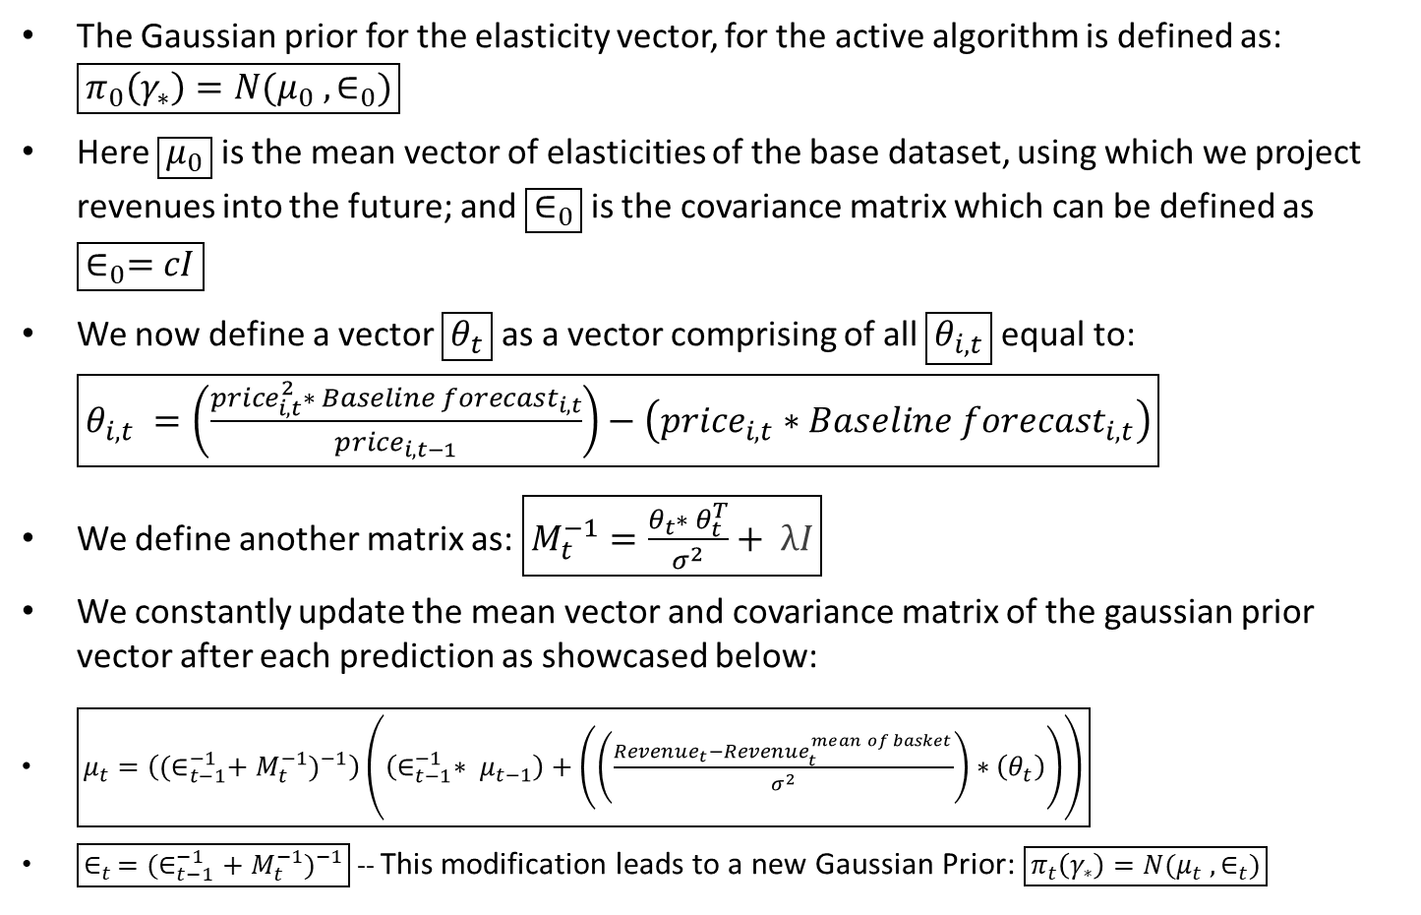
The Gaussian Prior framework for Active Algorithm
The Gaussian prior for the elasticity vector, for the active algorithm is defined as: $\boxed{π_{0}\left(γ_{∗}\right)=N(μ_{0} , ∈_{0})}$
Here $\boxed{μ_{0}}$ is the mean vector of elasticities of the base dataset, using which we project revenues into the future; and $\boxed{∈_{0}}$ is the covariance matrix which can be defined as $\boxed{∈_{0}=cI}$
We now define a vector $\boxed{θ_{t}}$ as a vector comprising of all $\boxed{θ_{i,t}}$ equal to: $\boxed{θ_{i,t} =\left(\frac{{price}_{i,t}^{2}∗ {Baseline forecast}_{i,t}}{{price}_{i,t−1}}\right)−\left({price}_{i,t}∗{Baseline forecast}_{i,t}\right)}$
We define another matrix as: $\boxed{M_{t}^{−1}=\frac{θ_{t}∗ θ_{t}^{T}}{σ^{2}}+ λI}$
We constantly update the mean vector and covariance matrix of the gaussian prior vector after each prediction as showcased below:
$\boxed{μ_{t}=\left({{(∈}_{t−1}^{−1}+ M_{t}^{−1})}^{−1}\right)\left(\left(∈_{t−1}^{−1}∗ μ_{t−1}\right)+\left(\left(\frac{{Revenue}_{t}−{Revenue}_{t}^{mean of basket}}{σ^{2}}\right)∗\left(θ_{t}\right)\right)\right)}$
$\boxed{∈_{t }={(∈_{t−1}^{−1}+ M_{t}^{−1})}^{−1}}$ -- This modification leads to a new Gaussian Prior: $\boxed{π_{t}\left(γ_{∗}\right)=N(μ_{t} , ∈_{t})}$

Slide 11
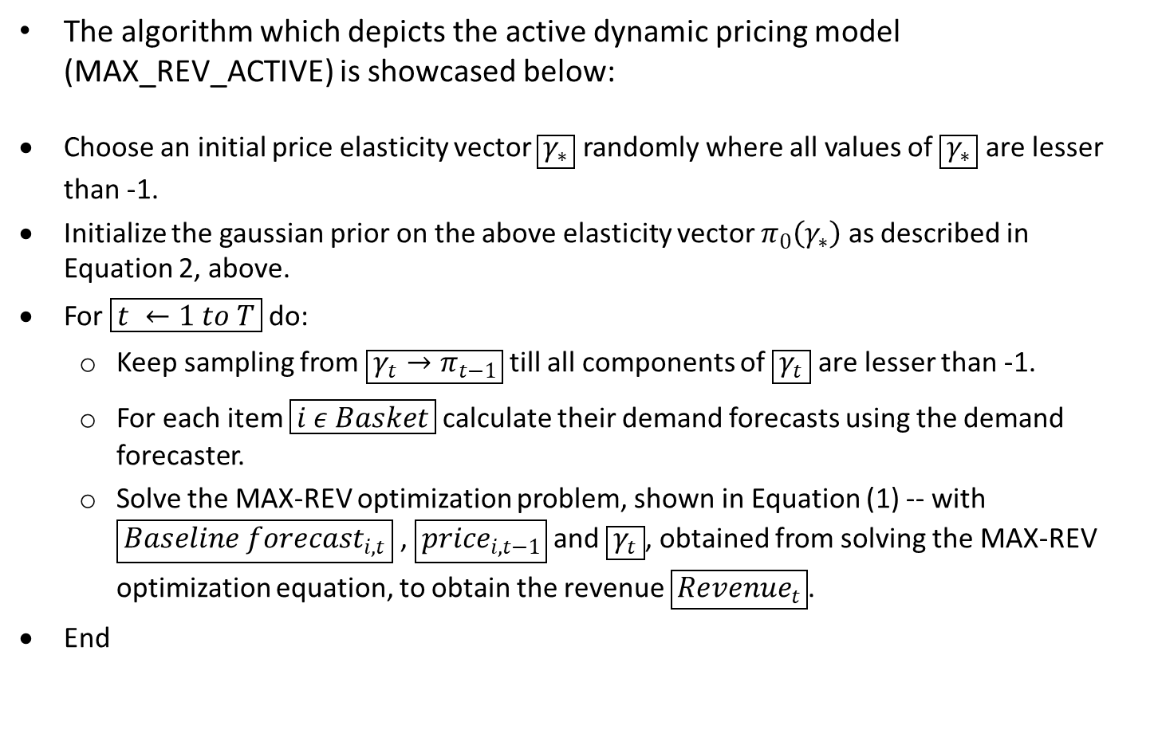
Active Algorithm (Non-Myopic) for DP
The algorithm which depicts the active dynamic pricing model (MAX_REV_ACTIVE) is showcased below:
Choose an initial price elasticity vector $\boxed{γ_{∗}}$ randomly where all values of $\boxed{γ_{∗}}$ are lesser than -1.
Initialize the gaussian prior on the above elasticity vector $π_{0}\left(γ_{∗}\right)$ as described in Equation 2, above.
For $\boxed{t ←1 to T}$do:
Keep sampling from $\boxed{γ_{t}→π_{t−1}}$ till all components of $\boxed{γ_{t}}$ are lesser than -1.
For each item $\boxed{i ε Basket}$calculate their demand forecasts using the demand forecaster.
Solve the MAX-REV optimization problem, shown in Equation (1) -- with $\boxed{{Baseline forecast}_{i,t}}$ , $\boxed{{price}_{i,t−1}}$ and $\boxed{γ_{t}}$, obtained from solving the MAX-REV optimization equation, to obtain the revenue $\boxed{{Revenue}_{t}}$.
End

Slide 12
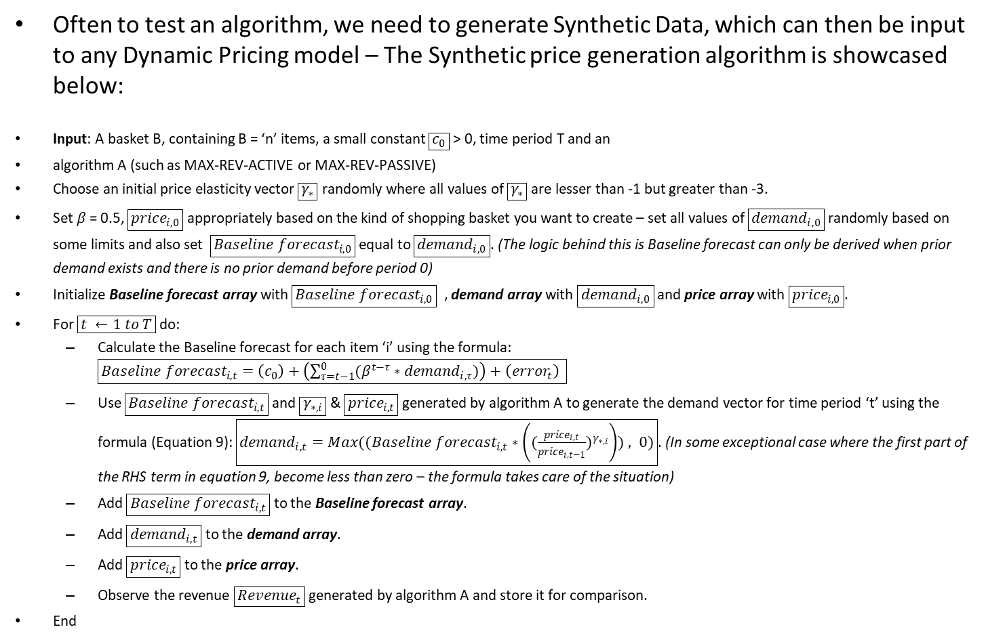
Synthetic Data Generation Algorithm
Often to test an algorithm, we need to generate Synthetic Data, which can then be input to any Dynamic Pricing model – The Synthetic price generation algorithm is showcased below:
Input: A basket B, containing B = ‘n’ items, a small constant $\boxed{c_{0}}$ > 0, time period T and an
algorithm A (such as MAX-REV-ACTIVE or MAX-REV-PASSIVE)
Choose an initial price elasticity vector $\boxed{γ_{∗}}$ randomly where all values of $\boxed{γ_{∗}}$ are lesser than -1 but greater than -3.
Set $β$= 0.5, $\boxed{{price}_{i,0}}$ appropriately based on the kind of shopping basket you want to create – set all values of $\boxed{{demand}_{i,0}}$ randomly based on some limits and also set $\boxed{{Baseline forecast}_{i,0}}$equal to $\boxed{{demand}_{i,0}}$. (The logic behind this is Baseline forecast can only be derived when prior demand exists and there is no prior demand before period 0)
Initialize Baseline forecast array with $\boxed{{Baseline forecast}_{i,0}}$ , demand array with $\boxed{{demand}_{i,0}}$ and price array with $\boxed{{price}_{i,0}}$.
For $\boxed{t ←1 to T}$do:
Calculate the Baseline forecast for each item ‘i’ using the formula: $\boxed{{Baseline forecast}_{i,t}=\left(c_{0}\right)+\left(\sum_{τ=t−1}^{0}{(β^{t−τ}∗{demand}_{i,τ})}\right)+\left({error}_{t}\right) }$
Use $\boxed{{Baseline forecast}_{i,t}}$ and $\boxed{γ_{∗,i}}$ & $\boxed{{price}_{i,t}}$ generated by algorithm A to generate the demand vector for time period ‘t’ using the formula (Equation 9): $\boxed{{demand}_{i,t}=Max(({Baseline forecast}_{i,t}∗\left({(\frac{{price}_{i,t}}{{price}_{i,t−1}})}^{γ_{∗,i}}\right)) , 0)}$. (In some exceptional case where the first part of the RHS term in equation 9, become less than zero – the formula takes care of the situation)
Add $\boxed{{Baseline forecast}_{i,t}}$ to the Baseline forecast array.
Add $\boxed{{demand}_{i,t}}$ to the demand array.
Add $\boxed{{price}_{i,t}}$ to the price array.
Observe the revenue $\boxed{{Revenue}_{t}}$ generated by algorithm A and store it for comparison.
End

Slide 13
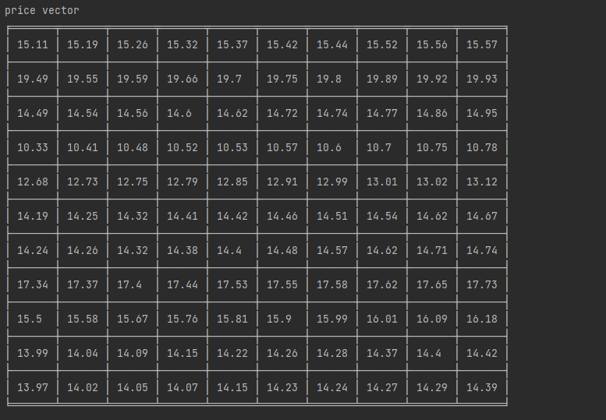
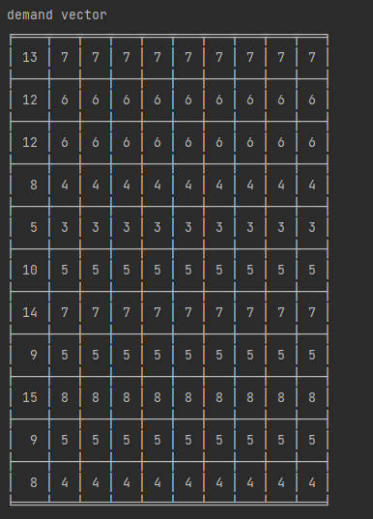
Results – Synthetic Dataset 1
Initial Base Price and Demand Vectors (number of iterations – 10):

Slide 14
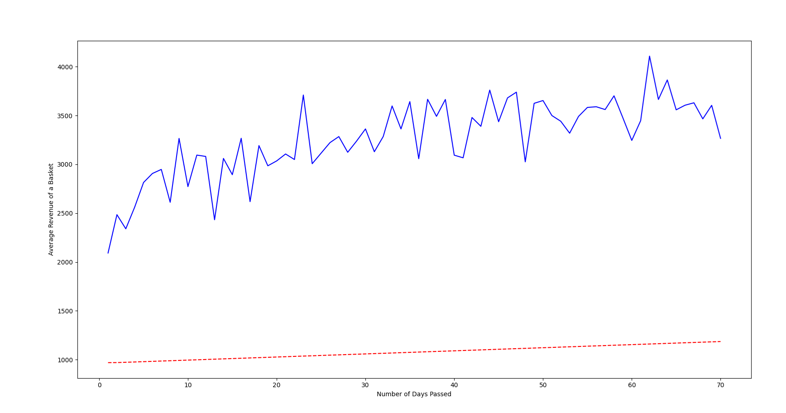
Results – Synthetic Dataset 1 (contd.)
Active Algorithm vs Passive Algorithm graph

Slide 15
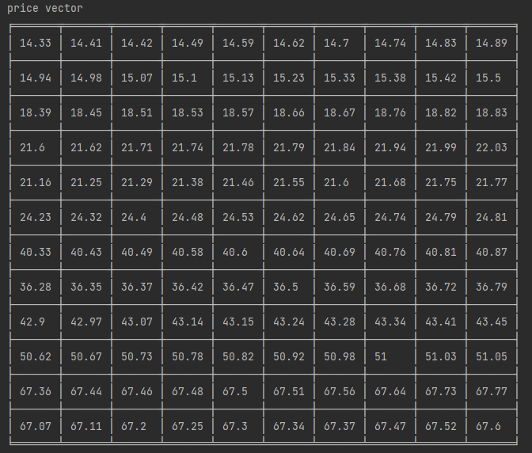
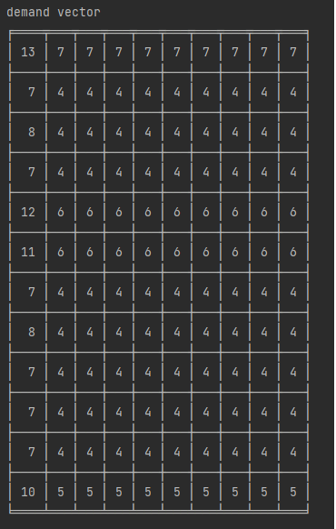
Results – Synthetic Dataset 2
Initial Base Price and Demand Vectors (number of iterations – 20):

Slide 16
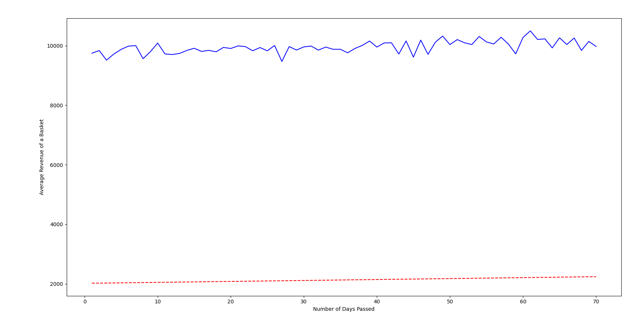
Results – Synthetic Dataset 2 (contd.)
Active Algorithm vs Passive Algorithm graph

Slide 17
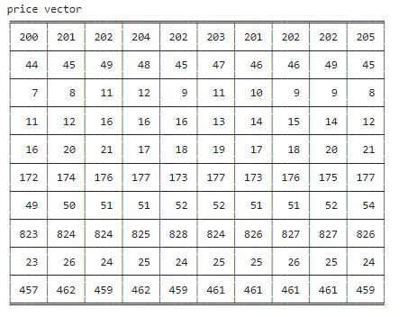
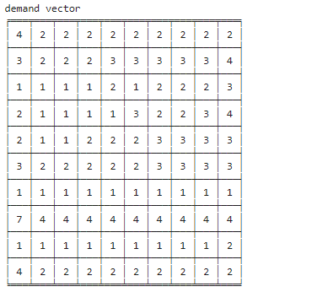
Results – Real e-commerce Dataset
Initial Base Price and Demand Vectors (number of iterations – 15):

Slide 18
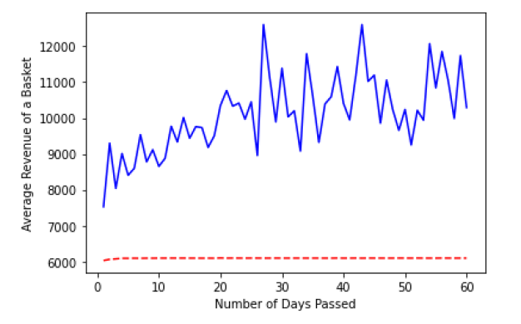
Results – Real e-commerce Dataset (contd.)
Active Algorithm vs Passive Algorithm graph

Slide 19
Observations from Experiments
From the experiments shown in previous 6 slides, it is clear that the active bandit algorithm based on Thompson Sampling greatly outperforms the passive demand generation algorithm whether:
The price basket is comprised of items with price points in a defined range (or)
The price basket is comprised of items with varying price points (or)
The price basket is taken directly from an e-commerce firm’s historical demand and price data.
The main reason for this is that in case of the passive demand generation algorithm, elasticities are simply forecasted using historical values using some time-series model like ARMA/ARIMA; whereas in the case of the active bandit algorithm which leverages Thompson Sampling, elasticities are computed on a continuous basis by updating the Gaussian prior (using latest forecasted optimal revenue) -- This clearly showcases the power of the active algorithm.

Slide 20
Future Scope
Further Investigations to this project study could include:
Finding out the use-cases where the active bandit algorithm (Thompson Sampling), underperforms compared to other datasets showcased above.
Instead of using revenue maximization as objective -- if ‘volume of sales’ is instead used as an objective function then what would be the performance of active vs passive dynamic pricing algorithms.
Testing the performance of other ‘Bandit Algorithms’ compared to the ‘Passive Maximum Revenue Optimization Algorithm’.
Developing a framework for Regret Analysis, in an endeavor to better deal with modelling demand under uncertainty.

Slide 21
References
Aviv, Yossi and Pazgal, Amit. A partially observed markov decision process for dynamic pricing. Management Science, 51(9):1400–1416, 2005.
Alexandre X. Carvalho and Martin L. Puterman, (2005), Dynamic Optimization and Learning: How Should a Manager set Prices when the Demand Function is Unknown ?, No 1117, Discussion Papers, Instituto de Pesquisa Econômica Aplicada - IPEA.
Ferreira, Kris Johnson, Simchi-Levi, David, and Wang, He. Online network revenue management using thompson sampling. Harvard Business School Technology & Operations Mgt. Unit Working Paper. Available at SSRN: https://ssrn.com/abstract=2588730, 2016.
Ganti, Ravi, et al. "Thompson sampling for dynamic pricing." arXiv preprint arXiv:1802.03050 (2018).

Slide 22
Appendix
The GitHub links for the code developed are listed below:
Revenue Optimization Passive vs Active for Synthetic Data: https://github.com/HarideepakM/MAX_REVENUE_OPT_Passive_vs_Active/blob/main/Max_Rev_Passive_vs_Active_main_Synthetic_Data.ipynb
Revenue Optimization Passive vs Active for Real Data: https://github.com/HarideepakM/MAX_REVENUE_OPT_Passive_vs_Active/blob/main/Max_Rev_Passive_vs_Active_main_Real_Data.ipynb

Slide 23


