Slide 1



Website tour
Section 2B: Customer Account

Slide 2
Customer Account

Slide 3
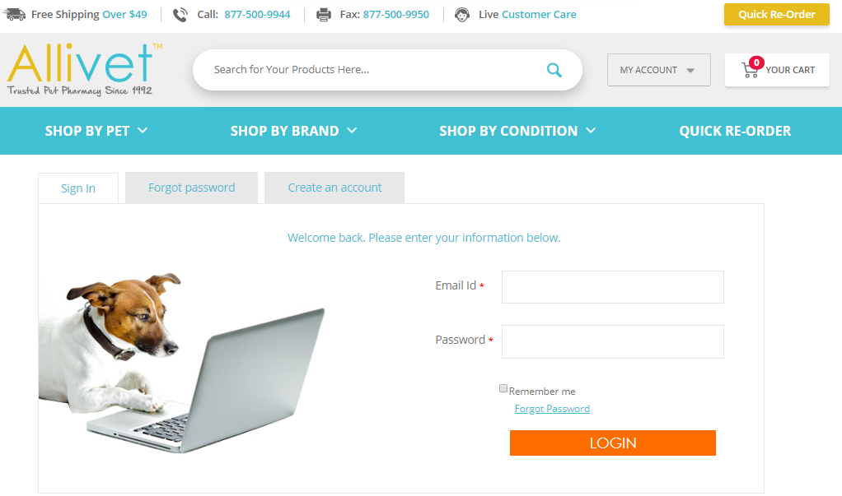
Customer Account
Logging In and Out
Logging In
Click on the "MY ACCOUNT"
Select "Sign In" from the drop down and you will be directed to your home page.

Slide 4
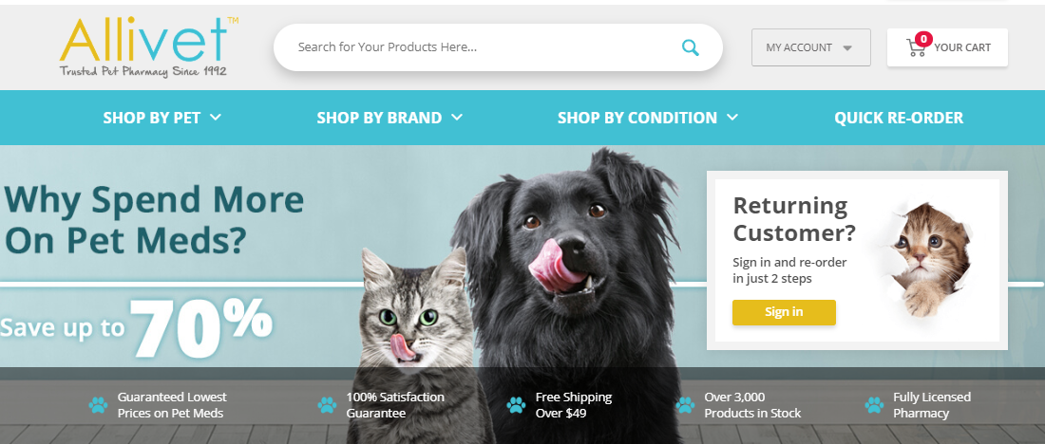
Customer Account
Logging In and Out
Logging Out
Click on the "MY ACCOUNT"
Select "Sign Out" from the drop down and you will be redirected to the home page.

Slide 5
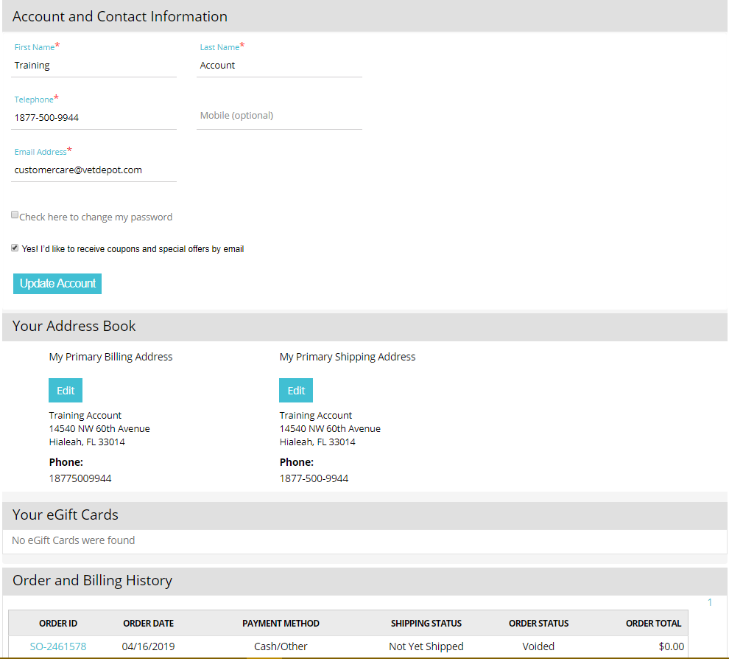
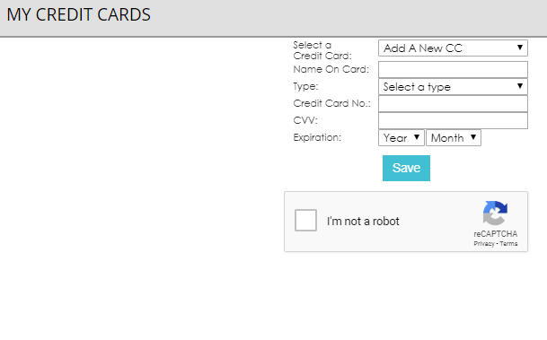
Customer Account
Customer Profile
Notes:
Transition Arrows
The Customer Profile is broken down into six different sections:
Arrow 1= Account and Contact Info.
Arrow 2= Your Address Book
Arrow 3= Your Egift Cards
We do not encourage for clients to purchase gift cards at this point in time
Arrow 4= Order and Billing History
Arrow 5= My Cerdit Cards
Arrow 6= Suggested Products

Slide 6
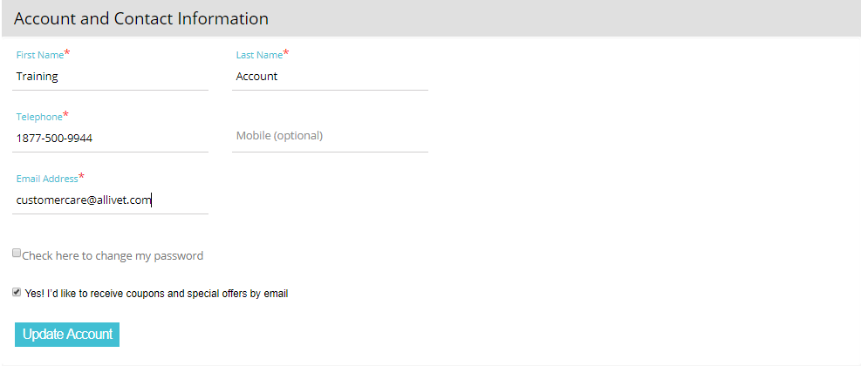
Customer Account
Account and Contact Information
Notes:
You will be able to update all your main account information from this section
Account Name
Telephone Numbers
Telephone
Mobile
You can only select one number as a primary number
Email Address
If you have duplicate accounts different email addresses will need to be provided
Change Password
Subscribe/Unsubscribe for coupons
- If you are not subscribed you will not receive order updates via email.

Slide 7
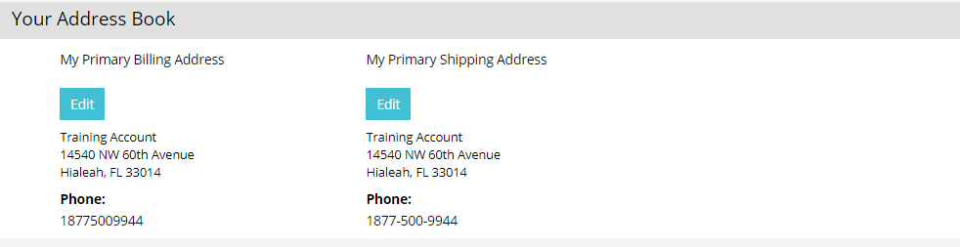
Customer Account
Your Address Book
Notes:
Here you will be able to keep track of all the different addresses you may have saved.
Your primary billing and shipping address will always default
You may edit each by clicking on the blue “Edit” buttons

Slide 8
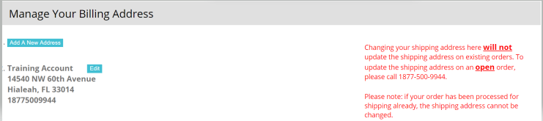
Customer Account
Your Address Book
Notes:
Once you click on the “Edit” button you will be redirected to the “Manage Your Billing Address” Page
Here you can add new addresses
Edit old ones
Change you primary address by clicking on the blue button that says “Make Primary”

Slide 9
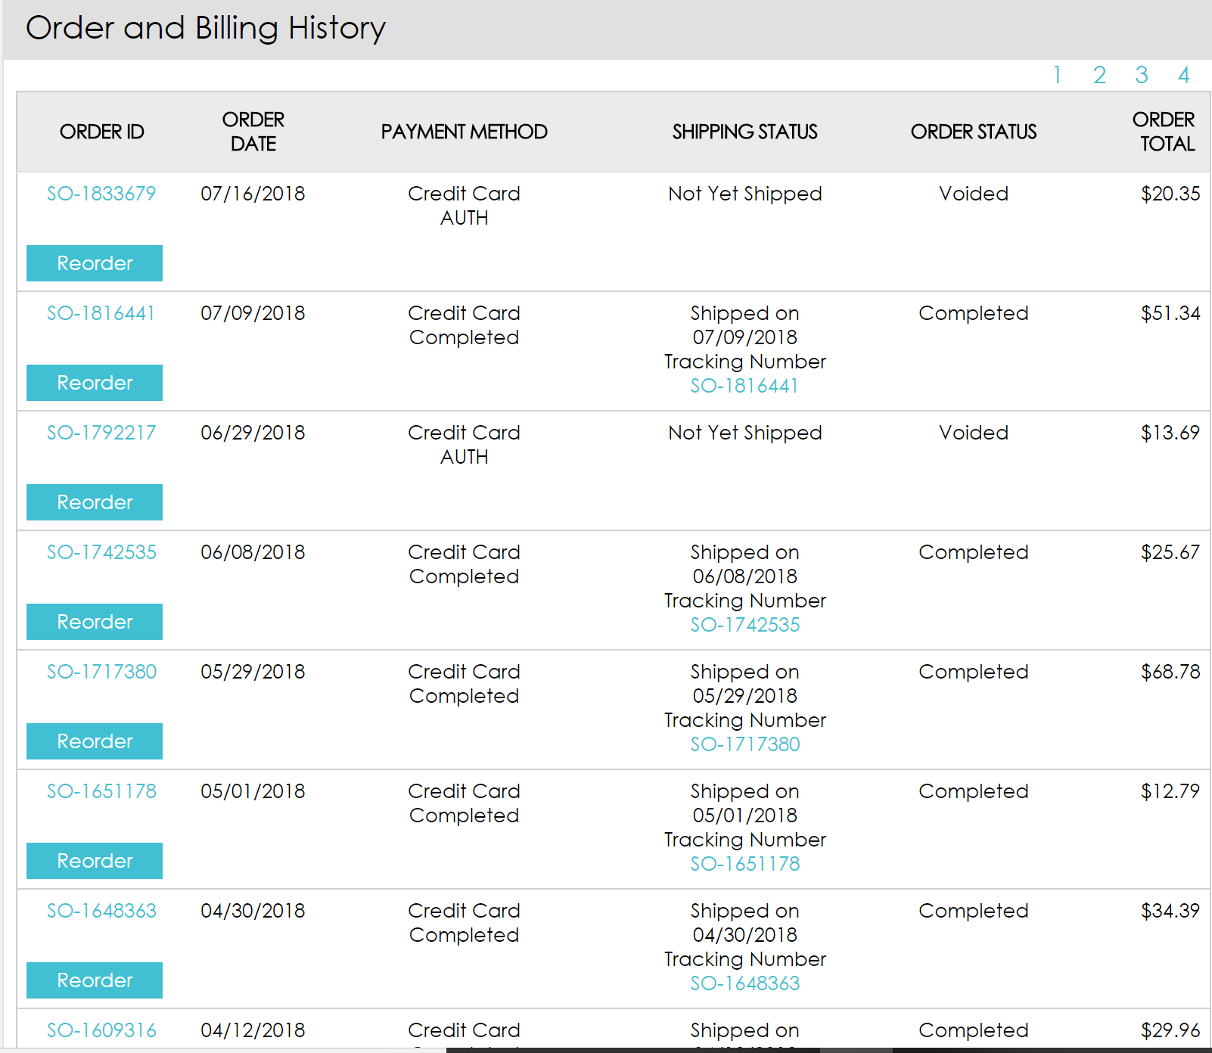
Customer Account
Order and Billing History
Both current and past orders are viewable here.
Set up in table form, making navigation easier for clients.
It is broken up into six columns:
Order ID
Order Date
Payment Method
Shipping Status
Order Status
Order Total

Slide 10
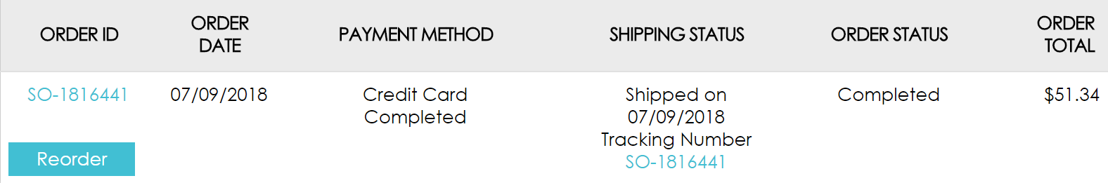
Customer Account
Order and Billing History
The “Order Acknowledgement” can be viewed by clicking on “Order ID”
The “Reorder” button will allow you to automatically add items within your order to your shopping cart
Clicking on the Order ID under the Shipping Status column will link you to the carrier’s website where you can track your package.
Notes:
Once you click on the “Edit” button you will be redirected to the “Manage Your Billing Address” Page
Here you can add new addresses
Edit old ones
Change you primary address by clicking on the blue button that says “Make Primary”

Slide 11
Customer Account
My Credit Cards
Here you can view all your saved payment methods.
You can select different payment methods from the dropdown menu.
Once selected the following information will populate:
Name On Card
Card Type
Credit Card No.
Expiration Date

Slide 12
My Allivet

Slide 13
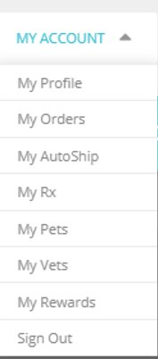
My Allivet
My Account menu will allow you to navigate to different areas within your account.
It is broken into eight different pages:
My Profile
My Orders
My Autoship
My RX
My Pets
My Vets
My Rewards Points
Sign Out

Slide 14
My Allivet
My Profile & My Orders
Notes:
“My Profile” and “My Orders” will direct you back to the main customer account page.
- My orders will take you directly to the “Order History” section of the account page

Slide 15
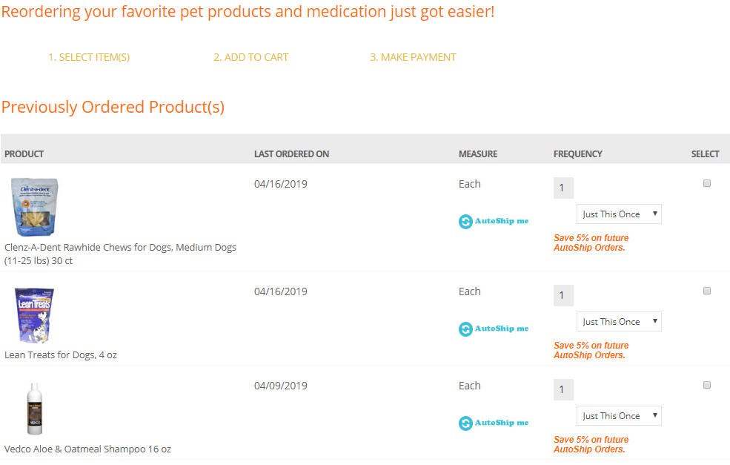
My Allivet
Quick Re-Order
This page is designed for customers to navigate through previously purchased products without having to remember which order it was placed on.
The page is broken up into six columns:
Product
Last Ordered On
Measure (Unit)
Frequency
Select
Notes:
Measure
How the item is sold
Per tablet
Per Box
Frequency
Allows clients the option to set up a reoccurring order via our Autoship Program
A dropdown menu is available to add how often they would like this item shipped
Select
Allows for the client to select multiple items at once to add to the cart

Slide 16
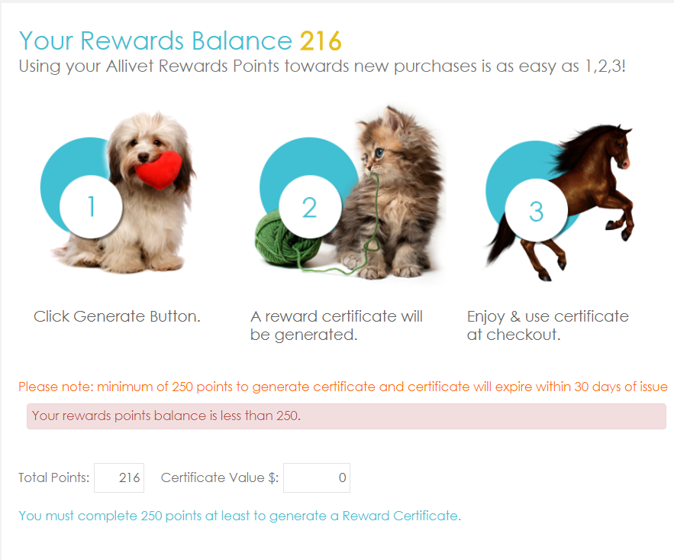
My Allivet
My Reward Points
Allivet offers our customers a chance to earn points back for every dollar they spend on qualifying items.
Your points can be redeemed for coupon codes by clicking on the “My Reward Points”.
Here you will be able to view how many points you have, and what kind of a certificate value they will generate.
Notes:
RULES
Allivet Rewards Points will be reflected on your account once your order is shipped.
Allivet Rewards Points can only be redeemed online.
Allivet Rewards Points cannot be combined with coupons or any other special offer.
Allivet Rewards Points cannot be redeemed for cash.
Allivet Rewards Points cannot be refunded on canceled orders.
Allivet Rewards Points are not transferable or exchangeable.
Allivet Rewards Points are valid for 1 year.
Allivet Rewards Points Certificate are valid for 30 days after redemption.
Additional Information
Points do not always have to be redeemed for coupon codes they can be donated
Allivet works with a few different Charites
Once you are able to redeem your points you will see a donate option within the dropdown menu
This will allow you to choose your charity

Slide 17
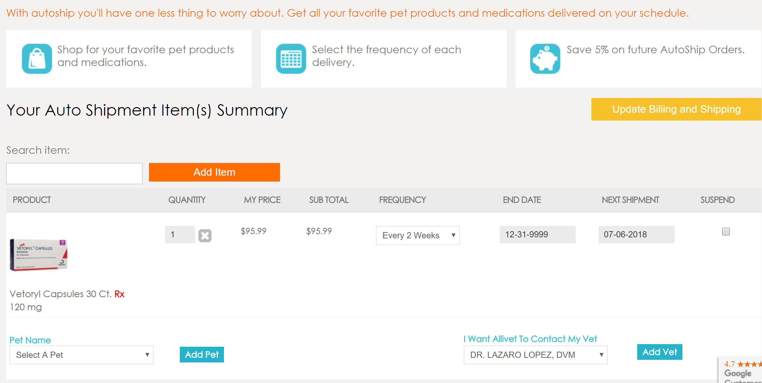
My Allivet
My Autoship
Notes:
Transition Arrows
Arrow 1= Search bar
- Clients can add items here
Arrow 2 = Quantity/Removal
- Clients can adjust the QTY within the box
- Client can also remove the item by clicking on the white “X” in this area
Arrow 3 = Frequency
- Clients will be able to adjust their frequency of shipment here
- Shipments are set based in weeks rather than days or months
Arrow 4 = Pet/Vet
- Clients will need to specify in this area what pet and vet this medication is to be placed under
- Only applied to RX items
Arrow 5 = Next Ship Date
- Client can see when exactly their orders will be shipped
- They can also adjust the ship date if they do not wish to change the frequency of their order
Arrow 6 = Suspend
- Clients can suspend an item/autoshipment by checking this box
-This will allow the client to reactivate the item without having to read it to the program should they wish to just place a hold on the order

Slide 18
My Allivet
My Autoship
Rules | Things to Remember
Autoship orders will use the REGULAR PRICE at the time the autoship is placed less the 5% discount. | A customer receives an email three days ahead of their order generating. We generate orders three days ahead of the scheduled ship date. Meaning orders may generate ahead of their scheduled ship date. Items scheduled to ship Regular Price
Can only be combined with Reward points for additional discounts. | Changes can be made until midnight EST the day before your scheduled ship date
Autoship orders will not use any special or discount pricing that may have been available on a prior order. | Prices can change from time to time. Please check pre-order notification for confirmation of current pricing
Credit Cards need to be saved on file for your autoship to automatically generate | On the day your order is processed you will receive an email confirmation with tracking information

Slide 19
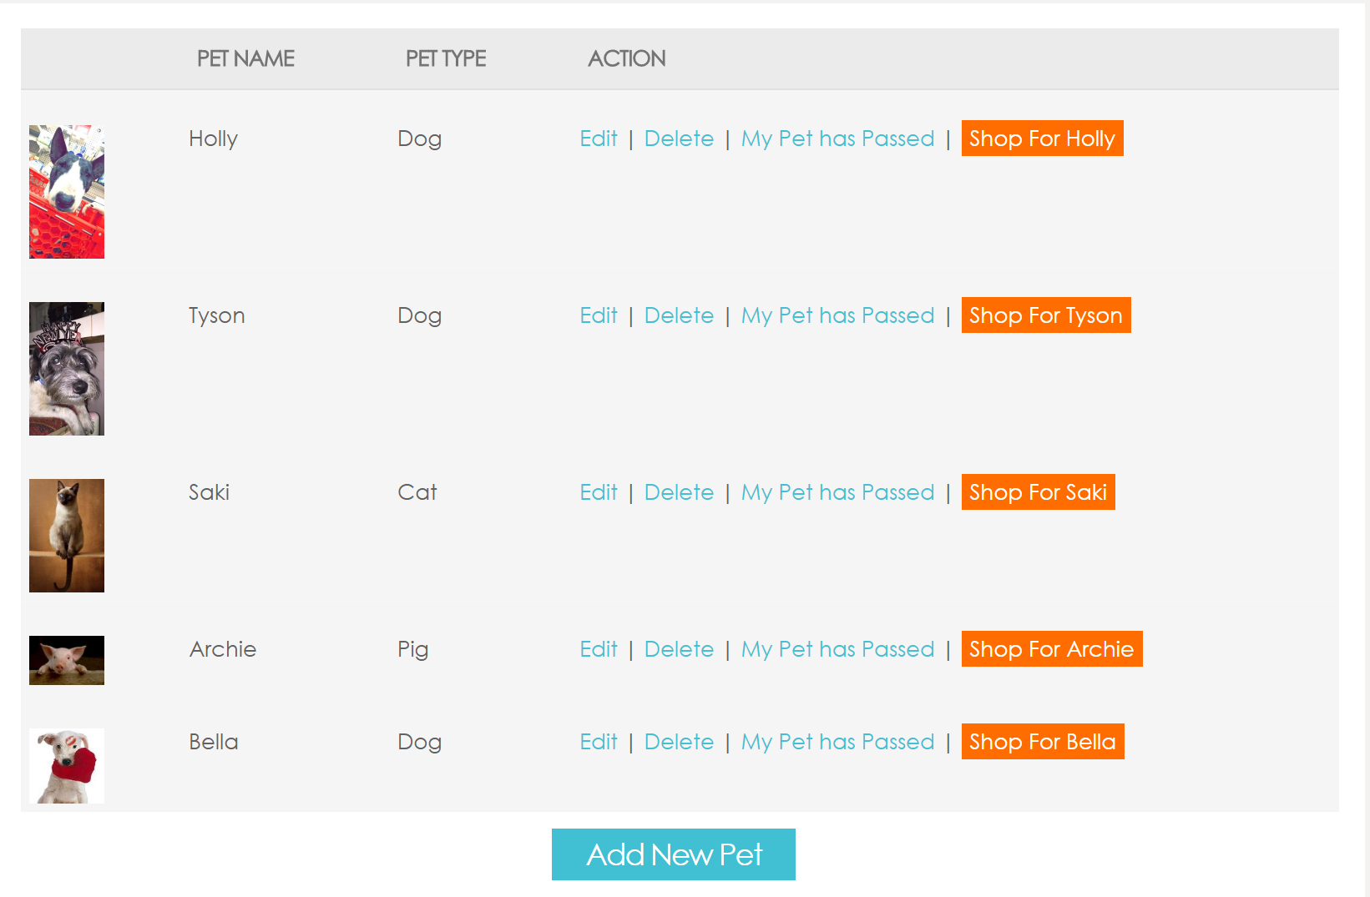
My Allivet
My Pets
Notes:
Editing Existing Pets
Edit
- Will allow you to edit any information previously entered
Delete
Will remove your pet’s profile
My Pet Has Passed
Allows you to specify that this pet has passed
Will be indicated for Customer Service agents in Red lettering
Shop For (Pet Name)
By clicking on this the system will automatically assign any prescription medications you may add to the cart to this pet
Add New Pet
A pop up will appear asking you to enter your pet information:
Pet Name
Owner Name
Type
Some animal Species will require you to enter their breed
Gender
Weight
DOB
Age
List Any Medications Currently On
List Any Medical Conditions
List Any Allergies To Medications

Slide 20
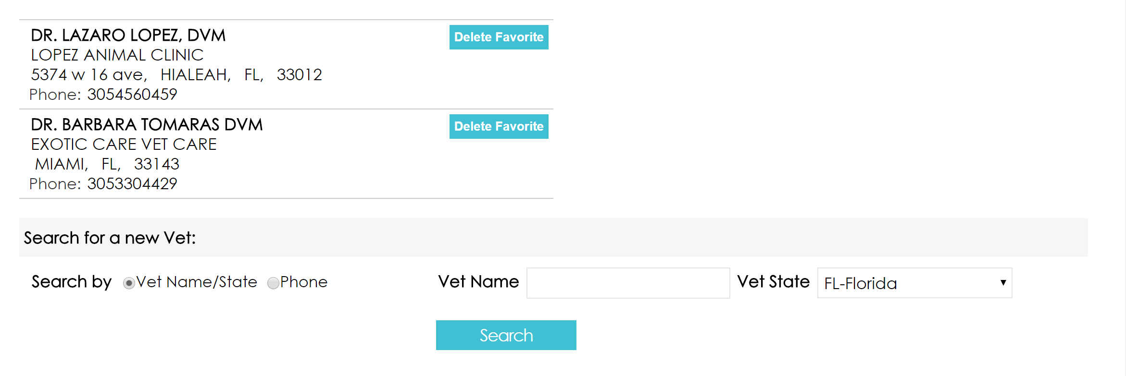
My Allivet
My Vets
Here you can save all of the different veterinarians your pets may see. This information is required in order to purchase prescription items.
Notes:
Editing Existing Vets
Delete Favorite
Add New Vet
You will need to enter your primary vet information.
- You can search via two methods:
- Vet Name/Sate
- Phone
Enter the required information of which ever method you selected and click on the blue “Search Button”
When you have found your vet click the blue button on the right that says “Make Favorite”
- This will add them to your vet list

Slide 21
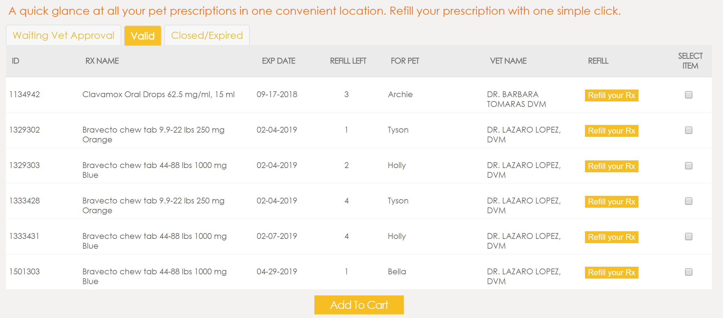
My Allivet
My RX
Notes:
Tabs
My Rx is divided by three different tabs:
- Waiting Vet Approval
- Valid
- Closed/Expired
Each tab is divided into 8 columns
ID
This is the prescription number our pharmacists work with
RX Name
EXP Date
Refill Left
For Pet
Vet Name
Refill
Will redirect you to the shopping cart
Works best for single item refill orders
Select Item
Will redirect you to the shopping cart
Works best for multiple refill items
Valid
Any open orders where your vet has already approved the prescription will reflect here
Any prescriptions with refills still valid will appear here

Slide 22
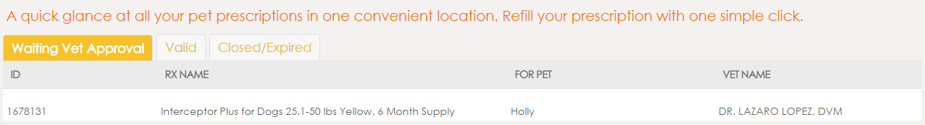
My Allivet
My RX
Any open order with a prescription medication which has yet to be approved will be listed here
Divided into 4 columns:
ID
RX Name
For Pet
Vet Name
Once approved it will be moved into the “Valid” tab
Notes:
Waiting Vet Approval

Slide 23
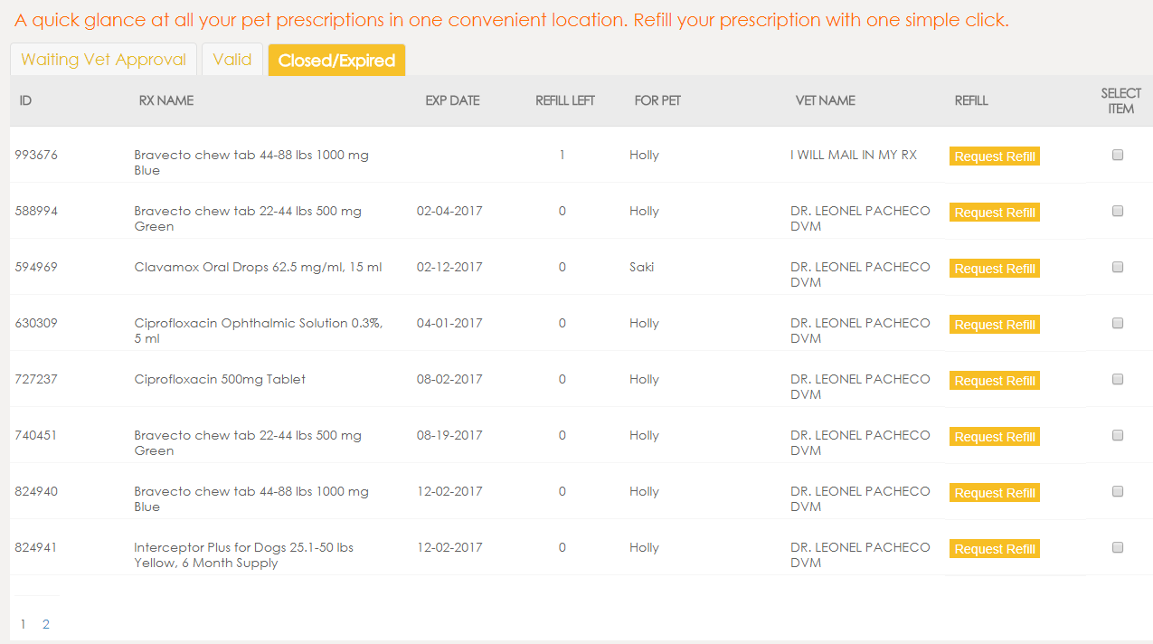
My Allivet
My RX
Notes:
Closed/Expired
Any previously used prescriptions which have been fully filled and are no longer valid will reflect here

Slide 24

My Allivet
Exercise
In this exercise you will practice creating an Autoship account, while managing your pet profiles.
Add a Pet
Delete a Pet
Create an AS and set at 4 week intervals
2 Examples
Dog and Cat

