Slide 1
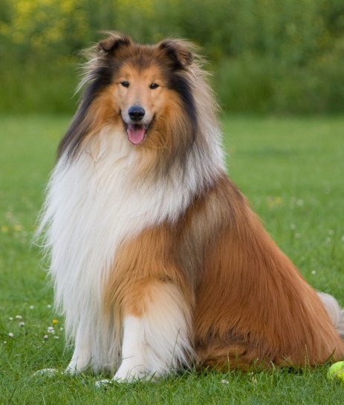


Pharmacy Procedures

Slide 2
Prescription Order Flow

Slide 3
Order Flow
RX Received
Our pharmacy has a set order flow for every prescription that is to be shipped.
Client places order
System reads if there is a valid prescription already on file
Valid Rx on file: The system will automatically process the order
No valid Rx on file: The following steps are required:
RX Received
RPH Review
Valid
To Be Filled
Notes:
Transition of location

Slide 4
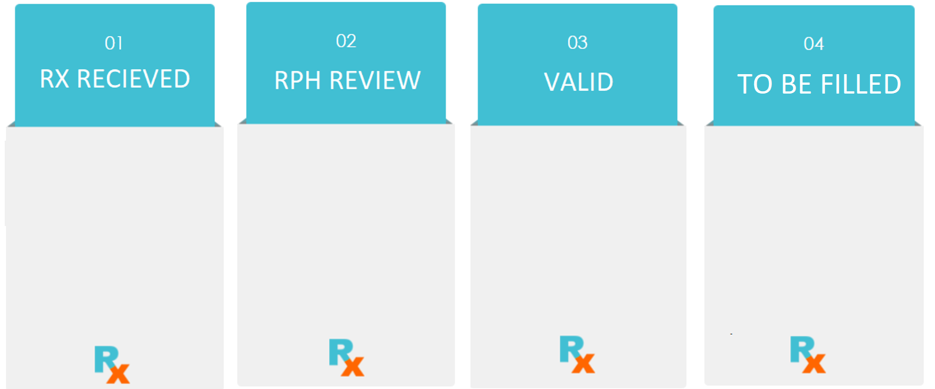
Order Flow
Order has been approved by the veterinarian and submitted to us.
Pharmacy Technicians will type the prescription for the pharmacists to approve.
Pharmacists will review the prescription to be sure the order matched what the veterinarian has approved.
If there are any errors the pharmacists will contact both the client and the veterinarian.
Pharmacists will validate the prescription that is ready to be filled and send it to the pharmacy to fill.
Production pharmacy technicians will fill the medication.
Once filled the pharmacists will review it once more to ensure the proper counts and medication has been dispensed.

Slide 5

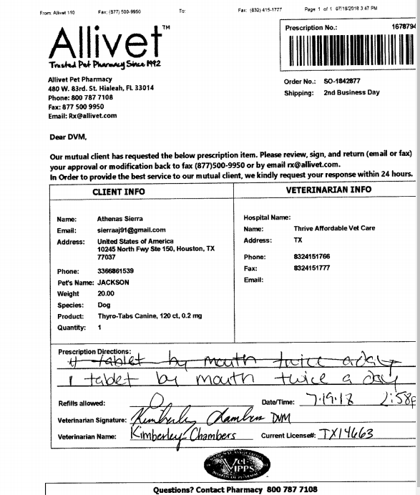
Order Flow
RX Received
Approved prescriptions must be attached to the correct order.
Prescriptions with readable barcodes will automatically be attached to the order.All unreadable barcodes or mailed in prescriptions will be reviewed and attached by a technician.
Notes:
Transition of location

Slide 6

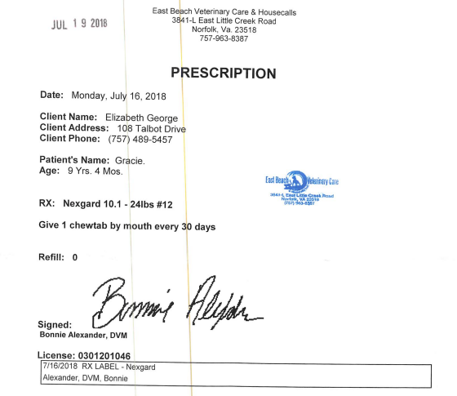
Order Flow
RPH Review
After the Rx has been received and attached, our technicians will send the order to RPH Review.
RPH Review (RPH): Indicates an approved prescription has been received and is waiting for approval by our pharmacists.
Notes:
Transition of location

Slide 7

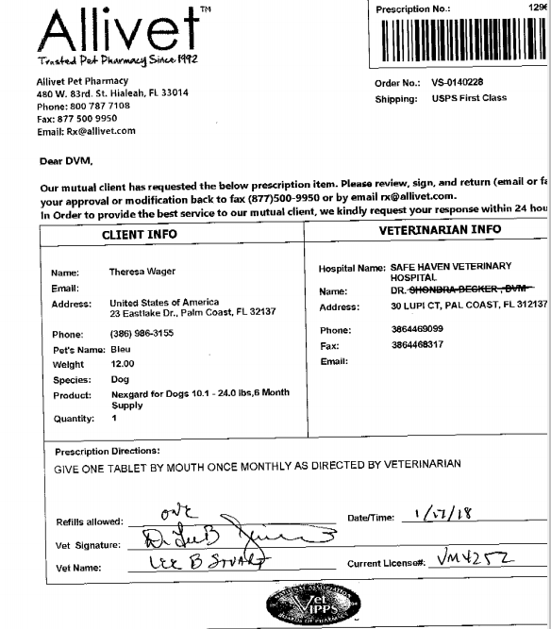
Order Flow
Valid
After being sent to RPH, a
pharmacist will do one of two
things:
Approve It
Re-Submit It
Approve: Pharmacist will mark an item approved so long as the item and dosage ordered matches what the veterinarian has directed.
Notes:
Transition of location

Slide 8
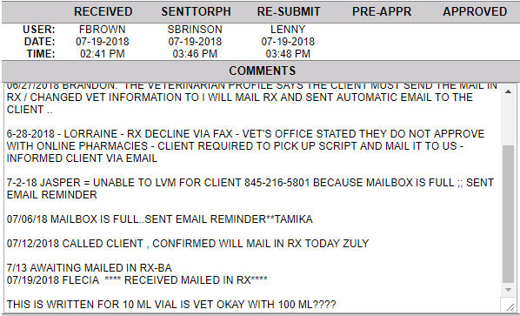
Order Flow
Valid Cont.
Re-Submit:
Occurs when there is a discrepancy with the item ordered versus what was prescribed by the vet, or
The pharmacist requires additional information to approve the prescription.
Notes:
Transitions
Where the Re-submit is located
The reason the order was re-submitted

Slide 9
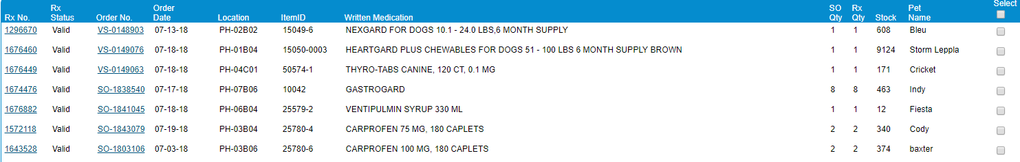
Order Flow
Filled
After being validated, the order will be sent to the pharmacy production team where it will be filled and checked once more for accuracy before being packaged for shipment.
Notes:
Transition of location

Slide 10
Rx Exceptions

Slide 11

Rx Exceptions
There are a few things that can interrupt a smooth prescription process:
RX Issue
Fill On Hold
Notes:
Transition of location

Slide 12
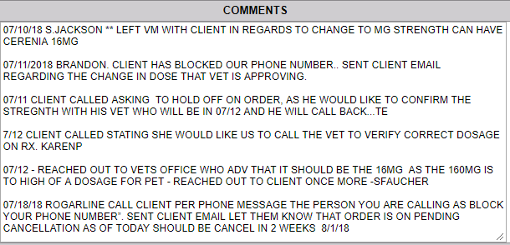
Rx Exceptions
RX Issue
RX Issue: Any issue with the prescription or order which has been identified by a pharmacy tech, or pharmacist prior to the prescription being validated.
Notes:
Transitions
Where the Rx Issue indicator is located
The reason the order was placed as an Rx Issue

Slide 13
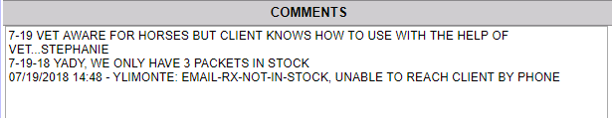
Rx Exceptions
Fill On Hold: Is any issue with the prescription or order that has been identified by a pharmacist after being validated.
Notes:
Transitions
The reason the order was placed as a Fill On Hold

Slide 14
Customer Service & Pharmacy

Slide 15

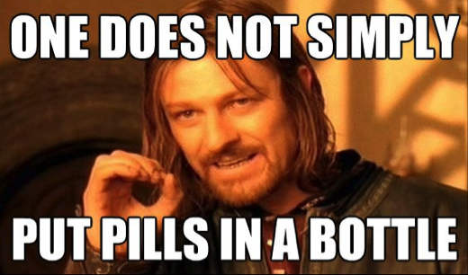
Customer Service vs. Pharmacy
Customer service and pharmacy work hand in hand to ensure customer orders go out as quickly and as smoothly as possible.
Although both departments share a common goal, they perform different customer facing functions:
Customer service works primarily with the customer
Pharmacy works primarily with the customer's veterinarians and their staff

Slide 16
Customer Service vs. Pharmacy
Customer Service
Pharmacy
Works with the customer to place orders.
Works with the customer should there be any issues regarding an order and provides a solution
Handles all customer affairs regarding accounts, questions, and order follow ups.
Works with the veterinary office should there be an issue with a RX.
Provide consultations to customers regarding any RX medication.
Fill all Rx orders and confirm that the customer is ordering the correct medication
Works together to ensure all orders are shipped accurately and in a timely manner.
Notes:
Transition per bullet point
Customer Service: 3 bullet points
Pharmacy: 3 bullet points
Middle: 1 bullet point

Slide 17
Contacting the pharmacy
In order to ensure the best customer experience, there are a few situations where you will need to transfer a customer to a pharmacist.
Consultations regarding Rx medications ONLY
Questions regarding anything their veterinarian has authorized.
Any time a veterinarian office calls to provide a verbal authorization.
Any medical issue:
Reaction to medication
Medication not effective
Incorrect medication sent

