Slide 1



QUALITY ASSURANCE

Slide 2
Call flow
Inbound customer service

Slide 3
section 1: soft skills
Soft skills are interpersonal (people) skills:
Communication
Self Motivation
Self Awareness
Empathy
Flexibility
Notes:
Full Scope of Medication
Allergy & Antihistamines
Antibiotics
Anti-Cancer & Tumor
Anti-Fungal
Anxiety & Behavior
Arthritis Pain & Anti-Inflamatory
Asthma & Respiratory
Colic & Musculoskeletal
Cushing’s Disease
Diabetes & Insulin
Diagnostic Devices
Digestive Track, Liver, & Pancreas
Ear Medication
Epilepsy & Seizure
Estrus & Luteolytic
Eye Medication
Heart & Blood Pressure
Heartworm Preventatives
Immune System
Injectable Vitamins & Electrolytes
Parasite Internal & External
Sedatives
Skin Irritation
Syringes & Needles
Thyroid & Hormone
Urinary Tract & Kidney
Wound Care

Slide 4
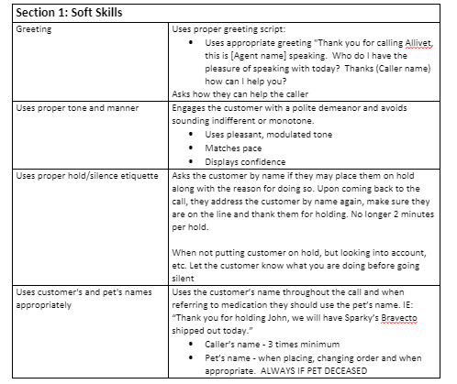
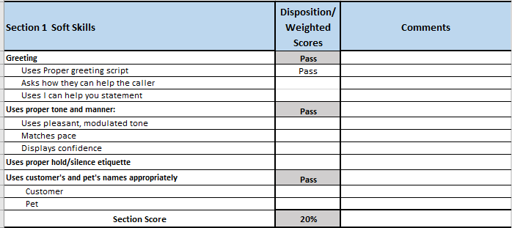
SECTION 1: Soft Skills

Slide 5
SECTION 2: lISTEN & rESOLVE
Ability to put things into perspective, weigh the options.
Responsibility
Problem solving
Decisiveness

Slide 6
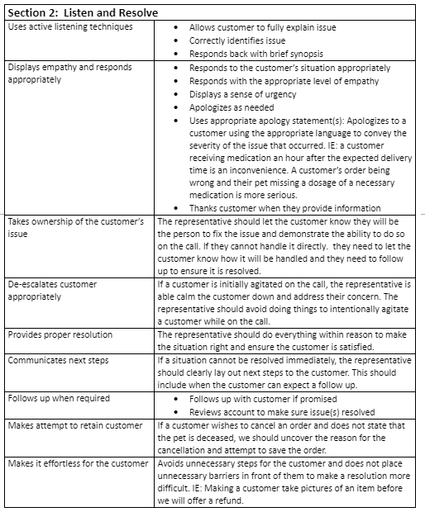
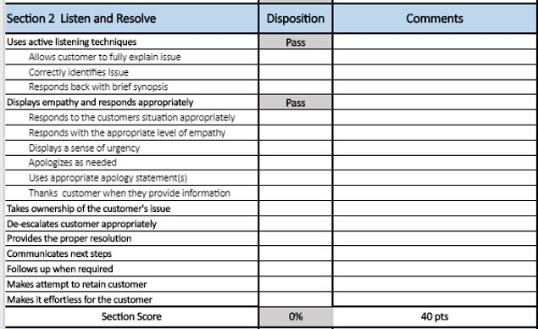
SECTION 2: lISTEN & rESOLVE

Slide 7
SECTION 3: SYSTEMS & PROCEDURES
Thorough knowledge of systems and procedures ensures a consistently high level of quality and service.
Accuracy
Thoroughness
Compliance

Slide 8
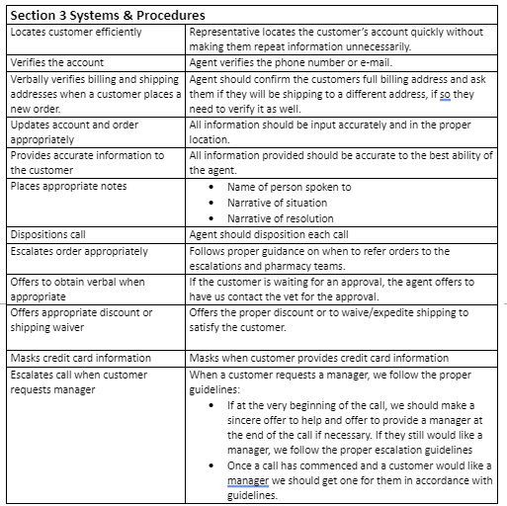
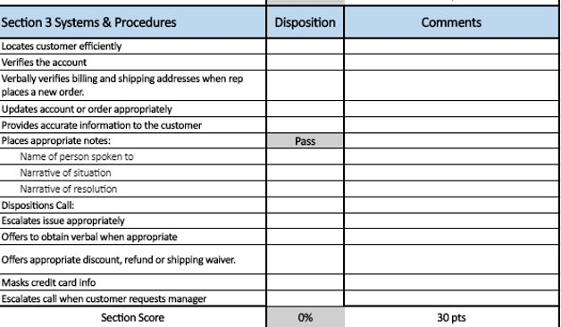
SECTION 3: SYSTEMS & PROCEDURES

Slide 9
SECTION 4: closing
Close out call with a strong recap of what actions were taken on behalf of the customer, what are the next steps and properly close. Doing this ensures:
Accuracy
Correct expectations set
Customer satisfaction

Slide 10
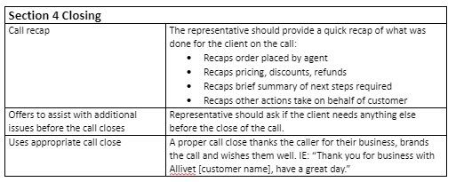
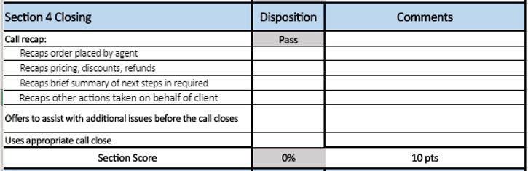
SECTION 4: closing

Slide 11
SECTION 5: AUTO FAIL
Behaviors that do not meet the high standards of Allivet!

Slide 12
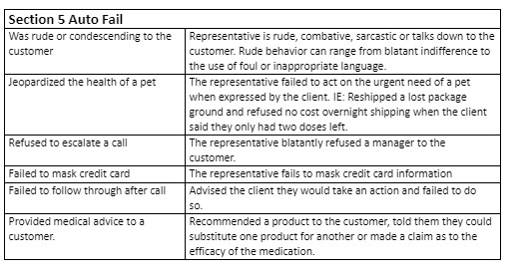
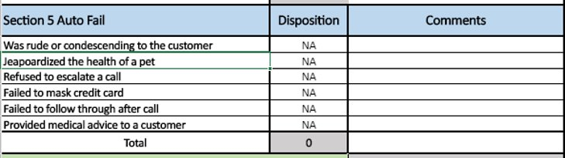
SECTION 5: AUTO FAIL

Slide 13
Call flow
Vet Rx Approvals/Denials

Slide 14
SECTION 1: SOFT SKILLS
Soft skills are interpersonal (people) skills:
Communication
Self-Motivation
Self-Awareness
Empathy
Flexibility

Slide 15
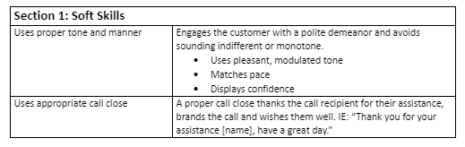
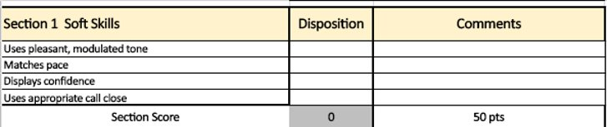
SECTION 1: SOFT SKILLS

Slide 16
SECTION 2: Systems & Procedures
Thorough knowledge of systems and procedures ensures a consistently high level of quality and service.

Slide 17
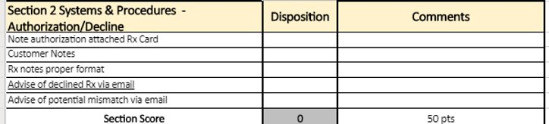
SECTION 2: Systems & Procedures

Slide 18
SECTION 4: auto fail
Behaviors that do not meet the high standards of Allivet and/or
failure to capture all necessary information on recording

Slide 19
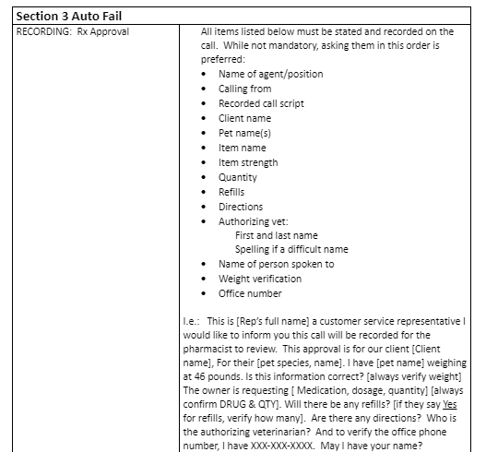
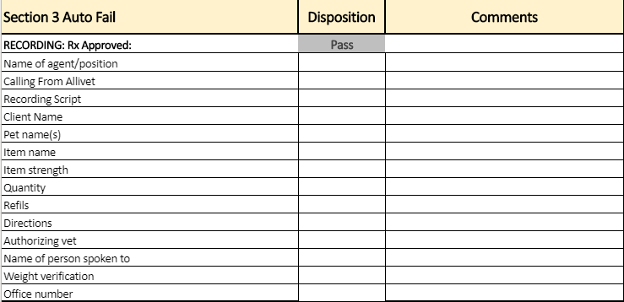
SECTION 3: auto fail

Slide 20
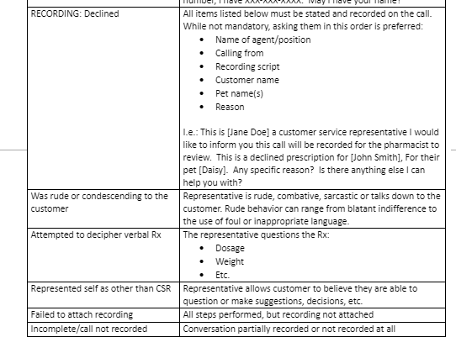
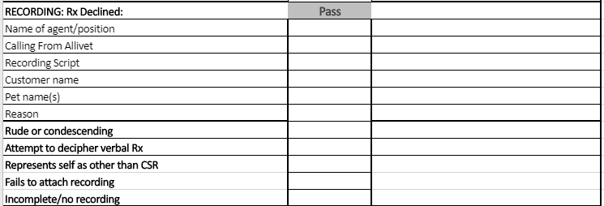
SECTION 3: auto fail

