Slide 1
Who we are

Slide 2

Company Overview
Welcome to Allivet, your most trusted pet pharmacy since 1992! Licensed in all 50 states, we have been the select provider of quality pet medication, and veterinary supplies for more than 25 years
Our mission is to provide the highest quality pet medications and products to our clients. We strive to uphold the lowest prices while upholding the highest pharmacy standards in the industry.
Notes:
1. Change picture to 27 Years & Counting
...

Slide 3
Our Teams

Slide 4



Welcome module

Slide 5
Department Structure
Customer Service
Pharmacy
Shipping
Notes:
Customer Service
All customer service agents perform a variety of customer service and related duties. Agents are expected to consistently demonstrate a sense of urgency in responding to our clients. As a member of the Allivet team each agent should enthusiastically provide the highest level of service to customers in conformance with Allivet’s policies and procedures.
Utilizing the Allivet’s approach; makes clients feel welcomed, engaged and significant. Agents will need to advise clients with questions to determine the right product, and refer clients to the correct department should they not be able to provide a proper response. By guiding clients to the proper channels and outlets in order to resolve an issue, or be able to resolve any issue and answer any question builds long lasting relationships with our clients by consistently following through to ensure the client’s needs are fully met.
Pharmacy
Allivet takes pride in their pharmacy as we strive to uphold the highest pharmacy standards. The pharmacy team consists of both licensed on staff pharmacists who provide client consultations, and licensed pharmacy technicians.
Our pharmacy prepares medications by working closely with our clients orders to interpret their veterinarians authorization of said medication.
Shipping
Our shipping department takes care of a variety of activities such as order verification and processing, picking, packing, shipping, receiving, storage, inventory management and record keeping.

Slide 6

Your Role
In joining the Customer Service Department there are a few things you will need to know:
Agents will need to address customers questions and concerns.
Agents will work with different departments within the company to resolve customer needs.
Agents will strive to live up to Allivet’s high customer experience standards on every contact.
Notes:
Customer Service Abilities/Responsibilities
Provide the highest level of customer service in a positive, courteous and enthusiastic manner to employees and customers.
Promotes our culture in all branch activities.
Greets all customers promptly and shows a genuine interest in meeting their needs.
Maintains customer as first priority in all interactions.
Processes all customers efficiently and in accordance with standard operating procedures.
Manages activities to ensure maximum customer service at all times.
Communicates effectively both in writing and verbally with current and potential clients.
Maintains a strong working knowledge and adheres to all Allivet Policies and Procedures, as well as all pharmacy policies, procedures, systems and programs used to serve customers and maintain efficient order records.
Utilizes Allivet’s approach to identify client’s problems and determine solutions.
Asks the right questions to determine additional needs and which product solution is right for them.
Counsels customers within scope of authority.
Responds to questions on complicated accounts.
Refers more complex customer matters to branch management.

Slide 7
What We do

Slide 8
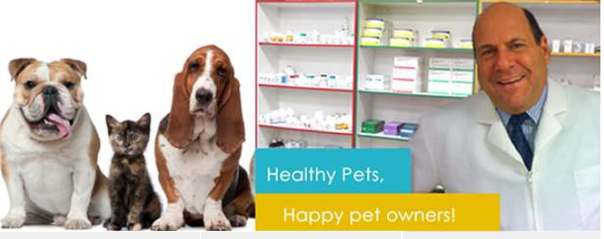
What is a pet pharmacy?
Pharmacy: A store where medical drugs are dispensed and sold.
Pet Pharmacy: Will ONLY dispense and sell medical drugs for animal use.
There are no licensed veterinarians on staff. Only licensed pharmacists and pharmacy technicians.
We do not prescribe or recommend and medical drug or over the counter supplement to our customers.

Slide 9





Product Offerings
We carry a variety of products:
Prescription Medications
Pet Food
Vaccines
Grooming Products
Vitamins/Supplements
Notes:
We do not only carry prescription items.
Many of our products are over the counter (OTC) items meaning they can be purchased without as prescription.
Any prescription medication will require veterinary authorization prior to shipment.

Slide 10
How do they find us

Slide 11
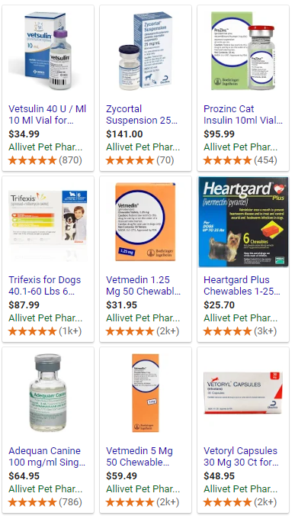


Online Ads
Notes:
Many of our clients come to us via Google Ads, and Email promotions.

Slide 12
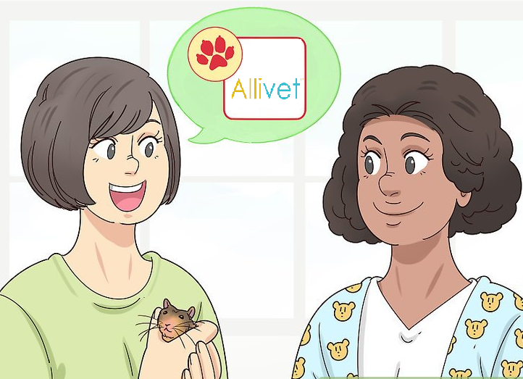


Recommendations
Notes:
Many of our clients are recommended by either their veterinary offices, or though our established clients.
We have such a strong word of mouth business due tour high customer service standards.

Slide 13


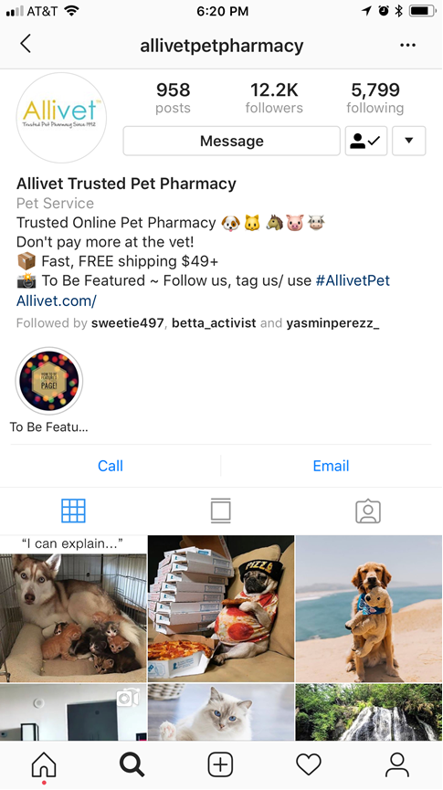
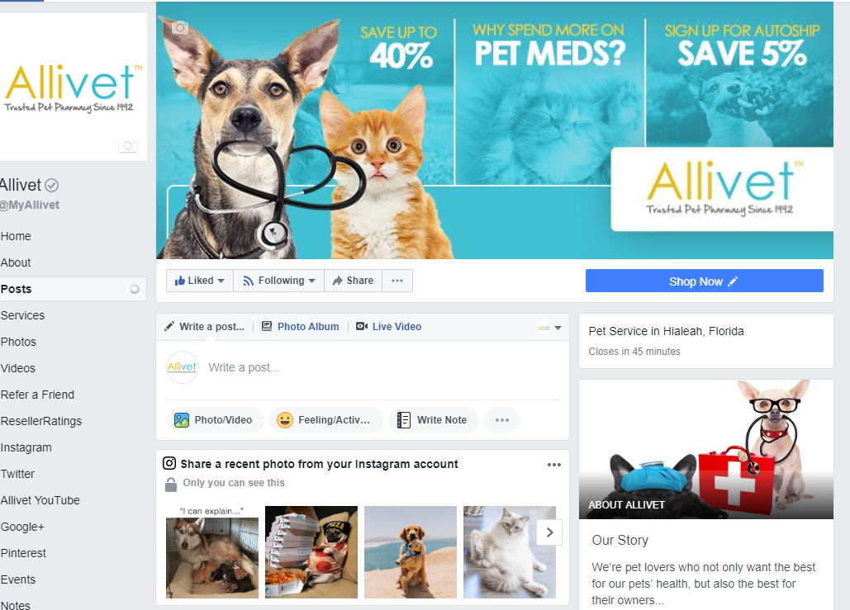
Social Media
Notes:
Social Media plays a very important roll in today’s world.
Many of our clients will find us via social media ads, or after being recommended by friends will look into our social media pages to see what our clients are saying.
We have a strong social media presence
We also have a specified team of people who handle our social media presence.

