Slide 1
Project TLDR: Standalone Desktop Application for Question Answering and Summarization
Manu Hegde
University of Washington
2025

Slide 2

Introduction
Offline QA & Summarization Tool: Standalone desktop app for querying and summarizing local documents using resource-efficient LLMs.
Optimized for Apple Silicon : Efficiently leverages on-device compute via Neural Engine (ANE) and Metal shaders, and unified memory architecture (UMA)
Privacy & Performance: Fully local processing with no cloud dependency, preserving user privacy while using minimal system resources.
User-Centric Approach: Tailored for students and researchers, with a graphical UI and only uses specified sources and references original documents with page numbers.

Slide 3
Motivations
Inconvenient for Researchers: Repeated LLM-based Q&A across multiple documents is limited or costly on cloud tools like ChatGPT.
Privacy Concerns: Cloud LLMs pose risks for sensitive or unpublished data due to potential data leakage and extraction attacks.
Hardware Opportunity: Apple Silicon (M1/M2) enables efficient on-device AI inference through its Neural Engine and unified memory.
Local and Secure: Project TLDR enables offline, source-specific interaction with academic corpora—no internet required.

Slide 4
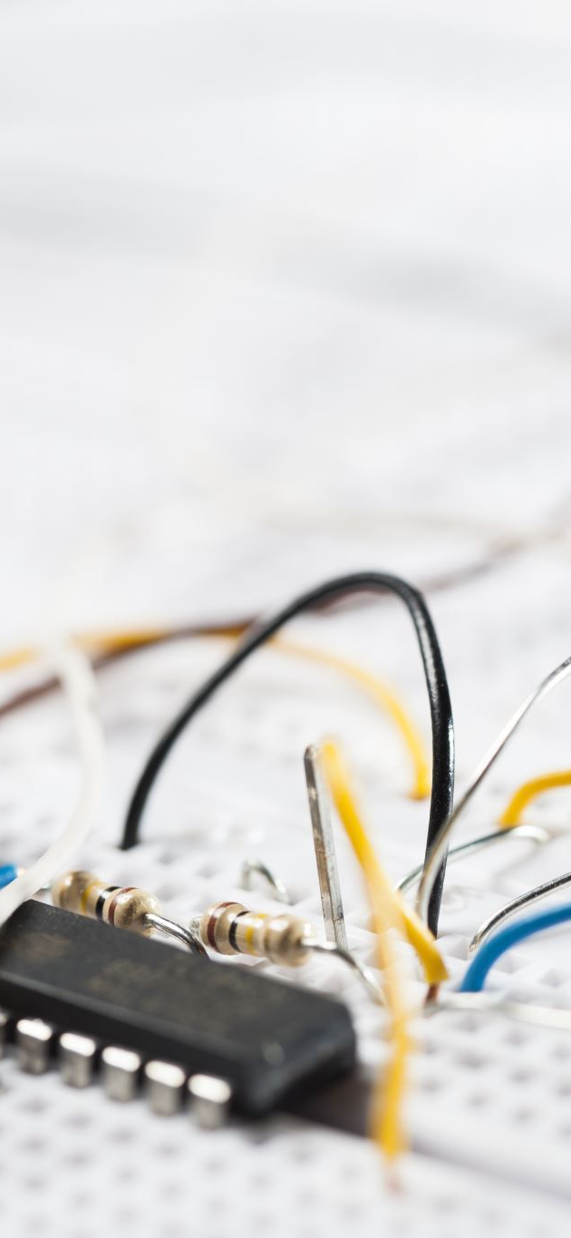
Our Contributions
Apple Neural Engine (ANE) Utilization: Explores leveraging of the underused NPU for LLM inference, going beyond standard CoreML use cases.
Retrieval-Augmented Generation (RAG) without Internet : Implements a lightweight RAG pipeline that only uses on device resources.
Portability and Ease of use: Application size of less than 1GB that includes everything.
Quantized LLMs: Uses compact models (50–500MB) for efficient, on-device inference allowing for seamless multitasking.

Slide 5

Related Work
1. Ollama:
Pros:
Desktop app for running local LLMs
Can download and use any LLM the user desires
Cons:
Requires manual model selection and setup
Lacks streamlined RAG: users must re-attach documents repeatedly
2. Llamafile:
Pros:
Packaged LLM with built-in web UI
Can be bundled into single package
Cons:
No native support for retrieval-augmented generation (RAG)
Limited to basic chat use cases without document-grounded context
Additionally, most applications focus on CPU based optimizations since they target to reach maximum number of devices

Slide 6
Theoretical Background

Slide 7
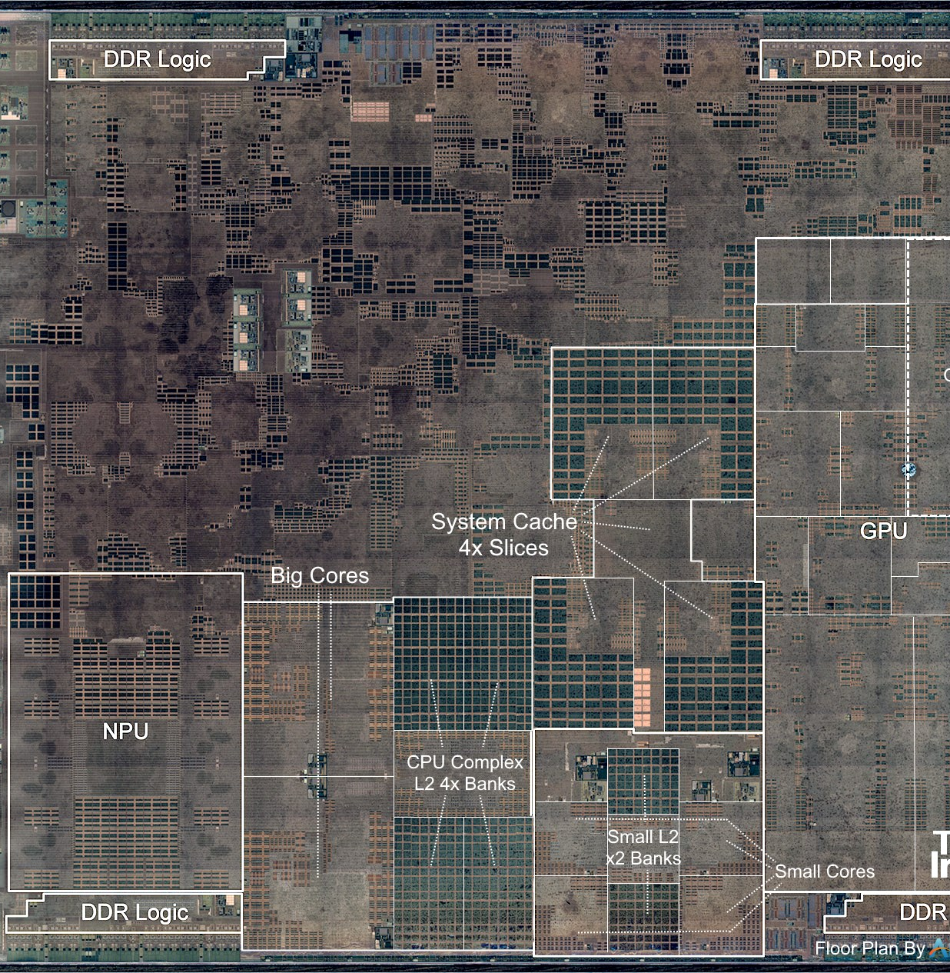
Apple Silicon and The M1 SOC
Built in with accelerators
GPU delivers up to 5.2 TOPS (INT8); supports general-purpose ML via Metal Shading Language
NPU (ANE) offers 11 TOPS (INT8) and is dedicated to ML tasks via CoreML interface
Unified Memory Architecture (UMA) and System-On-Chip Design:
CPU, GPU, and - NPU share the same memory address space— enables cross-referencing of same data without additional copies
High speed data links to enable low latency switch of control

Slide 8
Quantization
What is Quantization?
A compression technique that reduces model weight precision (e.g., from 32-bit floats to 8/4/3-bit integers)
Significantly reduces memory and compute requirements for LLM inference
Why Quantize?
Enables large models to run efficiently on edge devices (like MacBooks)
Maintains acceptable accuracy while reducing size and power usage
Benefits for Local LLM Inference:
Great trade-off between speed, size, and accuracy
Ideal for real-time, offline NLP applications on constrained hardware

Slide 9
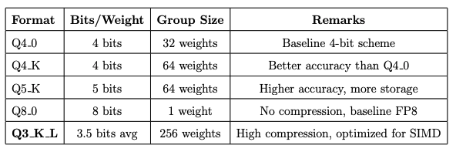
Quantization formats in GGML
GGML is a widely-used machine learning library designed for efficient inference on edge devices.
Rather than storing a separate scaling factor for each weight, GGML groups weights and shares quantization parameters
This grouping approach significantly reduces memory usage and enables efficient SIMD-based matrix multiplications, all while maintaining acceptable accuracy for most tasks.

Slide 10
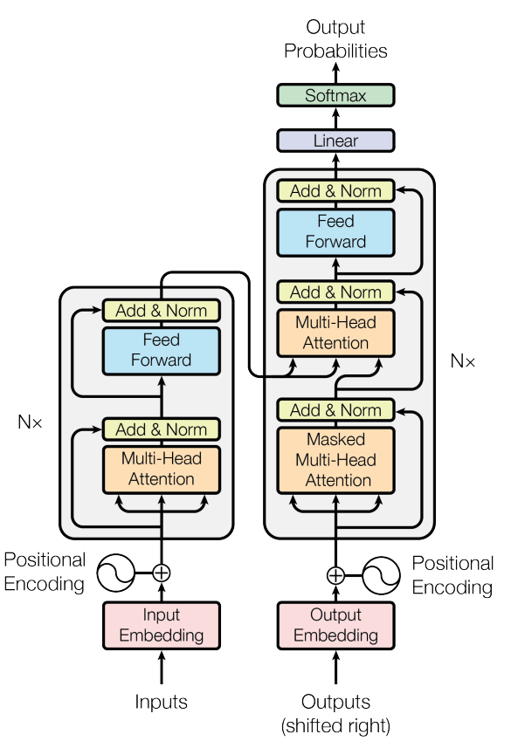
LLM and Transformers
Most modern Large Language Models (LLMs) are based on transformer architecture originally Introduced in paper called "Attention is all you need" paper * in 2017
The transformer architecture, which consists of encoder and decoder blocks and perform autoregressive decoding (one output token at a time)
Most modern LLMs, like GPT and LLaMA, use decoder-only transformers optimized for text generation.
* Vaswani et al., 2017 - Attention is All You Need, Google Research & Google Brain, arXiv:1706.03762

Slide 11
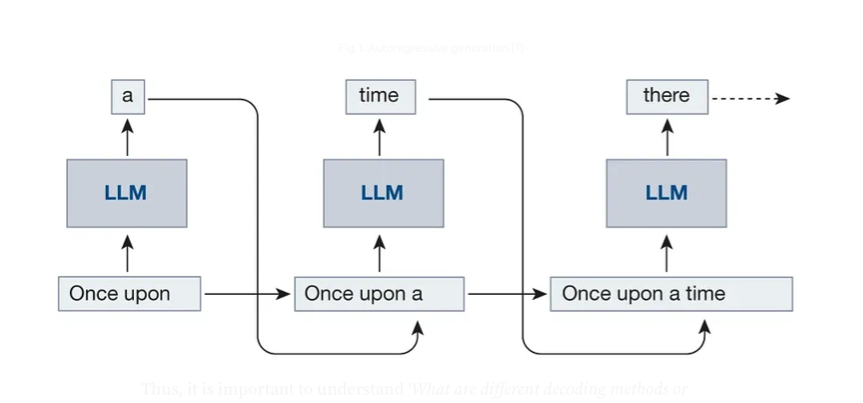
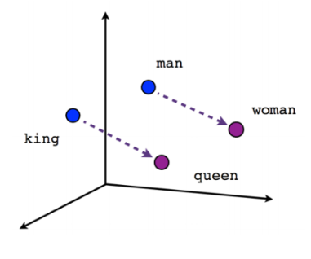
Core Concepts in LLM Inference
Tokenization
Converts raw input text into discrete units (tokens) using subword or byte-pair encoding (BPE).
Example: “transformers are cool” → ["transform", "ers", "are", "cool"].
Embeddings: Embeddings are dense vector representations of text that capture semantic meaning, enabling efficient similarity search and comparison in high-dimensional space.
Autoregressive Decoding
Generates text one token at a time.
Each new token is predicted based on all previously generated tokens.
Common in decoder-only models like GPT and LLaMA.
Sampling
The LLM outputs a probability distribution
A sampler samples an output token from the distribution
KV Cache (Key-Value Cache)
Caches attention keys and values for previously seen tokens.
Prevents re-computation during each decoding step, significantly boosting speed and reducing memory usage.
Auto regressive decoding
Auto regressive decoding
Embeddings visualization
Image credits: embeddings visualization, auto-regressive decoding visualization

Slide 12
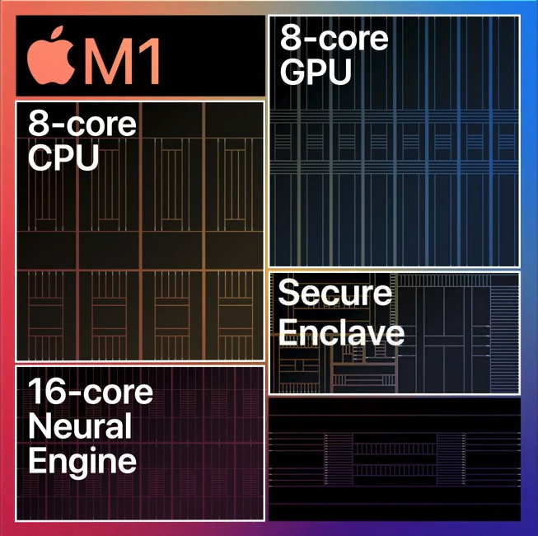
Apple Neural Engine
Apple Neural Engine (ANE) is a dedicated NPU in Apple silicon designed for efficient, low-power execution of machine learning tasks like matrix multiplications and convolutions.
While accessible only through CoreML, the ANE offers up to 11 TOPS performance at 335 MHz and is ideal for offloading parallel ML workloads, freeing CPU/GPU for other tasks *.
* machinelearning.apple.com/research/neural-engine-transformers

Slide 13

Tinygrad Project
tinygrad is a minimalist machine learning framework often used for educational and low-level system research
Made reverse engineering efforts to unlock low-level access to Apple’s Neural Engine (ANE), which is typically restricted via CoreML APIs only.
It shed light on Apple’s proprietary hwx file format and the execution pipeline used to dispatch ML workloads to the ANE.
This project derives inspiration from tinygrad's unconventional use of CoreML
* github.com/tinygrad/tinygrad

Slide 14
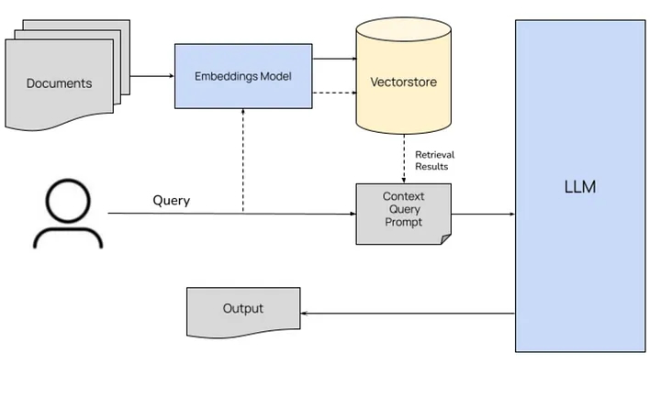
Retrieval Augmented Generation (RAG)
What is RAG?
It is a hybrid approach that combines retrieval of relevant documents with language generation to produce more grounded, factual, and context-aware responses.
Embedding: Index the source documents by converting them to embedding vectors
Retrieval: Searches a knowledge base or document corpus for passages relevant to the input query.
Generation: Uses a language model (e.g., LLaMA, GPT) to generate a response conditioned on the retrieved content.
Why Use RAG?
Helps the language model answer based on actual documents, improving credibility, reducing hallucinations, and enabling source attribution.
* blog.stackademic.com/mastering-rag

Slide 15
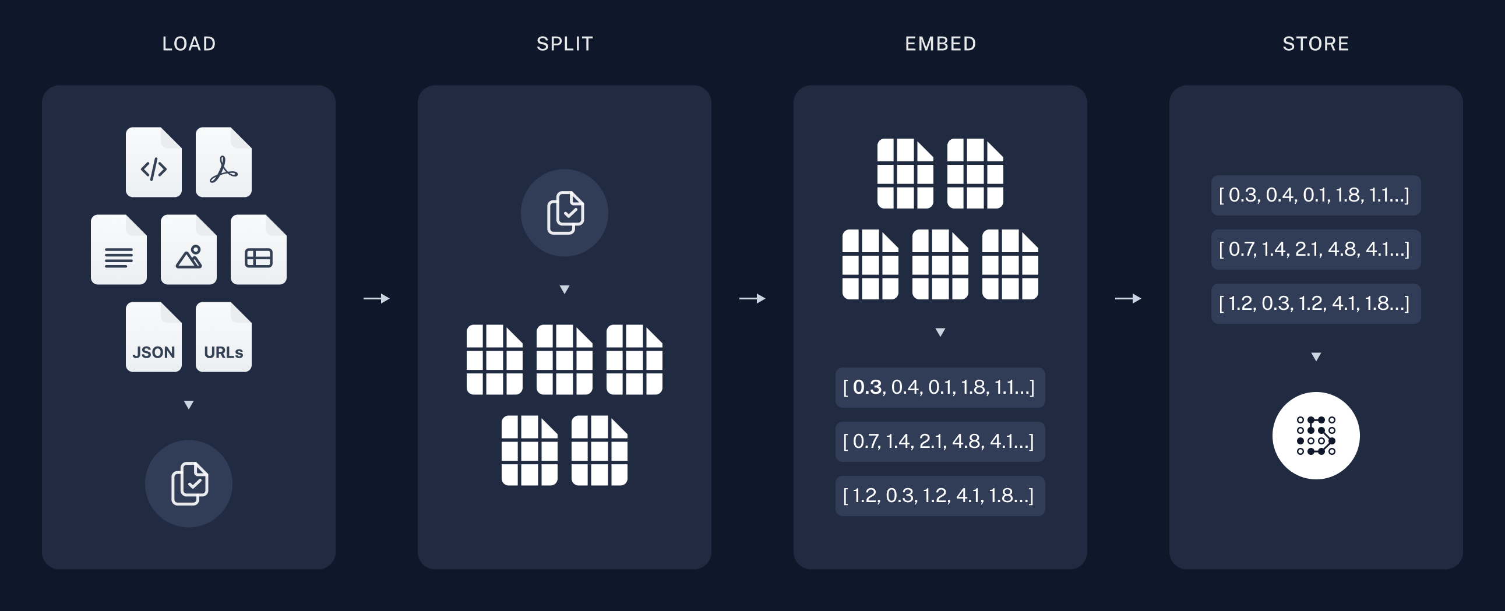
Embedding Phase
Document Chunking: Large documents are split into smaller, manageable text chunks using heuristics like length, sentence boundaries, or semantic structure to fit within the LLM’s context window.
Text Embedding: Each chunk is converted into a dense vector using a pre-trained embedding model (e.g., MiniLM or BERT), capturing the semantic meaning of the content.
Storage: The resulting embeddings are stored in a vector database or as binary vectordump files, alongside metadata like chunk text, document ID, and page number for efficient retrieval during inference.
* rag-langchain

Slide 16
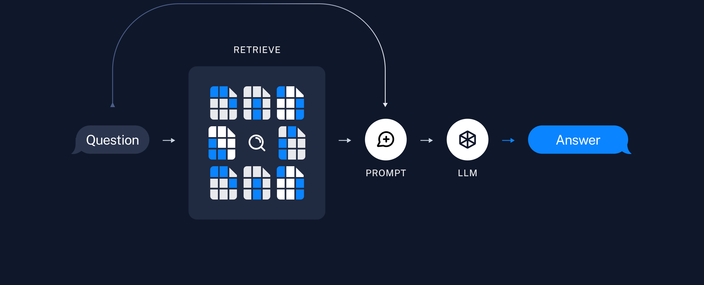
Retrieval & Generation Phase
Query Embedding: The user’s query is embedded using the same embedding model used during the indexing phase to ensure consistency.
Similarity Search: The embedded query vector is compared against the stored document embeddings using a similarity metric (e.g., cosine similarity) to retrieve the most relevant chunks.
Context Construction: The retrieved text chunks are compiled into a context that is passed, along with the original query, making a combined prompt.
Response Generation: A Decoder-only language model (e.g., LLaMA) generates the final answer based on the query and retrieved context, producing grounded and relevant responses.
* rag-langchain

Slide 17
Implementation

