Slide 1
INVESTMENT ASSIGNMENT SUBMISSION
Name: MANUJ BANDHU SHARMA

Slide 2
Abstract – Spark Funds Investment Decision
Objective :
To identify the best sectors, countries, and a suitable investment type for making investments.
Strategy :
To invest where most of the investors are investing.
Goals of Data Analysis :
• Investment type analysis : Understanding investments in different categories to help Spark Funds decide on the best suited investment for the strategy.
• Country analysis : Understanding which countries have had the most investments in the past.
• Sector analysis : Understanding the distribution of investments across the eight main sectors.
Investment Constraints :
• Invest between 5 to 15 million USD per round of investment.
• Invest only in English-speaking countries because of the ease of communication with the companies.

Slide 3
Problem Solving Methodology
Understand Data
• Collect relevant data
• Collecting useful data
• Describe datasets
• Check Data quality
Data Preparation
• Select relevant data
• Clean data
• Integrate Data
• Format Data
Business Understanding
• Business Objective
• Data Analysis Goals
Data Modelling & Analysis
Plotting Graph
Extracting meaningful insights
Datasets
Results
• Analyzed Reports
• Presentation
• Decision Making
Model Evaluation
TRUE
FALSE

Slide 4
Investment Type Analysis
Investment was limited to four types as per Spark Funds’ preference :
Venture
Angel
Seed
Private Equity
The highest average investments are made in “Private Equity”.
Spark Funds’ desired investment range per round is,
5 to 15 million .
As per getting average invested values, Venture funding mean bar
falls into the desired region which is the suitable investment type in this case.
M
M
M
M

Slide 5
Country Analysis
Countries have been filtered based on:
Investment type : Venture
Total Investment in the country.
These are the Top 9 countries based on total investment:
The top three English-speaking countries are: USA, GBR, IND.
Country | Total Investment (in Billions)
USA | $ 4,200.68
CHN | $ 393.39
GBR | $ 200.73
IND | $ 142.62
CAN | $ 94.82
FRA | $ 72.27
ISR | $ 68.54
DEU | $ 63.07
JPN | $ 31.68

Slide 6
Sector Analysis
The three most investment-friendly countries and the most suited funding type sectors for Spark Funds are :
Based on count of Investments | English-speaking country
 | United States of America | Great Britain | India
Top sector | Others (2950) | Others (147) | Others (110)
Second-best sector | Social, Finance, Analytics, Advertising (2714) | Social, Finance, Analytics, Advertising (133) | Social, Finance, Analytics, Advertising (60)
Third-best sector | Cleantech / Semiconductors (2300) | Cleantech / Semiconductors (128) | News, Search and Messaging (52)

Slide 7
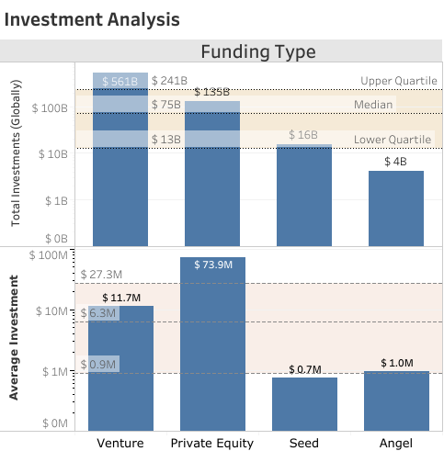
Result - Best suited Funding Type
Investment Analysis
This plot showing the fraction of total investments (globally) in , venture, angel, seed and private equity.
&
The average amount of investment in each funding type.
This chart should make it clear that ,
a Venture funding type (FT) is best suited for Spark Funds.

Slide 8
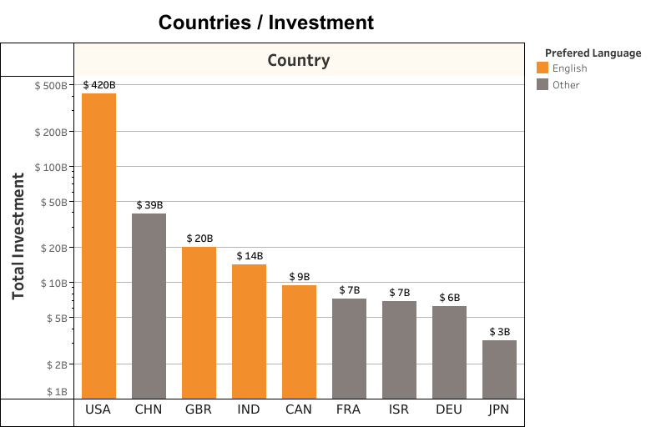
Result – Top Countries
This plot showing the top 9 countries against the total amount of investments of funding type Venture .
This should make us very clear that the top 3 countries are :-
United States of America
Britain
India
(As, English is more preferred to speak in those highlighting countries)

Slide 9
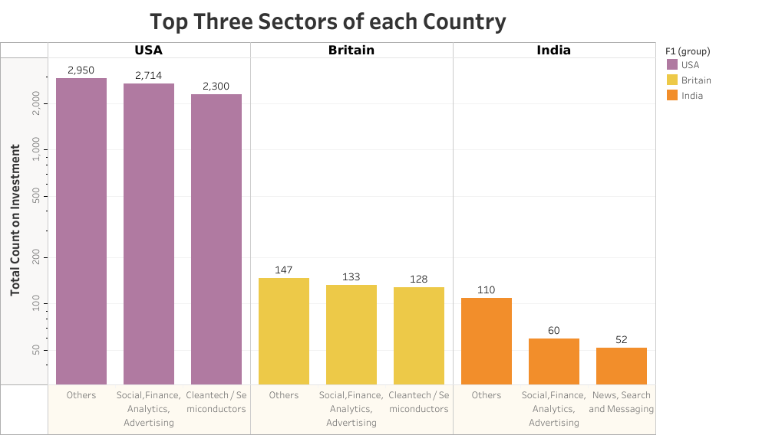
Result – Top Sectors
This plot showing the number of investments in the top 3 sectors of the top 3 countries.
This plot should clearly displays the top 3 sectors each in
USA, Britain & India

Slide 10
Conclusions
The type of fund to invest in , is “Ventures”
Meets Spark Funds’ range criteria
Has the highest total investment among the for chosen types.
Best type among the four investment types preferred.
The Venture investment in the “Others” sector is the highest among all the top 3 countries.
It is followed by “Social, Finance, Analytics, Advertising” sector, which is second in all the top 3 countries.
“Cleantech / Semiconductors” sector is another third place winner among these sectors in USA and GBR, whereas “News, Search and Messaging” sector wins the third place in IND.
Hence, we can recommend a Venture investment in these sectors. USA wins when it comes to amount of investment and number of investments by far. Investing in USA seems to be a good starter.
However, GBR and IND have almost the same opportunity. Considering India’s growth in the last few years, IND also seems to be a great country to invest in.

