Slide 1
Generics in JAVA

Slide 2
Generics
The idea is to allow type (Integer, String, … etc and user defined types) to be a parameter to methods, classes and interfaces.
Generic Class
Generic Functions
Generics in Java is similar to templates in C++

Slide 3
Why Use Generics?
Stronger type checks at compile time.
Elimination of casts.
Enabling programmers to implement generic algorithms.

Slide 4
Type Parameter Naming Conventions
The most commonly used type parameter names are:
E - Element (used extensively by the Java Collections Framework)
K - Key
N - Number
T - Type
V - Value
S,U,V etc. - 2nd, 3rd, 4th types

Slide 5
Bounded Type Parameters
To declare a bounded type parameter, list the type parameter's name, followed by the extends keyword, followed by its upper bound, which in this example is Number. Note that, in this context, extends is used in a general sense to mean either "extends" (as in classes) or "implements" (as in interfaces).
public <U extends Number> void method1(U u)
Multiple Bounds
The preceding example illustrates the use of a type parameter with a single bound, but a type parameter can have multiple bounds:
<T extends B1 & B2 & B3>

Slide 6
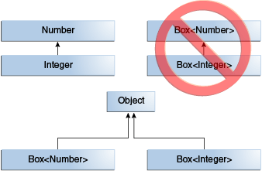
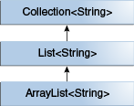
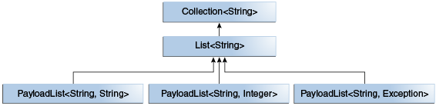
Generics, Inheritance, and Subtypes

Slide 7
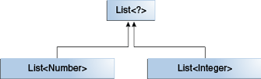
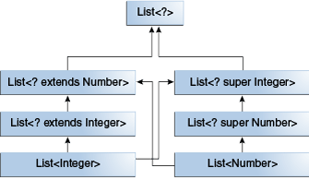
Wildcards
In generic code, the question mark (?), called the wildcard, represents an unknown type.
Upper Bounded Wildcards (extends)
Lower Bounded Wildcards (super)

Slide 8
Type Erasure
Generics were introduced to the Java language to provide tighter type checks at compile time and to support generic programming. To implement generics, the Java compiler applies type erasure to:
Replace all type parameters in generic types with their bounds or Object if the type parameters are unbounded. The produced bytecode, therefore, contains only ordinary classes, interfaces, and methods.
Insert type casts if necessary to preserve type safety.
Generate bridge methods to preserve polymorphism in extended generic types.
Type erasure ensures that no new classes are created for parameterized types; consequently, generics incur no runtime overhead.

Slide 9
Restrictions on Generics
To use Java generics effectively, you must consider the following restrictions:
Cannot Instantiate Generic Types with Primitive Types
Cannot Create Instances of Type Parameters
Cannot Declare Static Fields Whose Types are Type Parameters
Cannot Use Casts or instanceof With Parameterized Types
Cannot Create Arrays of Parameterized Types
Cannot Create, Catch, or Throw Objects of Parameterized Types
Cannot Overload a Method Where the Formal Parameter Types of Each Overload Erase to the Same Raw Type

Slide 10
https://docs.oracle.com/javase/tutorial/java/generics/index.html
https://www.geeksforgeeks.org/generics-in-java/
https://www.javatpoint.com/generics-in-java
https://www.baeldung.com/java-generics

