Slide 1
Working with SDK and Introduction to the Java language

Slide 2
About the Java Technology
Java technology is both a programming language and a platform.

Slide 3
The Java Programming Language
The Java programming language is a high-level language that can be characterized by all of the following buzzwords:
Simple
Object oriented
Distributed
Multithreaded
Dynamic
Architecture neutral
Portable
High performance
Robust
Secure

Slide 4
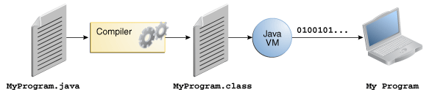
In the Java programming language, all source code is first written in plain text files ending with the .java extension. Those source files are then compiled into .class files by the javac compiler. A .class file does not contain code that is native to your processor; it instead contains bytecodes — the machine language of the Java Virtual Machine (Java VM). The java launcher tool then runs your application with an instance of the Java Virtual Machine.

Slide 5
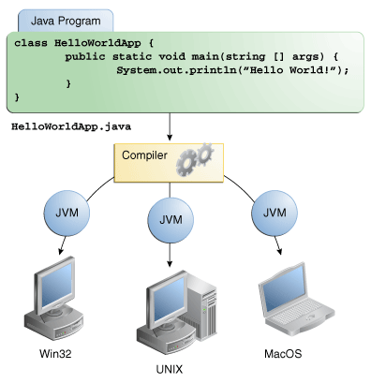
Through the Java VM, the same application is capable of running on multiple platforms.

Slide 6
The Java Platform
A platform is the hardware or software environment in which a program runs.
We've already mentioned some of the most popular platforms like Microsoft Windows, Linux, Solaris OS, and Mac OS.
Most platforms can be described as a combination of the operating system and underlying hardware.
The Java platform differs from most other platforms in that it's a software-only platform that runs on top of other hardware-based platforms.

Slide 7
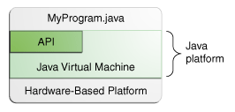
The Java platform has two components:
The Java Virtual Machine
The Java Application Programming Interface (API)

Slide 8
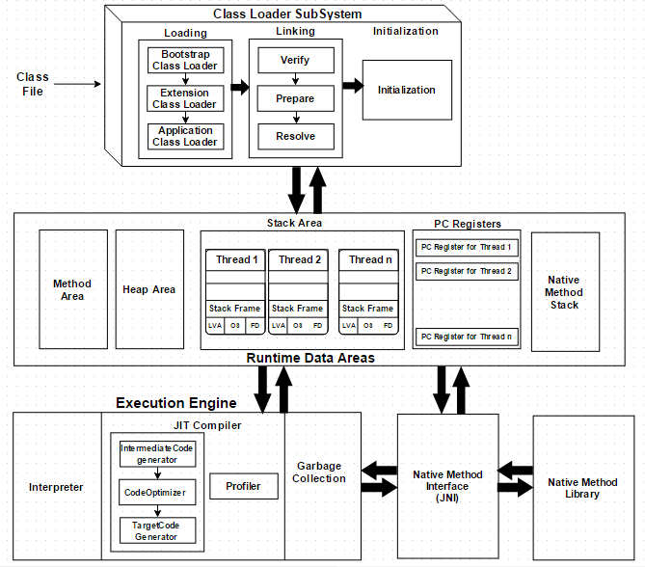
JVM Architecture

Slide 9
What Can Java Technology Do?
The general-purpose, high-level Java programming language is a powerful software platform.
Every full implementation of the Java platform gives you the following features

Slide 10
Development Tools
The development tools provide everything you'll need for compiling, running, monitoring, debugging, and documenting your applications.
As a new developer, the main tools you'll be using are the javac compiler, the java launcher, and the javadoc documentation tool.

Slide 11
Application Programming Interface (API)
The API provides the core functionality of the Java programming language. It offers a wide array of useful classes ready for use in your own applications.
It spans everything from basic objects, to networking and security, to XML generation and database access, and more.
The core API is very large; to get an overview of what it contains, consult the Java Platform Standard Edition 8 Documentation.

Slide 12
Deployment Technologies
The JDK software provides standard mechanisms such as the Java Web Start software and Java Plug-In software for deploying your applications to end users.

Slide 13
User Interface Toolkits
The JavaFX, Swing, and Java 2D toolkits make it possible to create sophisticated Graphical User Interfaces (GUIs).

Slide 14
Integration Libraries
Integration libraries such as the Java IDL API, JDBC API, Java Naming and Directory Interface (JNDI) API, Java RMI, and Java Remote Method Invocation over Internet Inter-ORB Protocol Technology (Java RMI-IIOP Technology) enable database access and manipulation of remote objects.

Slide 15
How Will Java Technology Change My Life?
We can't promise you fame, fortune, or even a job if you learn the Java programming language. Still, it is likely to make your programs better and requires less effort than other languages. We believe that Java technology will help you do the following:

Slide 16
Get started quickly: Although the Java programming language is a powerful object-oriented language, it's easy to learn, especially for programmers already familiar with C or C++.
Write less code: Comparisons of program metrics (class counts, method counts, and so on) suggest that a program written in the Java programming language can be four times smaller than the same program written in C++.
Write better code: The Java programming language encourages good coding practices, and automatic garbage collection helps you avoid memory leaks. Its object orientation, its JavaBeans™ component architecture, and its wide-ranging, easily extendible API let you reuse existing, tested code and introduce fewer bugs.
Develop programs more quickly: The Java programming language is simpler than C++, and as such, your development time could be up to twice as fast when writing in it. Your programs will also require fewer lines of code.
Avoid platform dependencies: You can keep your program portable by avoiding the use of libraries written in other languages.
Write once, run anywhere: Because applications written in the Java programming language are compiled into machine-independent bytecodes, they run consistently on any Java platform.
Distribute software more easily: With Java Web Start software, users will be able to launch your applications with a single click of the mouse. An automatic version check at startup ensures that users are always up to date with the latest version of your software. If an update is available, the Java Web Start software will automatically update their installation.

Slide 17
https://docs.oracle.com/javase/tutorial/getStarted/index.html
https://www.oracle.com/technetwork/java/intro-141325.html#937
https://javainterviewpoint.com/java-virtual-machine-architecture-in-java/
http://cr.openjdk.java.net/~vlivanov/talks/2015_JIT_Overview.pdf
https://www.ibm.com/support/knowledgecenter/SSYKE2_8.0.0/com.ibm.java.vm.80.doc/docs/jit_overview.html
https://www.researchgate.net/publication/221137847_Inlining_java_native_calls_at_runtime
https://en.wikipedia.org/wiki/Java_bytecode
https://en.wikipedia.org/wiki/Java_bytecode_instruction_listings
http://blog.jamesdbloom.com/JavaCodeToByteCode_PartOne.html
http://blog.jamesdbloom.com/JVMInternals.html

