Slide 1
Java classes in-depth / The Object class Object orientation, inheritance, access modifiers

Slide 2
Java Class
<<Access Specifier>> class <<Class Name>> extends <<Super Class Name>> implements <<Interface Name>>{}
Access specifier : Allowable Access specifier for a class are public and default. Access specifiers defines the range of a class where it can be accessed. If a class is public then it can be accessed from anywhere. If you have not added anything in front of a class then it is called as default access specifier. Default access falls between protected and private access, allowing only classes in the same package to access.
class keyword : The access specifier is followed by class keyword which symbolizes that this entity is a class.
Class Name : The class keyword is followed by a class name, which follows the rules of identifiers
Extending & Implement : A class can extends only 1 other class, whereas it can implement any number of interfaces.
https://javainterviewpoint.com/class-in-java-with-example/

Slide 3
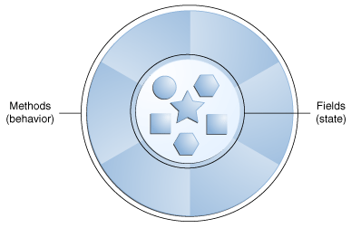
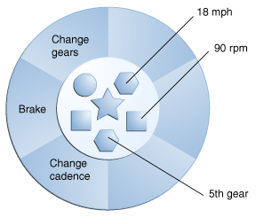
What Is an Object?
An object is a software bundle of related state and behavior. Software objects are often used to model the real-world objects that you find in everyday life.
A software object.
A bicycle modeled as a software object.

Slide 4
The Object class
https://javainterviewpoint.com/object-and-object-class-in-java/

Slide 5
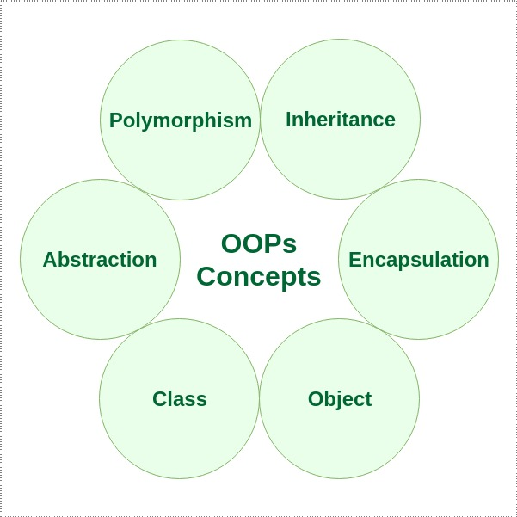
Object orientation

Slide 6
Polymorphism
In Java polymorphism is mainly divided into two types:
Compile time Polymorphism
Runtime Polymorphism
Compile time polymorphism: It is also known as static polymorphism. This type of polymorphism is achieved by function overloading or operator overloading.
Runtime polymorphism: It is also known as Dynamic Method Dispatch. It is a process in which a function call to the overridden method is resolved at Runtime. This type of polymorphism is achieved by Method Overriding.

Slide 7
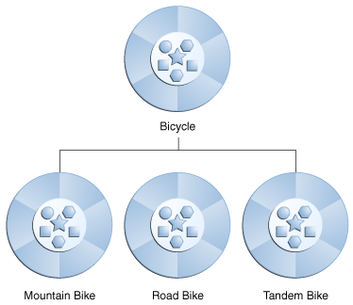
Inheritance
Java Inheritance is a process by which one class can re-use the methods and fields of other class.

Slide 8
Types of Inheritance
Single Inheritance
Multiple Inheritance (Through Interface)
Multilevel Inheritance
Hierarchical Inheritance
Hybrid Inheritance (Through Interface)

Slide 9
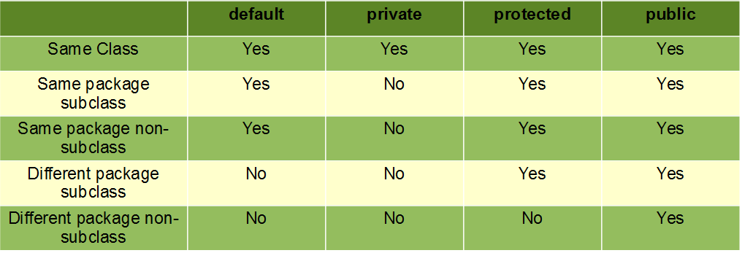
Access Modifiers
As the name suggests access modifiers in Java helps to restrict the scope of a class, constructor , variable , method or data member.

Slide 10
https://docs.oracle.com/javase/tutorial/java/index.html
https://javainterviewpoint.com/object-and-object-class-in-java/
https://www.geeksforgeeks.org/object-oriented-programming-oops-concept-in-java/
https://www.geeksforgeeks.org/autoboxing-unboxing-java/
https://www.geeksforgeeks.org/access-modifiers-java/
https://www.geeksforgeeks.org/interfaces-in-java/
https://www.geeksforgeeks.org/abstraction-in-java-2/
https://www.geeksforgeeks.org/classes-objects-java/

