Slide 1
“Introduction to the Stochastic modelling of reaction networks” Day 1: The Gillespie algorithm (intro)
Manuel Lera Ramírez
manuel.lera@embl.de
CBB – François Nédélec Group

Slide 2
Deterministic vs. stochastic

Slide 3

Notation: Describing a chemical system over time
The total volume of the system, V.
A series of chemical species: $Si (i=1,2,…, N)$, N total number of chemical species.
The quantities of those elements at time t: $Xi (i=1,2,…, N)$
The possible reactions: $R_{μ}(μ=1,2,…,M)$M, total number of reactions.
Parameter for the evolution of the system:
$k_{μ}$(deterministic)
$c_{μ}$(stochastic)

Slide 4
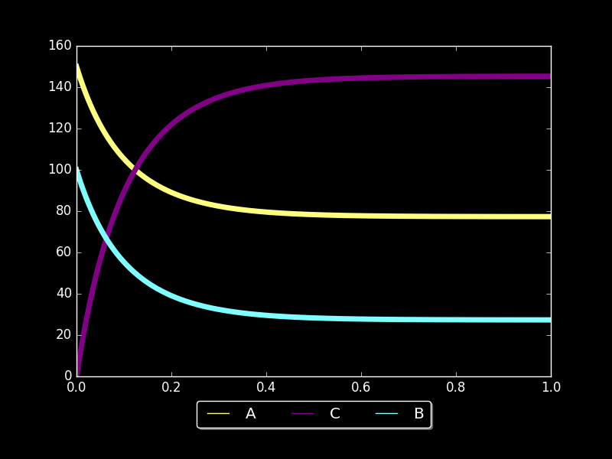
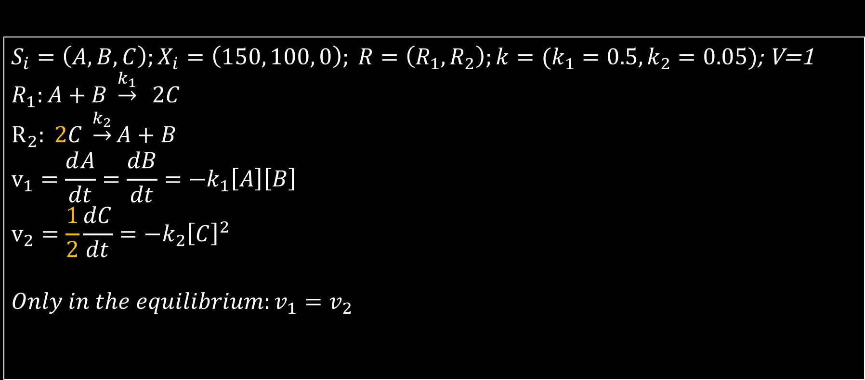
The deterministic approach to chemical reactions
Back to high-school: A simple equilibrium
$S_{i}=\left(A,B,C\right);X_{i}=\left(150, 100, 0\right); R=\left(R_{1}, R_{2}\right);k=(k_{1}=0.5,k_{2}=0.05)$; V=1
$R_{1}:A+B \underset{→}{k_{1}} 2C$ $$R_{2}: 2C \underset{→}{k_{2}}A+B \\ v_{1}=\frac{ⅆA}{dt}=\frac{dB}{dt}=−k_{1}\left[A\right]\left[B\right] \\ v_{2}=\frac{1}{2}\frac{dC}{dt}=−k_{2}{\left[C\right]}^{2}$$
$$Only in the equilibrium:v_{1}=v_{2}$$

Slide 5
A stochastic approach to the chemical system
Time evolution of a chemical system is not continuous, chemical species quantities can only change by discrete integer amounts.
It is not deterministic if we take into account only the quantities of the chemical species. It is impossible to predict the exact molecular population levels at a future time, unless we take into account all the positions and velocities of the molecules in the system.
A better approach is to consider the process as a random walk

Slide 6

Stochastic model assumptions
The volume V is fixed
The molecules are in thermal equilibrium, collisions occur in a random manner. The mixture is spatially homogeneous.
A reaction happens when two interacting molecules collide in an "appropriate way”.
$R_{1}:A+B \underset{→}{k_{1}} 2C$ $$R_{2}: 2C \underset{→}{k_{2}}A+B \\ \frac{{dP}_{1}}{dt}=c_{1}n_{A}n_{B} \\ \frac{{dP}_{2}}{dt}=\frac{c_{1}n_{C}\left(n_{c}−1\right)}{2}$$

Slide 7
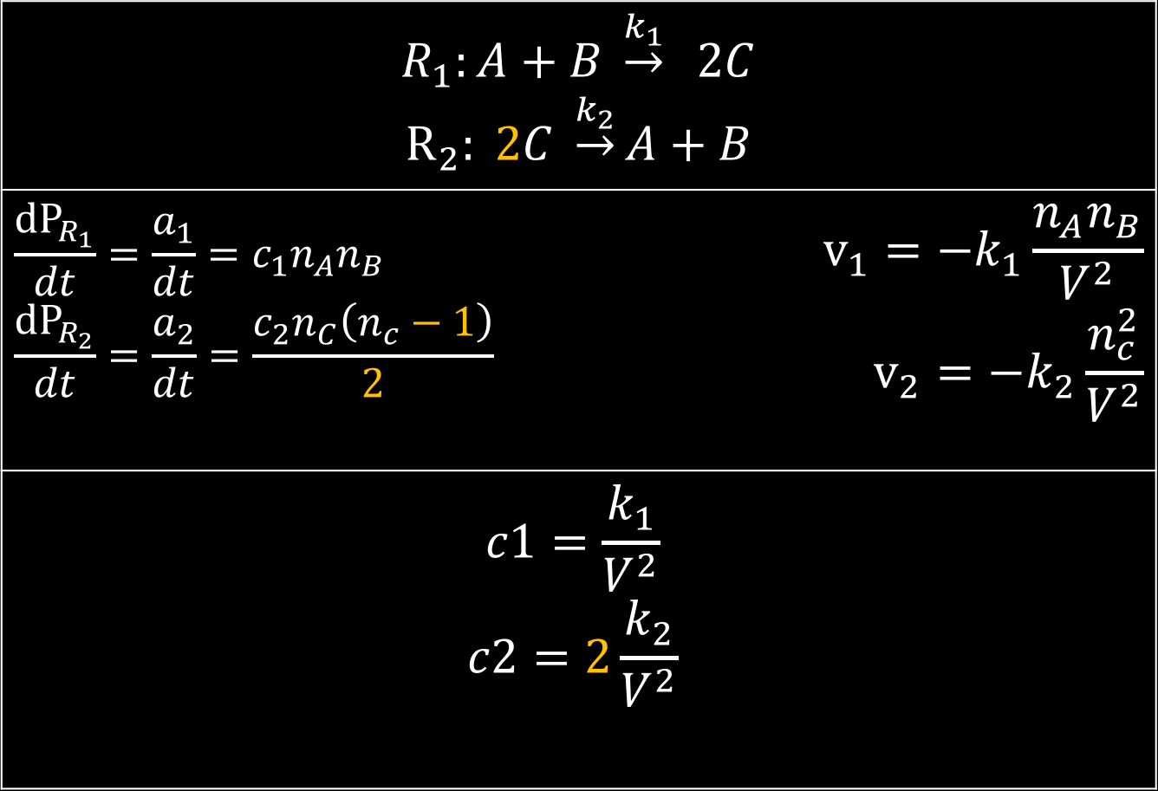
Possible combinations
$R_{1}:A+B \underset{→}{k_{1}} 2C$ $$R_{2}: 2C \underset{→}{k_{2}}A+B$$
$$\frac{{dP}_{R_{1}}}{dt}=\frac{a_{1}}{dt}=c_{1}n_{A}n_{B} \\ \frac{{dP}_{R_{2}}}{dt}=\frac{a_{2}}{dt}=\frac{c_{2}n_{C}\left(n_{c}−1\right)}{2}$$ | $$v_{1}=−k_{1}\frac{n_{A}n_{B}}{V^{2}} \\ v_{2}=−k_{2}\frac{n_{c}^{2}}{V^{2}}$$
$$c1=\frac{k_{1}}{V^{2}}$$ $$c2=2\frac{k_{2}}{V^{2}}$$
Units?
Volume effect?

Slide 8
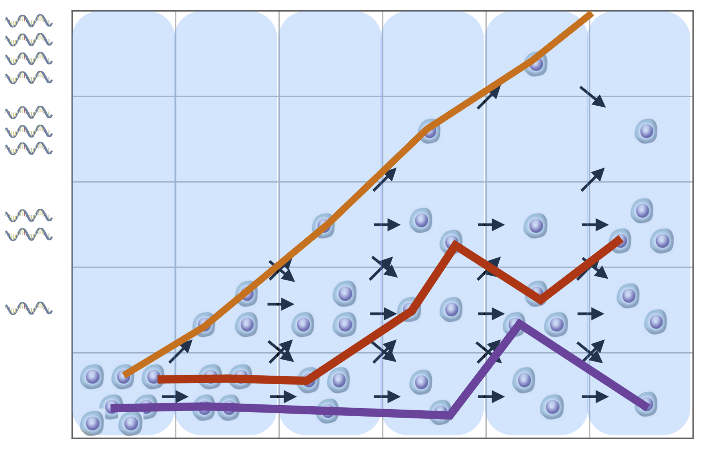
Master equation vs. stochastic simulation algorithm
Master equation: Probability distribution over time
Stochastic simulation: Calculates a particular trajectory

Slide 10
The Gillespie algorithm
Basically, we can simulate the evolution of a chemical system by repeatedly asking this two following questions:
Which reaction will happen next?
When will it happen?
How to find the response to them?
This is the main goal of this session

Slide 11

The Gillespie algorithm: First, Refreshment
The total volume of the system, V.
A series of chemical species: $S_{i} (i=1,2,…, N)$, N total number of chemical species.
The quantities of those elements at time t: $X_{i} (i=1,2,…, N)$
The possible reactions: $R_{μ}(μ=1,2,…,M)$M, total number of reactions.
Parameter for the evolution of the system: $c_{μ}$(stochastic)
$$R_{2}: 2C \underset{→}{k_{2}}A+B ;\frac{a_{2}}{dt}=\frac{c_{2}n_{C}\left(n_{c}−1\right)}{2}→R_{μ}: a_{μ}=c_{μ}h_{μ}dt$$

Slide 12

The Gillespie algorithm: which reaction will happen next?
$$P\left(z,μ\right)dz=P_{0}\left(z\right)a_{μ}dz$$
$P\left(z,μ\right)dz$ : probability that no reaction happens in the interval (t, t+z), and THE NEXT reaction happens in the interval (t+z,t+z+dz) and its $R_{μ}$.
$P_{0}\left(z\right)$ : probability that no reaction happens in interval (t, t+z)
$a_{μ}dz$ : probability that reaction $μ$ happens in the interval (t+z,t+z+dz).
Reaction!
No reaction
t+z+dz
t
t+z

Slide 13

The Gillespie algorithm: which reaction will happen next?
$$P\left(z,μ\right)dz=P_{0}\left(z\right)a_{μ}dz$$
$$P_{0}\left(z’+dz'\right)=P_{0}\left(z’\right)\left[1−\sum_{m=1}^{M}{a_{m}dz'}\right]=P_{0}\left(z'\right)−P_{0}\left(z'\right)a_{0}d_{z}$$
$$P_{0}\left(z’+dz′\right)−P_{0}\left(z^{′}\right)=dP_{0}\left(z\right)=−P_{0}\left(z^{′}\right)a_{0}d_{z}$$
$$\frac{dP_{0}\left(z\right)}{P_{0}\left(z\right)}={−a}_{0}dz→\ln\left(P_{0}(z)\right)=a_{0}z→P_{0}\left(z\right)=e^{−a_{0}z}$$
$$Substitute in the first equation: P\left(z,μ\right)dz=e^{−a_{0}z}a_{μ}dz$$
$$P\left(z,μ\right)=e^{−a_{0}z}a_{μ}$$

Slide 16
Possible projects
Try it on your own data
Build master equation
Think of an example and compare stochastic and deterministic results
How does tau change with time in different situations?
Suggestions?

