Slide 1
Learning Financial Time-Varying Networks

Slide 2
Introduction: TESLA
Why Network analysis: used to detect anomalies, predict vulnerability and assess the potential impact of intervention on different kind of systems.
Interactions between variables not always observable, but we can infer them by representing the system as a network.
TESLA [1]: from the acronym TESLLOR (temporally smoothed l1-regularized logistic regression) Classically network analysis considered only static networks.
TESLA is developed to explore and understand more complex systems or processes that change over time.
Evaluation:
Synthetic data (simple birth-death model)
U.S. Senate Network
Author-Keyword Academic Social Network
Drosophila melanogaster life cycle
[1] Ahmed A and Xing E. (2009) Recovering time-varying networks of dependencies in social and biological studies. PNAS 106 (29) 11878-11883

Slide 3
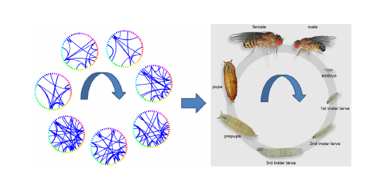
Introduction: TESLA results
Ahmed & Xing 2009 show promising results when studying the performance of the algorithm.
The temporally rewiring patterns of interactions among gene ontology groups during D. melanogaster development, divided in 23 epochs.
Synthetic data
Outperforms the static approach (significantly in high and even precision areas).
Large topological changes can be observed from the temporal rewiring patterns, even showing different interactions in each phase of its life, an ‘expected’ result that enforces the potential of the algorithm on real world problems.

Slide 4
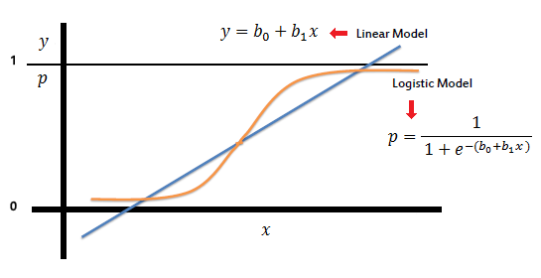
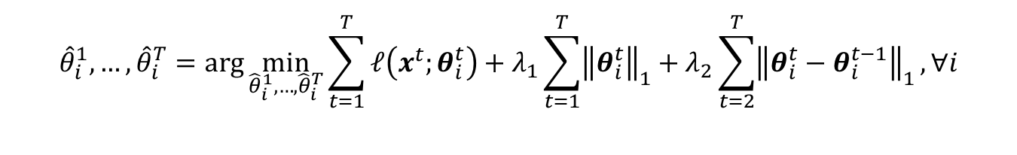
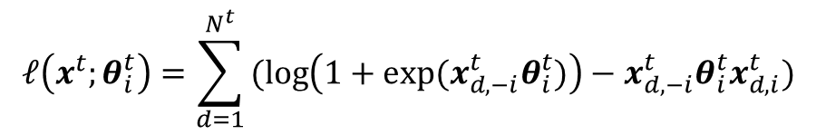
TESLA algorithm: description
Logistic Regression
Lasso Regularization
Smoothing Term
$${\hat{θ}}_{i}^{1},…, {\hat{θ}}_{i}^{T}=\arg{\min_{{\hat{θ}}_{i}^{1},…, {\hat{θ}}_{i}^{T}}{\sum_{t=1}^{T}{𝓁\left(x^{t};θ_{i}^{t}\right)}}}+λ_{1}\sum_{t=1}^{T}{{\left\|θ_{i}^{t}\right\|}_{1}}+λ_{2}\sum_{t=2}^{T}{{\left\|θ_{i}^{t}−θ_{i}^{t−1}\right\|}_{1}}, ∀i$$
$$𝓁\left(x^{t};θ_{i}^{t}\right)=\sum_{d=1}^{N^{t}}{(log\left(1+exp⁡(x_{d,−i}^{t}θ_{i}^{t})\right)−x_{d,−i}^{t}θ_{i}^{t}x_{d,i}^{t})}$$

Slide 5
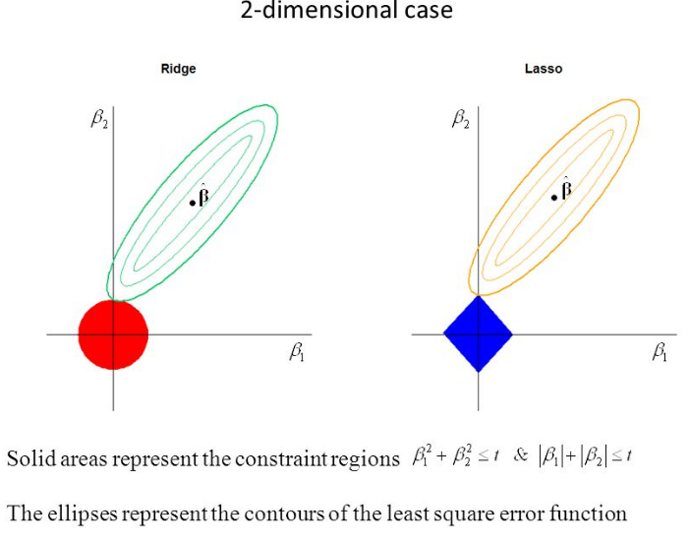
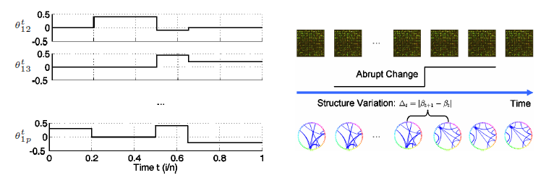
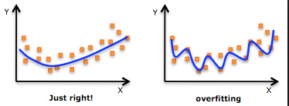
TESLA algorithm: description
Regularization term
Temporal smooth changes

Slide 6

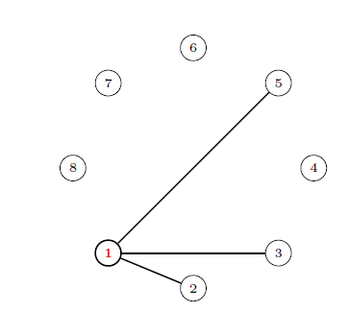
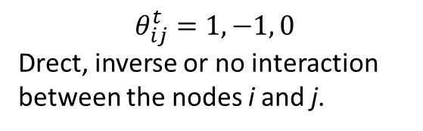
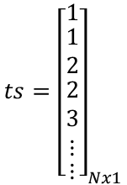
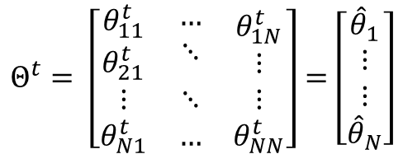
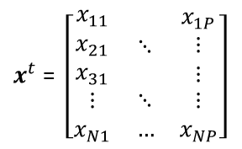
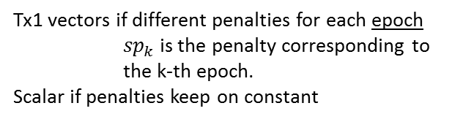


TESLA algorithm: data
INPUT
OUTPUT
$x^{t}$ = $\left[\begin{matrix}\begin{aligned}x_{11} \\ x_{21} \\ x_{31}\end{aligned} & ⋱ & \begin{aligned}x_{1P} \\ ⋮ \\ ⋮\end{aligned} \\ ⋮ & ⋱ & ⋮ \\ x_{N1} & … & x_{NP}\end{matrix}\right]$
$$Θ^{t}= \left[\begin{matrix}\begin{aligned}θ_{11}^{t} \\ θ_{21}^{t}\end{aligned} & \begin{aligned}… \\ ⋱\end{aligned} & \begin{aligned}θ_{1N}^{t} \\ ⋮\end{aligned} \\ ⋮ & ⋱ & ⋮ \\ θ_{N1}^{t} & … & θ_{NN}^{t}\end{matrix}\right]=\left[\begin{matrix}{\hat{θ}}_{1} \\ \begin{matrix}⋮ \\ ⋮\end{matrix} \\ {\hat{θ}}_{N}\end{matrix}\right]$$
N rows: samples (time series points)
P columns: nodes (stocks)
$$ts={\left[\begin{matrix}1 \\ \begin{matrix}1 \\ 2 \\ \begin{matrix}2 \\ 3 \\ ⋮\end{matrix}\end{matrix} \\ ⋮\end{matrix}\right]}_{Nx1}$$
$$θ_{ij}^{t}=1, −1, 0$$
Drect, inverse or no interaction between the nodes i and j.
Nx1 vector in which ts(i) is the time stamp corresponding to the i sample → ts(i) = 1, …, T.
$$sp={\left[\begin{matrix}{sp}_{1} \\ ⋮ \\ {sp}_{T}\end{matrix}\right]}_{Tx1} or λ_{1}$$
Tx1 vectors if different penalties for each epoch
${sp}_{k}$ is the penalty corresponding to the k-th epoch.
Scalar if penalties keep on constant
$$sp={\left[\begin{matrix}{sm}_{1} \\ ⋮ \\ {sm}_{T}\end{matrix}\right]}_{Tx1} or λ_{2}$$

Slide 7
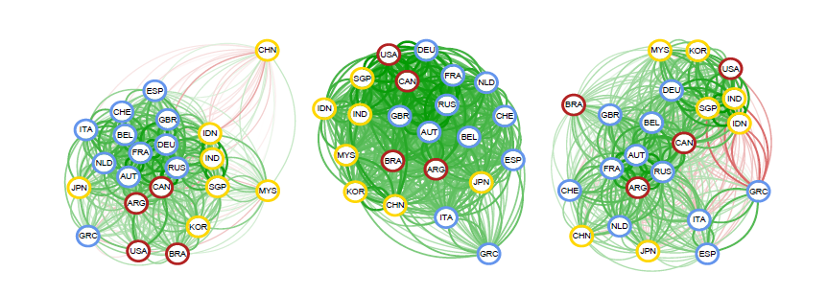
TESLA on finance
Network analysis is useful for detecting anomalies, predicting vulnerability and assessing the potential impact of intervention on different kind of systems (Ahmed & Xing 2009)
International markets recovered for different epochs. 2005 to 2013 (left), overthe2008 global financial crisis (middle) and during the Greek debt crisis. Blue, red and yellow stand for European, American and Asian markets (Durante & Dunson 2014)
Understanding the interactions between stocks and the behaviour of the market in different situations.
Study of patterns that indicate upcoming critic/destabilizing events (2008 crisis).
Exploration of techniques to react to this events and avoid contagion.

Slide 8
TESLA on finance: data
Financial time-series: S&P500 close values.
Subsets with 100 most important stocks, by sectors etc.
Subsets with different frequencies of data (daily, monthly…) and using different time windows (epochs). Starting with daily data and one-month windows.
Preprocessing and Cleaning
Replace missing values: interpolation or closest value.
Normalization: the relationship between stocks we seek is on the movements
Design of Input matrix.
Create ts vector: establish the epochs we are going to consider.
sp & sm: for now just scalar values.

