Slide 1


STUDENT MARKS PREDICTION (DATA SCIENCE PROJECT) SUBMITTED TO : Mr. Devansh Kasaudhan
SUBMITTED BY :
Manul Sahu (72411681)
Mehak (72411630)
Kurapati Yashwanth Sai (72412857)
Simran Vij(72413557)

Slide 2
INTRODUCTION
Predicting student marks enables early interventions and focused academic support .
This project uses , Machine Learning to predict math scores in student’s exams.
With Data Science ,we automate mark predicting using real exam and demographic data.

Slide 3

PROJECT PIPELINE
Data Acquisition
Data Preprocessing
Model Training
Model Evaluation
Visualization and insights

Slide 4
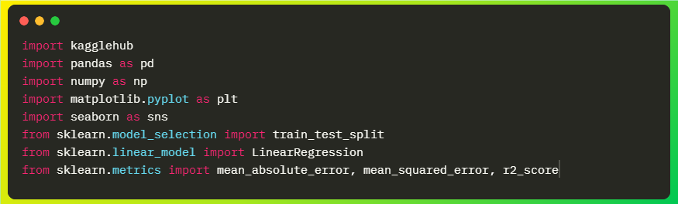
Importing libraries
Pandas , Numpy : Data Handling
Matplotlib , Seaborn : Visualization
Scikit-learn: ML models & metrices

Slide 5
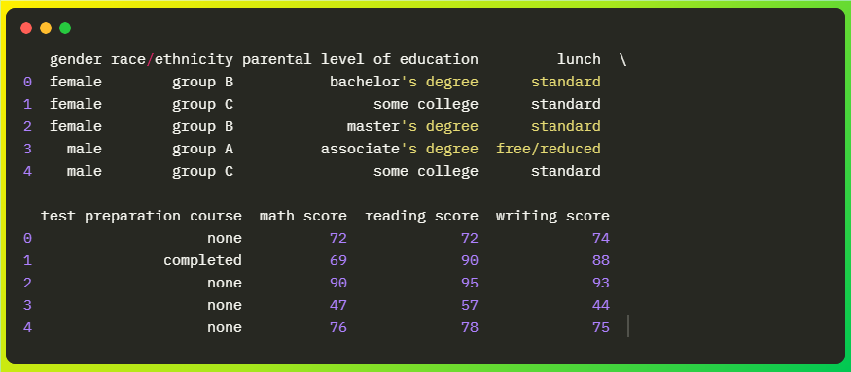
DATASET DESCRIPTION
Dataset : Student Performance in Exams (from Kaggle)
StudentsPerformance.csv(1 File)
Columns: Gender, race/ethnicity, parental education, lunch, test preparation, scores in math, reading, writing
Shape: 1000rows*8columns

Slide 6
FEATURE SELECTION & TARGET
Features: All columns except ‘math_score’ .
Target: ‘math_score’ (score to predict )
Prepared input matrix X and output y

Slide 7
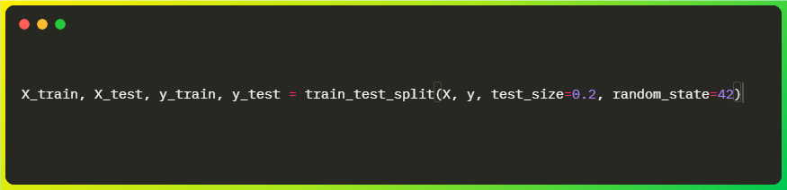
DATA SPLITTING
Split data (80% training, 20%testing) for fair model evaluation.
train_test_split ensures random, reproducible partition

Slide 8
MODEL TRAINING
Used linear regression from scikit-learn for prediction.
Trained on preprocessed training data.
Model learns relationships between input features and math score.

Slide 9
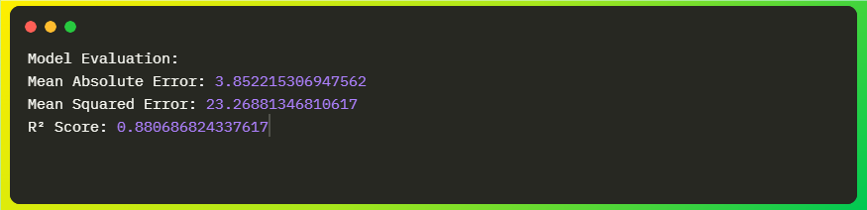
MODEL EVALUATION METRICES
Mean Absolute Error(MAE):Measures average prediction error magnitude.
Mean Squared Error(MSE): Penalizes large errors.
R² Score: Proportion of variance and high R² indicates good model fit.

Slide 10
VISUALIZATION-Actual vs Predicted marks
Scatter plot: x=actual marks ,y =predicted marks
Perfect model has points on the diagonal.
(Insert matplotlib plot output here)

Slide 11
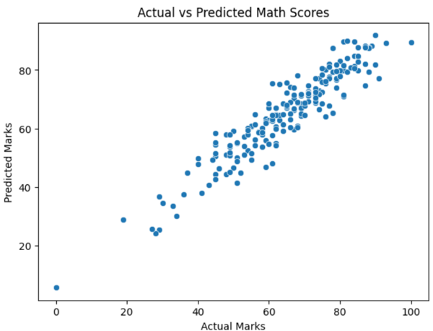

Slide 12
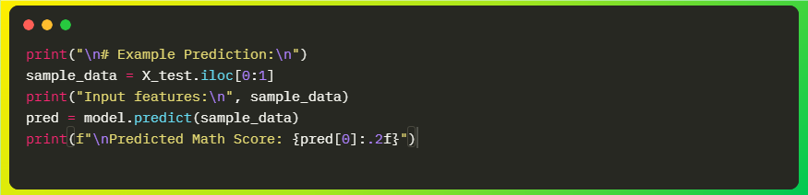
EXAMPLE PREDICTION
Demonstrated single prediction from test data.
Input features:(show sample values from x_test).
Predicted math score:(show value from pred).

Slide 13
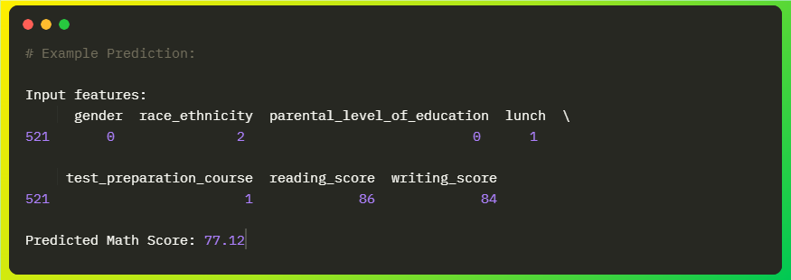
Example Output

Slide 14
LIMITATIONS & FUTURE WORK
Only tested on this dataset- other schools or regions may vary.
Try advanced models(Random Forest , XGBoost ).
Experiment with more features(attendance , assignments , behavior)

Slide 15
CONCLUSION
Successful application of linear regression for student mark prediction.
Model provides accurate, actionable insights for educators.
Demonstrates effectiveness of machine learning in educational analytics.

Slide 16
REFRENCES
Kaggle dataset: Student Performance in Exams.
Scikit-learn Documentation.
Project code and research articles on educational data mining.

Slide 17
Thank you

