Slide 1
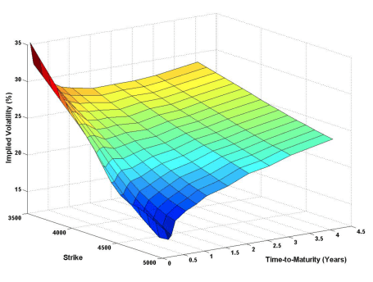
Current structure
Gaussian kernel
SVI
Cubic spline
. . .
OOP
Completely independent modules
Easily extensible
IV fitting methods
Database access
IV root finder methods
Axioma IV Surface
Vendor
Pandora
. . .
Constant
Historical average
Linear approx.
Log linear approx.
. . .
Dividend calculation methods
Discount factor
Constant
Historical average
Linear approx.
Log linear approx.
. . .
Libor + futures
Libor + OIS
. . .

Slide 2
Show must go on…
Axioma IV Surface
Arbitrage checking
Option price
Market data split in training and validation set

