Slide 1
A research on generating IV and volatility surface

Slide 2

Question 1: Would it be possible to generate our IV surfaces from raw market data?
What have I done (in progress) up to now:
Research marketdata database (SQL, pandas-python)
Research of models documentation:
  Raw data
  Derived/analytical data
Research on how Axioma uses this data -and which particular data
Implementation in python of several modules:
  Data extraction
  Data cleanse
  Black Scholes / CRR models
  Methods to extract Implied volatility
  Volatility Surface
  Tests

Slide 3
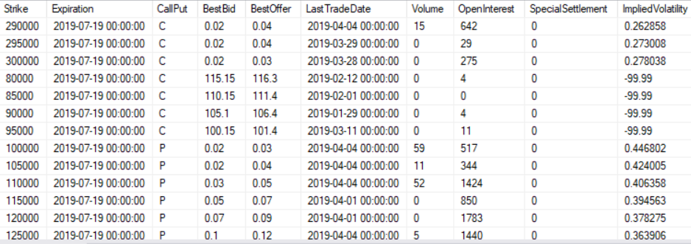
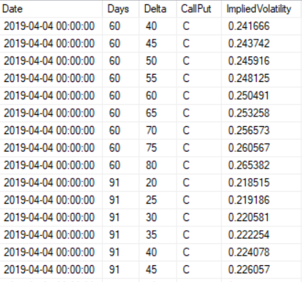

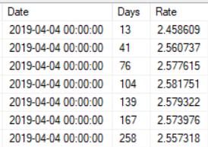
Raw Data (what kind of data)
1. Historical option prices: For EACH valuation date, for each available option (strike-maturity) and type P/C:
LAST Bid-Ask prices
Volume, OpenInterest, additional mkt data
Implied Vol
Delta, Gamma, Vega, Theta
2. Historical volatility surface info: For EACH valuation date:
A Delta/Maturity implied volatility surface with standard/fixed Deltas and standard Maturities:
Deltas: 0.2, 0.25, …0.75, 0.8 (+negatives for Puts)
Maturities: 30, 91, 122, 152, 182, 273, 365, 547, 730
3. Interest rate curve (Swap ZC) – ticker independent

Slide 4
Implied Volatility Problem, in a nutshell 1/2
Definition (brief facts)
The market's view of what will happen to a given security's price in the future.
A metric used by investors to estimate future fluctuations (volatility) of a security's price
Denoted by the symbol σ (sigma), can often be thought to be a proxy of market risk.
Commonly expressed using percentages and standard deviations over a specified time horizon.
It is one of the deciding factors in the pricing of options.
It is not the same as historical volatility -also known as realized volatility or statistical volatility.
[Historical volatility measures past market changes and their actual results]

Slide 5
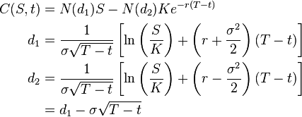
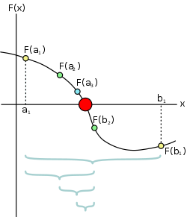
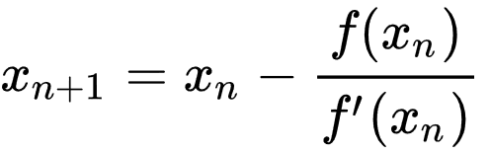
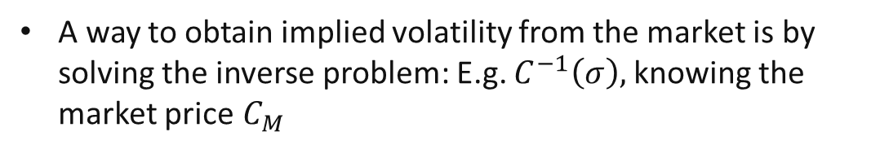

Implied Volatility Problem, in a nutshell 2/2
How to imply it
As σ is an input in option pricing models:
A way to obtain implied volatility from the market is by solving the inverse problem: E.g. $C^{−1}\left(σ\right),$knowing the market price $C_{M}$
What we really need to do:
Root-finding problem: $Find σ s.t. C\left(σ\right)–C_{M}= 0 … C\left(σ\right)–\frac{{(C}_{B}+C_{A})}{2}= 0$
    Good old Bisection
    PROS: simple to implement, no vega needed
    CONS: slow and need bound for sign change
    Newton-Raphson with f=price and f’=vega
    PROS: fast, elegant
    CONS: need vega, need convexity
    OTHERS…

Slide 6
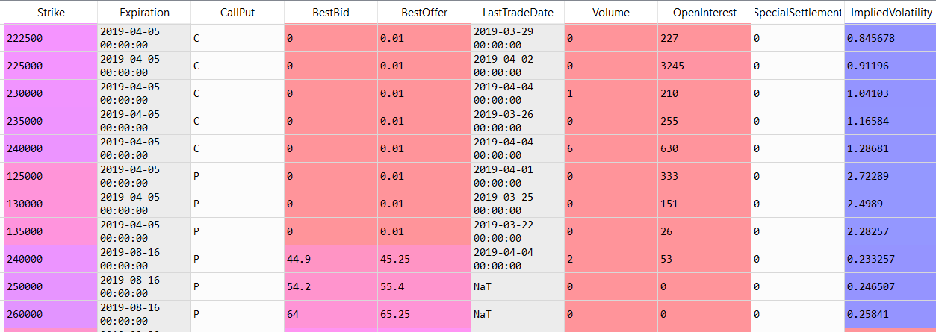
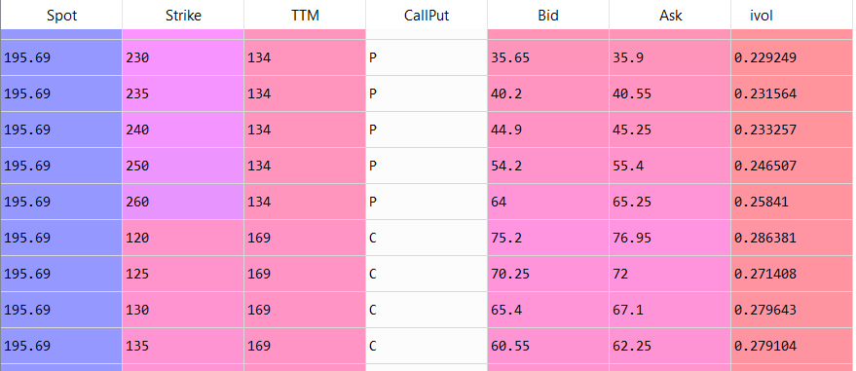
What have I done up to now (1/4)
Accessed database through pyhton (pyodbc + pandas), pull the data with a SQL query
Cleaned the dataframe (database has some “-99.9999” elements) and Retrieve relevant info from raw data option table: Spot, Strike, TTM, CallPut, Bid, Ask, ivol (for comparison reasons)

Slide 7
What have I done up to now (2/4)
DATABASE METHODS
  pull_optionprice_database(securityID, date)
  pull_ZCcurve_database(date)
  pull_volatilitysurface_database(securityID, date)
  get_securityid_from_ticker(ticker)
  get_securityid_from_CUSIP(cusip)
  get_option_info(securityID)
  get_spot_from_securityID_date(securityID,date)
  is_index(securityID)
  get_dividendyield_for_securityID_date(securityID, date, freq = 4
  …
2. DATAFRAMES METHODS
  clean_optionprice_database(df,df_ZC)
  get_type_from_clean_database(df_clean,CP)
  …

Slide 8
What have I done up to now (3/4)
3. ANALYTICS
BSMerton class – closed formula
CRR – Binamial tree
Leisen-Reimer – Improvement to binomial tree
  For all these:
    Premium
    Delta
    Vega
    More greeks in BSMerton
6. PLOT METHODS (misc)
  plot_vol_surface(df_vol_surface)
  plot_vol_smiles(df_vol_surface)
4. ANALYTICS - DATAFRAME METHODS
  generate_implied_volatilities(df_clean):
    Bisection**
    Newton-Raphson
  generate_model_outputs(df_clean, i_vols)
5. VOLSURFACE METHODS
  generate_standard_volatility_surface(df_model,df_ZC)
  implied_strike_from_delta(r,cp, delta, spot, ttm, ivol)* (for BSM)

Slide 9
What have I done up to now (3/4)
  generate_standard_volatility_surface(df_model,df_ZC)
  Define standard deltas and standard TTMs
    std_ttms = np.array([30, 60, 91, 122, 152, 182, 273, 365, 547, 730])
    std_deltas=np.arange(0.2,0.8,0.05)
  Generate standard vol surface dataframe (empty)
  Populate implied volatilities using smoothing algorithm

Slide 10
Testing Results
Testing ivol calculation and pricing helped me understand:
Use of Rate curve data in pricer – I tested constant, piecewise constant, piecewise linear
Use of Dividend data in pricer – I tested constant (from another data source) and constant from OM analytics
CRR vs LR algorithms
Convergenge of Leisen-Reimer algorithm
What I have tested:
Tested AAPL, WFC and SPX options on a couple of business dates
Ivol from market data:
  average of 2-5% match – relative difference
  missmatch (>25 %) in deep in the money options (CALLS Delta ~1, PUTS Delta ~ -1)
Perfect repricing (1e-8 rel error)
Good Greeks calculations
Ivol for standard options:
  average of 2-3% match – relative difference
  missmatch (5 (index)-15(stock) % MAX) in out of the money options (Delta +-20%)

Slide 11
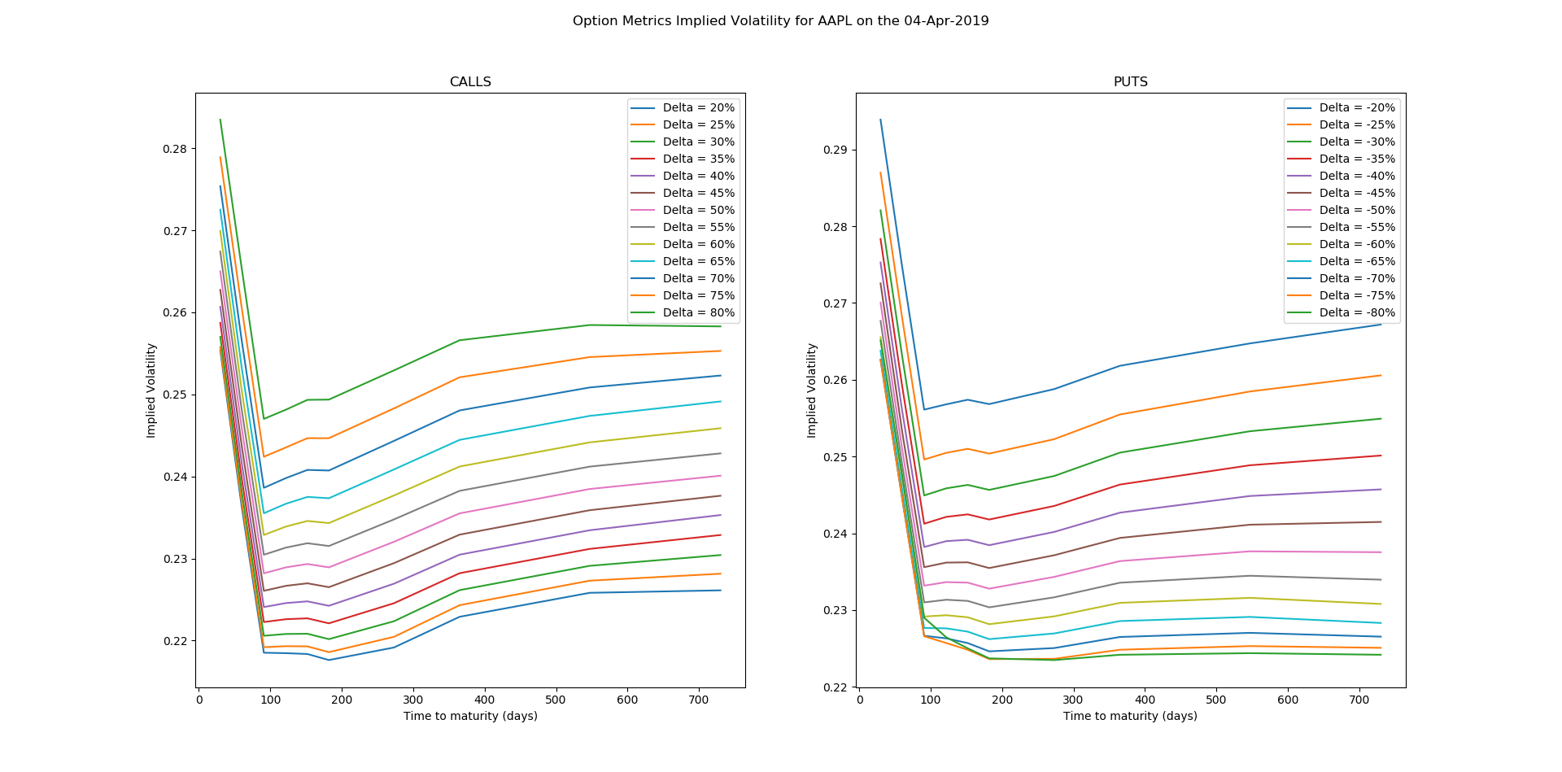
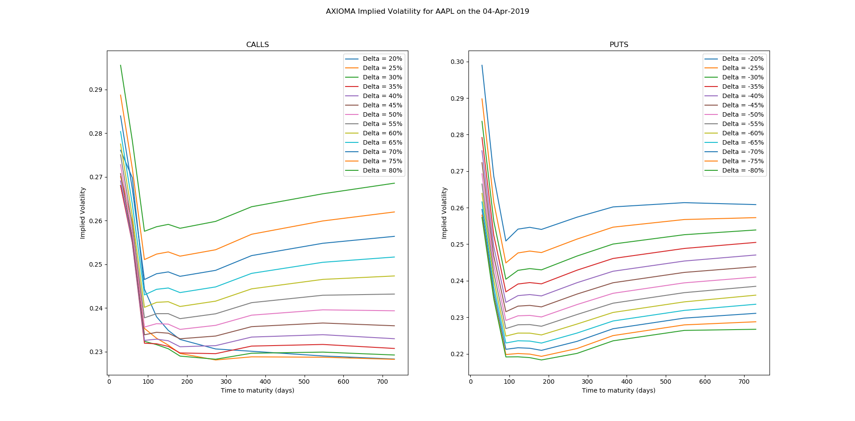
Comparison 1 – AAPL 04/04/2019 - 1604 listed options P+C (1407 after cleanse)
Data CALLS AXIOMA

Slide 12
Comparison 2 – AAPL 04/04/2019
Data PUTS AXIOMA

Slide 13
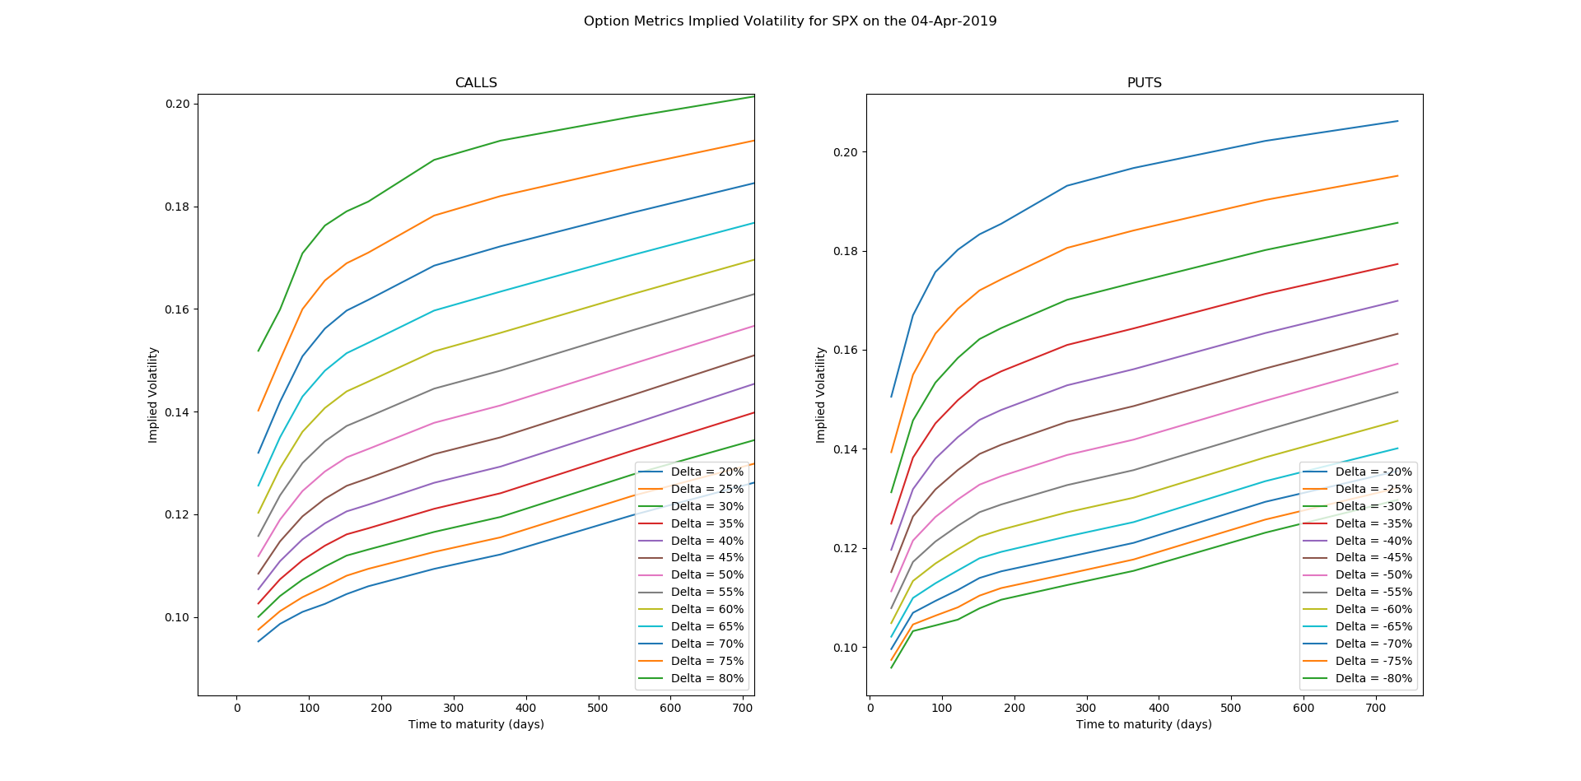
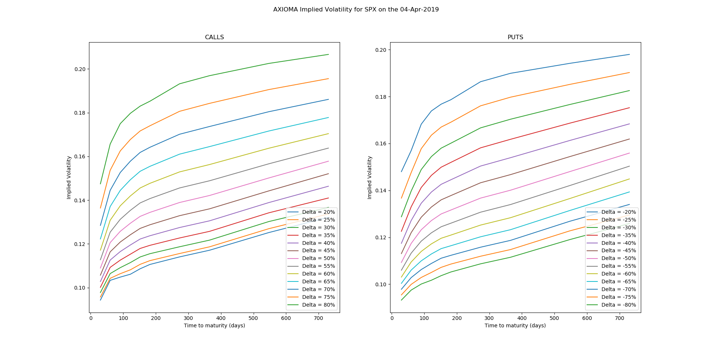
Comparison 3 – SPX 04/04/2019 – 13473 listed options P+C (11465 after cleanse)
Data CALLS AXIOMA

Slide 14
Comparison 4 – SPX 04/04/2019
Data PUTS AXIOMA

Slide 15
The devil is in the details
Risk-Free interest rate for pricing formulas source of error :
  We follow what database is doing – by using their ZC SWAP curve and interpolating
  We should be able to generate our own ZC SWAP curve (e.g. replicating what database does)
Dividend Yield
  Tricky issue. Database provides some information though it is not entirely clear – source of error
  Index has different dividend yield structure
Discrepancies in implied volatilities for options with Deltas\sim +-1 (Deep ITM) – up to 50%, though exact repricing.
Discrepancies in implied vol/dispersion for standard Call options low Deltas (20,25%) – up to 15%
CRR model slow (at least my implementation!) – When looking for implied vol using an iterative method, pricer needs to be called several times. Quite time consuming. So, reduced iterations (source of error)
Greeks
  Europeans: Standard analytical formulas
  Americans: Finite Difference (source of error)

Slide 16
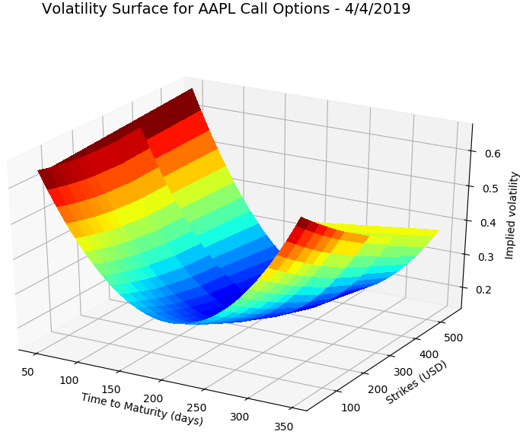
Next steps?
Implement the zero rate calculation (could be avoided if we get data from another source)
Replicate using NON database data
Investigate which components AxR actually uses
Generate a Proof of Concept document with results

Slide 17
Comments / Tips?
Any Comment / tip would be greatly appreciated!

