Slide 1
A research on generating IV and volatility surface

Slide 2

Refresh of question: Would it be possible to generate our IV surfaces from raw market data?
Answering this Question involves:
DATA
  Availability of Data sources (Nattu)
  Vendor Data sources management (Nattu and Ross)
ANALYTICS
  In house derivative pricing modules (Diogo and Emma)
  In house calculation methods (Diogo, Emma, Eric)
    * Implied volatility * Dividend calculation
    * Curve construction
TESTING
  Vendor data
  Analytics
  Outputs
PRODUCTION
  Feasibility
  Scalability

Slide 3
1) DATA
The Vendor Database
In PROD_VNDR_DB: IvyDBUS:
  Option Prices – OPTION_PRICE
  ZC Curve for discounting – ZC_CURVE
  Dividend methods - DISTRIBUTION
  Vol Surface data – VOL_SURFACE
  Others were also used…
Alternative Axioma DataBases (all in Pandora/Pluto):
  Option Prices - EJV_DERIVS
  ZC Curve for discounting – MarketData-InstumentData, EJV_RIGS, QAI
  Equity, for Dividend methods – ORACLE
  Indeces
Here, Nattu was crucial for us to understand the broad availability of DBs. Ross also was helpful.

Slide 4
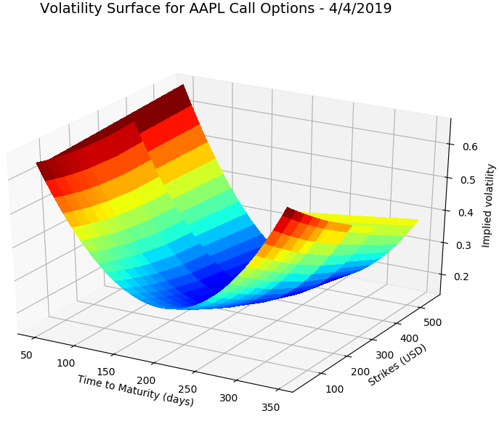
Last time we met…
Next steps?
Implement the zero rate calculation (could be avoided if we get data from another source)
Replicate using NON database data
Investigate which components AxR actually uses
Generate a Proof of Concept document with results

Slide 5
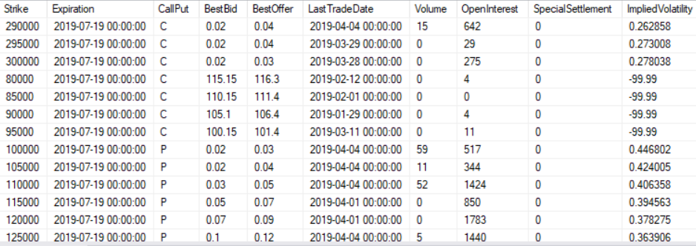
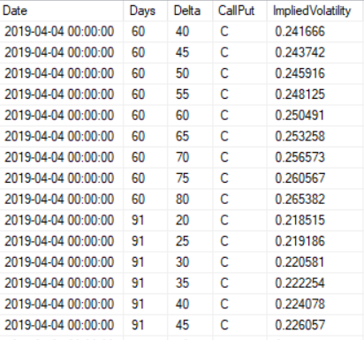

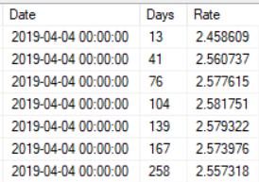
What do we use NOW: Vendor Data
1. Historical option prices: For EACH valuation date, for each available option (strike-maturity) and type P/C:
LAST Bid-Ask prices
Volume, OpenInterest, additional mkt data
Implied Vol
Delta, Gamma, Vega, Theta
2. Historical volatility surface info: For EACH valuation date:
A Delta/Maturity implied volatility surface with standard/fixed Deltas and standard Maturities:
Deltas: 0.2, 0.25, …0.75, 0.8 (+negatives for Puts)
Maturities: 30, 91, 122, 152, 182, 273, 365, 547, 730
3. Interest rate curve (ZC curve) – ticker independent
4. Dividend Yield!

Slide 6
Dat Sources
US Option Prices | DB | Table | Details | Limitations
Vendor | IvyDB US | OPTION_PRICES | Gives analytics: ImpVol, greeks | Several data
Axioma | Pandora | EJV_DERIVS | Only Market
US Equity Prices | DB | Table | Details | Limitations
Vendor | IvyDB US | SECURITY_PRICES
Axioma | ORACLE | ORA-GLPROD-marketdb_global | Calling from openquery()
US Equity Dividend | DB | Table | Details
Vendor | IvyDB US | DISTRIBUTION
Axioma | ORACLE | ORA-GLPROD-marketdb_global | Calling from openquery()

Slide 7
Dat Sources
US Index Prices | DB | Table | Details
Vendor | IvyDB US | SECURITY_PRICES
Axioma | MarkertData
US Index Dividend | DB | Table | Details
Vendor | NA | NA | Algorithm | Analytics
Axioma | NA | NA | Replication | Analytics
USD ZC Curve | DB | Table | Details
Vendor | IvyDB US | ZC_CURVE
Axioma | EJV | EJV_DERIVS | Ibor | Analytics
Axioma | QAI | DSFutContrInfo DSFutContrVal | Eurodollar | Analytics

Slide 8
What were we able to replicate
1. Historical option prices: For EACH valuation date, for each available option (strike-maturity) and type P/C:
LAST Bid-Ask prices
Volume,
Implied Vol
Delta, Gamma, Vega, Theta
Using EJV_Derivs Option Prices data, plus ORACLE database info on Spots and Dividends we were able to get the necessary input data to calculate implied volatilities
We were able to replicate exactly the Vendor Fitter algorithm *
Vendor extrapolates in some places (not documented)
2. Historical volatility surface info: For EACH valuation date:
A Delta/Maturity implied volatility surface with standard/fixed Deltas and standard Maturities:
Deltas: 0.2, 0.25, …0.75, 0.8 (+negatives for Puts)
Maturities: 30, 91, 122, 152, 182, 273, 365, 547, 730
Using Alternative sources we were able to replicate EXACTLY the vendor ZC curve
3. Interest rate curve (ZC) – ticker independent

Slide 9
Updates from Last time
All the code has been refactored in an OOP way (thanks Diogo)
  Pricing classes
  Database Access Clases
  Imp Vol classes
  Vol Surface casses
  Dividend method classes
Analytics were tested:
  Pricers
  Imp Vol calculator
  Vol Surface Fitter
  Dividend Calculation Methods
  Zero Coupon Curve replication
Testing was donde broadly
  Several Tickers
  Several Val Dates

Slide 10
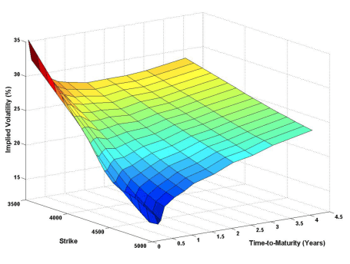
Code structure
Gaussian kernel (vendor)
SVI
Cubic spline
. . .
OOP
Completely independent modules
Easily extensible
IV fitting methods
Database access
IV root finder methods
Axioma IV Surface
Vendor
Pandora
. . .
Bisection
Jakel – (E)
Newton
Brent
Other Scipy…
Dividend calculation methods
Discount factor
Libor + futures
Libor + OIS
. . .
Constant
Historical average
Linear approx.
Log linear approx.
. . .

Slide 11
Testing Results
Testing ivol calculation and pricing helped me understand:
Use of Rate curve data in pricer – I tested constant, piecewise constant, piecewise linear
Use of Dividend data in pricer – I tested constant (from another data source) and constant from OM analytics
CRR vs LR algorithms
Convergenge of Leisen-Reimer algorithm
What I have tested:
Tested AAPL, WFC and SPX options on a couple of business dates
Ivol from market data:
  average of 2-5% match – relative difference
  missmatch (>25 %) in deep in the money options (CALLS Delta ~1, PUTS Delta ~ -1)
Perfect repricing (1e-8 rel error)
Good Greeks calculations
Ivol for standard options:
  average of 2-3% match – relative difference
  missmatch (5 (index)-15(stock) % MAX) in out of the money options (Delta +-20%)

Slide 12
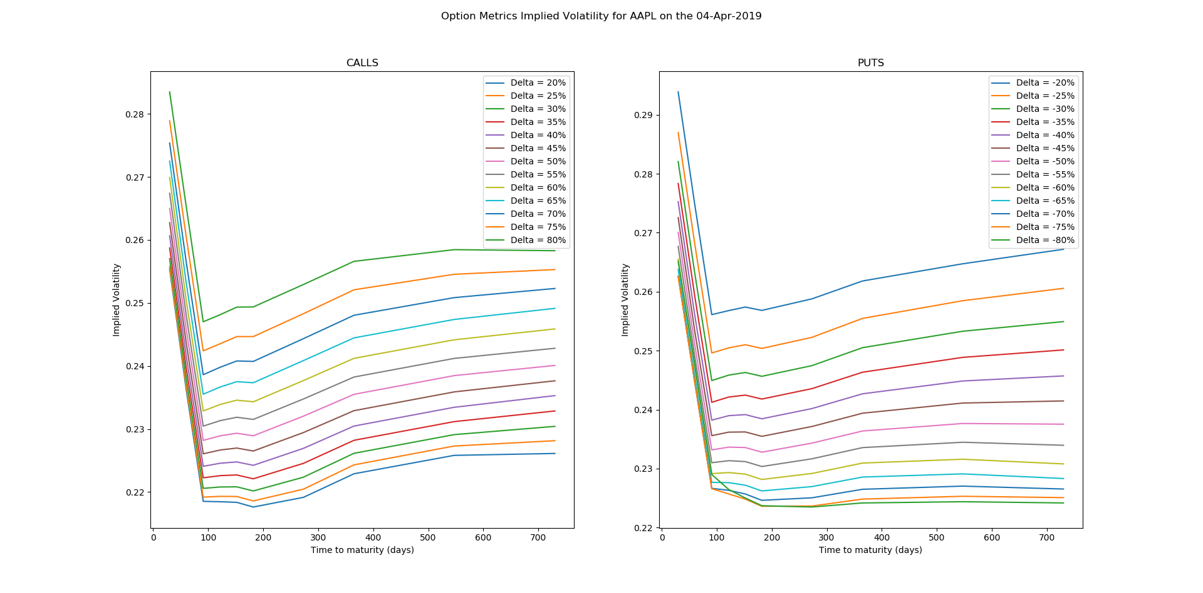
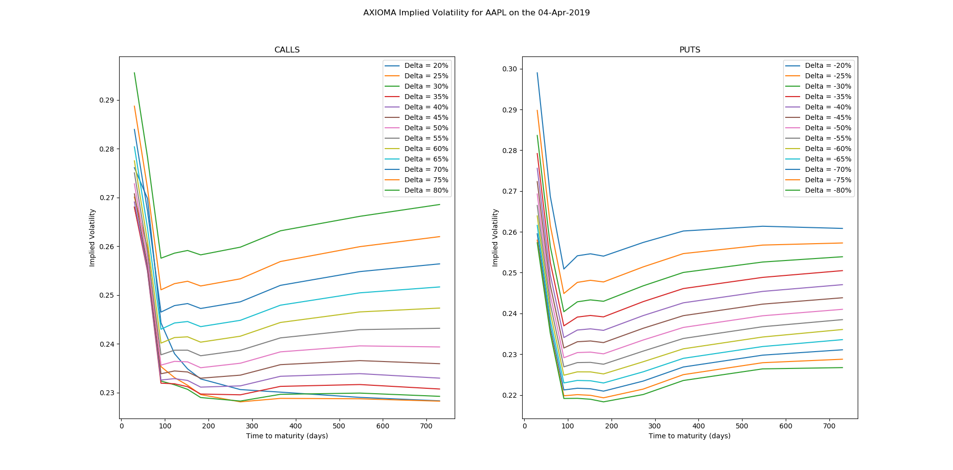
Comparison 1 – AAPL 04/04/2019 - 1604 listed options P+C (1407 after cleanse)
Data CALLS AXIOMA

Slide 13
Comparison 2 – AAPL 04/04/2019
Data PUTS AXIOMA

Slide 14
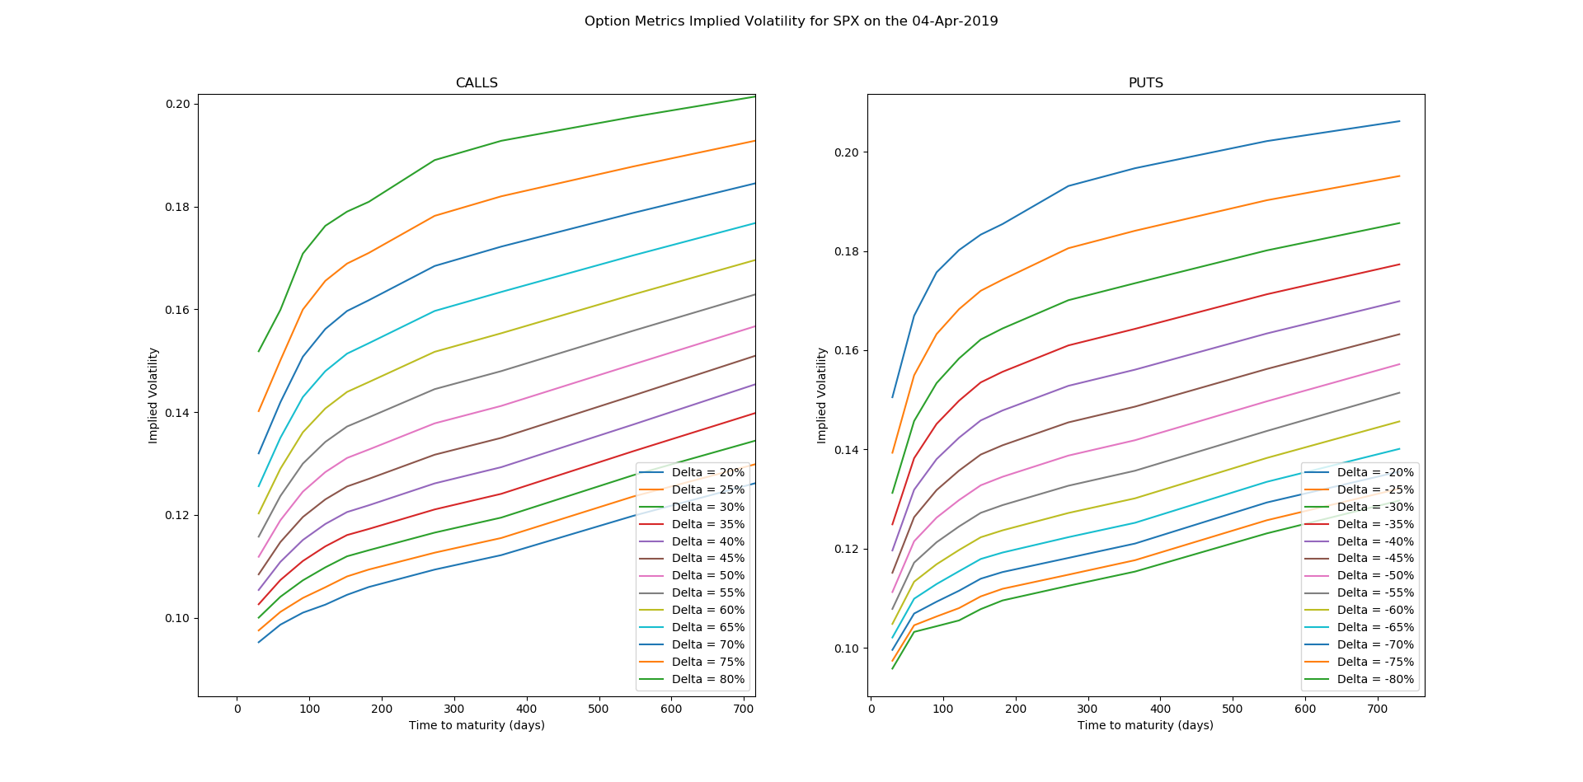
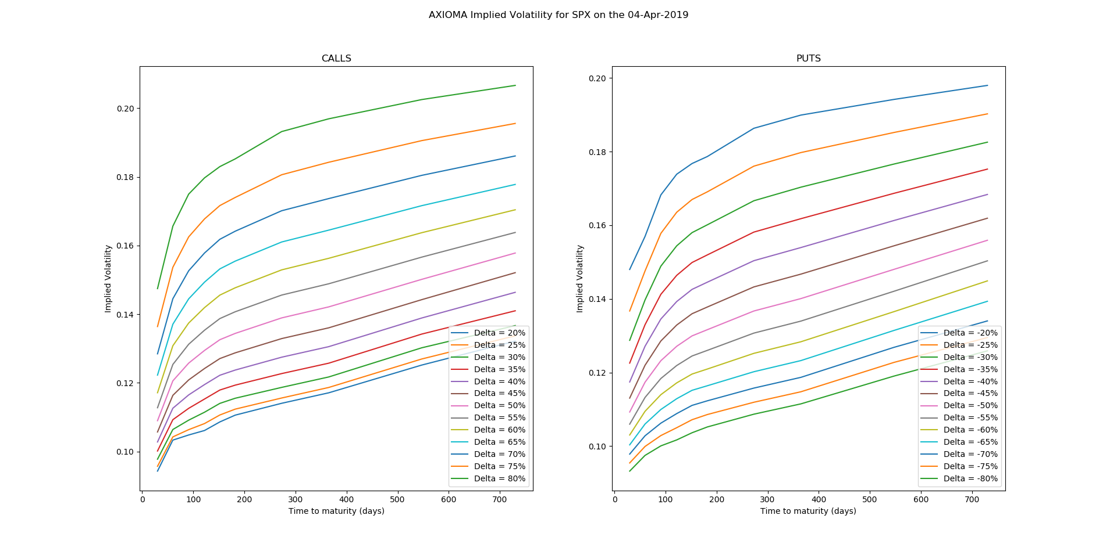
Comparison 3 – SPX 04/04/2019 – 13473 listed options P+C (11465 after cleanse)
Data CALLS AXIOMA

Slide 15
Comparison 4 – SPX 04/04/2019
Data PUTS AXIOMA

Slide 16
The devil is in the details
Risk-Free interest rate for pricing formulas source of error :
  We follow what database is doing – by using their ZC SWAP curve and interpolating
  We should be able to generate our own ZC SWAP curve (e.g. replicating what database does)
Dividend Yield
  Tricky issue. Database provides some information though it is not entirely clear – source of error
  Index has different dividend yield structure
Discrepancies in implied volatilities for options with Deltas\sim +-1 (Deep ITM) – up to 50%, though exact repricing.
Discrepancies in implied vol/dispersion for standard Call options low Deltas (20,25%) – up to 15%
CRR model slow (at least my implementation!) – When looking for implied vol using an iterative method, pricer needs to be called several times. Quite time consuming. So, reduced iterations (source of error)
Greeks
  Europeans: Standard analytical formulas
  Americans: Finite Difference (source of error)

Slide 17
Comments / Tips?
Any Comment / tip would be greatly appreciated!

