Slide 1
MOTION PLANNING AND CONTROL IN URBAN PARKING SPACES
GIREESH SURESH MANOHAR ANUMOLU

Slide 2
Introduction
Automatic Parking is a car maneuvering system that moves a vehicle from a traffic lane to a parking spot.
It aims to enhance the comfort and the safety of driving in constrained environments where much attention and experience is required to steer the car.
In this project, we consider the parallel parking problem for ease of vehicle maneuvering.

Slide 3
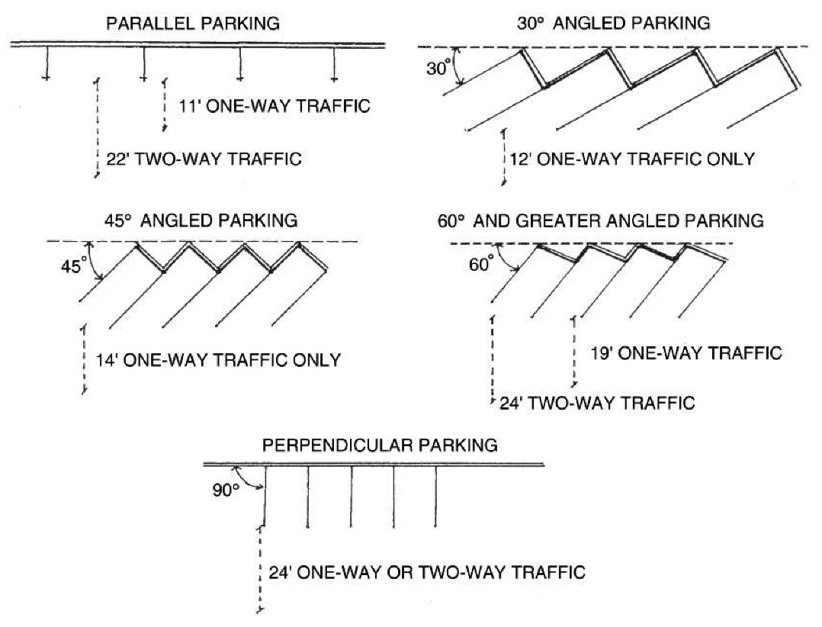
Contd.
The objective is to generate a feasible path using available environment data to proceed in the parking maneuvers.
The path is a series of vehicle configurations containing the positional and orientation parameters of the vehicle during the motion sequence.
There are many proposals; depending on different mathematical models.

Slide 4
Related Work
Common Proposals for path computation include path curves generated with:
Circular Arcs and Straight Lines
Clothoid Curves
Arc Tangent Curves
Cubic Polynomial Curves
Bezier Curves
A combination of above mentioned geometries.
Higher Order Polynomials

Slide 5
Problem Formulation
The priority objective is to test and implement a motion-planning algorithm and the path generation that will facilitate parking in urban spaces.
The path geometry being used for computation is a fifth-order polynomial.
In this method, the path is recalculated for each successive step depending on the initial conditions, leading to the determination of the next move.

Slide 6
Problem Formulation
Though other geometries of the parking path may be calculated based on simpler mathematical equations, a fifth degree polynomial curve with continuous curvatures is going to satisfy the path’s smoothness and flexibility better
Since second and third order derivatives are needed for calculations, a fifth-order polynomial is chosen.

Slide 7
Path Planning
Compute the parking path curve in a coordinate system.
Each dot (x,y) on the curve represents the midpoint of the robot.
The robot velocity and orientation are assumed to be parallel to the parking lot and approaches to zero when it is near the goal point, the curve’s slope (y’), and curvature (y’’) at the goal point (which is assumed to be the origin (0,0) are both zero.

Slide 8
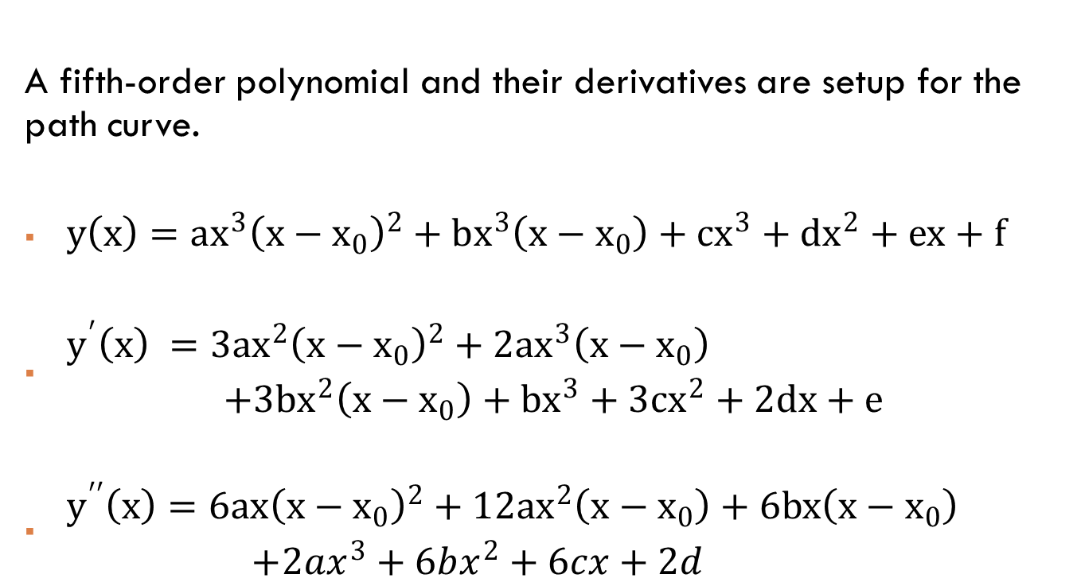
Curve Generation
A fifth-order polynomial and their derivatives are setup for the path curve.
$y\left(x\right)=ax^{3}{\left(x−x_{0}\right)}^{2}+bx^{3}\left(x−x_{0}\right)+cx^{3}+dx^{2}+ex+f$
$\begin{aligned}y^{′}\left(x\right) =3ax^{2}{\left(x−x_{0}\right)}^{2}+2ax^{3}\left(x−x_{0}\right) \\ +3bx^{2}\left(x−x_{0}\right)+bx^{3}+3cx^{2}+2dx+e \end{aligned}$
$\begin{aligned}y^{′′}\left(x\right)=6ax{\left(x−x_{0}\right)}^{2}+12ax^{2}\left(x−x_{0}\right)+6bx\left(x−x_{0}\right) \\ +2ax^{3}+6bx^{2}+6cx+2d \end{aligned}$

Slide 9
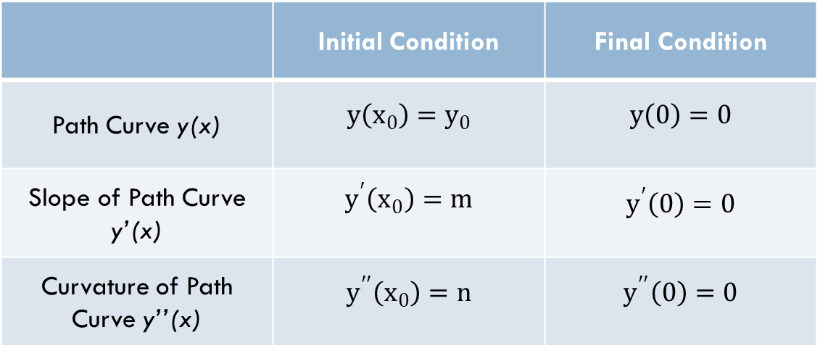
Curve Generation Contd.
Applying given initial and final conditions mentioned before,
 | Initial Condition | Final Condition
Path Curve y(x) | $$y\left(x_{0}\right)=y_{0}$$ | $$y\left(0\right)=0$$
Slope of Path Curve y’(x) | $$y^{′}\left(x_{0}\right)=m$$ | $$y^{′}\left(0\right)=0$$
Curvature of Path Curve y’’(x) | $$y^{′′}\left(x_{0}\right)=n$$ | $$y^{′′}\left(0\right)=0$$

Slide 10
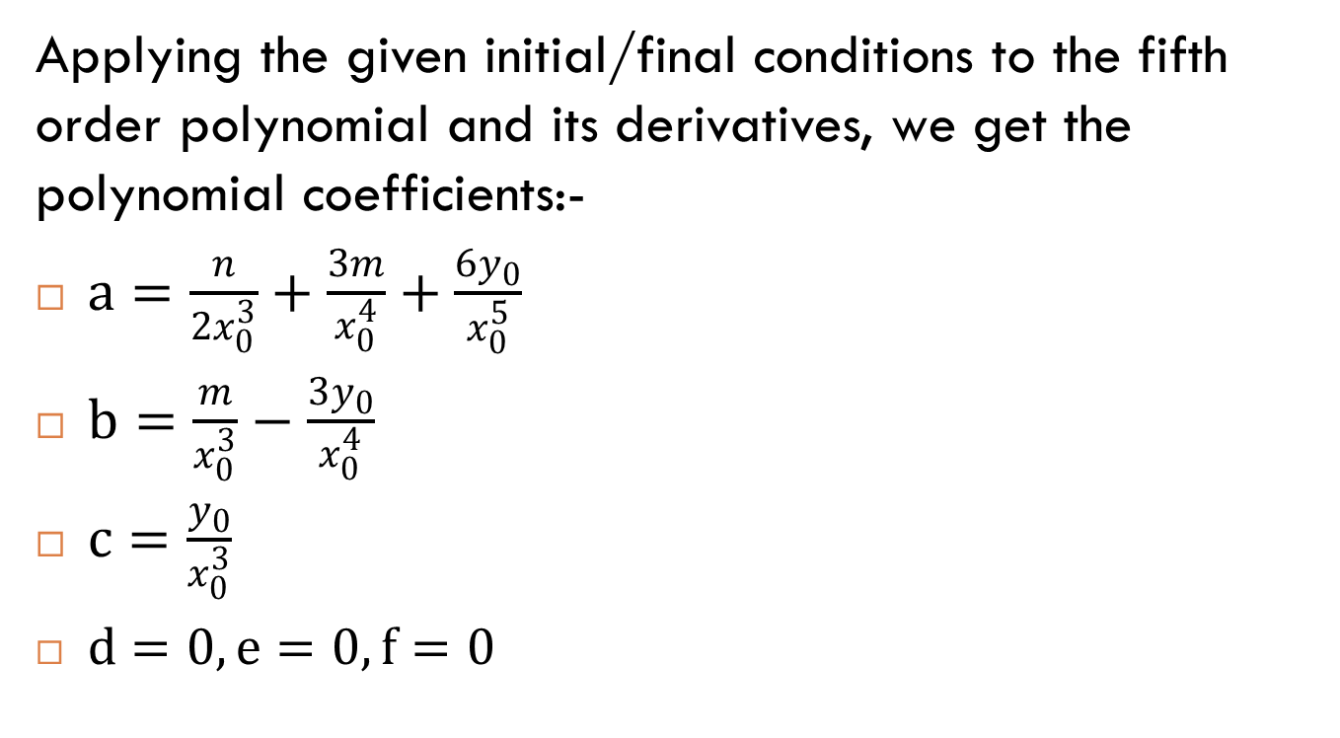
Curve Generation Contd.
Applying the given initial/final conditions to the fifth order polynomial and its derivatives, we get the polynomial coefficients:-
$a=\frac{n}{2x_{0}^{3}}+\frac{3m}{x_{0}^{4}}+\frac{6y_{0}}{x_{0}^{5}}$
$b=\frac{m}{x_{0}^{3}}−\frac{3y_{0}}{x_{0}^{4}}$
$c=\frac{y_{0}}{x_{0}^{3}}$
$d=0,e=0,f=0$

Slide 11
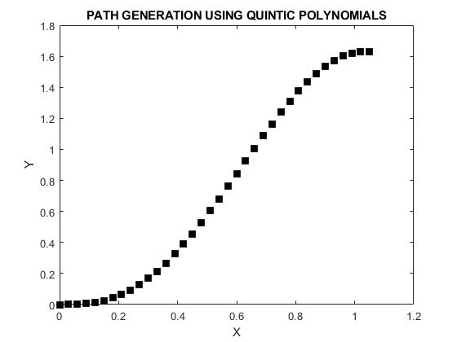
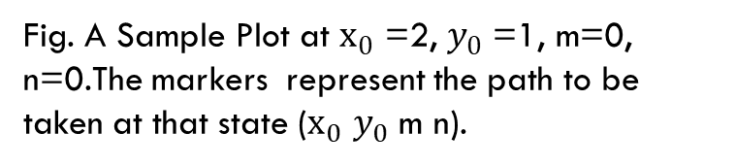
Curve Generation Contd.
Fig. A Sample Plot at $x_{0}$ =2, $y_{0}$ =1, m=0, n=0.The markers represent the path to be taken at that state ($x_{0}$ $y_{0}$ m n).

Slide 12
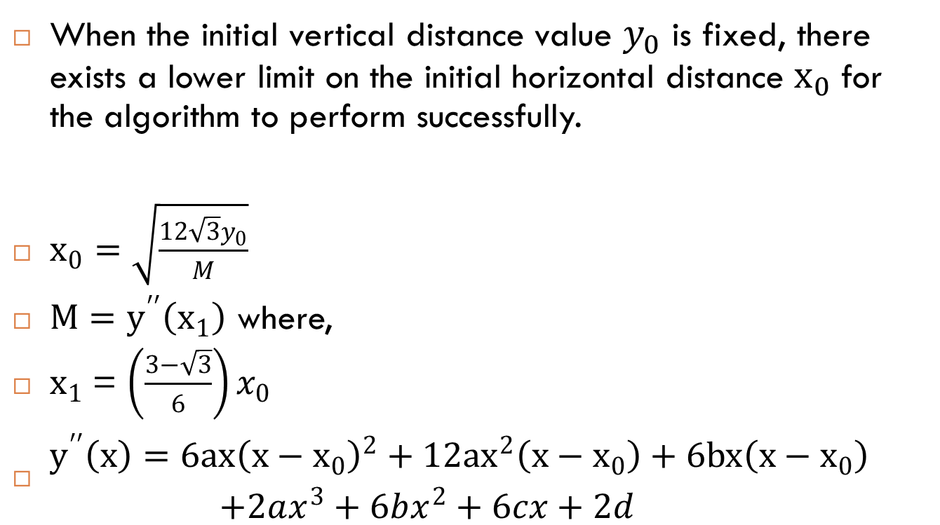
Minimum Horizontal Distance
When the initial vertical distance value $y_{0}$ is fixed, there exists a lower limit on the initial horizontal distance $x_{0}$for the algorithm to perform successfully.
$x_{0}=\sqrt{\frac{12\sqrt{3}y_{0}}{M}}$
$M=y^{′′}\left(x_{1}\right)$ where,
$x_{1}$= $\left(\frac{3−\sqrt{3}}{6}\right)x_{0}$
$\begin{aligned}y^{′′}\left(x\right)=6ax{\left(x−x_{0}\right)}^{2}+12ax^{2}\left(x−x_{0}\right)+6bx\left(x−x_{0}\right) \\ +2ax^{3}+6bx^{2}+6cx+2d \end{aligned}$

Slide 13
Automatic Parking Algorithm
Using the above-mentioned information and data, an adaptive algorithm can be proposed, which recalculates the path curve, slope and curvature of the path curve over multiple iterations.
At each new iteration, new initial conditions are observed, which leads to a path curve to determine the next motion command.
This computation, however, requires that the precise location of the car can be observed at any given interval of time, (for example, using motion sensors, video surveillance etc.)

Slide 14
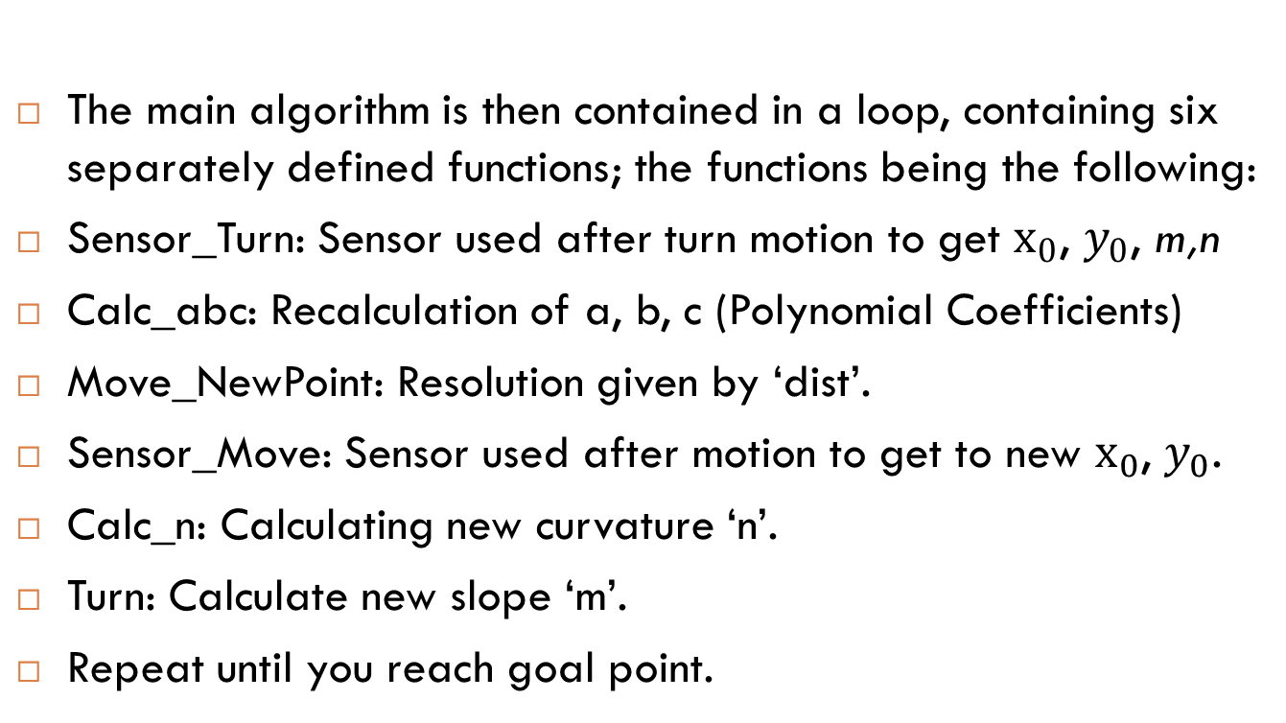
Automatic Parking Algorithm Contd.
The main algorithm is then contained in a loop, containing six separately defined functions; the functions being the following:
Sensor_Turn: Sensor used after turn motion to get $x_{0}$, $y_{0}$, m,n
Calc_abc: Recalculation of a, b, c (Polynomial Coefficients)
Move_NewPoint: Resolution given by ‘dist’.
Sensor_Move: Sensor used after motion to get to new $x_{0}$, $y_{0}$.
Calc_n: Calculating new curvature ‘n’.
Turn: Calculate new slope ‘m’.
Repeat until you reach goal point.

Slide 15
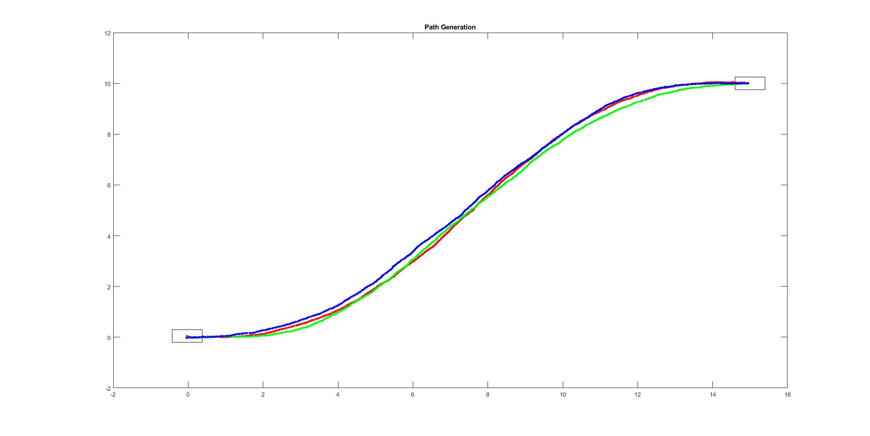
Path Generation with sensor noise
(15,10)
(0,0)

Slide 16
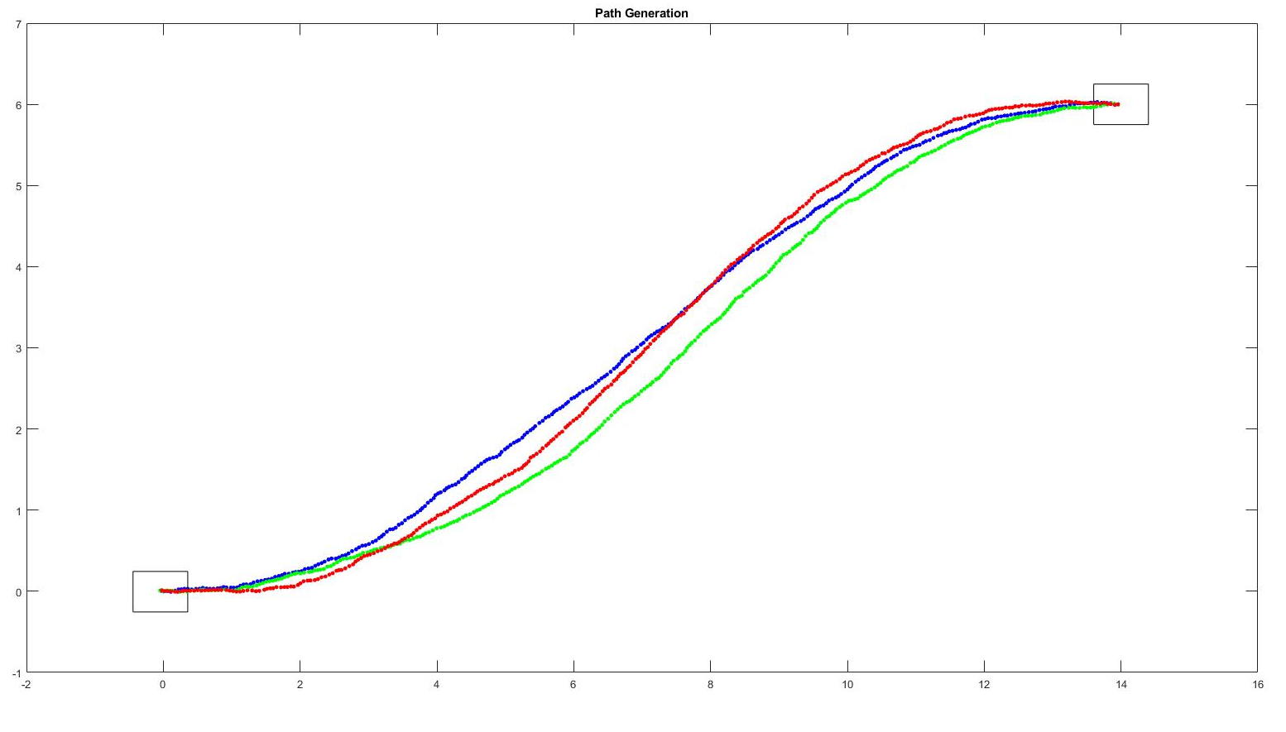
Path Generation with sensor noise
(14,6)
(0,0)

Slide 17
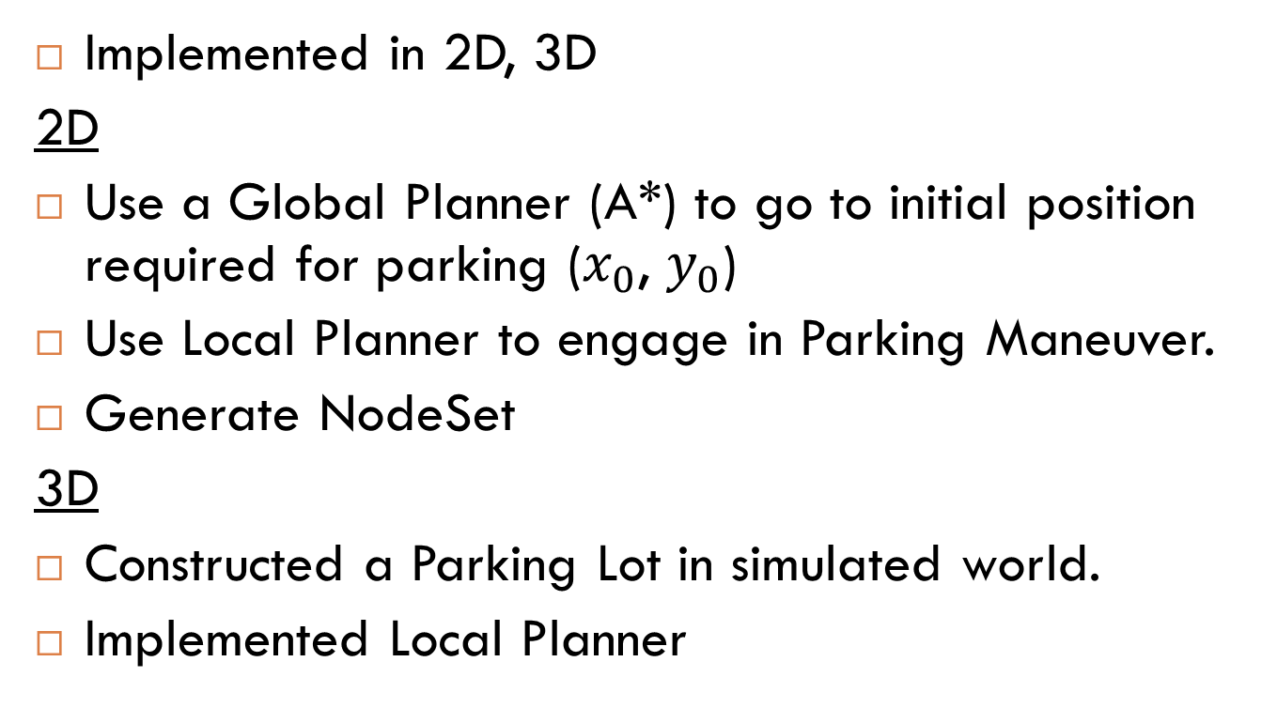
Implementation
Implemented in 2D, 3D
2D
Use a Global Planner (A*) to go to initial position required for parking ($x_{0}$, $y_{0}$)
Use Local Planner to engage in Parking Maneuver.
Generate NodeSet
3D
Constructed a Parking Lot in simulated world.
Implemented Local Planner

Slide 18
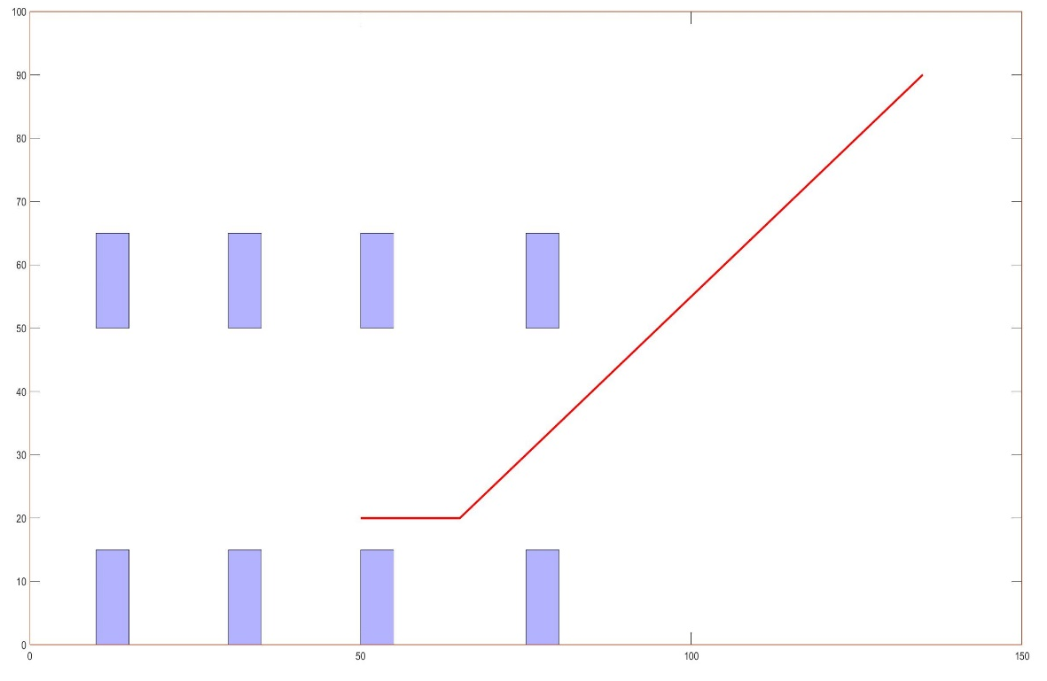
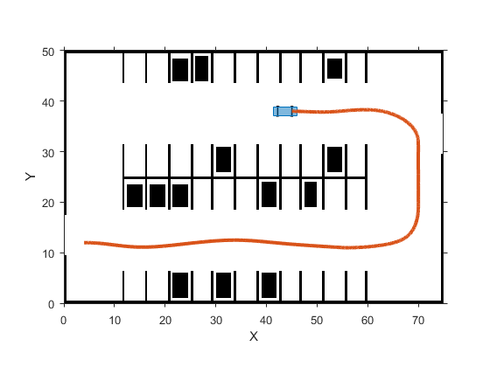
Implementation Contd.
Global Planner (using A* from P3) to reach initial point for parking maneuver.

Slide 19
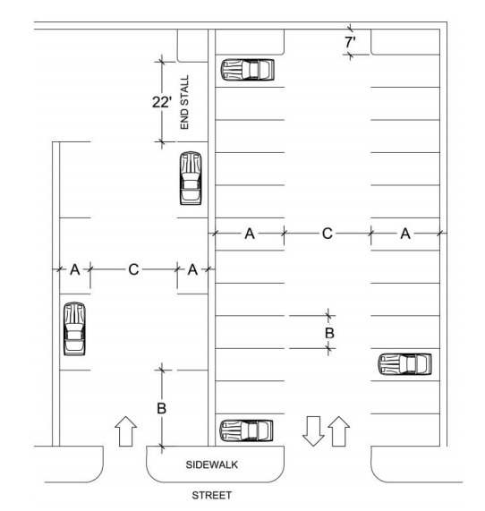
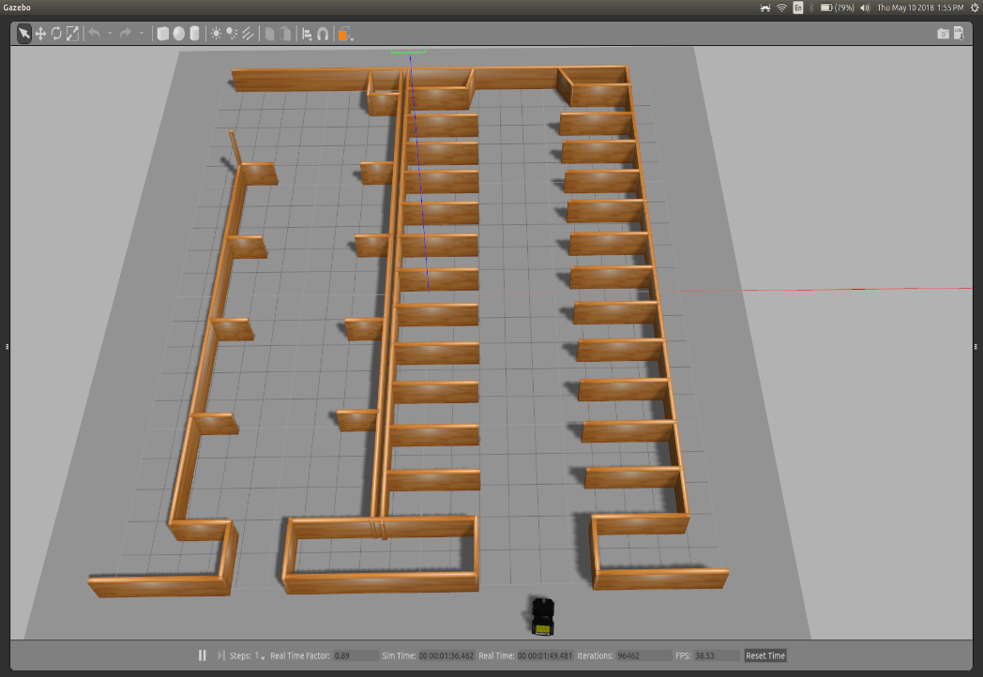
Implementation Contd.
Construction of Parking Lot World

Slide 20
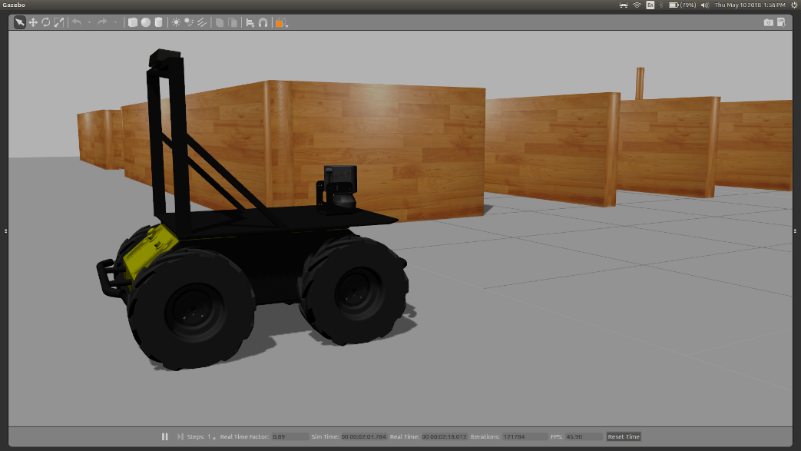
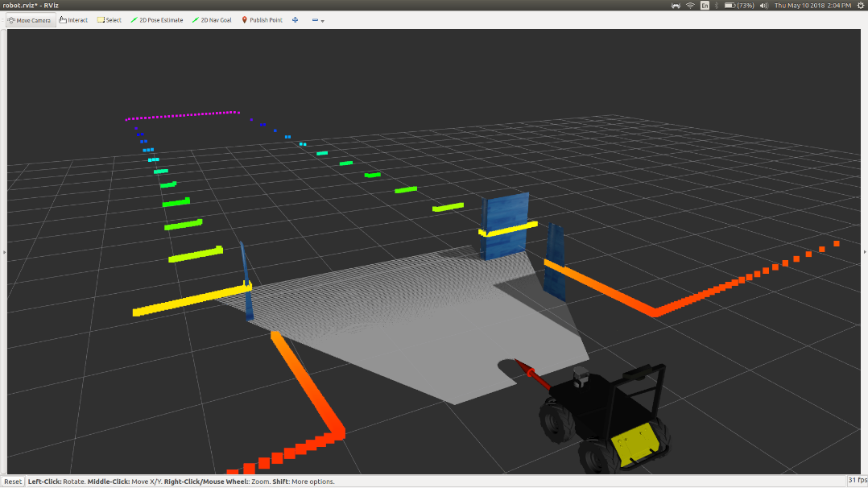
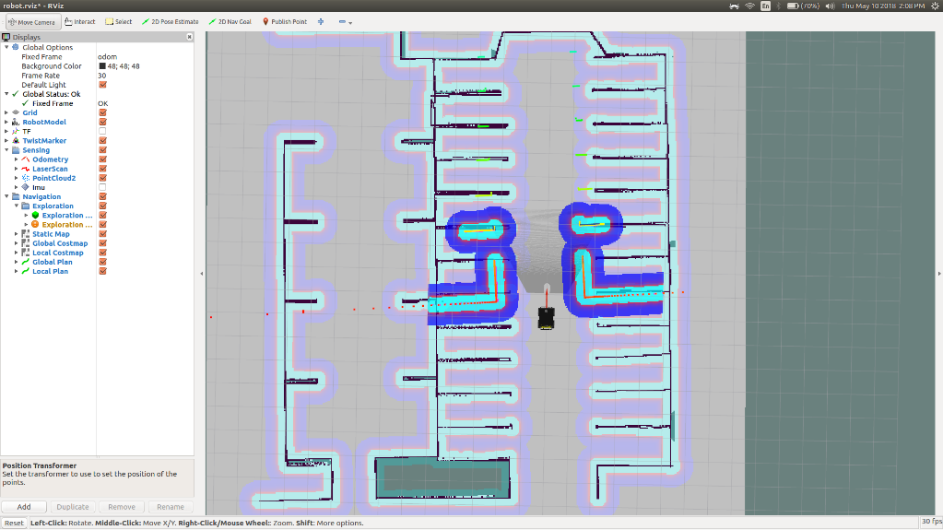
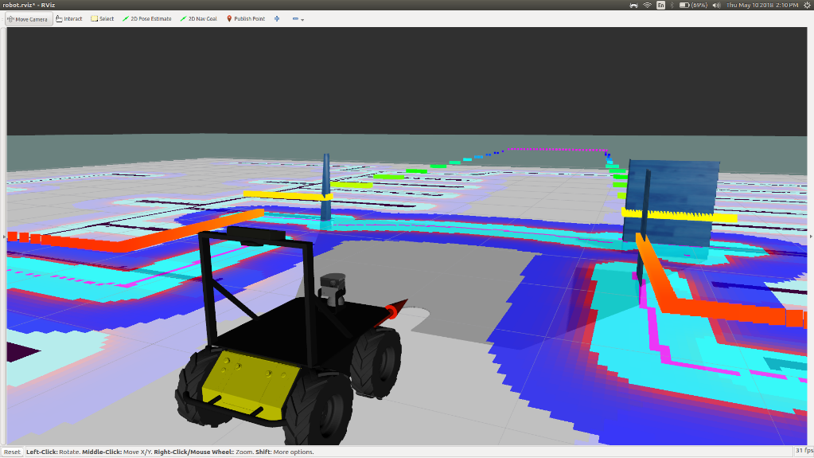
Implementation Contd.

Slide 21
Observations and Conclusions
Path planning using polynomials is computationally very cheap.
Computed primary objective of generating path using a fifth-order polynomial model.
Algorithm very robust to noise as shown
No Accumulation of errors, as initial conditions are computed every iteration using sensors.
Need Real-time Location data to implement algorithm.
In a 2D-Coordinate Plane, with a resolution of 0.05, time taken to generate path from (using parking planner) is around 250ms
Can Integrate with a global planner to engage in fully automatic parking after entering a parking lot.

Slide 22
References
Paromtchik, Igor (June 2003). "Planning Control Commands to Assist in Car Maneuvers" (PDF). Proceedings of the IEEE International Conference on Advanced Robotics. Coimbra, Portugal. pp. 1308–1313.
Banzhaf.H et al “The Future of Parking: A survey on automated valet Parking with an outlook on high-density parking”,2017 IEE Intelligent Vehicles Syposium (IV) , June, 11-14, 2017, Redondo Beach, CA.
J. Vandorpe, Navigation techniques for the mobile robot LiAS. PhD thesis, Katholieke Universiteit Leuven-Faculteit Teogepaste Wetenschappen, 199
S. Fleury et al., Primitives for smoothing mobile robot trajectories, IEEE transactions on robotics and automation, 11, No. 3 (June 1995).
C. Zhu, R. Rajamani, Global positioning system-based vehicle control for automated parking, IMechE, 220 (2006) Part D: J. Automobile Engineering.
A. Scheuer, T.H Fraichard, Planning continuous-curvature paths for carlike robots, IEEE Transactions on Intelligent Robots and Systems 3 (1996) 1304-1311. Asg
A. Scheuer, T.H Fraichard, From reeds and shepp’s to continuouscurvarure paths, IEEE Transactions on Robotics and Automation 20 (2004) 1025-1035.
E. Szádeczky-Kardoss, B. Kiss, Path planning and tracking control for an automatic parking assist system, Springer Tracts in Advanced Robotics 44 (2008) 175-184.
T.-H.S. Li, S.-J. Chang, Y-X. Chen, Implementation of human-like driving skills by autonomous fuzzy behavior control on an FPGA-based car-like mobile robots, IEEE Transactions on Industrial Electronics 50 (2003) 867-880.
Image for illustration : -http://www.permastripe.com/parking-lot-design-orlando-florida/
Images: F. Lamiraux and J.P. Laumond “Smooth Motion Planning for car-like vehicles, IEEE Transactions on Robotics and Automation,Vol 17, No.4, August 2001
Zhang.S et al, “Automatic Vehicle Parallel Parking Design using FIfith Degree Polynomial Path Planning” Vehicular technology Conference, IEEE 2011, San Francisco, CA, USA.

