Slide 1
ABC
Own Your Future
FASTFOOD
FRANCHISE
Join India's fastest growing QSR franchise brand
INVESTOR PRESENTATION
Pizza | Burgers | Chicken-Based Fast Food
Franchise Investment: ₹50 Lakhs | Space: 1,000 sq ft | ROI: Within 24 Months
Pan-India Franchise Opportunity | 2026

Slide 2
PRESENTATION OVERVIEW
01
Brand Story & Vision
07
SWOT Analysis
02
India QSR Market Opportunity
08
Competitive Landscape
03
Our Products & USP
09
Why ABC FastFood Over Competitors
04
Franchise Business Model
10
Support & Training System
05
Investment & Financial Projections
11
Expansion Roadmap
06
Unit Economics & ROI Analysis
12
Next Steps

Slide 3
01 | BRAND STORY & VISION
WHO WE ARE
ABC FastFood was born from a simple belief — every Indian deserves
world-class fast food at honest prices, served fresh and fast.
Founded with a passion for bold flavours and warm hospitality,
ABC brings together the best of Pizza, Burgers and Chicken-based
fast food under one roof — creating an unbeatable dining experience.
Our brand stands for TASTE, VALUE & TRUST.
🎯 OUR VISION
To become India's most-loved homegrown QSR brand with 500+ franchise outlets by 2030.
🚀 OUR MISSION
Empower franchise partners with a proven system, exceptional support & profitable business.
🏆 OUR CORE VALUES: Quality | Consistency | Community | Speed
₹50L
24M
1000
3
Franchise Investment
ROI Target
Sq Ft Required
Revenue Streams

Slide 4
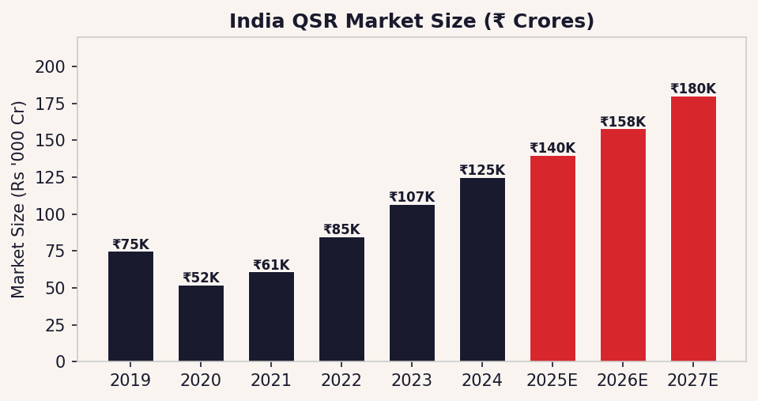
02 | INDIA QSR MARKET OPPORTUNITY
A BOOMING ₹1.5 LAKH CRORE INDUSTRY
14-16%
7,500+
Annual Growth Rate (CAGR)
QSR Outlets Across India
500M+
72%
Young Consumer Base (<35 yrs)
Urban Population Eating Out Weekly
₹1.5L Cr
3x Growth
Market Size by 2027
Tier 2 & 3 City Expansion
India QSR sector: One of the TOP 5 fastest growing food markets globally

Slide 5
03 | OUR PRODUCTS & USP
THREE WINNING CATEGORIES. ONE POWERFUL BRAND.
🍕
🍔
🍗
PIZZA
BURGERS
CHICKEN
✔ Signature Indian-fusion pizzas
✔ Crispy & Grilled options
✔ Crispy Fried Chicken (7 spices)
✔ Classic Margherita to Spicy Tikka
✔ Aloo Tikki | Chicken | Paneer
✔ Popcorn Chicken & Strips
✔ 7", 10", 14" sizes
✔ Double-stack signature burgers
✔ Hot Wings (Honey Chilli / BBQ)
✔ Veg & Non-Veg variants
✔ Combo meals with fries & drinks
✔ Spicy Grilled Chicken options
✔ Starting at ₹149
✔ Starting at ₹99
✔ Starting at ₹129
🧑‍🍳 Freshly Prepared | ⚡ 10-Min Service | 🌱 Locally Sourced | 📦 Dine-in + Delivery + Takeaway | 💰 Value Pricing

Slide 6
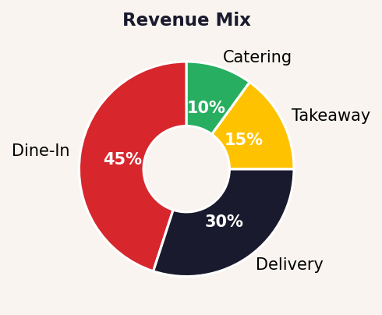
04 | FRANCHISE BUSINESS MODEL
HOW THE ABC FASTFOOD FRANCHISE WORKS
1
2
3
4
5
SIGN AGREEMENT
SETUP & FIT-OUT
TRAINING & LAUNCH
OPERATE & EARN
GROW & EXPAND
▶
▶
▶
▶
Legal franchise agreement & territory protection
Brand-standard outlet setup with our design team
Full staff & owner training + grand opening support
Daily operations with HQ support & supply chain
Multi-unit opportunities for top performers
REVENUE STREAMS
Franchise Fee
₹5,00,000 (one-time)
Royalty
5% of monthly net sales
Marketing Fund
2% of monthly net sales
Agreement Term
5 Years (renewable)
Territory Rights
Exclusive 2 km radius
Avg Daily Orders
200–350 covers/day
Avg Ticket Size
₹220–₹280 per cover
Monthly Revenue
₹5.5L – ₹9L (est.)

Slide 7
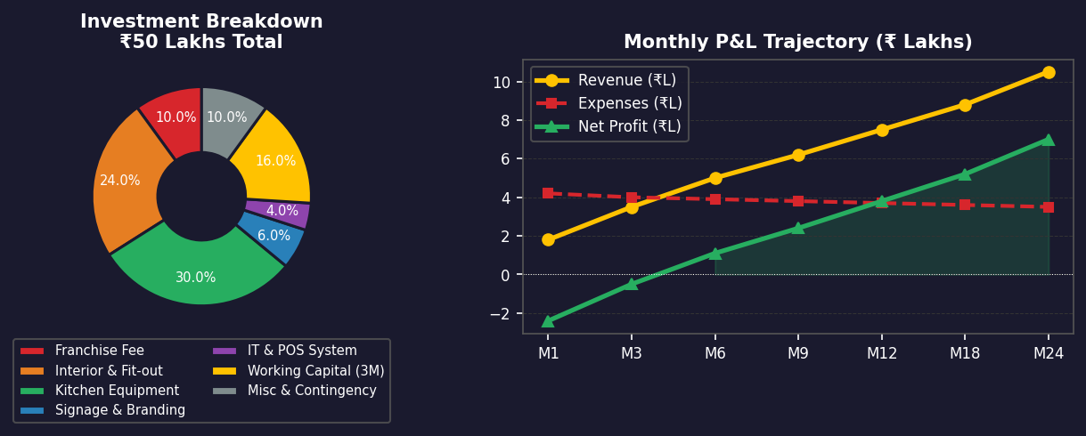
05 | INVESTMENT & FINANCIAL PROJECTIONS
YOUR COMPLETE INVESTMENT SNAPSHOT
₹50 Lakhs
Total Investment
₹5.5–9L/mo
Avg Monthly Revenue
~35–40%
Gross Margin
Month 18–24
Break-even Point

Slide 8
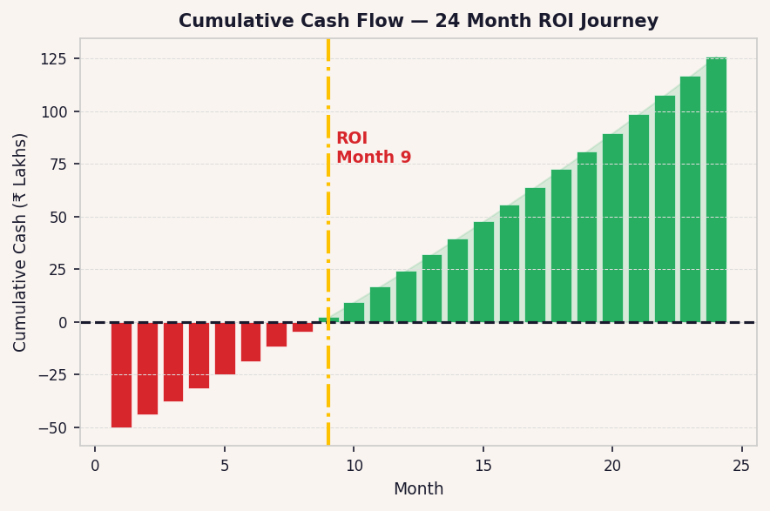
06 | UNIT ECONOMICS & ROI ANALYSIS
YOUR MONEY WORKING FOR YOU — WITHIN 24 MONTHS
REVENUE
Avg Daily Orders
280 covers
Avg Ticket Size
₹250
Monthly Gross Revenue
₹21,00,000
Less: Aggregator Commission (15%)
-₹94,500
Net Revenue
₹19,05,500
EXPENSES
Raw Material Cost (28%)
₹5,33,540
Staff (6 persons)
₹1,20,000
Rent
₹60,000
Royalty (5%)
₹95,275
Marketing Fund (2%)
₹38,110
Utilities & Misc
₹35,000
Total Expenses
₹8,81,925
EBITDA / NET PROFIT
~₹10,23,575/month
💰 Estimated Full ROI: 18–24 Months | Annual Return: 20–25%+

Slide 9
07 | SWOT ANALYSIS
STRATEGIC ASSESSMENT — ABC FASTFOOD FRANCHISE
💪 STRENGTHS
⚠ WEAKNESSES
• Multi-category offering (Pizza, Burger, Chicken)
• Brand recognition still growing vs MNCs
• Affordable pricing vs international chains
• Limited brand history vs legacy players
• India-specific menu with local flavours
• Dependent on franchisee execution quality
SWOT
• Proven franchise system with full support
• Supply chain consistency in remote Tier 3
• Low investment vs competition (₹50L)
• Premium positioning challenged in rural markets
• Fast service model — 10-min guarantee
• Strong delivery platform integration
🚀 OPPORTUNITIES
🔥 THREATS
• Massive Tier 2 & 3 city expansion potential
• Strong MNC competition (Domino's, KFC, McDonald's)
• India QSR growing at 14–16% CAGR
• Raw material cost inflation risk
• Growing young population (18–35 demographic)
• Increasing real estate / rental costs
• Digital food delivery market at ₹2L Cr+
• Trained staff attrition challenges
• Ghost kitchen / dark kitchen model expansion
• Regulatory / FSSAI compliance costs
• Corporate & institutional catering segment
• First-mover advantage in many markets

Slide 10
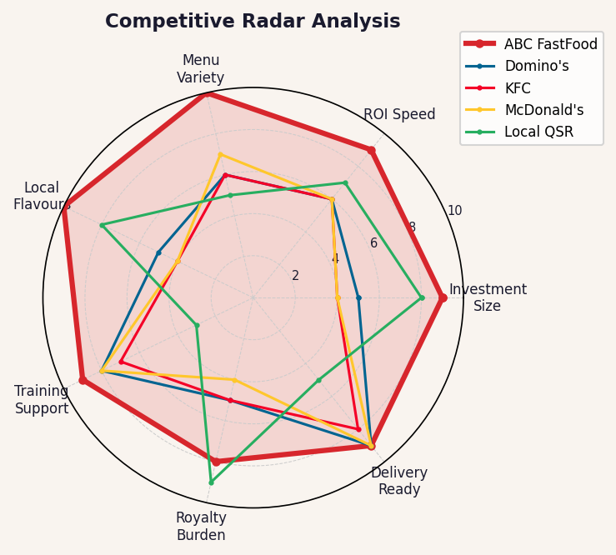
08 | COMPETITIVE LANDSCAPE
WHO ELSE IS IN THE GAME?
Brand
Investment
Royalty
Menu Type
ROI Period
India Focus
ABC FastFood
₹50 Lakhs
5%
Pizza+Burger+Chicken
18–24M
✅ 100%
Domino's India
₹75–100L
5.5%
Pizza Only
36–48M
⚠ Partial
KFC India
₹1–1.5 Cr
6%
Chicken Only
36–60M
⚠ Partial
McDonald's
₹1.5–2 Cr
4%
Burger Only
48–72M
⚠ Partial
Subway India
₹40–60L
8%
Sandwiches
24–36M
⚠ Partial
Local QSR
₹20–40L
0%
Limited
12–24M
✅ Yes
★ ABC FastFood offers the BEST value-to-investment ratio in the Indian QSR market

Slide 11
09 | WHY ABC FASTFOOD OVER COMPETITION
10 COMPELLING REASONS TO CHOOSE ABC
LOWEST INVESTMENT
3-IN-1 MENU
01
02
₹50L vs ₹75L–₹200L for MNCs — 50–75% cheaper to start
Pizza + Burgers + Chicken = 3x customer base. No competitor matches this breadth
FASTEST ROI
100% INDIA-FIRST
03
04
18–24 months vs 36–72 months for major MNC franchises
Menu engineered for Indian tastes — Tikka Pizza, Desi Burgers, Spicy Wings
END-TO-END SUPPORT
LOWER ROYALTY
05
06
Site selection → design → training → launch → ongoing ops support
5% royalty vs 6–8% at Subway/KFC — more profit stays with YOU
SMALLER SPACE NEEDED
DELIVERY-FIRST DESIGN
07
08
Profitable at 1,000 sq ft vs 1,500–2,500 sq ft for MNCs
Swiggy + Zomato + own app integration from Day 1
SCALABLE MODEL
GROWING BRAND EQUITY
09
10
Multi-unit rights available — grow from 1 to 10+ outlets
National marketing campaigns + social media with 500K+ followers
BOTTOM LINE: More menu. Less money. Faster returns. Better support. ABC FastFood is built for YOUR success.

Slide 12
10 | SUPPORT & TRAINING SYSTEM
YOU ARE NEVER ALONE — WE'RE WITH YOU 24/7
🏗
Pre-Launch Support
🎓
Training Programme
🚀
Launch Support
✓ Site selection & lease negotiation
✓ 14-day intensive at ABC Training Hub
✓ Dedicated opening team on-site
✓ Store design & layout blueprint
✓ Operations manual & SOPs provided
✓ Grand opening marketing push
✓ Equipment procurement guidance
✓ Kitchen management & food safety
✓ Social media activation
✓ Pre-opening marketing campaign
✓ POS system & inventory training
✓ Free PR & local press coverage
🤝
Ongoing Operations
📊
Marketing & Tech
🌱
Growth Support
✓ Monthly field visits by business coach
✓ National & regional ad campaigns
✓ Multi-unit franchise opportunities
✓ 24/7 helpline & WhatsApp support
✓ Swiggy/Zomato account management
✓ Annual franchisee conference
✓ Supply chain — centralized procurement
✓ Own ABC app with loyalty programme
✓ New product rollout support
✓ Quarterly performance reviews
✓ Data dashboard — real-time analytics
✓ Territory expansion rights

Slide 13
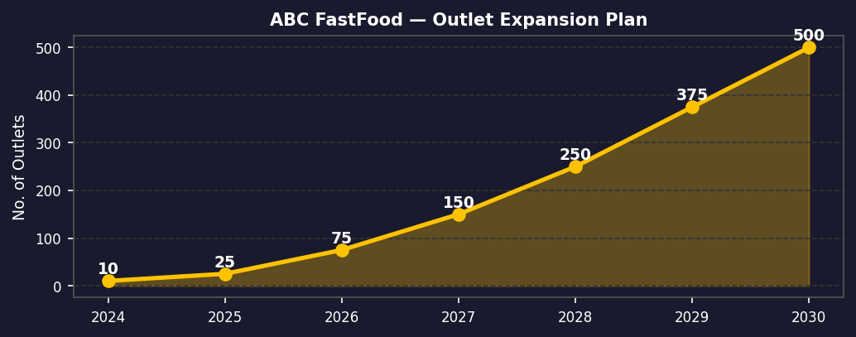
11 | EXPANSION ROADMAP
SCALING INDIA — 500 OUTLETS BY 2030
2024–25 PHASE 1
2025–26 PHASE 2
2026–27 PHASE 3
2028–30 PHASE 4
Foundation
Expansion
Scale
Domination
25 outlets
Metro cities
Delhi, Mumbai,
Bengaluru, Hyderabad
100 outlets
Tier 1 & Tier 2
cities across
12 states
250 outlets
Tier 2 & Tier 3
cities, dark kitchens
& cloud outlets
500+ outlets
Pan-India presence
International
exploration

Slide 14
IDEAL FRANCHISEE PROFILE
ARE YOU THE RIGHT FIT FOR ABC FASTFOOD?
💰
Financial Capacity
🧠
Business Mindset
Minimum liquid funds of ₹50 Lakhs. Proof of financial capability required.
Entrepreneurial drive with willingness to follow the ABC system and SOPs.
📍
Local Market Knowledge
⏰
Commitment
Understanding of local consumer behaviour, footfall areas, and competition.
Owner-operated or active oversight. We prefer hands-on franchisees.
🤝
Team Builder
📱
Tech Savvy
Ability to recruit, manage and motivate a team of 6–10 staff members.
Comfortable with POS systems, delivery apps, and digital marketing basics.
No food industry experience required — our training system will make you a pro!

Slide 15
12 | NEXT STEPS
READY TO OWN YOUR
ABC FASTFOOD
GET IN TOUCH
FRANCHISE?
📞 +91 98765 43210
STEP 1
Fill Franchise Enquiry Form
📧 franchise@abcfastfood.in
Apply online or contact our franchise team
STEP 2
Discovery Call / Meeting
🌐 www.abcfastfood.in/franchise
30-min call with our franchise development team
📍 ABC FastFood HQ, Mumbai, India
STEP 3
Site Evaluation
Our experts visit & approve your proposed location
Agreement Signing
APPLY NOW
STEP 4
Legal documentation & territory allocation
STEP 5
Training & Setup
Limited franchise territories
available in your city.
First-come, first-served basis.
Apply before slots fill up!
14-day training + store fit-out begins
STEP 6
GRAND OPENING!
Launch your ABC FastFood franchise!

