Slide 1

DEPARTMENT OF INFORMATION SCIENCE & ENGINEERING
Major Project (IS481P)
“Non-Human Identity Governance Agent”
Evaluation- Phase-III
Academic Year – 2025-26
Carried Out By:
Manu Prakash Bhat (1RV22IS035)
Internal Guide:
Dr. Merin Meleet
Associate Professor,
Dept. of ISE
Carried Out At:
Honeywell
External Guide:
Tejeshwar Rao
Manager DevSecOps & Cloud
Honeywell
1

Slide 2

Incorporation of Suggestions
Refined UML component, class, and sequence diagrams — improved label clarity and reduced visual clutter for presentation readability
Redesigned system architecture as a compact four-layer left-to-right flow diagram with labeled data-flow arrows between layers

Slide 3
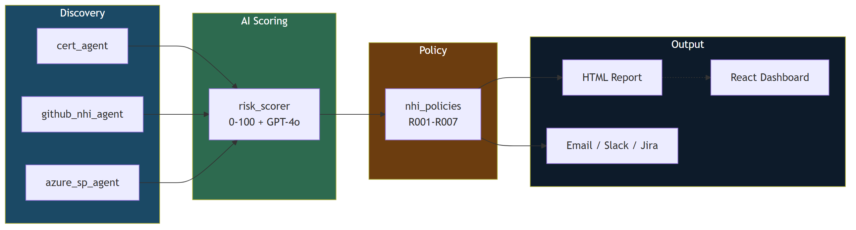
Detailed Design
Four-layer modular architecture where each layer operates independently. Discovery agents feed findings into the scoring engine, which passes scored results to the policy evaluator, and violations route to multi-channel reporting and notification outputs.
Fig. 1: Four-Layer NHI Governance Architecture

Slide 4
Implementation Details
Backend (Python 3.11+ — 6 Core Modules):
• Three discovery agents scan SSL/TLS certificates, GitHub non-human identities, and Azure service principal credentials independently
• Risk scorer computes weighted 0–100 severity scores with optional GPT-4o enrichment for high-risk findings
• Policy engine evaluates 7 governance rules mapped to SOC 2 and ISO 27001 compliance controls
• Report generator produces unified HTML reports with colour-coded severity badges and rolling 15-report retention
Frontend (React 19 + TypeScript + Vite):
• Five-page interactive dashboard covering risk overview, NHI inventory, certificate monitoring, policy violations, and system settings

Slide 5
Technical Solution Development
AI-Driven Risk Scoring:
Each finding scored 0–100 using four weighted components — age (40), type (30), privilege (20), and context (10)
Age score increases linearly as credential approaches its rotation deadline
Identity type weight reflects blast radius — PATs and write keys score highest
Privilege component penalizes broad scopes like admin:org and delete_repo
Findings scoring 50 or above are enriched with a GPT-4o generated risk summary
LLM enrichment is optional and gracefully skipped when API is unavailable
Final score maps to severity — CRITICAL, HIGH, MEDIUM, or LOW

Slide 6
Technical Solution Development
Policy-as-Code Enforcement:
Seven governance rules enforce rotation deadlines, certificate expiry thresholds, privilege escalation detection, and high-risk score escalation
Rotation rules flag stale PATs, write deploy keys, and Actions secrets based on configurable age limits
Certificate rules detect approaching and imminent SSL/TLS expiry separately
Catch-all rule escalates any finding scoring 70 or above regardless of type
All thresholds externalized in config.yaml for adjustment without code changes
Rules mapped to SOC 2 and ISO 27001 compliance controls for audit evidence

Slide 7
Environmental & Sustainability Considerations
Sustainable Design Principles:
Event-driven — workflows execute only on trigger, zero idle compute
Serverless-first — GitHub Actions runners are on-demand, no always-on cost
Rolling retention — 15-report window auto-prunes stale artifacts
Efficient API usage — batch queries with pagination reduce redundant calls
Graceful degradation — missing credentials silently skipped, not retried
LLM cost optimization — GPT-4o invoked only for findings scoring ≥ 50
Resource Metrics:
Average scan: 45 sec (certs) | 90 sec (GitHub + Azure) | 30 sec (reports)
Monthly compute cost: $0 (GitHub Actions free tier)
No persistent database — stateless JSON inventory, no idle DB cost
• Non-critical scans scheduled off-peak hours to reduce CI queue load

Slide 8
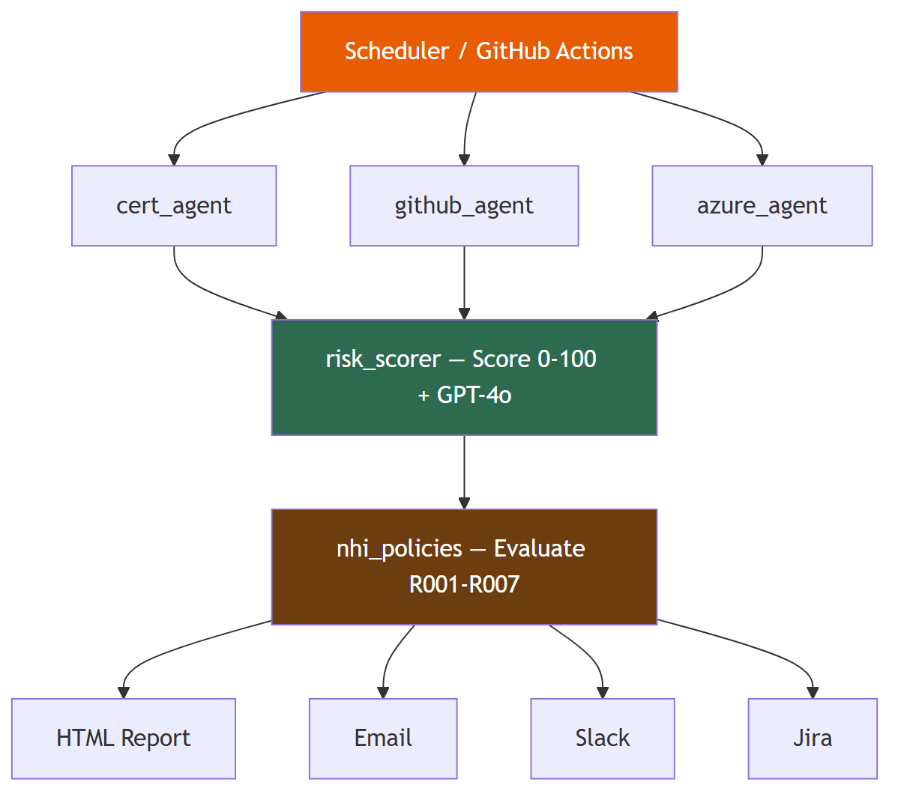
Demonstration — System Workflow
End-to-end governance cycle: Discovery agents scan NHIs across three platforms, risk scorer classifies severity, policy engine evaluates 7 rules, and violations route to reports and multi-channel notifications.
Fig. 2: Governance Workflow Pipeline

Slide 9
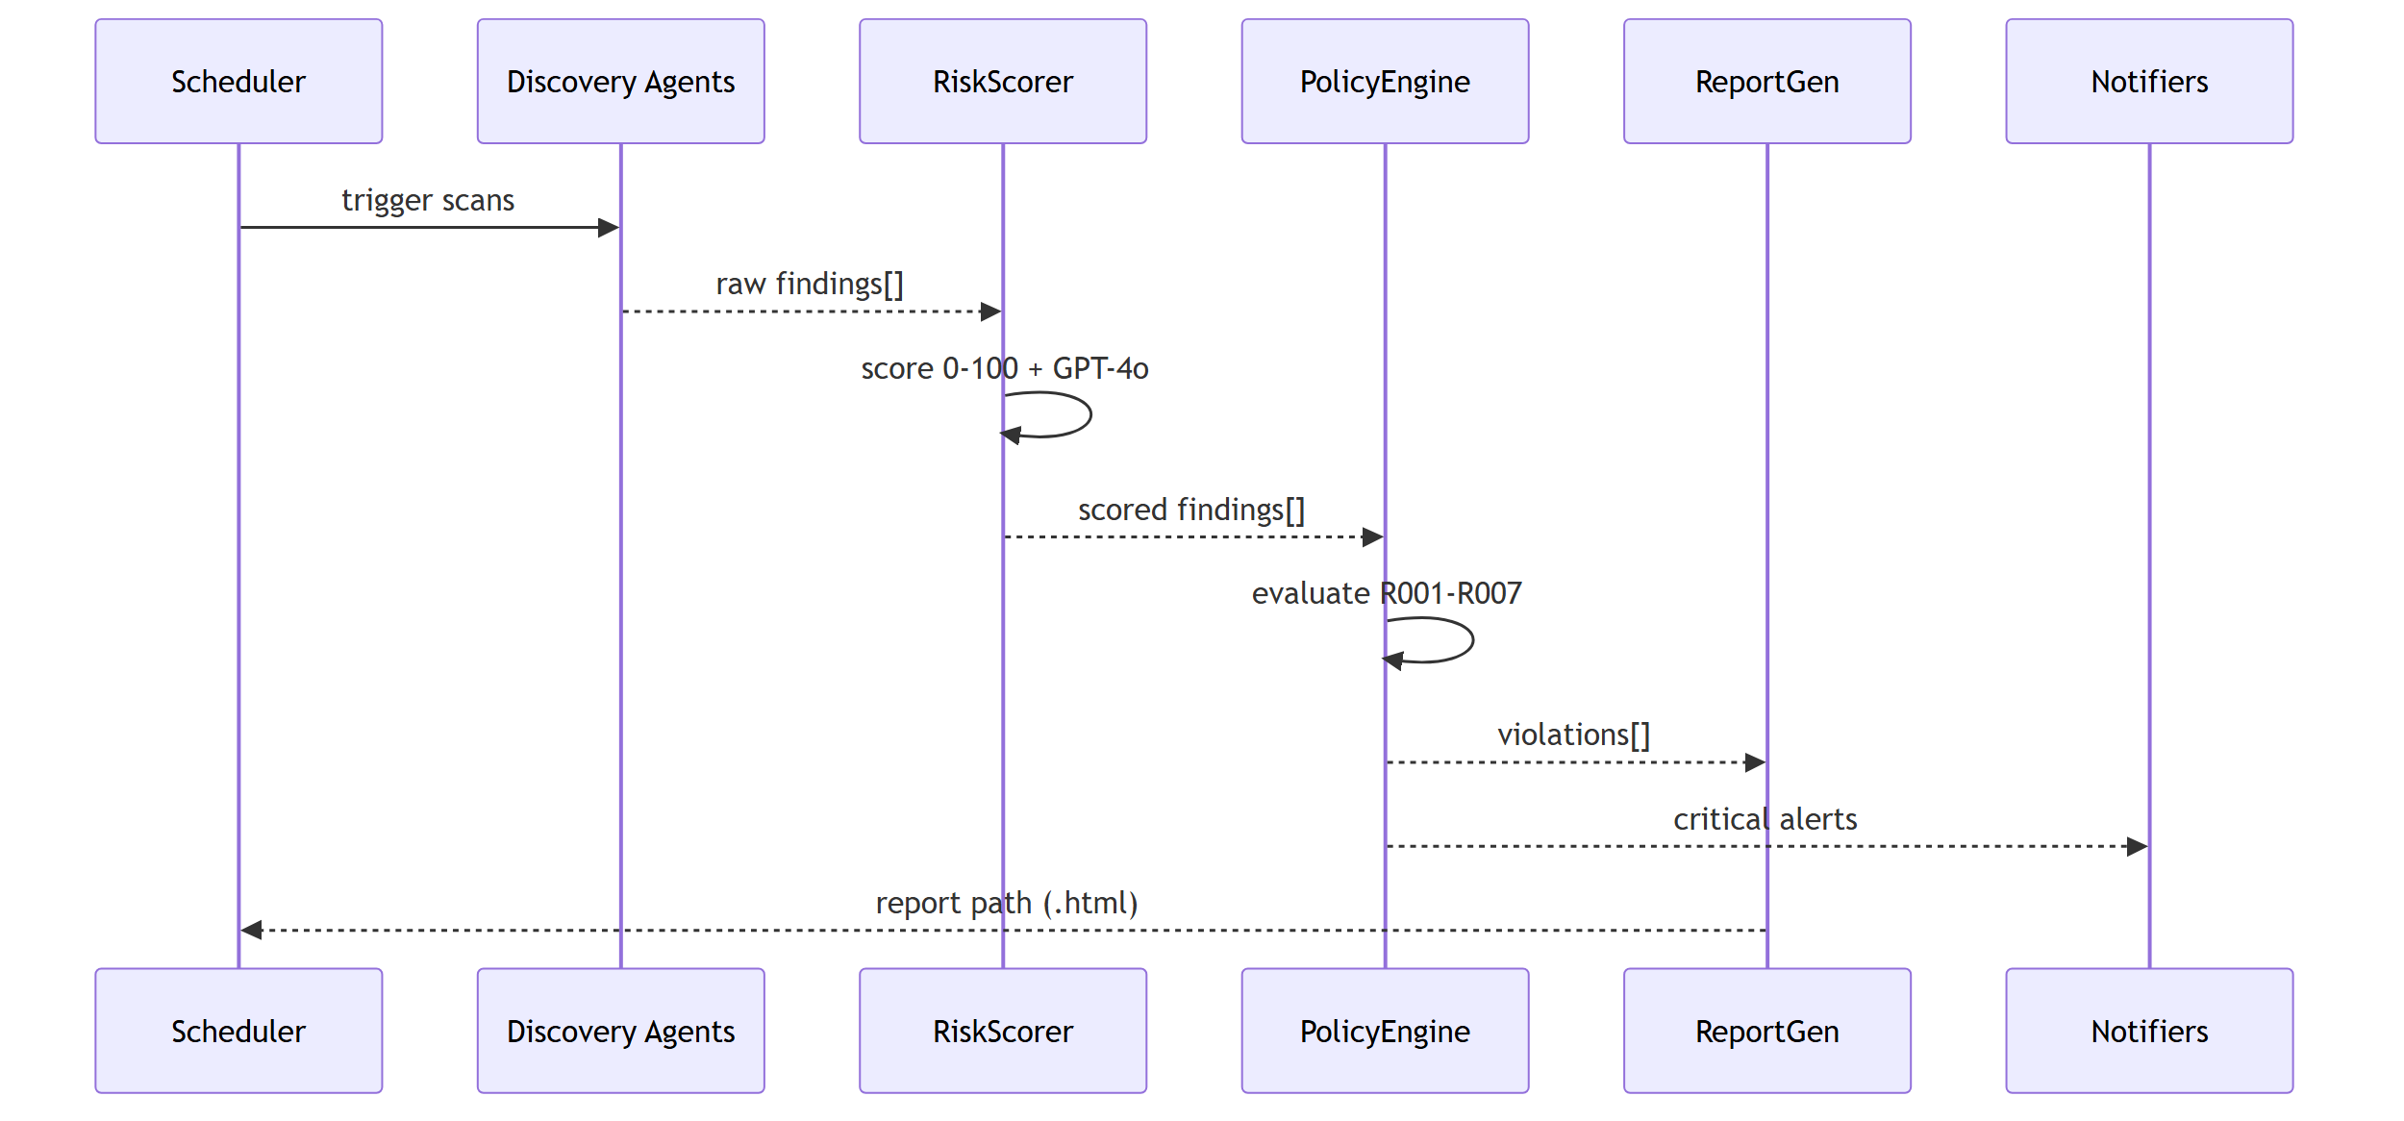
Demonstration — Execution Flow
Interaction sequence during a single governance scan showing data flow from scheduler through discovery, scoring, policy, to output.
Fig. 3: Execution Sequence Diagram

Slide 10
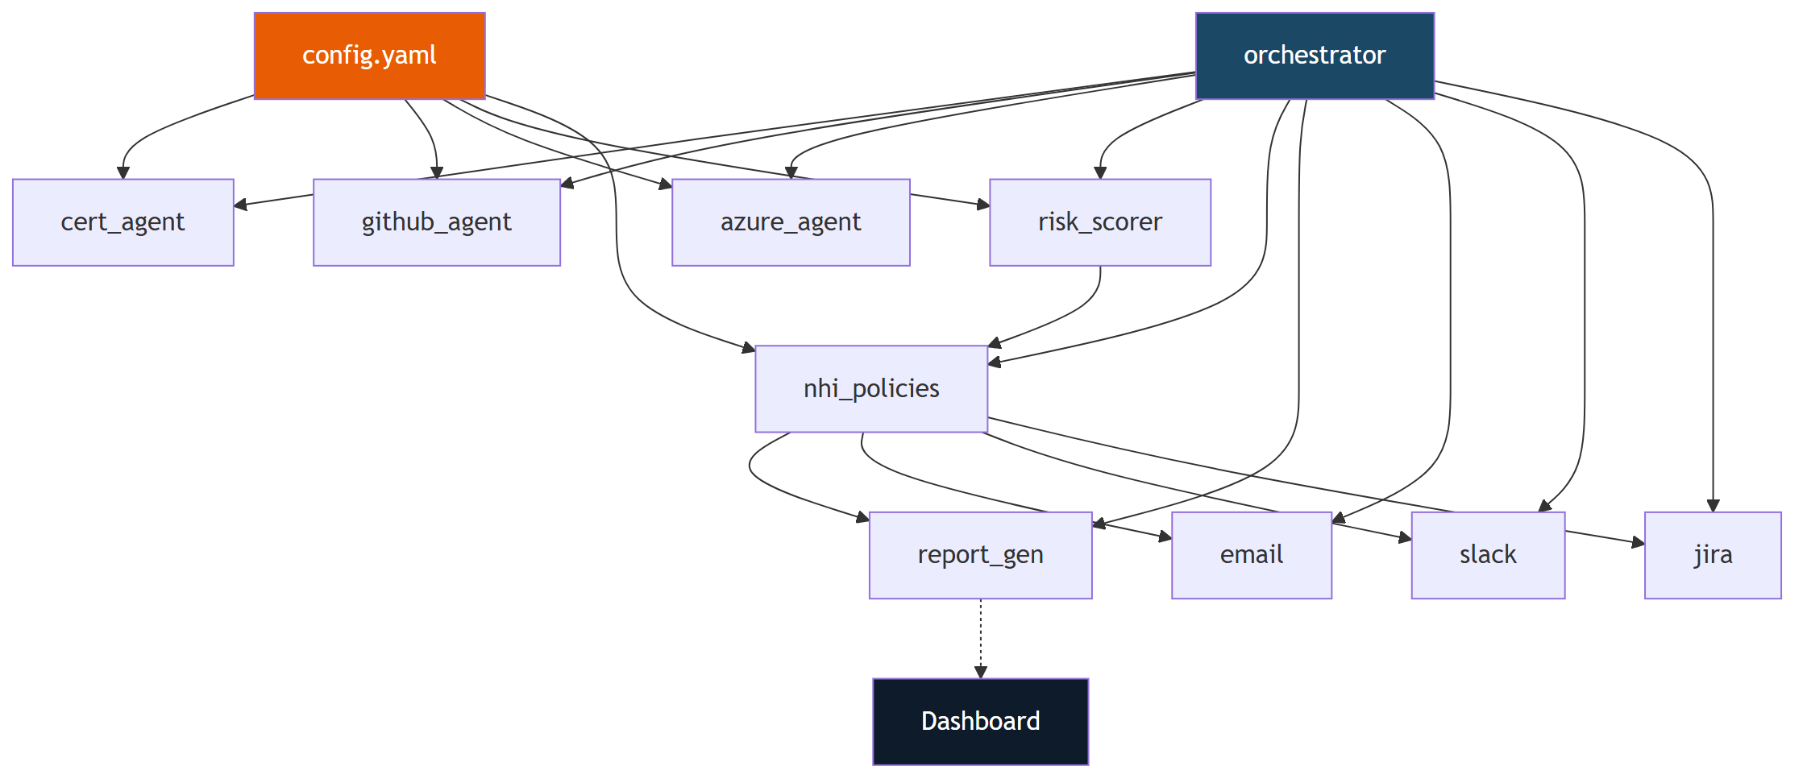
Component Architecture
Module dependency map showing how config.yaml drives all agents, the orchestrator coordinates execution, and outputs are independent.
Fig. 4: Component Dependency Diagram

Slide 11
Results Obtained so far
Discovery & Monitoring:
Full NHI discovery — GitHub PATs, deploy keys, Actions secrets, workflow secret references, Azure SPs, SSL/TLS certificates
Python-native SSL monitor replacing legacy Bash script
Custom GitHub REST API client with pagination and scope inspection
AI Classification:
Deterministic 0–100 scoring with four weighted components
LangChain + GPT-4o enrichment for findings scoring ≥ 50
Dual execution: LangChain Agent mode + Direct sequential mode
Policy & Compliance:
7 rules (R001–R007) with SOC 2 and ISO 27001 control mapping
All thresholds externalized in config.yaml — zero hard-coded values
Reporting & Notification:
Unified HTML report with severity badges and rolling retention
Multi-channel: SMTP email, Slack Block Kit, Jira ticket creation
5-page React dashboard with risk charts and NHI inventory

Slide 12
Work to be done
Automated credential rotation via Azure Key Vault with pre-rotation validation and rollback mechanism
Real-time anomaly detection for unusual identity access patterns
Migrate Python policy rules to OPA/Rego for language-agnostic evaluation and Kubernetes-native enforcement
Multi-tenant support for multiple Azure AD tenant governance
Enterprise-scale performance testing (1,000+ NHIs within SLA)
Unit and integration test suite with ≥ 80% code coverage
Docker containerization with Helm chart for Kubernetes deployment

Slide 13
References
[1] Ponemon Institute, "The 2024 State of Certificate Lifecycle Management," DigiCert, 2024.
[2] E. Barker, "Recommendation for Key Management: Part 1 – General," NIST SP 800-57 Rev. 5, May 2020.
[3] Microsoft, "Azure Well-Architected Framework: Identity and Access Management," Microsoft Learn, 2024.
[4] Microsoft, "Application and Service Principal Objects in Azure AD," Microsoft Learn, 2024.
[5] CISA, "IAM Best Practices Guide for Administrators," CISA, 2024.
[6] H. Chase et al., "LangChain: A Framework for LLM Applications," GitHub, 2023.
[7] T. Topsakal and T. Akinci, "Creating LLM Applications Utilizing LangChain," in Proc. ICAICE, 2023.
[8] Open Policy Agent, "Policy-Based Control for Cloud Native Environments," CNCF, 2024.
[9] GitHub Inc., "Security Hardening for GitHub Actions," GitHub Docs, 2024.
[10] B. Beyer et al., Site Reliability Engineering, O'Reilly, 2016.

