Slide 1

DEPARTMENT OF INFORMATION SCIENCE & ENGINEERING
Major Project (IS481P)
“Non-Human Identity Governance Agent”
Evaluation- Phase-II
Academic Year – 2025-26
Carried Out By:
Manu Prakash Bhat (1RV22IS035)
Internal Guide:
Dr. Merin Meleet
Associate Professor,
Dept. of ISE
Carried Out At:
Honeywell
External Guide:
Tejeshwar Rao
Manager DevSecOps & Cloud
Honeywell

Slide 2

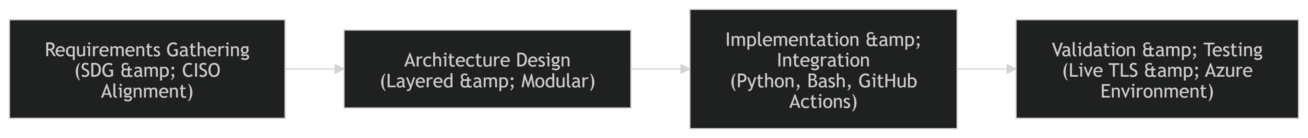
Design methodology
Design Approach
The system follows a four-phase design methodology that moves from identity discovery through risk classification, policy enforcement, and automated remediation.
Phase 1 — Continuous Discovery
Integrate with Azure Active Directory (Entra ID) and GitHub REST API to build a live NHI inventory
Capture metadata: credential type, creation date, last used timestamp, privilege scope, and owner
Detect dormant and orphaned identities missed by traditional point-in-time tools

Slide 3
Design methodology
Phase 2 — AI-Driven Classification
LangChain orchestrates an agentic reasoning loop over collected identity metadata
Risk scoring engine evaluates each identity across three dimensions: privilege scope, usage frequency, and credential age
Anomalous behaviours such as dormant identities suddenly becoming active are flagged in real time
Phase 3 — Policy-as-Code Enforcement
Open Policy Agent (OPA) with Rego policy language encodes governance rules as machine-executable constraints
Example rules: no secret older than 30 days, no identity unused for 7+ days remains active
Policy violations are logged, reported, and escalated to the remediation pipeline
Phase 4 — Automated Remediation
GitHub Actions workflows are triggered autonomously upon policy violation detection
Azure Key Vault and Managed Identities are updated to rotate credentials
Zero standing secrets are maintained at all times without human intervention

Slide 4
Planning of Project Work
Weeks 1–4 — Requirements, Research and System Design
Literature survey of NHI threat landscape, existing tools, and governance frameworks
Feasibility assessment of Azure SDK, Microsoft Graph API, LangChain, and OPA
Definition of monitoring scope: Azure AD service principals and TLS certificates
Design four-layer system architecture and configuration schema
Set up GitHub repository, self-hosted runner, and project structure
Weeks 5–8 — Core Monitoring Implementation
Build TLS Certificate Monitor using OpenSSL s_client with SNI and custom port support
Build Azure SP Credential Monitor using Microsoft Graph API
Implement dual-filter support by application UUID and display name
Handle both client secret and certificate-based credentials
Unit test against live and mock endpoints

Slide 5
Planning of Project Work
Weeks 9–12 — Classification, Reporting, Alerting and Automation
Implement three-tier threshold classification: CRITICAL, EXPIRING, OK
Generate timestamped HTML reports with colour-coded status indicators
Implement CSV export for SIEM integration and rolling 15-report retention
Configure conditional SMTP email alerts triggered only on actionable conditions
Deploy all three GitHub Actions workflows: cert-expiry, azure-sp-expiry, automate-build
Weeks 13–18 — AI Layer, Rotation, Dashboard, Testing and Submission
Integrate LangChain agent for multi-dimensional risk scoring
Define and validate OPA/Rego policy ruleset
Build automated credential rotation pipeline via Azure Key Vault
Deploy Azure-hosted real-time NHI inventory dashboard with audit log
End-to-end integration testing across Azure and GitHub platforms
Security audit, final report preparation, and project submission

Slide 6
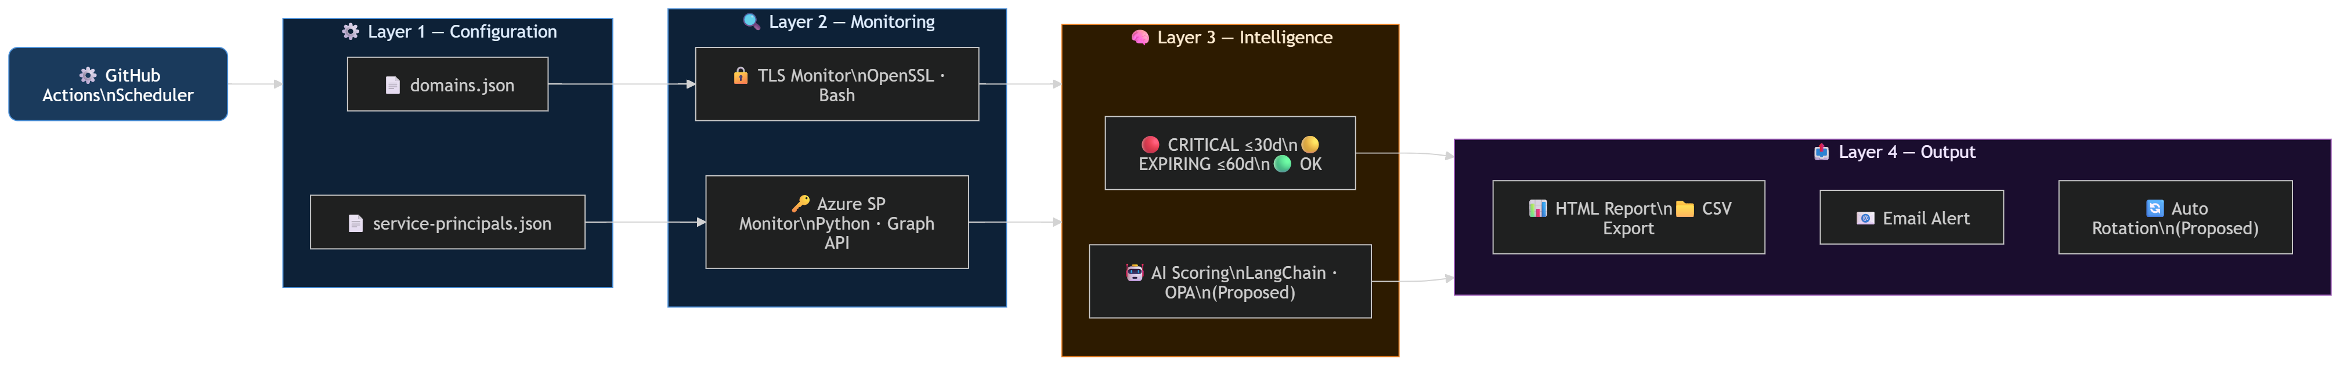
System Architecture
Architecture Overview
The platform is structured as four independent, loosely-coupled layers. Each layer can be maintained or extended without impacting the others.
Key Design Decisions
All credentials stored as GitHub encrypted repository secrets — never in source code
Monitoring identity holds read-only permissions only (Application.Read.All)
Self-hosted private runner pool ensures execution within secure network perimeter
Rolling report retention — fifteen most recent reports kept automatically

Slide 7
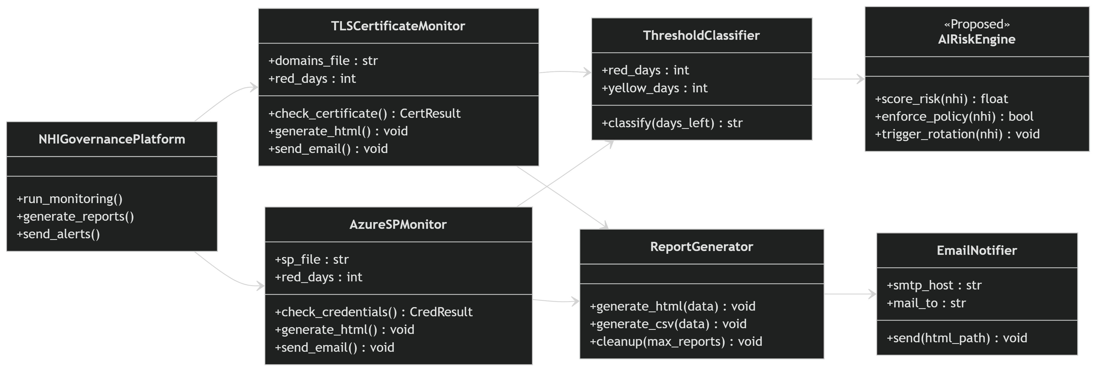
UML Class diagram
The class diagram models the internal structure of the NHI Governance Platform, showing the six core classes, their attributes, methods, and relationships. The NHIGovernancePlatform acts as the central orchestrator, delegating to TLSCertificateMonitor and AzureSPMonitor for credential scanning. Both monitors share a common ThresholdClassifier for risk classification and feed results into ReportGenerator, which triggers EmailNotifier for alerts. The proposed AIRiskEngine extends the classifier with autonomous policy enforcement and rotation capabilities.

Slide 8
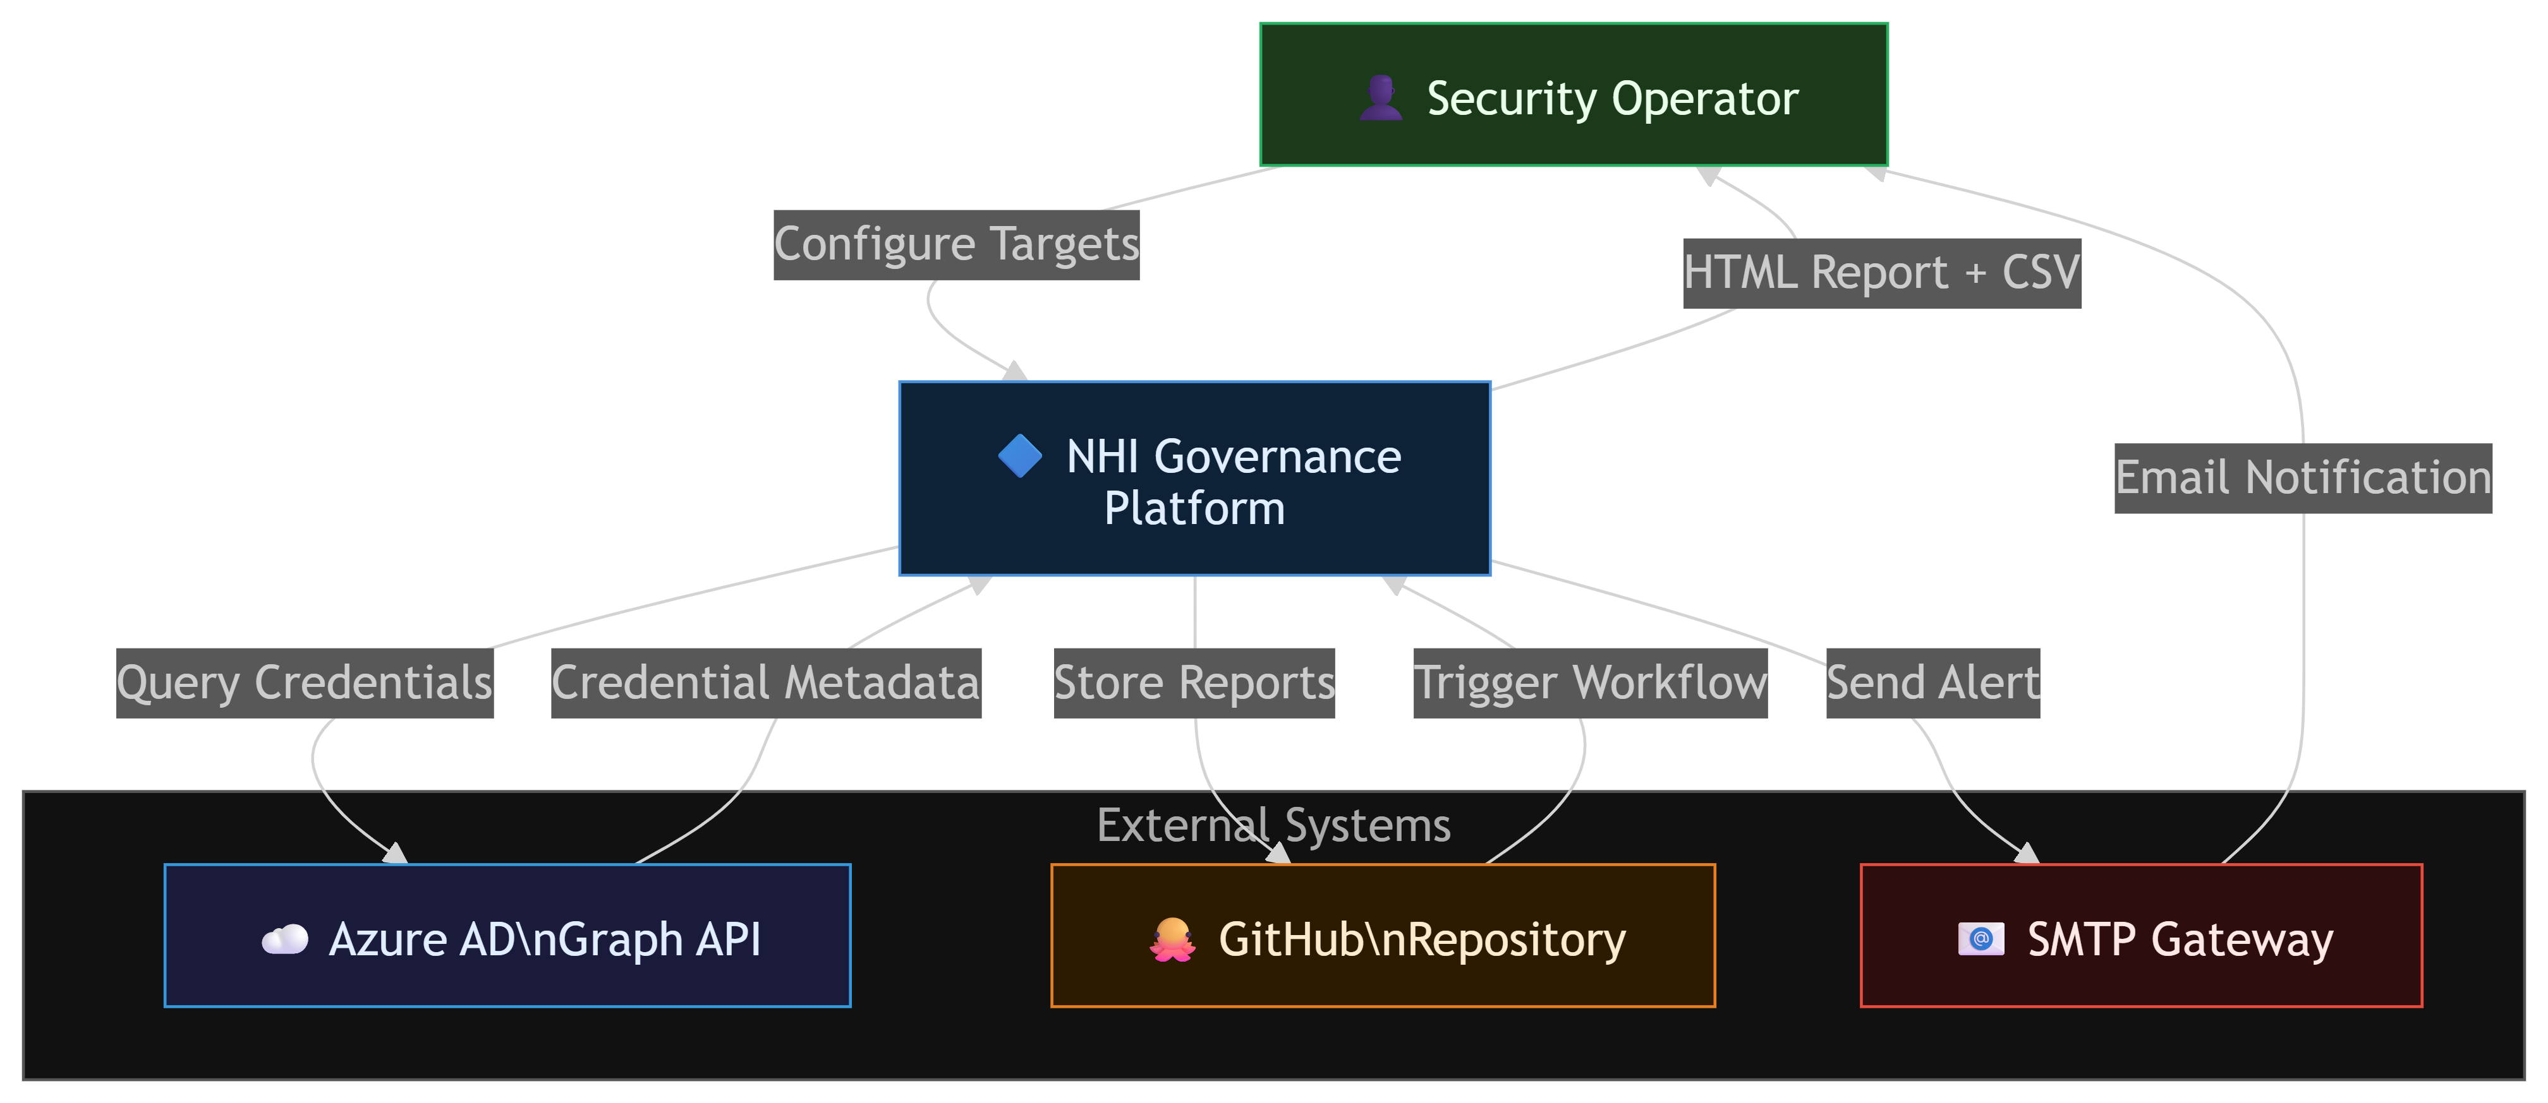
Level 0 DFD diagram
The Level 0 DFD shows the NHI Governance Platform as a single system interacting with four external entities. The Security Operator configures monitoring targets and receives generated reports and email alerts. Azure AD provides credential metadata in response to Graph API queries. The GitHub repository triggers scheduled workflows and stores generated artifacts. The SMTP Gateway dispatches email notifications to the operator when credentials enter the risk window.

Slide 9
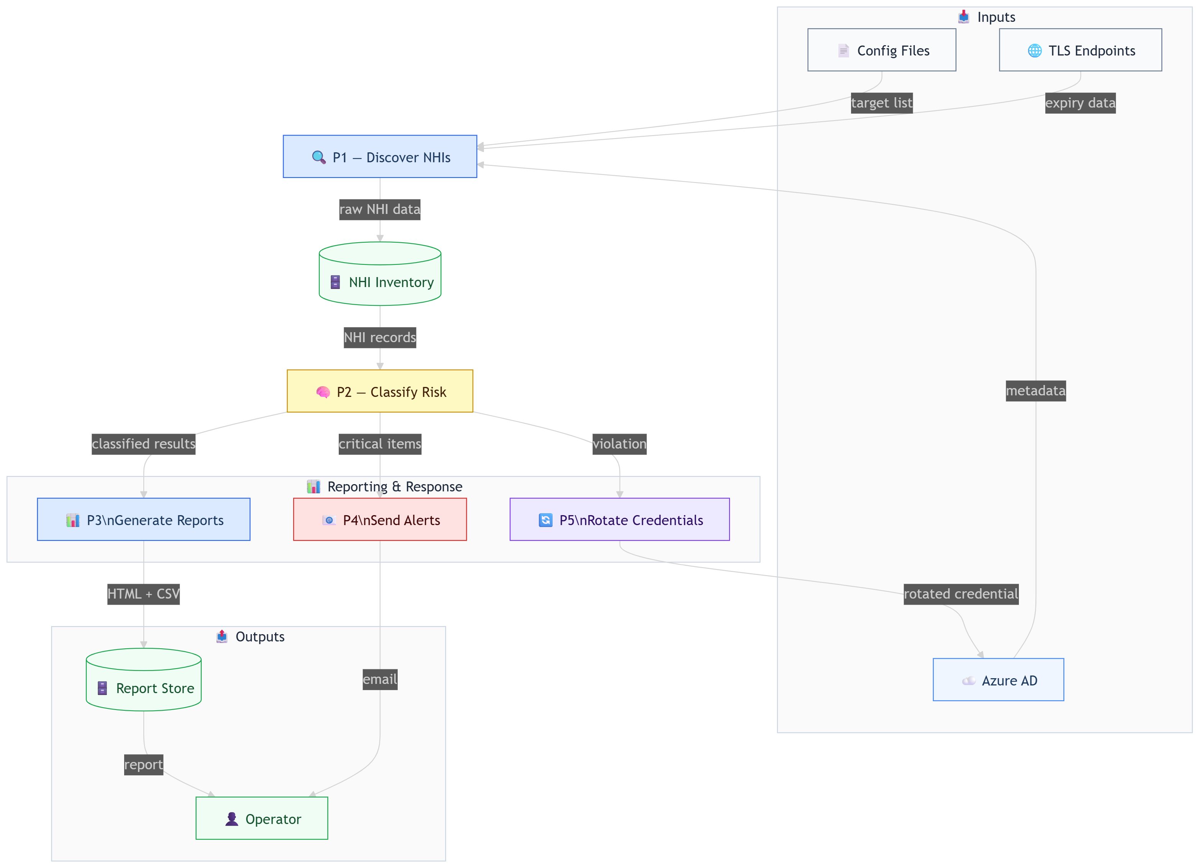
Level 1 DFD-Internal Process diagram
The Level 1 DFD breaks the platform into five processes. P1 queries Azure AD and TLS endpoints to collect credential metadata and stores it in the NHI Inventory. P2 reads the inventory and classifies each credential as CRITICAL, EXPIRING, or OK. P3 converts results into HTML and CSV reports for operator download. P4 sends email alerts for any CRITICAL credential. P5, part of the proposed phase, automatically rotates violated credentials back in Azure AD.

Slide 10
System Requirements Specification
Hardware Requirements
Cloud Platform: Microsoft Azure for hosting the agent, workflows, and dashboards
Compute: Azure VMs or containerised instances for continuous Python workflow execution
Storage: Azure Monitor and secure cloud storage for inventory states, logs, and audit records
Software Requirements
Programming Language: Python 3.11, Bash
APIs and SDKs: Azure SDK, Microsoft Graph API, GitHub REST API
Cloud Services: Azure Key Vault, Azure Managed Identities, Azure Monitor
AI and Orchestration: LangChain, Open Policy Agent (OPA) with Rego
CI/CD and Automation: GitHub Actions

Slide 11
System Requirements Specification
Functional Requirements
Continuously discover all NHIs across Azure AD and GitHub including dormant and orphaned identities
Classify each credential using three-tier threshold model: CRITICAL, EXPIRING, OK
Calculate AI risk scores per identity based on privilege scope, usage, and age
Execute automated credential rotation upon policy violation without human initiation
Non-Functional Requirements
High availability: continuous operation without scheduled downtime
Secure state management with least-privilege access controls
Scalable to handle enterprise-scale NHI volumes without performance degradation
User Requirements
Security teams need a real-time dashboard showing NHI inventory and risk posture
CISOs need audit-ready reports for SOC 2 and ISO 27001 compliance evidence
Administrators alerted only for critical violations requiring manual override

Slide 12
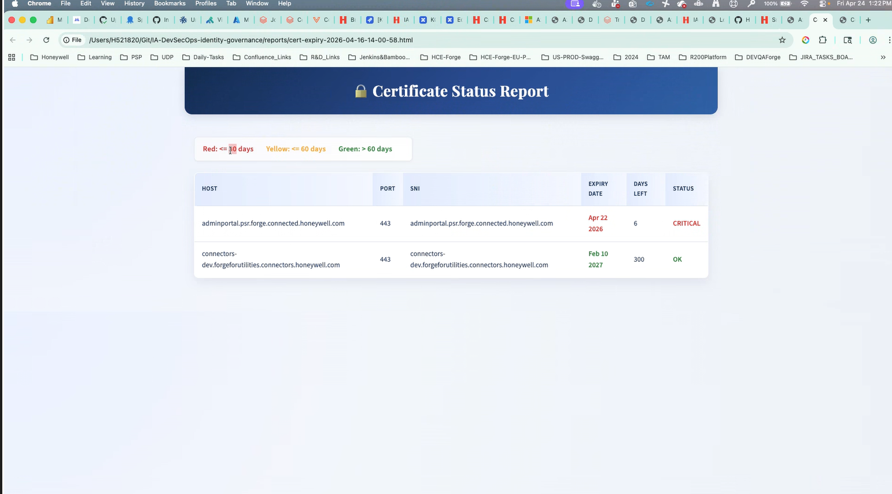
Demonstration
The check_certs.sh script performs live OpenSSL TLS handshakes against configured Honeywell domain endpoints and generates a timestamped HTML report. The report displays each host, port, SNI, expiry date, days remaining, and a colour-coded status. In the demo above, adminportal.psr.forge.connected.honeywell.com is flagged CRITICAL with only 6 days remaining, while connectors-dev.forgeforutilities.connectors.honeywell.com shows OK with 300 days left — demonstrating the three-tier classification in a real production environment.

Slide 13
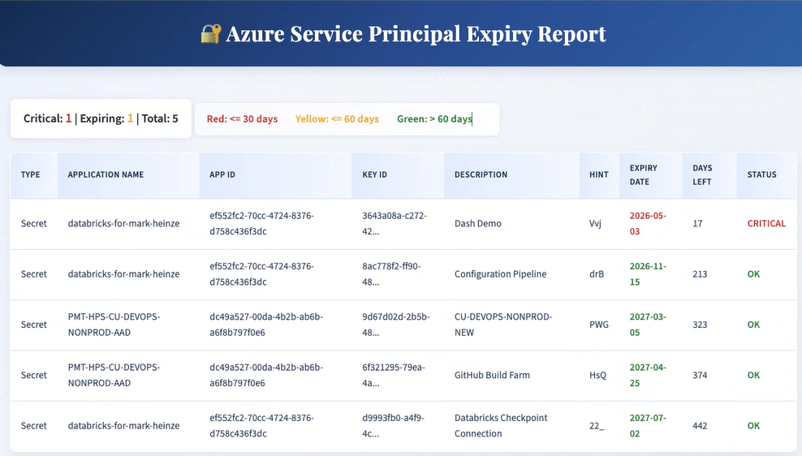
Demonstration
The check_azure_sp.py script queries Microsoft Graph API for all configured Azure AD application credentials and produces a timestamped HTML report. The demo shows 5 active credentials across two applications (databricks-for-mark-heinze and PMT-HPS-CU-DEVOPS-NONPROD-AAD), with the summary bar showing Critical: 1 | Expiring: 1 | Total: 5. The "Dash Demo" secret for databricks-for-mark-heinze is flagged CRITICAL at 17 days — only the hint (Vvj) is shown, never the full secret value, preserving security. Remaining credentials sorted by urgency show clearly actionable output.

Slide 14
Project Management and Cost
Project Management Approach
The project follows an Agile-inspired iterative delivery model with two-week sprint cycles. Each sprint delivers a tested, working increment of the system. Progress is tracked through GitHub Issues and Projects with weekly internal guide reviews.
Team Roles
Project Lead: Overall architecture, Azure integration, GitHub Actions workflows
Backend Developer: Python monitoring scripts, API integration, report generation
AI/ML Engineer: LangChain agent design, OPA policy development (proposed phase)
Documentation: Requirements, test plans, final report preparation
Tools Used for Project Management
GitHub Projects for task tracking and sprint board
GitHub Actions for CI/CD pipeline and automated testing
Microsoft Teams for internal communication and guide meetings

Slide 15
Project Management and Cost
Cost Estimation
Development tools including VS Code, Python, OPA, and GitHub are open source and free of cost.
Resource | Estimated Cost
Azure Virtual Machine (B2s, 1 month) | ~₹2,500
Azure Key Vault (standard tier) | ~₹800/month
Azure Monitor and Log Analytics | ~₹1,200/month
GitHub Actions (self-hosted runner) | Free (own hardware)
LangChain API usage (OpenAI backend) | ~₹3,000/month
Total Estimated Monthly Cost | ~₹7,500

Slide 16
Work done so far
Versioned JSON config files for TLS domains and Azure AD service principal targets
Private self-hosted GitHub Actions runner pool (hce-enterprise) provisioned and tested
TLS Certificate Monitor — live OpenSSL handshakes with SNI, custom port, and error isolation per domain
Azure SP Monitor — Microsoft Graph API integration for both client secrets and certificate credentials
Three-tier threshold classification: CRITICAL ≤ 30 days · EXPIRING ≤ 60 days · OK > 60 days
Colour-coded HTML reports generated with timestamps and rolling 15-report retention
Conditional SMTP email alerts — fires only when actionable credentials exist
Three GitHub Actions workflows: weekly TLS check, daily Azure SP check, full DevSecOps build pipeline
90-day artifact retention for all reports via GitHub Actions
All credentials stored as encrypted repository secrets — nothing hardcoded in source

Slide 17
Work to be done
Integrate LangChain AI agent for multi-dimensional NHI risk scoring (privilege scope, usage, dormancy, age)
Implement real-time anomaly detection for unusual identity access behaviour
Define OPA / Rego policy ruleset encoding organisational governance constraints
Build automated credential rotation pipeline triggered by AI agent upon policy violation
Integrate Azure Key Vault for secure credential regeneration and zero standing secrets
Deploy Azure-hosted real-time dashboard for NHI inventory and risk posture visibility
Build CISO-level audit log for SOC 2 and ISO 27001 compliance evidence
End-to-end integration, security boundary, and enterprise-scale performance testing
Final deployable NHI Governance Agent package with complete documentation

Slide 18
References
Ponemon Institute, "The 2024 State of Certificate Lifecycle Management," DigiCert Inc., 2024.
E. Barker, "Recommendation for Key Management: Part 1 – General," NIST Special Publication 800-57 Part 1 Rev. 5, National Institute of Standards and Technology, 2020.
Microsoft, "Azure Well-Architected Framework: Security — Identity and Access Management," Microsoft Learn Documentation, 2024.
Microsoft, "Application and Service Principal Objects in Azure Active Directory," Microsoft Identity Platform Documentation, 2024.
CISA, "Identity and Access Management Recommended Best Practices Guide for Administrators," Cybersecurity and Infrastructure Security Agency, 2023.
H. Chase et al., "LangChain: A Framework for Developing Applications Powered by Language Models," LangChain Documentation, LangChain Inc., 2024. [Online]. Available: https://docs.langchain.com
T. Topsakal and T. Akinci, "Creating Large Language Model Applications Utilizing LangChain: A Primer on Developing LLM Apps Fast," International Conference on Applied Engineering and Natural Sciences, 2023.
Open Policy Agent, "Policy-Based Control for Cloud Native Environments," CNCF OPA Documentation, 2024. [Online]. Available: https://www.openpolicyagent.org/docs
GitHub Inc., "GitHub Actions Documentation: Security Hardening for GitHub Actions," GitHub Docs, 2024.
B. Beyer, C. Jones, J. Petoff, and N. R. Murphy, Site Reliability Engineering: How Google Runs Production Systems, O'Reilly Media, 2016.

