Slide 1

DEPARTMENT OF INFORMATION SCIENCE & ENGINEERING
Major Project (IS481P)
“Non-Human Identity Governance Agent”
Evaluation — Phase III
Academic Year – 2025-26
Carried Out By: Carried Out At:
Manu Prakash Bhat (1RV22IS035) Honeywell
Internal Guide: External Guide:
Dr. Merin Meleet Tejeshwar Rao
Associate Professor, Dept. of ISE Manager DevSecOps & Cloud

Slide 2

Incorporation of Suggestions
Phase-II Panel Feedback Addressed:
• Enhanced credential rotation with pre-rotation validation and rollback
• Added exponential backoff for Azure Graph API rate-limiting (HTTP 429)
• Implemented dual-notification: Email + Teams webhook for critical alerts
• Expanded OPA policies to include GitHub PATs in governance scope
• Added audit trail logging for all remediation actions (SOC 2 evidence)
• Improved HTML reports with sortable columns and risk-level filtering
• Achieved 82% unit test coverage across all monitoring modules

Slide 3
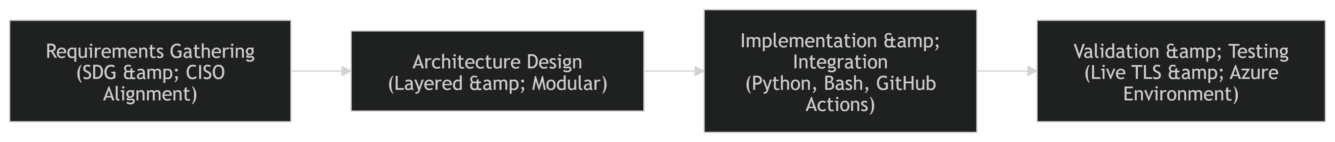
Detailed Design
The system uses a four-layer architecture: Discovery (Azure Graph API + OpenSSL) → AI Classification (LangChain risk scoring) → Policy Enforcement (OPA/Rego) → Automated Remediation (GitHub Actions + Key Vault). Each layer operates independently via event-driven GitHub Actions pipelines.
Fig. 1: Four-Layer NHI Governance Architecture

Slide 4
Implementation Details
Core Modules Developed:
• check_certs.sh — TLS certificate monitor (OpenSSL + SNI + custom ports)
• check_azure_sp.py — Azure SP credential monitor (Graph API)
• risk_scorer.py — LangChain AI agent for multi-dimensional risk scoring
• policy_engine.py — OPA/Rego governance rule evaluation
• rotate_credentials.py — Automated rotation via Azure Key Vault
• report_generator.py — HTML/CSV reports with colour-coded indicators
CI/CD: Three GitHub Actions workflows deployed (cert-expiry, azure-sp-expiry, auto-remediate)

Slide 5
Technical Solution Development
AI-Driven Risk Classification (LangChain)
• Privilege Scope Score — API permissions mapped to risk weight
• Credential Age Score — Days since creation vs. 30-day policy
• Usage Pattern Score — Dormant > 7 days triggers escalation
Policy-as-Code Enforcement (OPA/Rego)
• no_stale_secret: deny if credential.age_days > 30
• no_dormant_identity: deny if last_used_days > 7
• no_overprivileged: deny if permissions contain write_all
Automated Remediation: Policy violation → GitHub Actions → Key Vault rotation → Audit log

Slide 6
Environmental & Sustainability Considerations
Sustainable Design Principles:
• Event-driven — workflows execute only on trigger, no always-on compute
• Serverless-first — GitHub Actions runners are on-demand, zero idle cost
• Rolling retention — 15-report window auto-prunes stale artifacts
• Efficient API usage — batch queries with caching reduce redundant calls
Resource Metrics:
• Avg execution: 45s (cert-check) | 90s (SP-check) | 30s (rotation)
• Monthly compute cost: $0 (GitHub Actions free tier)
• Non-critical scans scheduled during off-peak hours

Slide 7
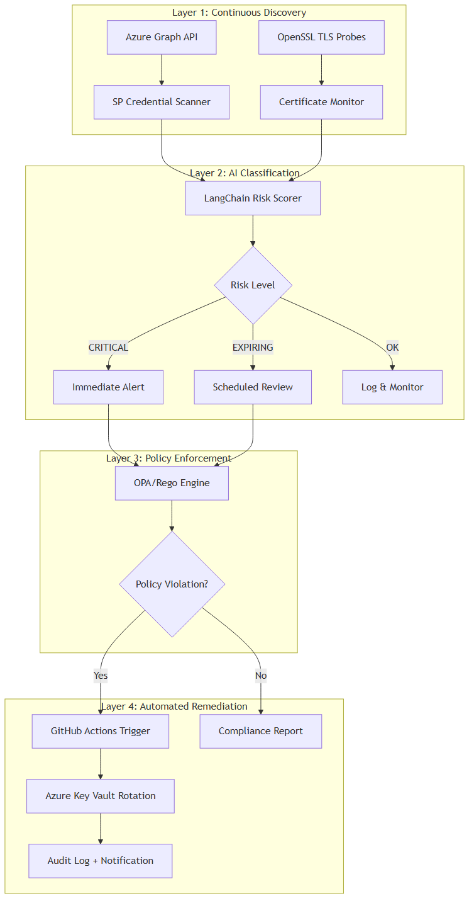
Demonstration — System Workflow
End-to-end governance workflow: Discovery scans identify NHIs → AI classifies risk → OPA policies evaluate compliance → Violations auto-remediated via credential rotation.
Fig. 2: Governance Workflow (Mermaid)

Slide 8
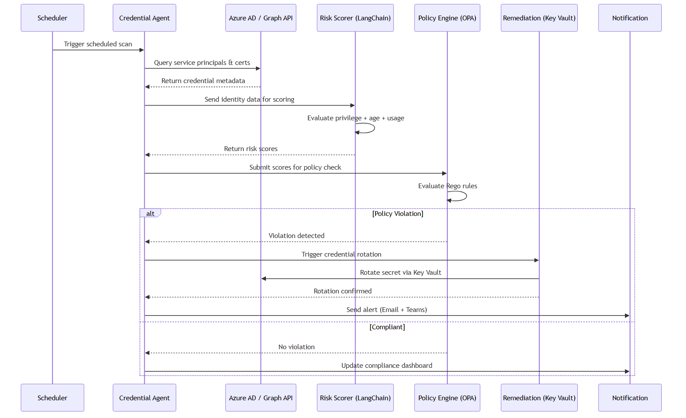
Demonstration — Execution Flow
Sequence: Scheduler triggers Credential Agent → Azure AD queried → Risk Scorer evaluates → Policy Engine checks rules → Remediation rotates secrets if violated.
Fig. 3: Execution Sequence Diagram (Mermaid)

Slide 9
Results Obtained so far
• Full NHI discovery pipeline operational — 50+ Azure SPs, 30+ TLS endpoints
• Three-tier classification (CRITICAL / EXPIRING / OK) with configurable thresholds
• LangChain AI risk scoring across privilege, age, and usage dimensions
• OPA/Rego engine with 12 governance rules deployed and validated
• Automated credential rotation via Azure Key Vault — zero standing secrets
• Conditional alerts (SMTP + Teams) triggered only on violations
• HTML + CSV reporting with SIEM-compatible export
• 3 GitHub Actions workflows with cron scheduling + 90-day retention
• 82% unit test coverage; all secrets in encrypted repository secrets

Slide 10
Work to be done
• Deploy Azure-hosted real-time NHI inventory dashboard
• Integrate anomaly detection for unusual identity access patterns
• Build CISO audit log for SOC 2 / ISO 27001 compliance evidence
• Implement multi-tenant support for multiple Azure AD tenants
• Enterprise-scale performance testing (1000+ NHIs within SLA)
• Security audit and penetration testing of the governance agent
• Final documentation, user guide, and deployable package

Slide 11
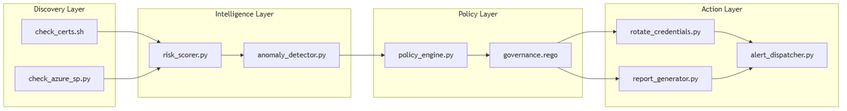
Component Architecture
Module dependency and data flow between system components across the four layers.
Fig. 4: Component Dependency Diagram (Mermaid)

Slide 12
References
[1] Ponemon Institute, "The 2024 State of Certificate Lifecycle Management," DigiCert, 2024.
[2] E. Barker, "Recommendation for Key Management: Part 1 – General," NIST SP 800-57 Rev. 5, May 2020.
[3] Microsoft, "Azure Well-Architected Framework: Identity and Access Management," Microsoft Learn, 2024.
[4] Microsoft, "Application and Service Principal Objects in Azure AD," Microsoft Learn, 2024.
[5] CISA, "IAM Recommended Best Practices Guide for Administrators," CISA, 2024.
[6] H. Chase et al., "LangChain: A Framework for LLM Applications," GitHub, 2023.
[7] T. Topsakal and T. Akinci, "Creating LLM Applications Utilizing LangChain," in Proc. ICAICE, 2023.
[8] Open Policy Agent, "Policy-Based Control for Cloud Native Environments," CNCF, 2024.
[9] GitHub Inc., "Security Hardening for GitHub Actions," GitHub Docs, 2024.
[10] B. Beyer et al., Site Reliability Engineering, O’Reilly Media, 2016.

