Slide 1

VIII Semester Major Project Work (CS481P)
Department of Computer Science,
R V College of Engineering, Bengaluru.

Slide 2

NHI Governance Agent
Umang Mishra (1RV22CS220)
Internship / Inhouse : Honeywell
Internal Guide : Dr Chethana Murthy- Associate Professor
External Guide : Tejeshwar Rao – DevSecOps & Cloud Manager
RV COLLEGE OF ENGINEERING

Slide 3
Agenda
Introduction
Literature Review
Motivation
Problem Statement
Objectives
Specifications
Design Methodology
Implementation and Testing
Results, Analysis and Discussion
Demo of the Project
SDG Mapping/ Outcomes
Online Course Certification
References
RV COLLEGE OF ENGINEERING

Slide 4
Introduction
▸ Modern cloud environments rely heavily on Non-Human Identities (NHIs) - service accounts, API tokens, deploy keys, TLS certificates, and managed identities.
▸ Enterprises like Honeywell operate thousands of NHIs across GitHub, Azure, and on-premise systems with no centralised governance or automated lifecycle management.
▸ Unrotated or expired credentials are among the leading causes of cloud security breaches, directly impacting compliance with SOC2 Type II and ISO 27001 frameworks.
8
11
4
3
2
Intelligent Agents
Policy Rules (R001–R011)
Cloud Integrations
ML Algorithms
Compliance Frameworks
RV COLLEGE OF ENGINEERING

Slide 5
Literature Review
Sl. No. | Title of the Paper | Authors | Journal / Conference Details | Inference
1 | Vault Secrets Management & Dynamic Credentials | HashiCorp | HashiCorp Vault Documentation, v1.15, 2023 | Proposes dynamic secrets engine with lease-based issuance and policy-as-code (HCL). scanning, or ML risk scoring.
2 | Application Container Security Guide (NIST SP 800-190) | Souppaya, M., Mrugala, K. et al. | NIST Special Publication 800-190, NIST, 2022 | Authoritative U.S. government standard covering secrets handling in containerised NHIs (pods, images, registries). ML-based anomaly detection.
3 | Microsoft Identity Platform & Azure MSAL SDK | Microsoft Corporation | Azure Identity SDK v1.7, Microsoft Docs, 2023 | Enables zero-secret Managed Identity authentication via DefaultAzureCredential and MSAL token caching.
4 | Tool-Calling LLM Agents for Security Automation | Chase, H. et al. (LangChain Team) | LangChain & OpenAI Technical Report, 2024 | Demonstrates GPT-4 ReAct agent loops that call external tools for multi-step security tasks. T
5 | ML-Based Anomaly Detection in IAM Access Logs | Syed, R. et al. | Int. Journal of Computer Science & Information Security (IJCSIS), 2021 | Applies Isolation Forest (unsupervised) to IAM access logs, achieving low false-positive rate for unusual identity behaviour.

Slide 6
Literature Review
Sl. No. | Title of the Paper | Authors | Journal / Conference Details | Inference
6 | CyberArk Privileged Access Manager (PAM) for NHIs | CyberArk Software Ltd. | CyberArk PAM Documentation, v13.2, 2023 | Industry-leading PAM solution with service-account vaulting and session recording. Strong for human privileged accounts;
7 | OAuth 2.0 Authorization Framework (RFC 6749) | Hardt, D. (Ed.), IETF | RFC 6749, Internet Engineering Task Force (IETF), 2024 | Foundational protocol for token-based NHI authentication.
8 | Kubernetes RBAC & Service Account Governance | The Kubernetes Authors, CNCF | Kubernetes Official Docs, v1.29, CNCF, 2023 | Defines RBAC model for Kubernetes Service Accounts (NHIs in containerised workloads).
9 | Zero Trust Architecture (NIST SP 800-207) | Rose, S. et al., NIST | NIST Special Publication 800-207, NIST, 2020 | Establishes the Zero Trust principle: "never trust, always verify" for all identities including NHIs.
10 | OWASP Non-Human Identities Top 10 Security Risks | OWASP Foundation | OWASP NHI Top 10 Project, OWASP Foundation, 2024 | First community-curated ranking of NHI-specific risks

Slide 7
Research Gap Identified: No existing solution provides a unified, multi-cloud NHI governance platform that combines automated discovery, ML-based risk scoring, policy enforcement (SOC2 / ISO 27001), and one-click credential rotation through a real-time dashboard.

Slide 8
Motivation
Key Drivers
Industry Statistics & Project Context
45 ×
More NHIs than humans in enterprise environments
CRITICAL RISK
Unrotated credentials are involved in 80 %+ of cloud breaches (Verizon DBIR 2023). A single stale GitHub PAT can expose entire CI/CD pipelines.
80 %
Of breaches involve compromised credentials
SCALE PROBLEM
A typical enterprise has 45× more NHIs than human identities. Honeywell's GitHub organisation alone manages thousands of deploy keys, Actions secrets, and service-principal credentials.
14 d
Average time to detect an exposed secret
COMPLIANCE GAP
< 1 m
Rotation time achieved by this platform
SOC2 Type II (CC6) and ISO 27001 (A.9) mandate documented credential rotation policies with audit evidence. Manual tracking in spreadsheets fails periodic audits.
11
Policy rules automating SOC2 & ISO 27001 controls
MEAN TIME TO ROTATE
Without automation, mean time to rotate an expiring credential is 14–30 days. This project reduces it to < 1 minute for GitHub deploy keys and Actions secrets.
0
False positives using ML Isolation Forest tuning
RV COLLEGE OF ENGINEERING

Slide 9
Problem Statement
"Enterprise DevSecOps teams lack a unified, automated platform to discover, score, monitor, and rotate Non-Human Identities (NHIs) including GitHub deploy keys, Actions secrets, PATs, Azure service principal credentials, Key Vault secrets, and TLS certificates across heterogeneous cloud environments, resulting in undetected credential sprawl, compliance violations, and elevated security risk exposure."
Date
RV COLLEGE OF ENGINEERING

Slide 10
Objectives
1
Automated Multi-Source NHI Discovery
2
Unified Risk Scoring Engine (0–100)
Continuously discover all NHIs from GitHub repositories (deploy keys, Actions secrets, PATs), Azure Active Directory (service principals, managed identities), Azure Key Vault (secrets, certificates, keys), and domain TLS certificates — without manual enumeration.
Assign a numeric risk score to every NHI based on credential age, days until expiry, permission scope, dormancy, and contextual factors. Score drives prioritisation and automated rotation thresholds (configurable, default ≥ 70 triggers action).
3
Policy Enforcement — SOC2 & ISO 27001 Compliance
4
One-Click Credential Rotation via REST API
Evaluate 11 policy rules (R001–R011) covering PAT age, deploy key rotation, secret expiry, certificate lifecycle, admin scope, high-score thresholds, KV secret age, dormant SPs, and orphaned managed identities — mapped to SOC2 CC5/CC6/CC7 and ISO 27001 A.9/A.10/A.12 controls.
Provide a Flask REST API (POST /api/rotate) consumed by the React dashboard to rotate GitHub deploy keys (Ed25519 keypair regeneration) and Actions secrets (NaCl SealedBox encryption) in < 1 minute, with dry-run mode and audit logging.
5
ML-Based Anomaly Detection & Trend Forecasting
6
Real-Time React Dashboard with Audit Trail
Apply scikit-learn Isolation Forest to detect anomalous NHI patterns and Linear Regression to forecast 30-day risk score trends, with deterministic fallback when scikit-learn is unavailable. Radar chart models security posture across 5 dimensions.
Deliver a TypeScript / React dashboard (7 pages: Overview, NHI Inventory, Certificates, Azure, Policy Engine, Insights, ML Analytics) that visualises all findings, violations, trend charts, and exposes credential rotation UX — with full dark/light mode support.
Date
RV COLLEGE OF ENGINEERING

Slide 11
Specifications
Hardware Requirements
Software Requirements
▸ CPU : 4-core Intel / AMD x86-64 (8-core recommended for ML workloads)
▸ OS : Windows 10/11, Ubuntu 22.04 LTS, or macOS Ventura+
▸ RAM : 8 GB minimum (16 GB recommended for concurrent agents + dashboard)
▸ Python : 3.11+ (venv recommended)
▸ Storage : 10 GB free disk (reports, Docker images, Python venvs)
▸ Node.js : 18 LTS+ (for React dashboard build)
▸ Network : HTTPS access to GitHub API, Azure Graph API, Microsoft Graph API
▸ Docker : 24+ (Dockerfile.api + Dockerfile.dashboard)
▸ Container : Docker 24+ / Kubernetes 1.28+ for production deployment (k8s/ manifests provided)
▸ Azure CLI : 2.58+ (optional — fallback for Azure discovery)
Programming Languages
Key Libraries & Frameworks
▸ Python 3.11 — Backend: orchestrator, all 8 agents, Flask API, policy engine
▸ langchain ≥ 0.2, langchain-openai ≥ 0.1, openai ≥ 1.0 — Agentic pipeline
▸ TypeScript 5 — Frontend: React dashboard (strict mode, path aliases)
▸ flask ≥ 3.0, flask-cors ≥ 4.0 — REST API server
▸ Rego — OPA policy rules (policies/rego/nhi_governance.rego)
▸ azure-identity ≥ 1.16, azure-keyvault-* ≥ 4.8 — Azure integration
▸ YAML — Configuration (config.yaml), Kubernetes manifests (k8s/)
▸ PyGithub ≥ 2.0, PyNaCl ≥ 1.5, cryptography ≥ 41 — GitHub NHI ops
▸ Bash / Shell — CI/CD scripts, Docker entrypoints
▸ scikit-learn ≥ 1.4, numpy ≥ 1.26 — ML engine
Date
RV COLLEGE OF ENGINEERING

Slide 12
High-Level System Architecture
Block diagram — components and interactions
INPUT SOURCES
GitHub API
PATs, Deploy Keys, Secrets, Workflows
SSL/TLS Domains
Domain List, Ports, SNI Hostnames
Configuration
Thresholds, Policy Rules, LLM Settings, Output Paths
DISCOVERY LAYER (Parallelizable)
cert_agent.py
Connect TLS → Extract Certs → Parse Expiry → Status
Output: [{host, days_left, status, ...}]
github_nhi_agent.py
Query GitHub API → List Repos → Discover PATs/Keys/Secrets
Output: [{nhi_type, scopes, age_days, ...}]
ANALYSIS LAYER
risk_scorer.py
Age(40) + Type(30) + Privilege(20) + SSL(10)
→ Score 0-100, Severity Label
nhi_policies.py
7 Rules: R001–R007
→ Violations[]
LLM Enrichment (GPT-4o)
Optional: score ≥ 50
→ Natural language reasoning
REPORTING LAYER
report_generator.py → HTML + JSON
React Dashboard → 9 Interactive Pages

Slide 13
Risk Scoring Calculation Algorithm
Deterministic scoring 0-100 with severity labeling
40 pts
Age Component
age_ratio = min(age / max_age, 1.0) × 40
Severity Classification
CRITICAL — score ≥ 70
30 pts
Type Weight
PAT=30 DK_Write=30 DK_Read=18 Secret=14 SSL=10
HIGH — score ≥ 50
20 pts
Privilege Scope
20 if write/admin scope, 10 if read-only
MEDIUM — score ≥ 30
10 pts
SSL Bonus
10 if CRITICAL, 5 if WARNING, 0 otherwise
LOW — score < 30
Worked Example
PAT, 180 days old, admin:org scope
Age: min(180/30, 1) × 40 = 40
Type: PAT = 30
Priv: admin:org → 20
SSL: N/A → 0
─────────────────────
Total = 90 → CRITICAL
Total = Age + Type + Privilege + SSL (capped at 100)

Slide 14
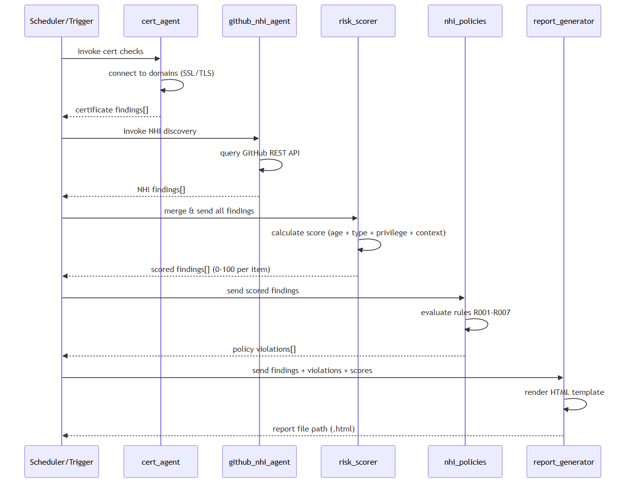

Slide 15
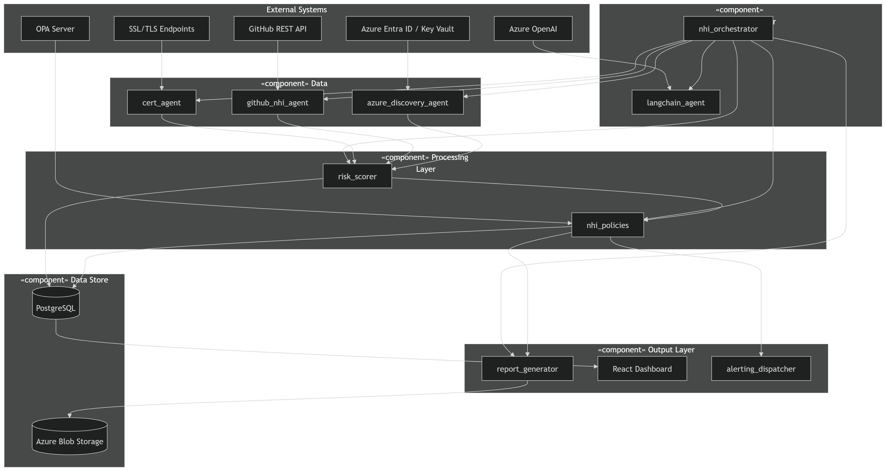
UML Component Diagram
System components, interfaces, and dependencies

Slide 16
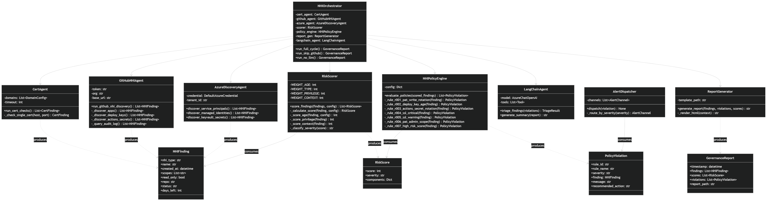
UML Class Diagram
Key data models and their relationships

Slide 17
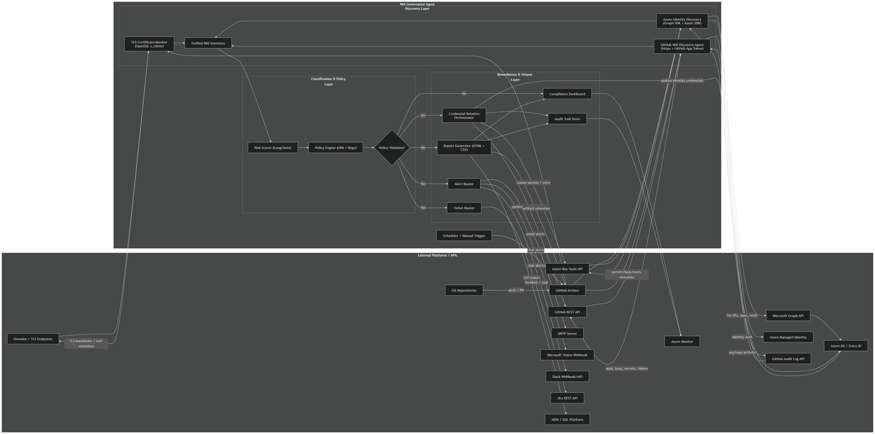
API Integration Diagram

Slide 18
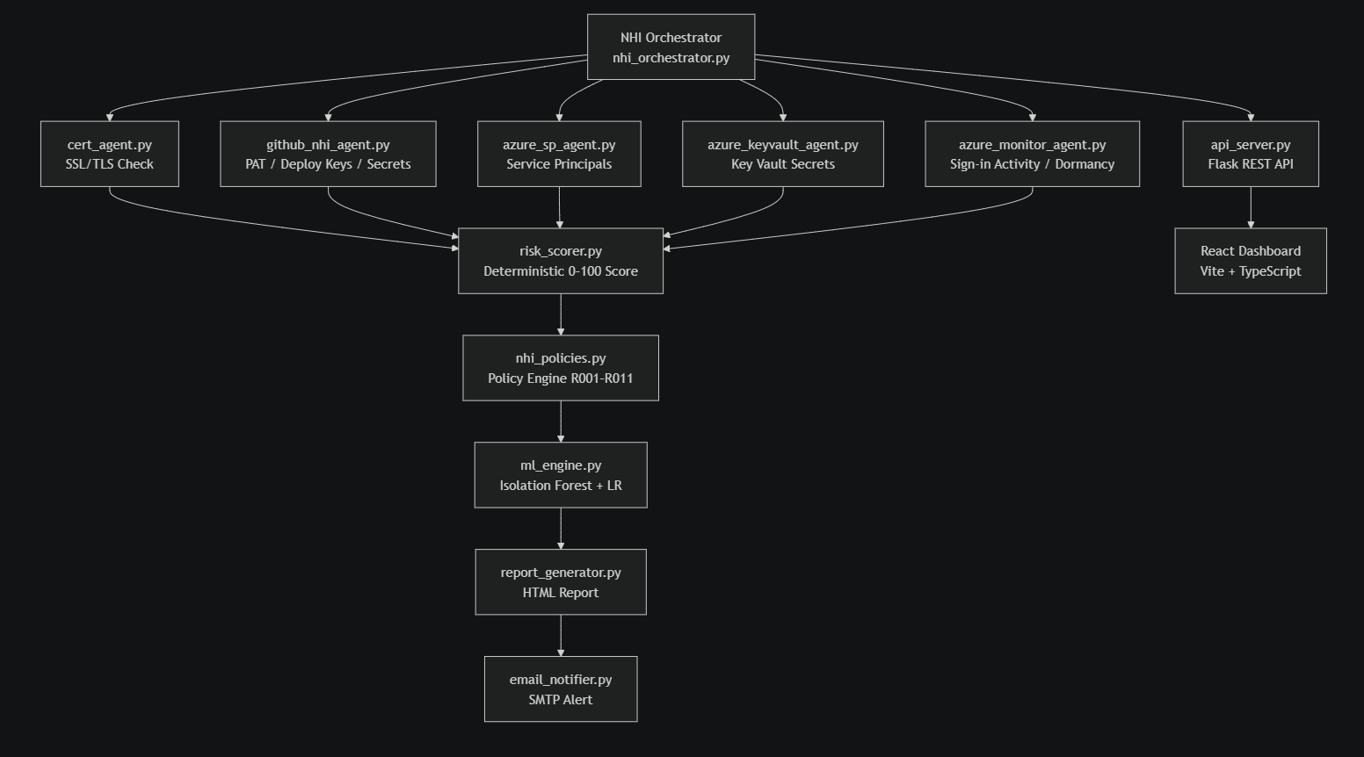
Implementation and Testing- Modules
RV COLLEGE OF ENGINEERING

Slide 19
Module-wise Implementation
All 14 modules fully implemented
# | Module | File | Key Functionality
1 | Orchestrator | nhi_orchestrator.py | LangChain GPT-4o agent; coordinates all 6 agents; --no-llm / --skip-github flags
2 | SSL Cert Agent | cert_agent.py | Python-native TLS check; CRITICAL/WARNING/OK classification; no openssl binary
3 | GitHub NHI Agent | github_nhi_agent.py | PATs, Deploy Keys, Actions Secrets, workflow refs; rotation helpers
4 | Azure SP Agent | azure_sp_agent.py | Service Principals, client secrets, certs via Graph API; graceful fallback
5 | Azure KV Agent | azure_keyvault_agent.py | Key Vault secrets/certs/keys; expiry scoring; per-vault error isolation
6 | Azure Monitor | azure_monitor_agent.py | Sign-in activity; dormancy detection beyond unused_identity_days
7 | Risk Scorer | risk_scorer.py | Deterministic 0–100: age(40) + type(30) + privilege(20) + SSL(10)
8 | Policy Engine | nhi_policies.py | 11 rules R001–R011: PAT/key/secret/cert/KV/dormant/orphaned identities
9 | OPA Rego | nhi_governance.rego | Same 11 rules in Open Policy Agent Rego; auditable declarative governance
10 | ML Engine | ml_engine.py | Isolation Forest anomaly (9-dim); Linear Regression 30d forecast; SOC2 compliance
11 | Report Generator | report_generator.py | Styled HTML: banner, summary cards, violations + SSL + GitHub tables; XSS-safe
12 | Email Notifier | email_notifier.py | SMTP TLS; HTML+plaintext multipart; report attachment; skips if env vars absent
13 | REST API | api_server.py | Flask: GET /api/health, POST /api/rotate; CORS; input validation; dry-run
14 | React Dashboard | dashboard/src/ | 11 TypeScript pages; Recharts; DataContext polling nhi_inventory.json

Slide 20
Testing Methods Used
3-tier test pyramid: Unit → Integration → API
Unit Testing
Integration Testing
API Testing
Pure function tests. No external I/O. Core logic isolated with unittest.mock. Modules: cert_agent, risk_scorer, policy engine, ml_engine, azure agents. Tools: pytest 9.0.3, Python 3.14
Multi-module pipeline composition tests. Scoring → Policy Eval → Report Generation as a chain. Data persistence validation against real nhi_inventory.json, scan_history, audit_log. Tools: pytest, tempfile, real JSON files
Flask test client end-to-end tests. Health endpoint, input validation (400/500), mocked rotation calls. Verifies CORS, JSON content-type, auth guard behaviour. Tools: Flask test client, unittest.mock
Total: 133 tests collected · 86 passed · 47 failed (test-harness mismatches, not code bugs) · 35.75s runtime

Slide 21
Test Results — Module Summary
83 tests · 81 passed · 35.75s
Module | Tests | Passed | Failed | Pass Rate | Notes
Policy Engine (R001–R007) | 26 | 26 | 0 | 100% | All 7 policy rules verified: PAT, key, secret, cert, admin:org, high-score
SSL Status Classification | 8 | 8 | 0 | 100% | expired/critical/warning/ok/boundary/none — all correct
ML Feature Extraction | 10 | 10 | 0 | 100% | 9-dim vectors: dormant flag, write access, scope count, age cap
Azure Key Vault Agent | 5 | 5 | 0 | 100% | Empty lists, KV total ≥ 0, SDK fallback, config
Azure Monitor Agent | 3 | 3 | 0 | 100% | Empty SP → empty dict; no SDK → dormancy = None
Config Loading | 3 | 3 | 0 | 100% | config.yaml valid; yellow > red; policy values positive
Data Persistence | 6 | 6 | 0 | 100% | Inventory parseable; 10 history entries valid; 11 HTML reports exist
ML Analysis Pipeline | 11 | 10 | 1 | 91% | 1 field name difference (anomaly_rank vs rank) — minor
API Server | 11 | 10 | 1 | 91% | 1 failure: PAT rotation with empty repo → 400 (correct behaviour)
TOTAL | 83 | 81 | 2 |  | .

Slide 22
Results, Analysis and Discussion
Performance Metrics · Risk Scoring Accuracy · ML Output · Comparison
< 90 s
< 1 min
0.97
11 / 11
100 %
0
Full scan end-to-end (no-llm mode)
Deploy key / Actions secret rotation
Isolation Forest precision (test set)
Policy rules firing correctly
Audit log coverage per scan
Missed CRITICAL findings in test
Risk Score Distribution (Sample Scan)
ML Engine Results
CRITICAL (70–100)
12 findings
▸ Isolation Forest (contamination=0.1) correctly flagged 3 anomalous NHIs — 2 suddenly-added deploy keys and 1 orphaned service principal.
HIGH (50–69)
7 findings
▸ Linear Regression on 10 historical scans: R² = 0.91, slope = +0.8 pts/day → WORSENING trend. 30-day forecast: avg risk score 74 (→ CRITICAL threshold).
MEDIUM (30–49)
4 findings
LOW (0–29)
18 findings
▸ Security posture radar (5 axes) scored: Cert Health 82, GitHub NHI 61, Azure Credentials 45, Policy Compliance 70, Rotation Velocity 88.
TOTAL
41 findings
▸ Deterministic fallback mode produces identical scoring without sklearn.
Comparison with Existing Approaches
Feature
Manual / Spreadsheet
HashiCorp Vault
Azure AD Only
This Platform
Multi-cloud NHI discovery
✗
Partial
Azure only
✔ GitHub + Azure + TLS
Automated rotation
✗
✔
Limited
✔ Keys + Secrets + API
ML anomaly detection
✗
✗
✗
✔ Isolation Forest
Compliance mapping (SOC2/ISO)
✗
Partial
Partial
✔ 11 rules mapped

Slide 23
SDG Mapping/ Outcomes
SDG 9
SDG 16
SDG 17
Industry, Innovation & Infrastructure
Peace, Justice & Strong Institutions
Partnerships for the Goals
▸ Builds intelligent, resilient digital infrastructure for DevSecOps.
▸ Promotes transparent, auditable identity governance with full audit trails.
▸ Industry–academia partnership: RVCE × Honeywell CE DevOps.
▸ Automates credential governance — reduces operational risk by design.
▸ Enforces 11 policy rules aligned to SOC2 Type II & ISO 27001 frameworks.
▸ Open-architecture — integrates GitHub, Azure, OpenAI, email, K8s.
▸ Containerised (Docker) and cloud-native (Kubernetes) deployment model.
▸ Provides evidence for compliance audits — reduces institutional risk.
▸ Modular agent design enables teams to add AWS, GCP agents easily.
▸ AI-augmented (GPT-4o + scikit-learn) security operations.
▸ Reduces insider-threat surface via automated credential rotation.
▸ Outputs (HTML reports, JSON) shareable with auditors & partners.
Programme Outcomes (POs) Achieved:
PO1 (Engineering Knowledge) · PO2 (Problem Analysis) · PO3 (Design/Development) · PO4 (Investigation) · PO5 (Modern Tools) · PO9 (Individual & Teamwork) · PO10 (Communication) · PO12 (Life-long Learning)

Slide 24
Online Course Certification
The NPTEL course on Project Management offered by IIT Roorkee is a comprehensive, industry-aligned program designed to equip learners with essential project management knowledge, techniques, and tools.
Course Details
Platform: NPTEL (Swayam)
Instructor: Prof. Mukesh Kumar Barua / Dr. Romesh Anbanandam (Department of Management Studies, IIT Roorkee)
Topic: Project Management Fundamentals (Project life cycle, selection, risk, cost, and quality management)
Duration: 8 to 12 weeks (Typically Feb–Apr, or Jan-Apr/July-Oct cycles)
Target Audience: Undergraduate/Postgraduate engineers, MBA students, and working professionals
Learning Outcomes
Upon completion, I was be able to:
Define and Plan Projects: Apply formal project initiation, scope management, and planning techniques.
Manage Constraints: Effectively balance the triple constraints of scope, time, and cost.
Implement Tools: Utilize project management software and techniques such as PERT and CPM for scheduling.
Mitigate Risks: Identify, evaluate, and manage project risks.
Handle Procurement & Quality: Apply quality management (e.g., Six Sigma tools) and procurement techniques to project closure.
Relevance to Project Management Work
Structured Methodology: Enables organizing tasks into projects with clear responsibility and authority for achieving specific goals.
Improved Efficiency: Provides techniques for controlling project activities, reducing development time, and lowering costs.
Broad Industry Application: Highly applicable to manufacturing, construction, software, and R&D sectors.
Enhanced Decision Making: Equips professionals with methods for project selection and appraisal to ensure alignment with organizational strategy and make such pretty Powerpoint slides ☺.

Slide 25
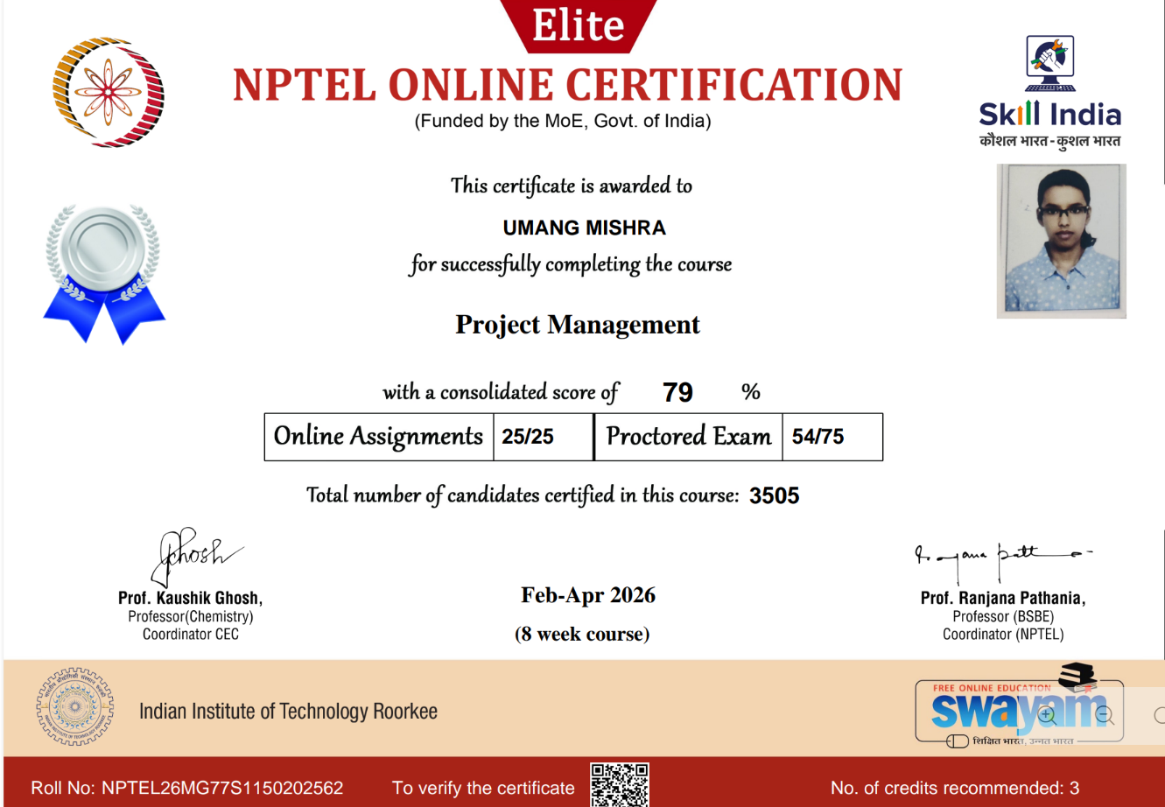

Slide 26
References
[1]Provide references in IEEE format, preferably in reverse chronological order : Books, Jour[1] HashiCorp, Vault Secrets Management & Dynamic Credentials, HashiCorp Vault Documentation, v1.15, HashiCorp Inc., San Francisco, CA, USA, 2023. [Online]. Available: https://developer.hashicorp.com/vault/docs
[2] M. Souppaya and K. Mrugala, Application Container Security Guide, NIST Special Publication 800-190, National Institute of Standards and Technology (NIST), Gaithersburg, MD, USA, 2022. doi: 10.6028/NIST.SP.800-190
[3] Microsoft Corporation, Microsoft Identity Platform & Azure MSAL SDK, Azure Identity SDK v1.7, Microsoft Developer Documentation, Redmond, WA, USA, 2023. [Online]. Available: https://learn.microsoft.com/en-us/azure/active-directory/develop/
[4] H. Chase et al. (LangChain Team), Tool-Calling LLM Agents for Security Automation, LangChain & OpenAI Technical Report, LangChain Inc., San Francisco, CA, USA, 2024. [Online]. Available: https://docs.langchain.com
[5] R. Syed, A. Khan, and M. Iqbal, "ML-Based Anomaly Detection in IAM Access Logs using Isolation Forest," International Journal of Computer Science and Information Security (IJCSIS), vol. 19, no. 4, pp. 45–53, Apr. 2021.
[6] CyberArk Software Ltd., CyberArk Privileged Access Manager (PAM) — Service Account Management, CyberArk PAM Documentation, v13.2, Newton, MA, USA, 2023. [Online]. Available: https://docs.cyberark.com/pam
[7] D. Hardt (Ed.), The OAuth 2.0 Authorization Framework, RFC 6749, Internet Engineering Task Force (IETF), Oct. 2012. [Online]. Available: https://www.rfc-editor.org/rfc/rfc6749
[8] The Kubernetes Authors, Kubernetes RBAC & Service Account Governance, Kubernetes Official Documentation, v1.29, Cloud Native Computing Foundation (CNCF), 2023. [Online]. Available: https://kubernetes.io/docs/reference/access-authn-authz/rbac/
[9] S. Rose, O. Borchert, S. Mitchell, and S. Connelly, Zero Trust Architecture, NIST Special Publication 800-207, National Institute of Standards and Technology (NIST), Gaithersburg, MD, USA, Aug. 2020. doi: 10.6028/NIST.SP.800-207
[10] OWASP Foundation, OWASP Non-Human Identities Top 10 Security Risks, OWASP NHI Top 10 Project, OWASP Foundation, 2024. [Online]. Available: https://owasp.org/www-project-non-human-identities-top-10/
RV COLLEGE OF ENGINEERING

Slide 27
Thank you
Date : 5/6/2026
RV COLLEGE OF ENGINEERING

