Slide 1
Project: Analyze Oil Stocks Based on Social Sentiments.
George
Alejandro
Manu
Rajat (Kaura Rocks)
Notes:
This template can be used as a starter file to give updates for project milestones.
Sections
Right-click on a slide to add sections. Sections can help to organize your slides or facilitate collaboration between multiple authors.
Notes
Use the Notes section for delivery notes or to provide additional details for the audience. View these notes in Presentation View during your presentation.
Keep in mind the font size (important for accessibility, visibility, videotaping, and online production)
Coordinated colors
Pay particular attention to the graphs, charts, and text boxes.
Consider that attendees will print in black and white or grayscale. Run a test print to make sure your colors work when printed in pure black and white and grayscale.
Graphics, tables, and graphs
Keep it simple: If possible, use consistent, non-distracting styles and colors.
Label all graphs and tables.

Slide 2
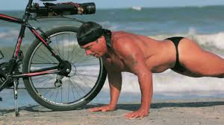
Project Overview:
Goal
Find correlation between Oil Stocks Price Vs Social Sentiments.
Hypothesis
Social Sentiment is correlated (~ >50%) to Oil or any other commodity Stocks.
Motivation
Investors can make smart decisions in terms of investing/divesting stocks based on the Social sentiments.
Notes:
What is the project about?
Define the goal of this project
Is it similar to projects in the past or is it a new effort?
Define the scope of this project
Is it an independent project or is it related to other projects?
* Note that this slide is not necessary for weekly status meetings

Slide 3

Key Q’s and Data Sources:
Why we believe in our Hypothesis?
What Stocks should we pick?
Can we predict Stock price movement using Sentiment Analysis?
Sources
Twitter
Watson IBM (Natural Language Processing)
Vader Sentiment
Alphavantage API (Stocks)
Quandl API
Notes:
* If any of these issues caused a schedule delay or need to be discussed further, include details in next slide.

Slide 4

Our Analytical Approach:
Data Access
Data Prepare
Visualize
Validate
Analyze
Python
Pandas
Clean &
Merge
Vader
IBM Watson
Matplotlib
Seaborn
Regression
T Test
Alphavantage
Alpha Vantage
Notes:
Duplicate this slide as necessary if there is more than one issue.
This and related slides can be moved to the appendix or hidden if necessary.

Slide 5
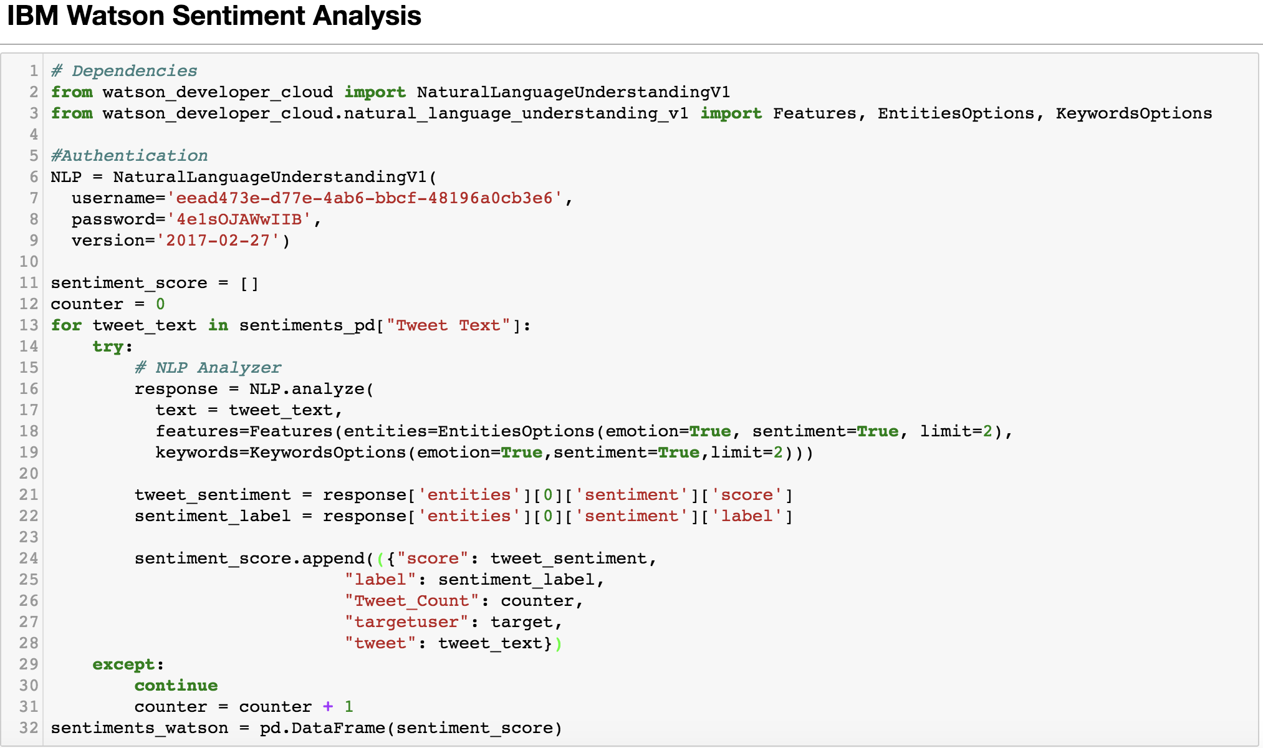
Sentiments Code Review:

Slide 6
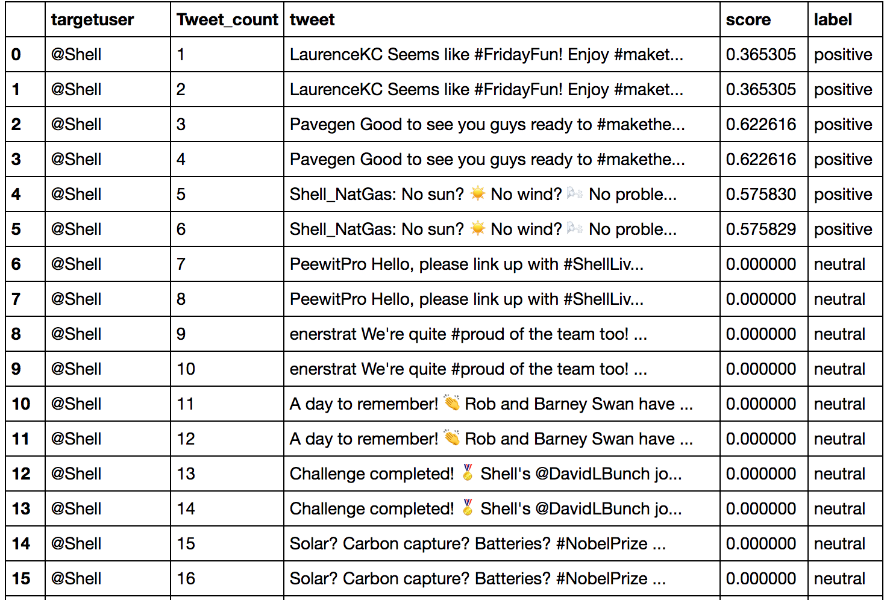
Sentiments Code Review:
DataFrame: Sentiments_watson

Slide 7
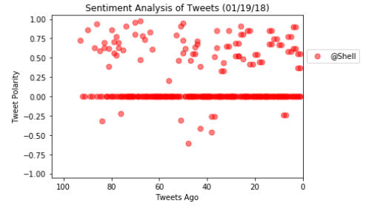
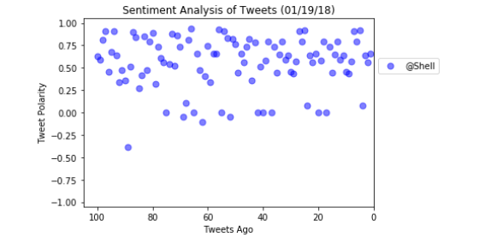
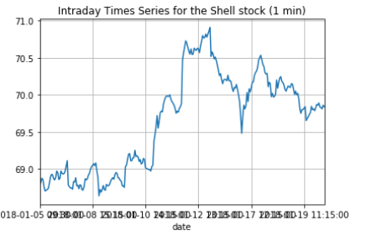
Data Visualization (‘Vader’ Vs ‘IBM Watson’):
Stock trend based on above sentiment.

Slide 8
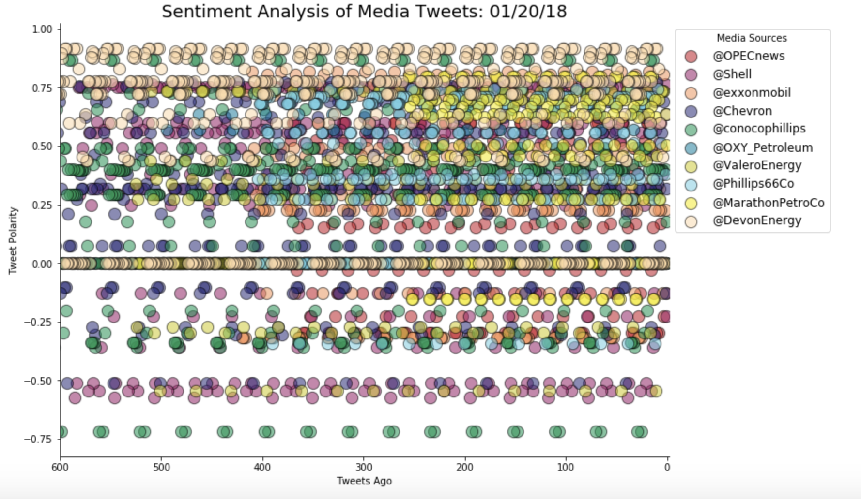
Vader Sentiment:

Slide 9
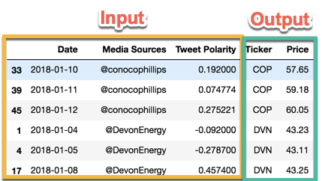
Stocks Code Review:
Processes
Learning Opportunities
API call for each day and each ticker
Returns NaN value on weekends and holidays
The free version data source (Quandl) doesn’t provide the latest pricing

Slide 10
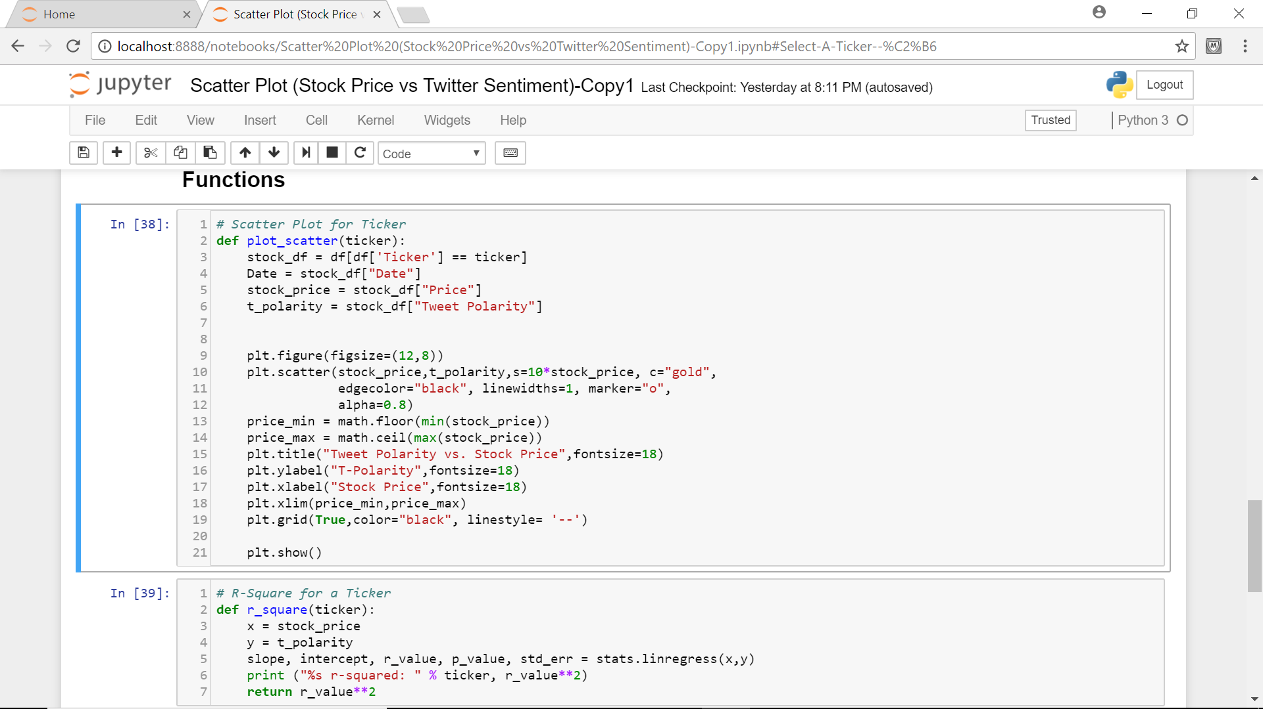
Analytical Codes Review:

Slide 11
Plotting Ticker “MPC”:
 | Unnamed: 0 | Unnamed: 0.1 | Date | Media Sources | Tweet Polarity | Ticker | date | Price
0 | 0 | 0 | 2018-01-03 | @MarathonPetroCo | 0.23845 | MPC | 2018-01-03 | 68.61
2 | 2 | 2 | 2018-01-04 | @MarathonPetroCo | 0.21230 | MPC | 2018-01-04 | 68.68
5 | 5 | 5 | 2018-01-05 | @MarathonPetroCo | 0.00000 | MPC | 2018-01-05 | 69.34
14 | 22 | 22 | 2018-01-09 | @MarathonPetroCo | 0.73300 | MPC | 2018-01-09 | 69.00
20 | 28 | 28 | 2018-01-10 | @MarathonPetroCo | 0.29840 | MPC | 2018-01-10 | 69.51
27 | 35 | 35 | 2018-01-11 | @MarathonPetroCo | 0.56775 | MPC | 2018-01-11 | 70.25
33 | 41 | 41 | 2018-01-12 | @MarathonPetroCo | 0.45740 | MPC | 2018-01-12 | 71.42

Slide 12
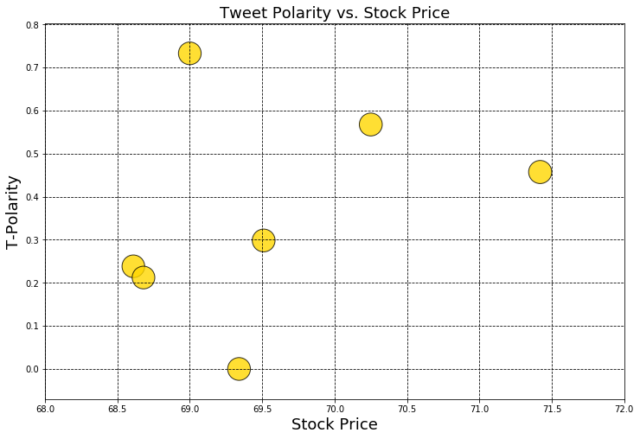
Calculate R² Ticker: MPC R²: 0.090858187381

Slide 13
Project Outcomes Based on Limited Data:
Market is almost stable (No major fluctuations in the field of commodities?), hence did not notice considerable negative sentiments to prove our hypothesis.
We are seeing little up trend in Stock Price based on positive sentiments.
Not a strong evidence of correlation between Stock Vs Sentiment with small R² value.
R² = 0.090858187381

Slide 14

Project Challenges:
No historical tweets beyond 7 days.
No minute/hourly stock pricing available on Alphavantage.
Finding out the best suitable statistical methods.
Understanding of ‘Watson IBM’ NLP (Natural Language Processing) functionality.
Based on time restriction, we could not analyze the correlation between weather and commodity stocks.

Slide 15
Learnings:
Exposure to various advanced APIs.
Understanding different Sentiments using ‘IBM Watson’ & ‘Vader’.
Familiarity with git functionality.

Slide 16

Conclusion:
Cannot conclude our hypothesis ☺ ??
Need more data source/variables to understand the exact correlation.
May help in going with live streaming and comparing the correlation.
Potential to store the data in database and perform some machine learning technics.

Slide 17
Q&A

