Slide 1
Regression
Tweet Polarity and Stock Price Correlation

Slide 2
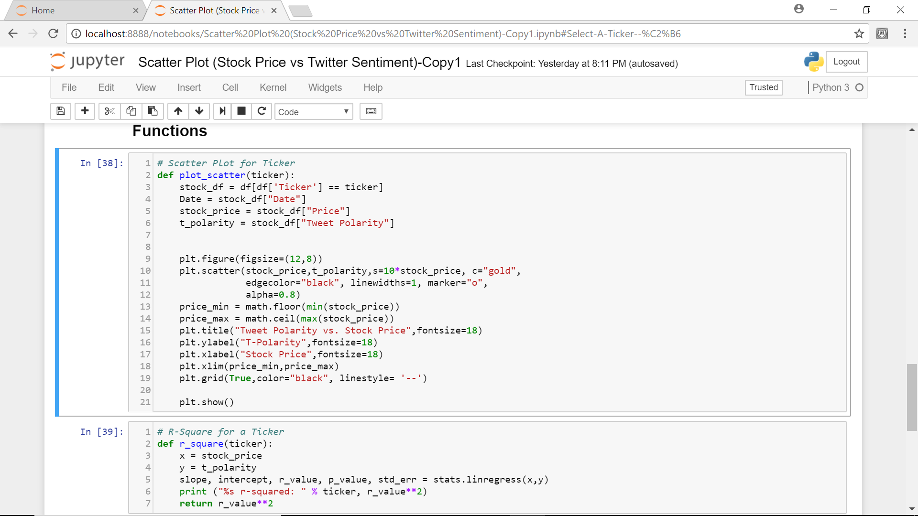
Codes

Slide 3
Plotting ticker “MPC”
 | Unnamed: 0 | Unnamed: 0.1 | Date | Media Sources | Tweet Polarity | Ticker | date | Price
0 | 0 | 0 | 2018-01-03 | @MarathonPetroCo | 0.23845 | MPC | 2018-01-03 | 68.61
2 | 2 | 2 | 2018-01-04 | @MarathonPetroCo | 0.21230 | MPC | 2018-01-04 | 68.68
5 | 5 | 5 | 2018-01-05 | @MarathonPetroCo | 0.00000 | MPC | 2018-01-05 | 69.34
14 | 22 | 22 | 2018-01-09 | @MarathonPetroCo | 0.73300 | MPC | 2018-01-09 | 69.00
20 | 28 | 28 | 2018-01-10 | @MarathonPetroCo | 0.29840 | MPC | 2018-01-10 | 69.51
27 | 35 | 35 | 2018-01-11 | @MarathonPetroCo | 0.56775 | MPC | 2018-01-11 | 70.25
33 | 41 | 41 | 2018-01-12 | @MarathonPetroCo | 0.45740 | MPC | 2018-01-12 | 71.42

Slide 4
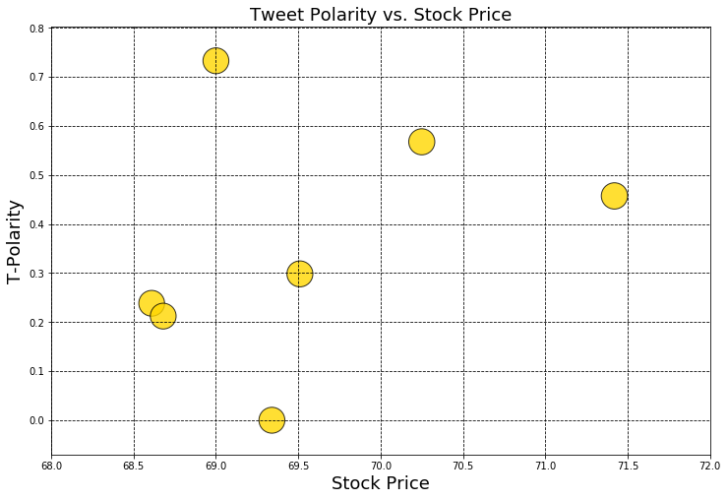

Slide 5
Calculate r-square Ticker: MPC r-squared: 0.090858187381

Slide 6
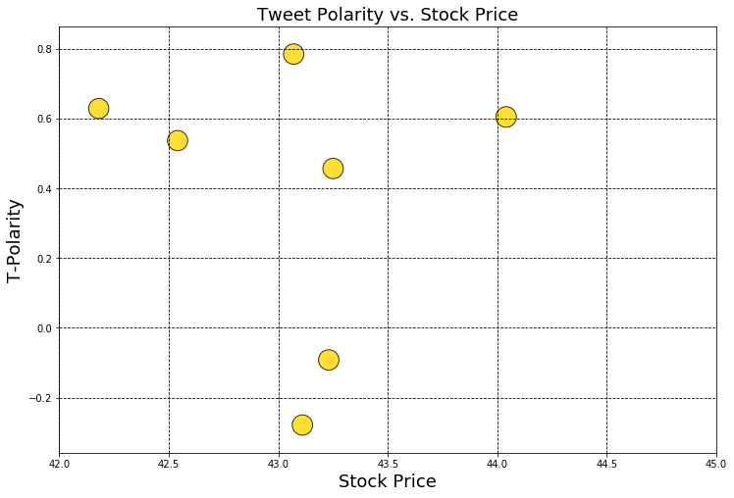
Calculate r-square Ticker: DVN r-squared:0.090858187381

