Slide 1
LOAN DEFAULT CASE STUDY

Slide 2
Lending Club Case Study
Background:
Lending club is the largest peer-to-peer marketplace connecting borrowers with lenders. Borrowers apply through an online platform where they are assigned an internal score. Lenders decide 1) whether to lend and 2) the terms of loan such as interest rate, monthly instalment, tenure etc.
Some popular products are credit card loans, debt consolidation loans, house loans, car loans etc.
Business Objective:
To identify variables which are strong indicators of default and potentially use the insights in approval / rejection decision making.

Slide 3
Data Understanding:
There are two files in lending club study
1) Loan :
These files contain complete loan data for all loans issued through the 2007-2011, including the current loan status (Current, Late, Fully Paid, etc.) and latest payment information. The file containing loan data through the "present" contains complete loan data for all loans issued through the previous completed calendar quarter. Additional features include credit scores, number of finance inquiries, address including zip codes, and state, and collections among others. The file is a matrix of about 39717 thousand observations and 111 variables and below are the few observations from Loan data set
Most of the loans issued were in the range of 10,000 to 20,000 USD.
The year of 2011 was the year were most loans were issued.
Loans were issued in an incremental manner. (Possible due to a recovery in the U.S economy)
The loans applied by potential borrowers, the amount issued to the borrowers and the amount funded by investors are similarly distributed, meaning that it is most likely that qualified borrowers are going to get the loan they had applied for.
2) Data_Dictionary :
This files contains descriptions all the Loan data

Slide 4
Data cleaning and Manipulation:
Removed all the columns with all null values
Removed columns with more than 50% null values
Removed all the columns where number of unique value is only 1 because that will not make any sense in the analysis
Created data_dictionary data frame and considered which are in Loan data frame only.
Dropped few un relevant columns which will not useful for analysis
Converted few categorical columns into numeric
Created some bins for the range purpose
And also some metrics for on columns for correlation

Slide 5
Derived metrics:
We have now derive some new columns based on our business understanding that will be helpful in our analysis.
Loan amount to Annual Income ratio
Extract Year & Month from Issue date
Change order of months from Jan to Dec, currently it's in alphabetical order(A-Z)
Create Bins for range of Loan Amount
Create Bins for range of Annual Income
Create Bins for range of Interest rates

Slide 6
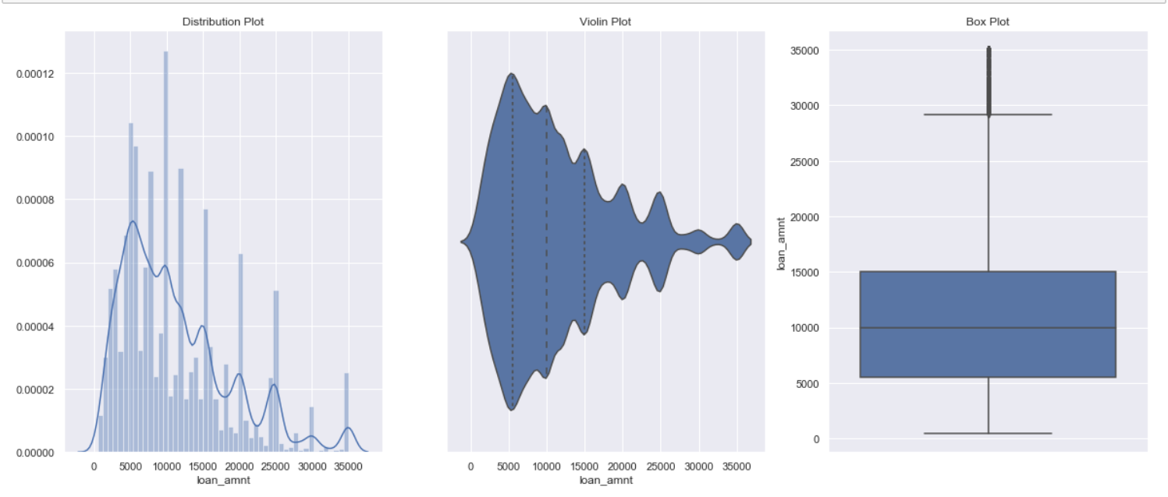
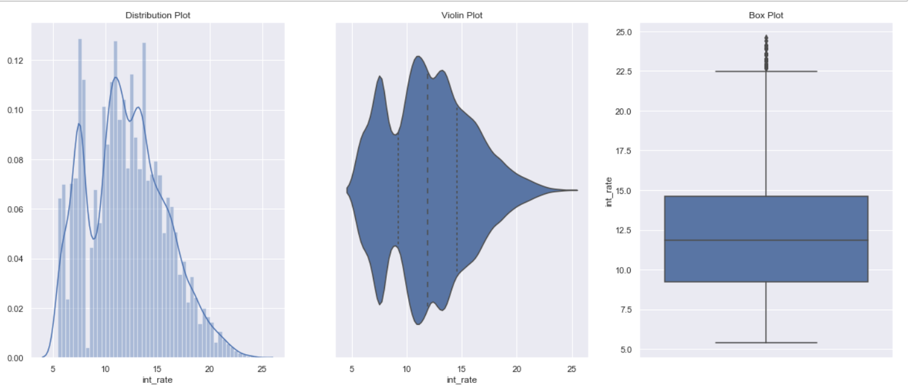
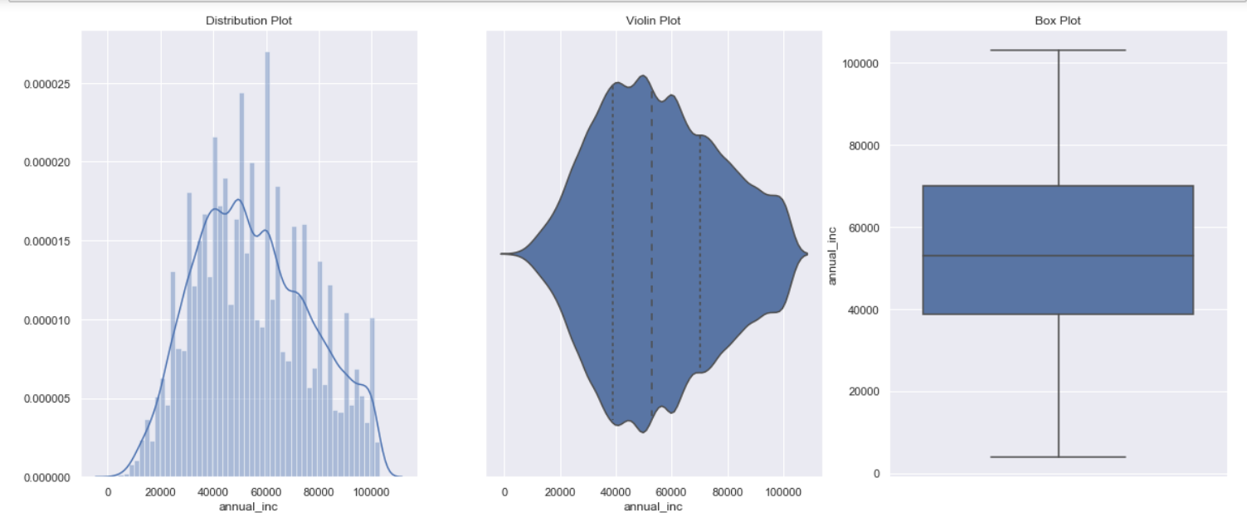
Univariate Analysis:
Univariate function will plot the graphs based on the parameter values (continuous and Categorical Variable)
Continuous Variables:
Loan amount Interest rate Annual income

Slide 7
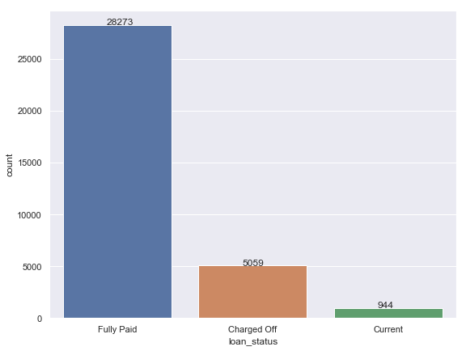
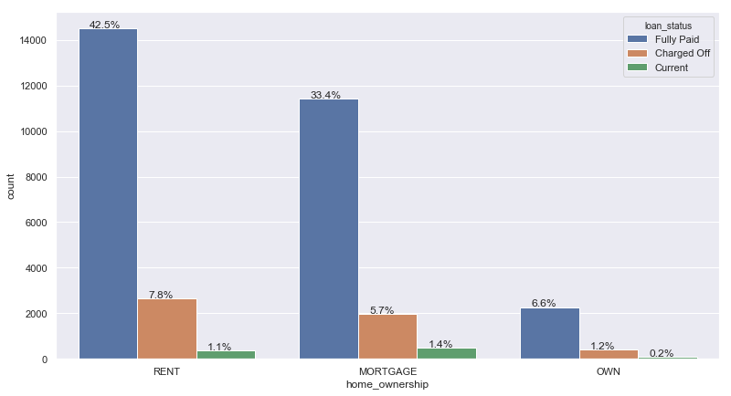
Categorical Variables:
Loan status: Home Ownership wise loan:

Slide 8
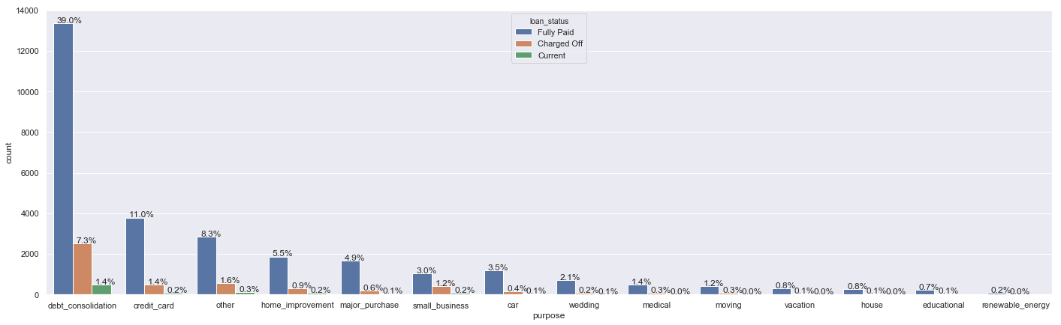
Categorical Variables (cont…..)
Purpose of loan:

Slide 9
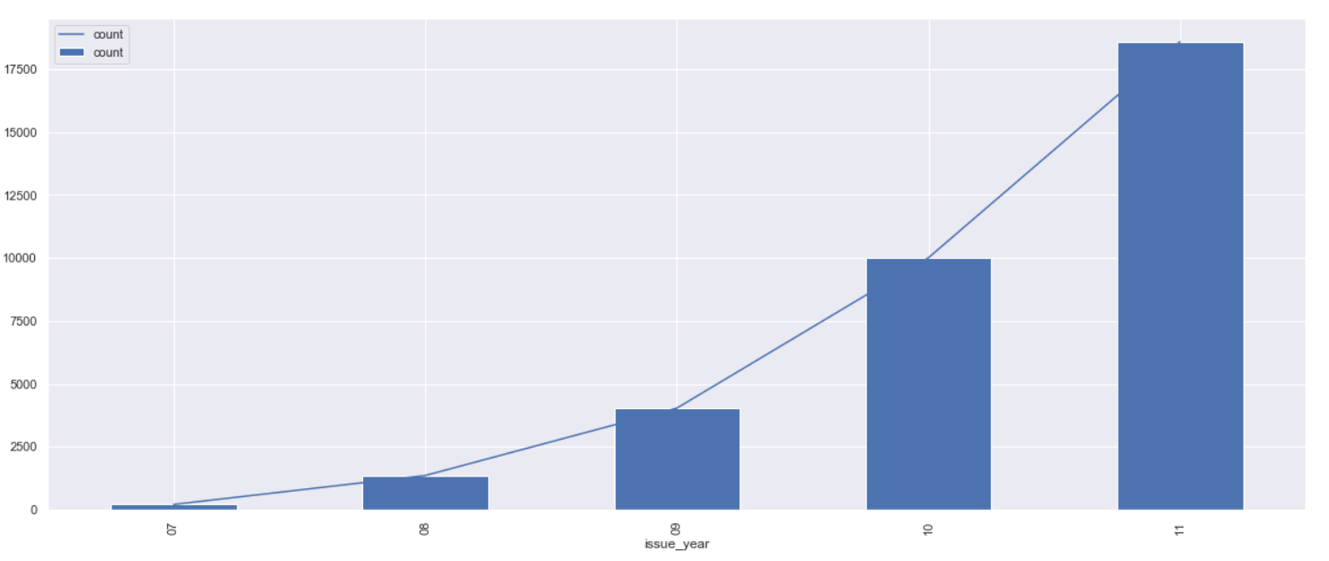
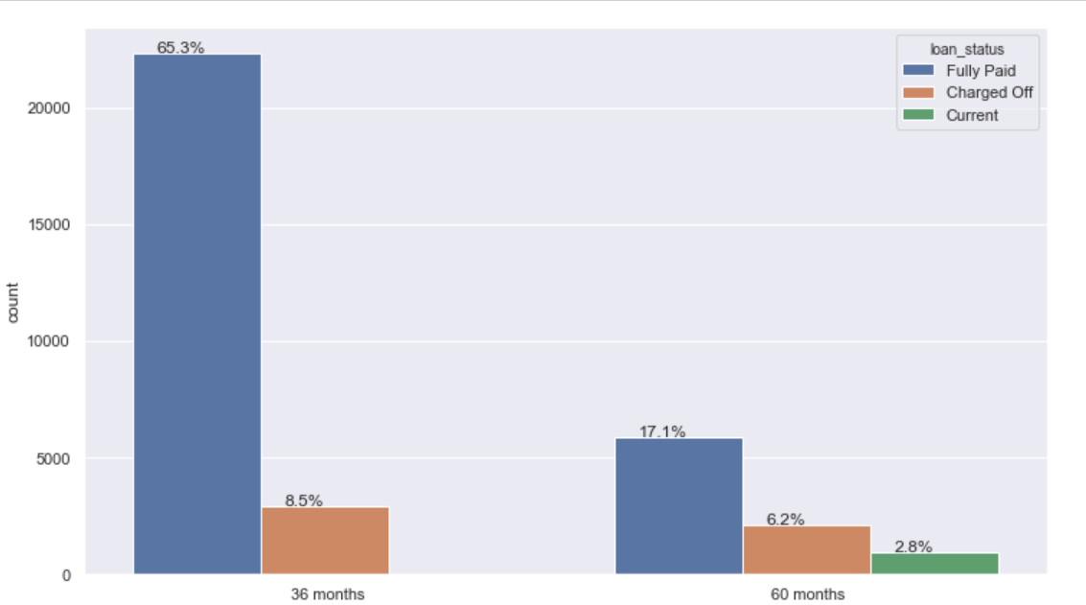
Categorical Variables (cont…..)
Year wise loan Loan Term

Slide 10
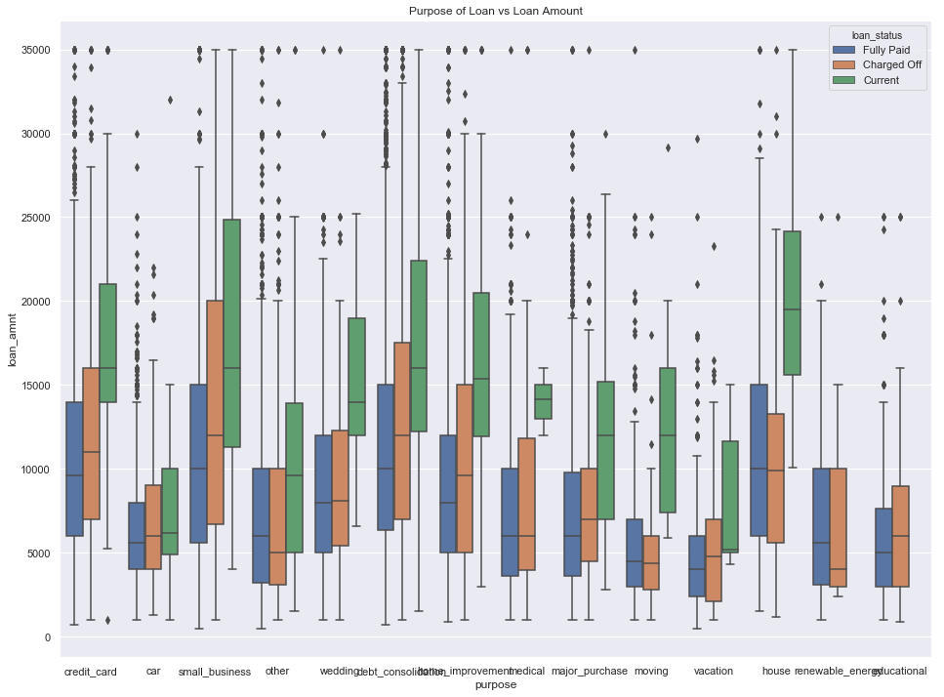
Bivariate/Multivariate Analysis
We are performing Bivariate/Multivariate analysis for any combination of categorical and continuous variables. The combination can be: Categorical & Categorical, Categorical & Continuous and Continuous & Continuous.
Purpose of Loan vs Loan Amount for each Loan Status

Slide 11
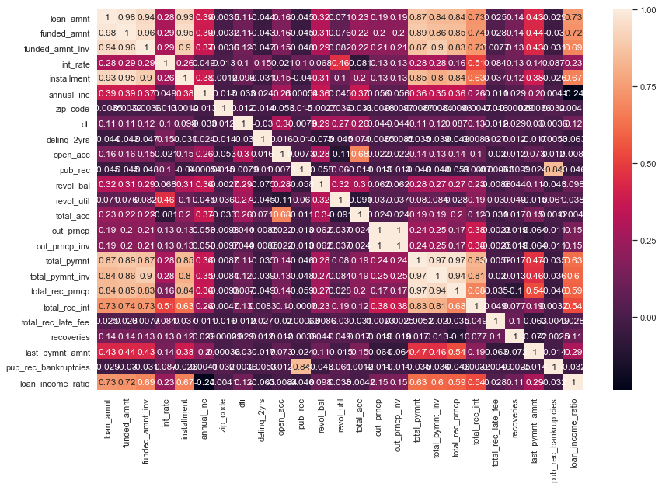
Bivariate/Multivariate Analysis(contd…)
Correlation Matrix : All Continuous (Numeric) Variables and Heatmap

Slide 12
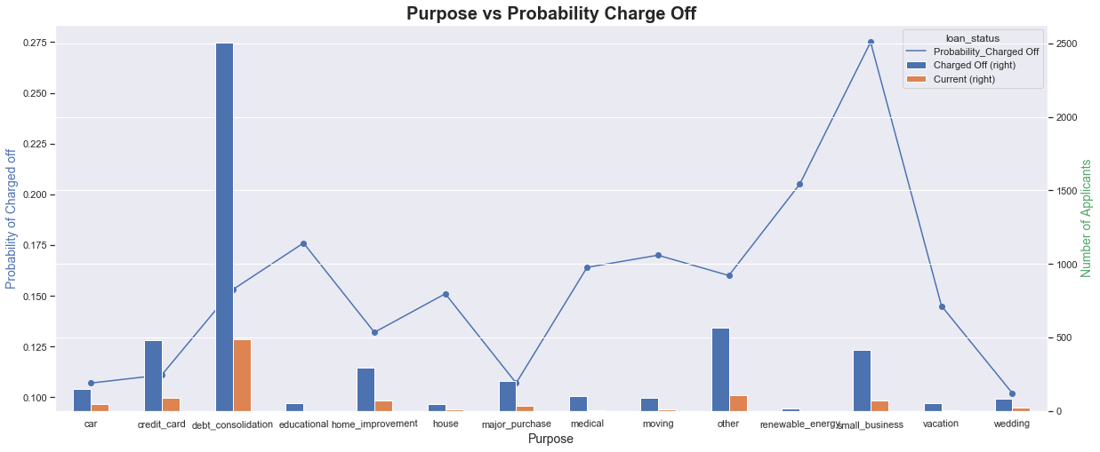
Bivariate/Multivariate Analysis with Probability of Charge off
Categorical Variables vs Probability of Charged Off
The main motive of this use case to find what parameters are impacting the most on Loan Status that is if a applicant will successfully complete the loan term or will charge off.
Purpose of Loan vs Probability Charge Off:

Slide 13
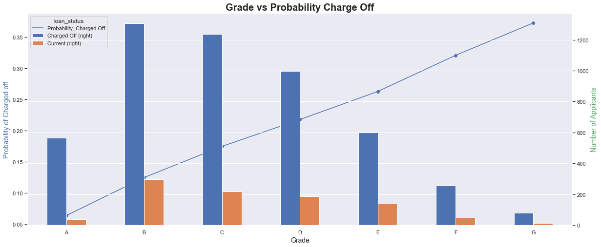
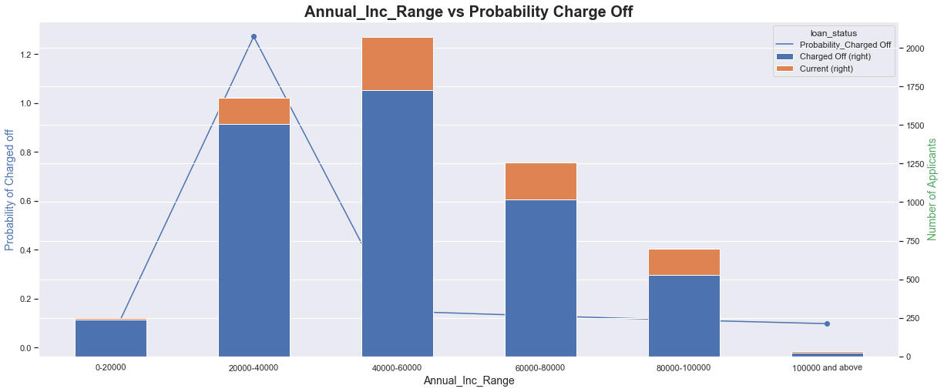
Bivariate/Multivariate Analysis with Probability of Charge off(contd..)
Grade vs Probability Charge Off Annual Income Range vs Probability Charge Off

Slide 14
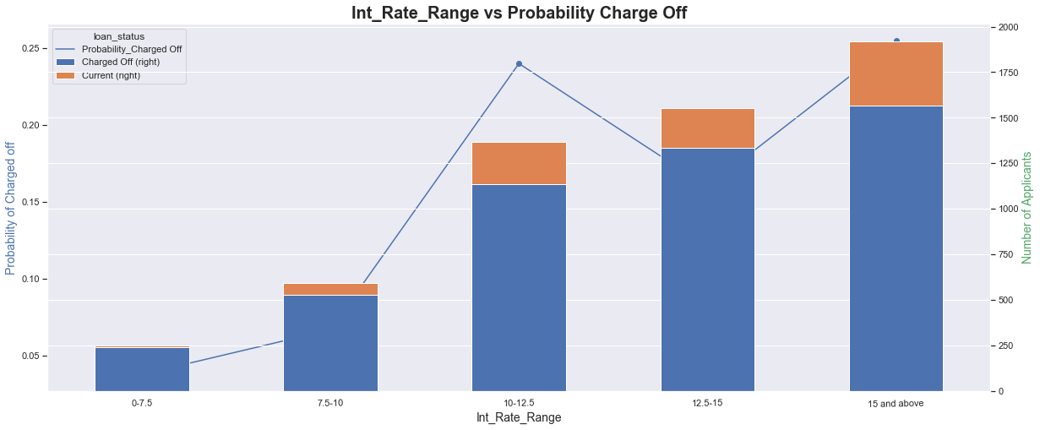
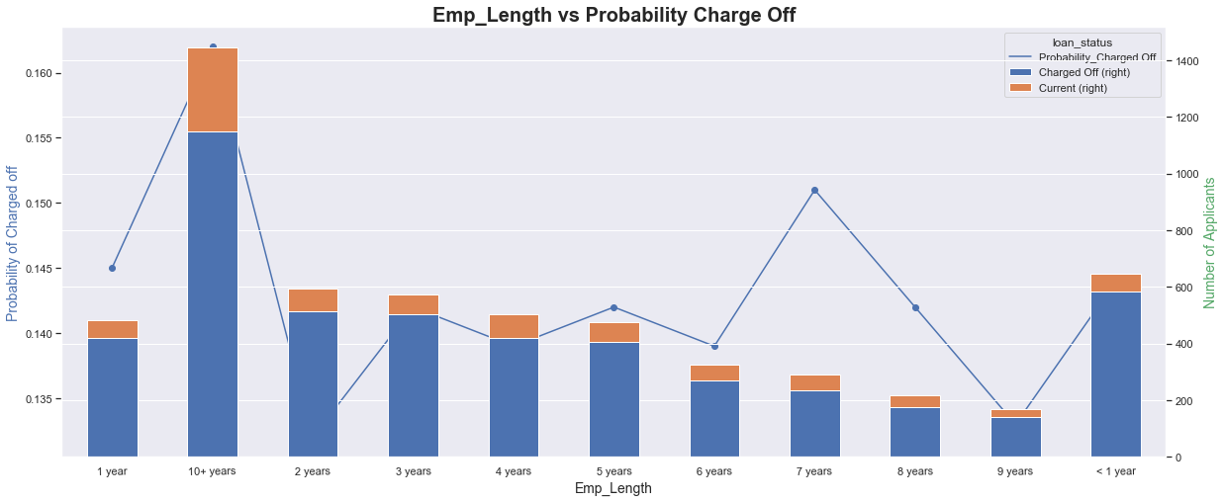
Bivariate/Multivariate Analysis with Probability of Charge off(contd..)
Interest rate Range vs Probability Charge Off Employment Length vs Probability Charge Off

Slide 15
Inferences
The loan count kept increasing over the years, significantly higher in 2011 as observed from the plot.
From the Purpose vs Probability charge off plot, we observe that the loans issued against debt consolidation were more likely to be charged off.
The loans offered with more interest rate showed higher chances of getting charged off.
Customers having employment length of more than 10 years were more likely to default on a loan.
Grade B accounts were more likely to default on a loan.
The customers having annual income of between USD 20000 to 40000 showed significantly higher probability to default on a loan.
The customers with Rented and Mortgaged type of home ownership were more likely to default on the loan than others.

Slide 16
Conclusion
We can conclude that the following metrices had the highest impact of loan default probability:
Purpose of Loan
Employment Length
Grade
Interest Rate
Annual income
Home ownership
And the main target variable is Loan status

