Slide 1
MultiCLIP: Four-View Contrastive Learning for
Metabolite Identification from Tandem Mass Spectra
Manuel Ruiz-Botella¹, Marta Sales-Pardo¹,², Roger Guimerà¹,²,³
¹ Department of Chemical Engineering, Universitat Rovira i Virgili, Tarragona, Spain
² ComSCIAM, Universitat Rovira i Virgili, Tarragona, Spain
³ ICREA, Barcelona, Spain
AI4Sci 2026, Mainz · Chemistry & Materials
Contact: manuel.ruiz@urv.cat
Notes:
00:00–00:20 · TITLE
SAY
Good afternoon. I am Manuel Ruiz-Botella, from Universitat Rovira i Virgili in Tarragona, with Marta Sales-Pardo and Roger Guimerà.
This talk is MultiCLIP: four-view contrastive learning for metabolite identification from tandem mass spectra.
[Pause 1 s. Click. Do not start the science on this slide.]

Slide 2
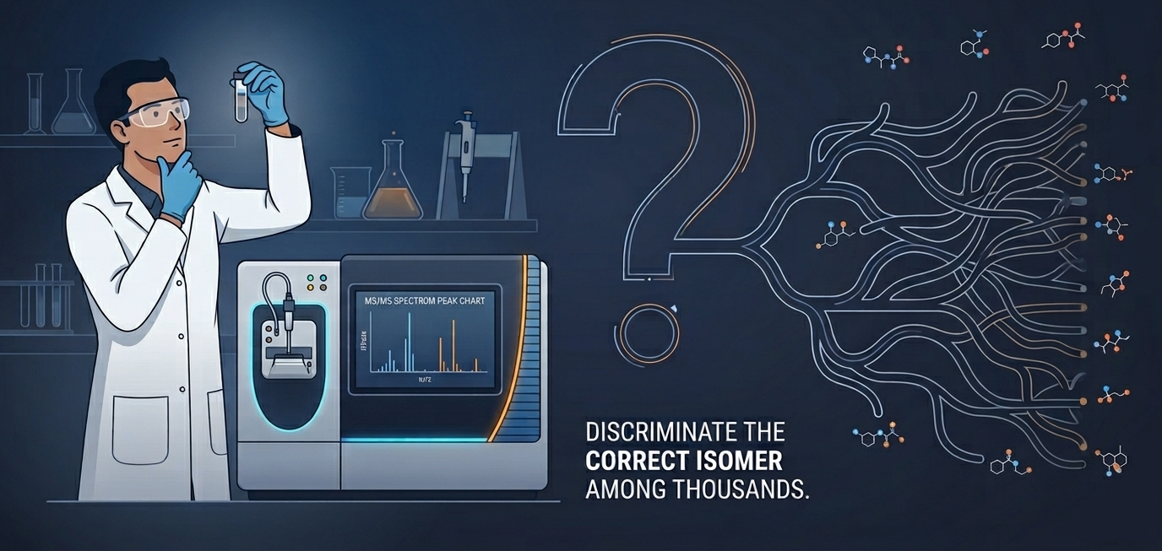
THE PROBLEM
00:35–01:25
MultiCLIP | Ruiz-Botella, Sales-Pardo & Guimerà | URV · ComSCIAM · ICREA
02
Notes:
00:20–00:45 · THE PROBLEM (clock on slide still says 00:35–01:25 for the whole opening)
SAY
Imagine you are at the bench with a biological sample, and you need to know which molecule is in it.
You run it on the mass spectrometer. You get a spectrum.
Then the question starts: is it this isomer, or this one, or this one?
You search the library. It is not there.
So you are back to reading peaks by hand — among thousands of possible structures.
[Pause 2 s. Point at the question mark, then at the branching isomers.]
That is the problem this talk is about.
[Click]

Slide 3
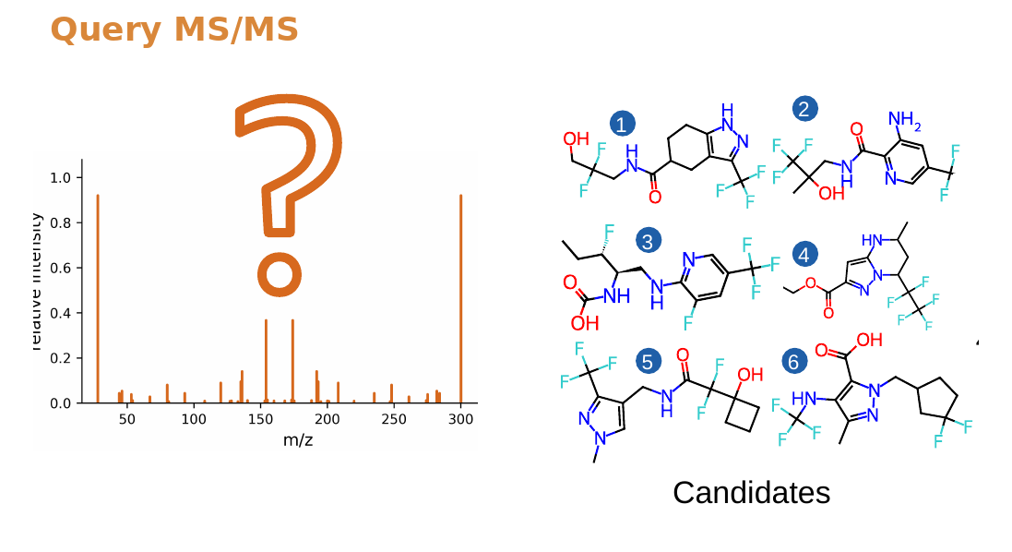
THE PROBLEM
This spectrum was produced by one of these molecules.
They share the same precursor mass and the molecular formula.
MultiCLIP | Ruiz-Botella, Sales-Pardo & Guimerà | URV · ComSCIAM · ICREA
02
Notes:
00:45–01:10 · THE ISOMER GRID
SAY
This spectrum on the left was produced by one of these molecules.
They all share the same precursor mass, and the same molecular formula.
[Pause 3 s. Let them look at the grid. Do not give numbers yet.]
This is the inverse problem of mass spectrometry: from incomplete fragments, to one exact structure.
[Click]

Slide 4
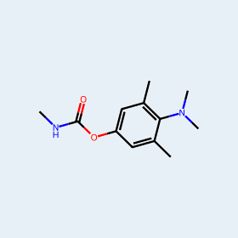
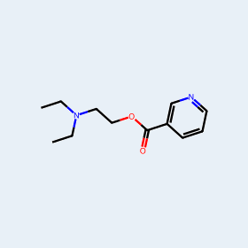
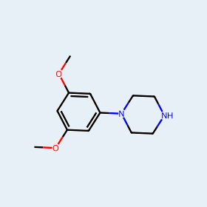
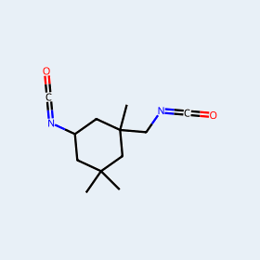
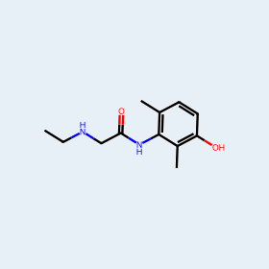
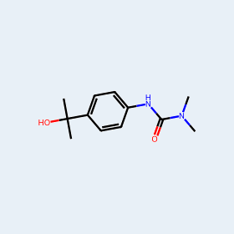
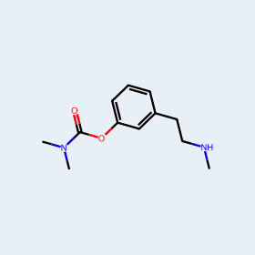
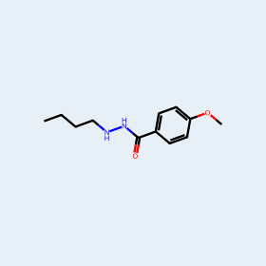
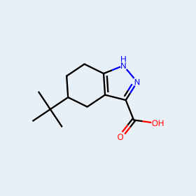
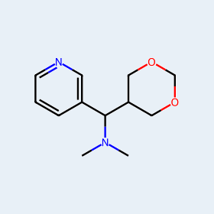
THE PROBLEM
But how hard can get this problem?
You can write C₁₂H₁₈N₂O₂ from the precursor mass. You still do not know which compound is in the sample.
C₁₂H₁₈N₂O₂
44,374
isomers in PubChem
MultiCLIP | Ruiz-Botella, Sales-Pardo & Guimerà | URV · ComSCIAM · ICREA
03
Notes:
01:10–01:30 · 44,374 ISOMERS
SAY
But how hard can this problem get?
You can write C₁₂H₁₈N₂O₂ from the precursor mass. You still do not know which compound is in the sample.
That modest formula has 44,374 structures in PubChem. The molecules around this number are real isomers of it.
Knowing the formula is not an identification.
[Click]

Slide 5
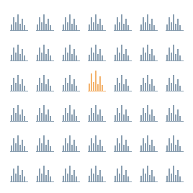
THE PROBLEM
But how hard can get this problem?
And looking it up in a library barely helps.
2.3%
of experimental MS/MS spectra
are named by a GNPS library search
1 in 42 spectra gets a name. Martin et al., 2024
MultiCLIP | Ruiz-Botella, Sales-Pardo & Guimerà | URV · ComSCIAM · ICREA
03
Notes:
01:30–01:50 · 2.3% LIBRARY HIT RATE
SAY
And looking it up in a library barely helps.
If we search experimental MS/MS against GNPS, the public reference library, only 2.3% of measurements get a name. One in forty-two.
The rest is dark metabolome: either the molecule is not in the library, or the spectrum does not match well enough.
[Pause 2 s]
This was the difficulty. Today I will show you how we attack it.
[Click]

Slide 6
THE IDEA
01:25–02:00
Aligning four views of a metabolite
helps to identify the isomer from several candidates.
MultiCLIP | Ruiz-Botella, Sales-Pardo & Guimerà | URV · ComSCIAM · ICREA
03
Notes:
01:50–02:10 · THE IDEA (clock on slide: 01:25–02:00)
SAY
One sentence for the rest of this talk:
[Pause 2 s]
Aligning four views of a metabolite helps to identify the isomer from several candidates.
[Pause 3 s. Look at the centre of the room.]
If this works, you rank isomers from the raw spectrum, without a precursor formula in the encoder. If we keep one pair and formula-dependent tokens, we leave evidence unused.
[Click]

Slide 7
03
Notes:
02:10–02:15 · BEAT (almost empty on purpose)
SAY
[Almost nothing. One breath.]
What are those four views?
[Click immediately.]

Slide 8
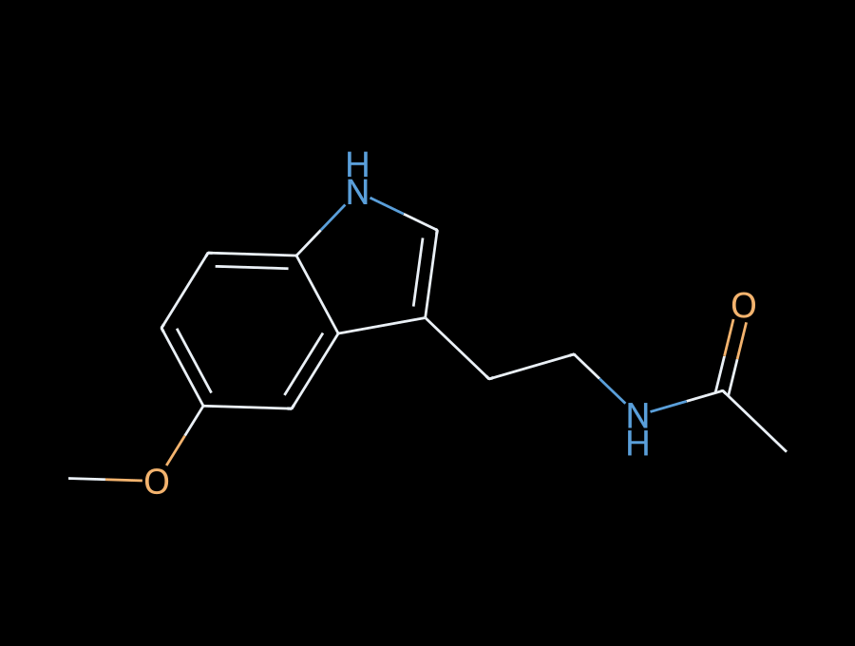
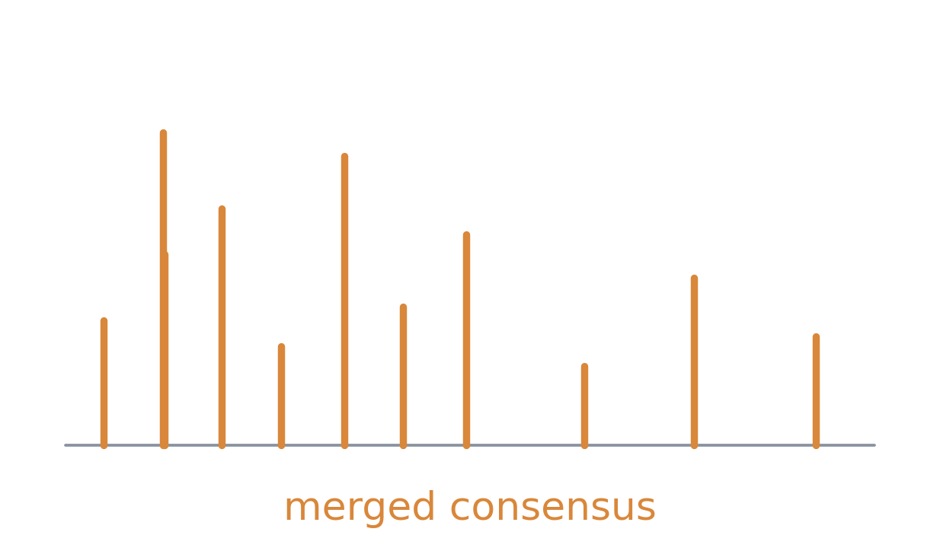
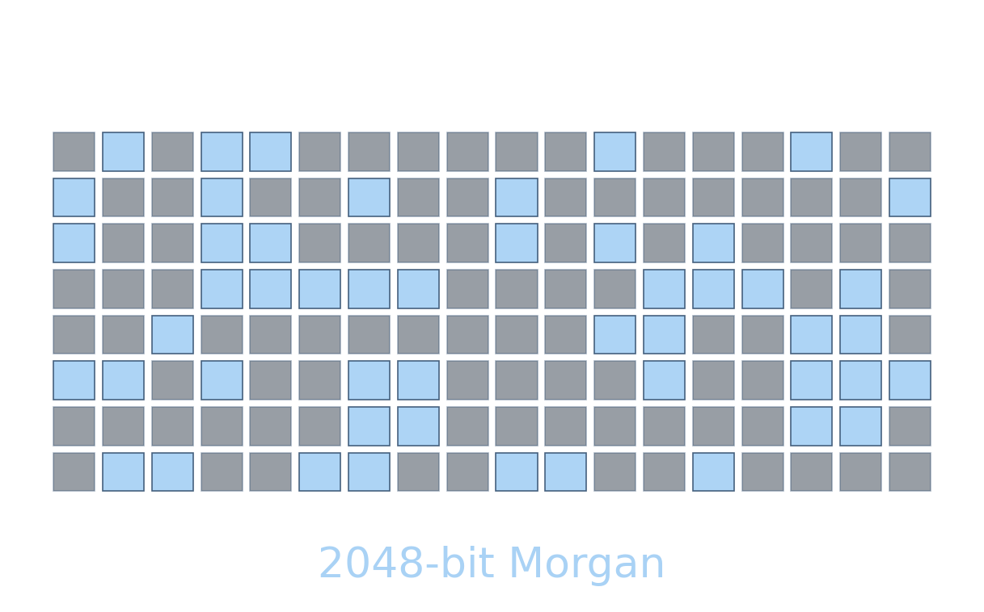
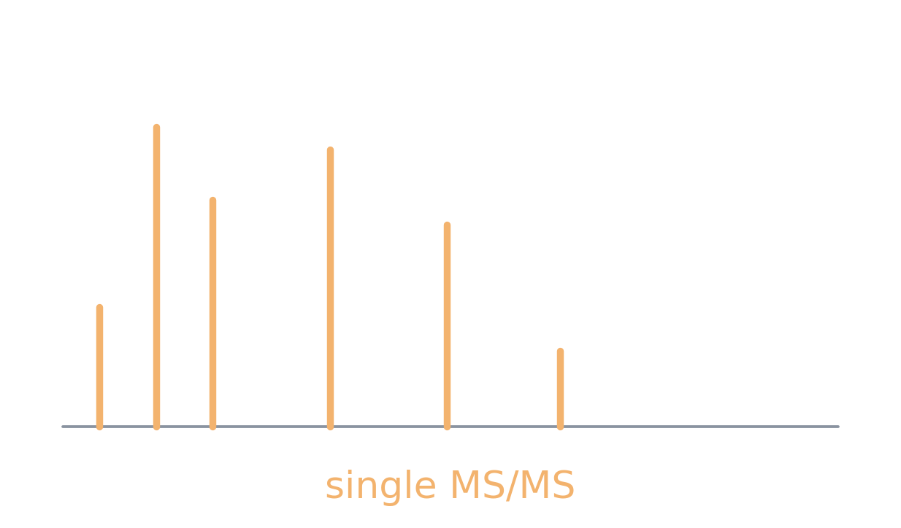
One metabolite · four views
03
Notes:
02:15–02:35 · ONE METABOLITE, FOUR VIEWS
SAY
Upper left: the 2D graph — atom connectivity.
Lower left: the Morgan fingerprint — the substructure pattern.
Upper right: the merged consensus spectrum — a stable signature.
Lower right: a single MS/MS measurement — intensity and losses from one run.
They are four views of the same metabolite.
[Pause 2 s]
[Click]

Slide 9
THE IDEA
01:25–02:00
Aligning four views of a metabolite
helps to identify the isomer from several candidates.
01
INPUT
02
ENGINE
03
HORIZON
Tokenise every m/z peak directly, instead of current approaches
Align and fuse four views: graph view molecule, fingerprints, merged spectra, and single spectra.
Understand the latent geometry of the four views, to understand how to reconstruct new molecules.
MultiCLIP | Ruiz-Botella, Sales-Pardo & Guimerà | URV · ComSCIAM · ICREA
03
Notes:
02:35–03:00 · THREE ACTS (clock on slide: 01:25–02:00)
SAY
Aligning four views of a metabolite helps to identify the isomer from several candidates.
[Pause 2 s]
I will build that claim in three acts.
Input: tokenise every m/z peak directly, instead of the encodings used today.
Engine: align and fuse those four views — graph, fingerprint, merged spectra, and single spectra.
Horizon: understand the latent geometry, so we can reconstruct molecules that are not in any library.
[Click]

Slide 10
THE IDEA
02:00–02:15
How do you encode a spectrum?
01
INPUT
02
ENGINE
03
HORIZON
Tokenise m/z directly
Align and fuse four views
Understand the latent geometry
MultiCLIP | Ruiz-Botella, Sales-Pardo & Guimerà | URV · ComSCIAM · ICREA
·
Notes:
03:00–03:10 · ACT 1 BEGINS
On-slide clock still says 02:00–02:15 — ignore it. The opening now has more slides.
SAY
Act 1 starts here: how do you encode a spectrum?
[Pause 2 s. Point at card 01.]
[Click]

Slide 11
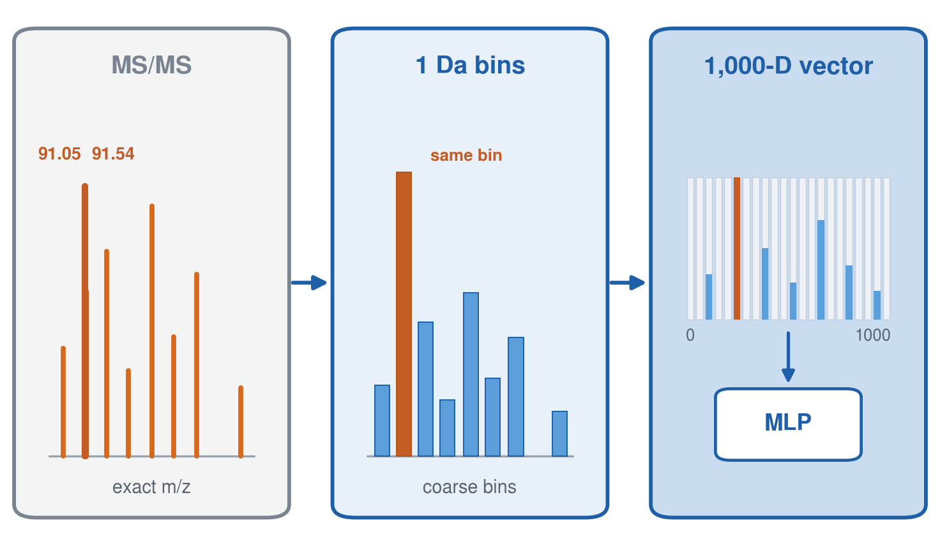
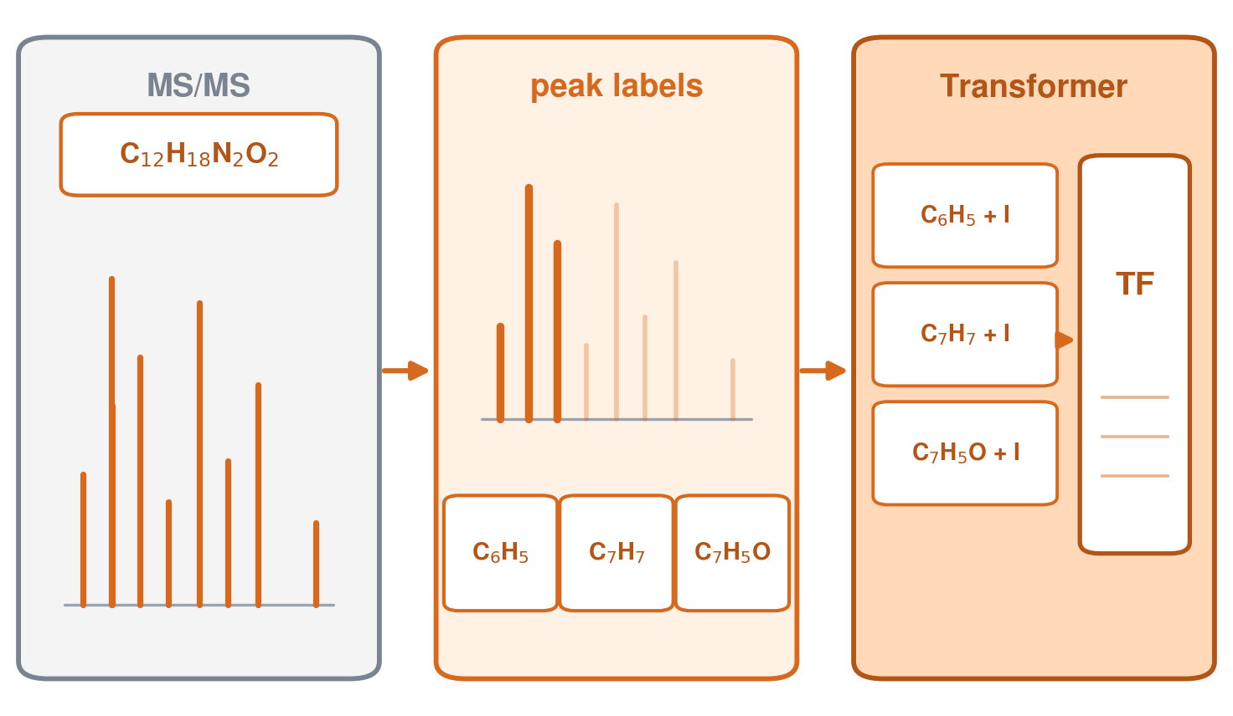
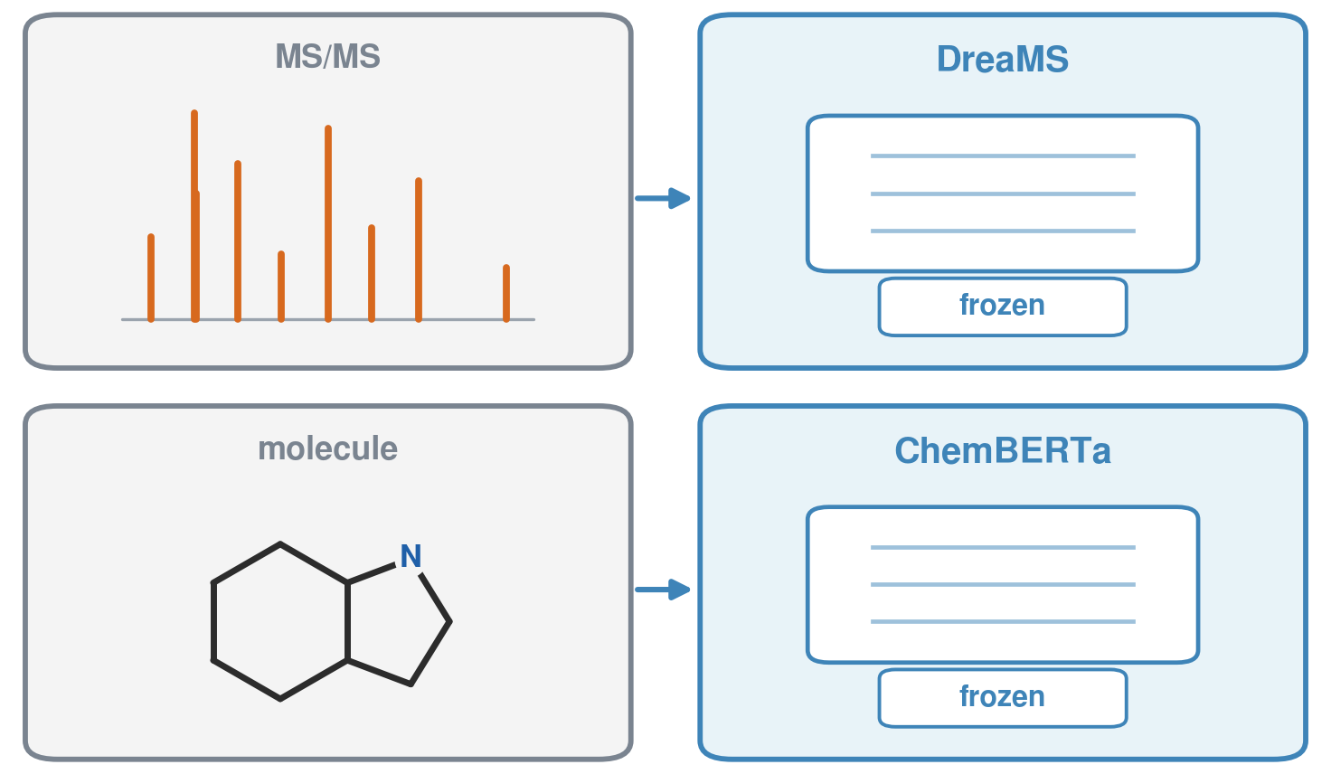
ACT 1 · INPUT
02:15–03:00
Current methods encode spectra in three different ways
The chemically richest tokens assume a precursor formula. The formula-free ones pay another price.
1 Da histogram
Subformula peak tokens
Foundation embeddings
JESTR
MIST · MVP · FLARE
MSAlign
Formula-free
Needs precursor formula
Formula-free
Exact mass is collapsed into 1,000 bins.
Isomer resolution is what you lose.
Each peak is labeled from the precursor formula.
A wrong formula poisons every token.
Frozen DreaMS + ChemBERTa, then MLPs.
No peak chemistry. No formula.
MultiCLIP | Ruiz-Botella, Sales-Pardo & Guimerà | URV · ComSCIAM · ICREA
04
Notes:
03:10–03:55 · CURRENT SPECTRUM ENCODINGS
On-slide clock: 02:15–03:00. Take ~45 seconds.
SAY
Current methods encode the same spectrum in three different ways.
Left — JESTR. Exact masses are collapsed into a 1-dalton histogram, then a thousand-dimensional vector goes through an MLP. Formula-free. Isomer resolution is what you lose.
Centre — MIST, MVP and FLARE. Each peak is labelled with a subformula of the precursor. Chemically rich. If formula inference is wrong, every token is wrong.
Right — MSAlign. Frozen DreaMS on the spectrum, frozen ChemBERTa on the structure, then MLPs. Formula-free, but no peak-level chemistry.
[Pause 2 s]
The chemically richest tokens assume a formula you often do not have. The formula-free ones pay another price.
Next: we tokenise m/z directly.
[Click]

Slide 12
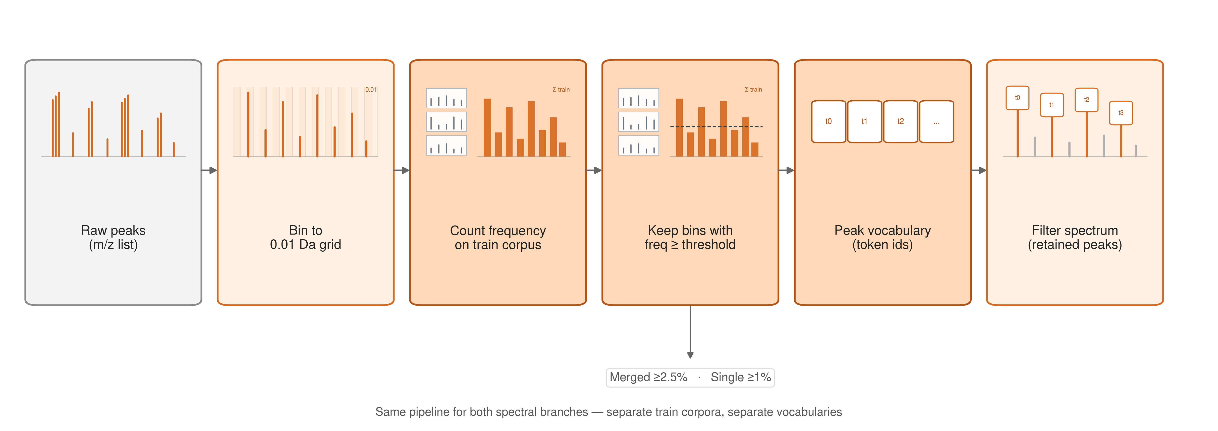
ACT 1 · TOKENIZER
03:00–03:45
Build the vocabulary from recurrent and informative m/z peaks
Frequency on the training corpus decides which peaks become tokens.
No precursor formula. Training corpus only.
MultiCLIP | Ruiz-Botella, Sales-Pardo & Guimerà | URV · ComSCIAM · ICREA
05
Notes:
03:55–04:40 · TOKENIZER
On-slide clock: 03:00–03:45. Take ~45 seconds.
SAY
We treat each peak as a token, the way a language model treats a word.
Walk left to right. Raw m/z peaks. Bin at 0.01 dalton. Count occupancy on the training corpus. Keep the recurrent bins above a threshold. Map them to token IDs. Filter the spectrum.
Merged spectra: keep bins in at least 2.5% of the corpus. Single spectra: 1%.
Frequency on the training corpus decides which peaks become tokens. No evaluation data. No precursor formula.
[Click]

Slide 13
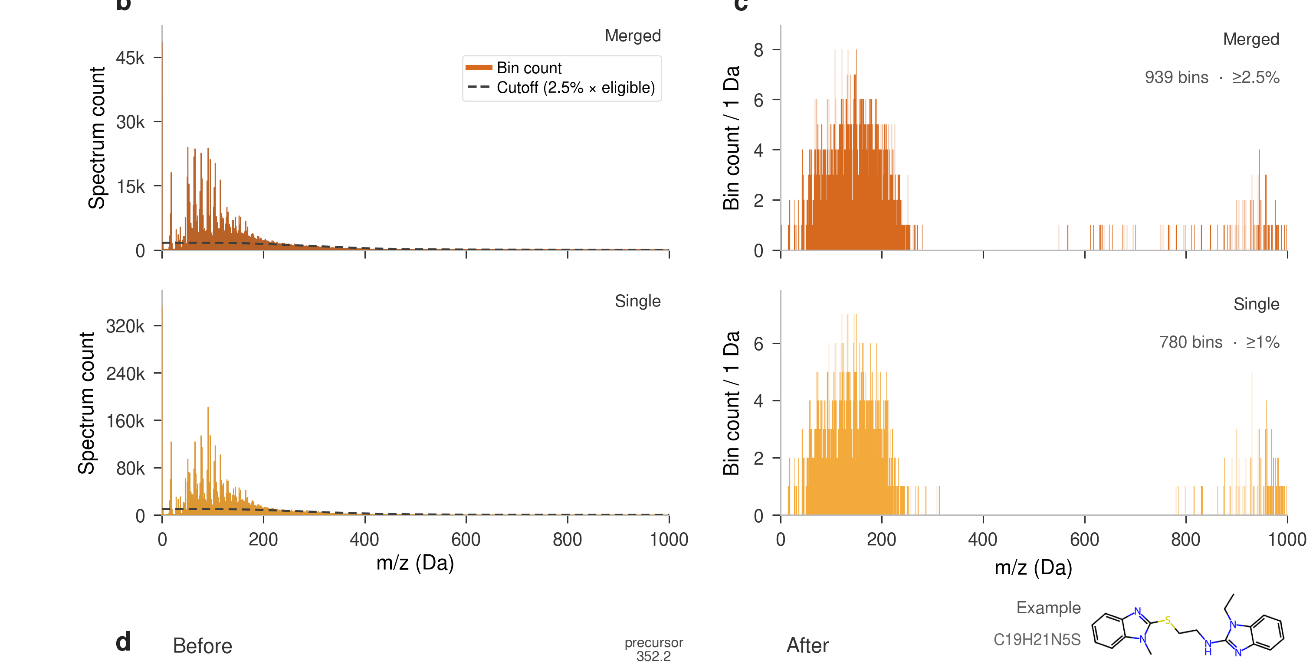
ACT 1 · EVIDENCE
03:45–04:10
The vocabulary concentrates on recurrent low-mass fragments
Paper evidence: occupancy thresholds select compact, data-driven token sets.
Merged
939
tokens · ≥ 2.5%
Single
780
tokens · ≥ 1.0%
Coverage
33%
of peak occurrences
No precursor-dependent subformulae.
MultiCLIP | Ruiz-Botella, Sales-Pardo & Guimerà | URV · ComSCIAM · ICREA
06
Notes:
04:40–05:00 · VOCABULARY SIZE
On-slide clock: 03:45–04:10.
SAY
Those thresholds give 939 tokens for merged spectra, and 780 for single spectra.
They cover about one third of all peak occurrences.
The vocabulary concentrates on recurrent low-mass fragments, and throws away the long tail of rare peaks.
No precursor-dependent subformulae.
[Click]

Slide 14
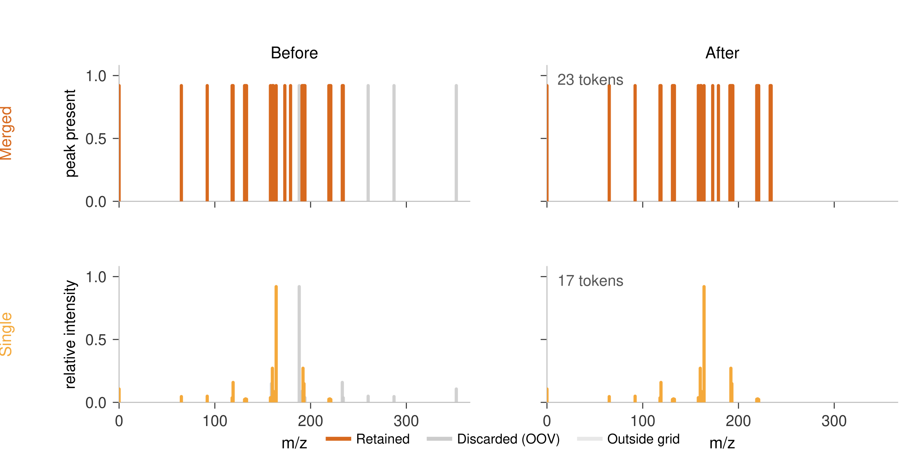
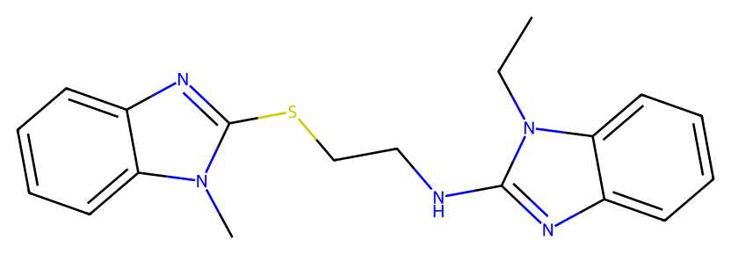
ACT 1 · EXAMPLE
04:10–04:25
Vocabulary filtering on one molecule
In-vocabulary peaks stay as tokens — rare peaks, and the precursor, drop out.
C₁₉H₂₁N₅S
Merged
23 tokens
Single
17 tokens
Grey peaks = out of vocabulary
The grey peak near m/z 352 is the precursor ion — discarded as out of vocabulary.
MultiCLIP | Ruiz-Botella, Sales-Pardo & Guimerà | URV · ComSCIAM · ICREA
06
Notes:
05:00–05:20 · ONE-MOLECULE EXAMPLE
On-slide clock: 04:10–04:25.
SAY
Same molecule: C₁₉H₂₁N₅S.
Orange peaks stay as tokens. Grey peaks are out of vocabulary and are thrown away.
Merged consensus: 23 tokens. Single measurement: 17.
The grey peak near m/z 352 is the precursor ion — discarded, because it is rare in the corpus. No formula was used to decide that.
Next: align this input with the molecule.
[Click]

Slide 15
THE IDEA
04:25–04:40
How do four views of a molecule get aligned?
01
INPUT
02
ENGINE
03
HORIZON
Tokenise m/z directly
Align and fuse four views
Understand the latent geometry
MultiCLIP | Ruiz-Botella, Sales-Pardo & Guimerà | URV · ComSCIAM · ICREA
·
Notes:
05:20–05:30 · ACT 2 BEGINS
On-slide clock: 04:25–04:40.
SAY
Act 1 gave us an m/z vocabulary that does not need a formula.
The next problem is architectural: two molecular views, two spectral views, one ranking.
How do four views of a molecule get aligned?
[Pause 2 s. Point at card 02.]
That is Act 2.
[Click]

Slide 16
ACT 2 · FOUR VIEWS
04:40–05:30
The molecule and the experiment each have two complementary views
Connectivity + substructure. Stability + measurement-specific detail.
MOLECULE
SPECTRUM
2D graph
Merged consensus
atom connectivity
stable signature
GNN
512-D
Transformer
shared
embedding space
MOLECULE
SPECTRUM
Morgan fingerprint
Single spectrum
substructure pattern
intensity + losses
MLP
Transformer
Same compound → four compatible embeddings
MultiCLIP | Ruiz-Botella, Sales-Pardo & Guimerà | URV · ComSCIAM · ICREA
07
Notes:
05:30–06:10 · FOUR VIEWS
On-slide clock: 04:40–05:30. Take ~40 seconds.
SAY
The molecule and the experiment each have two complementary views.
On the molecular side: the 2D graph captures atom connectivity, through a GNN. The Morgan fingerprint captures substructure patterns, through an MLP.
On the spectral side: the merged consensus is the stable signature. The single spectrum keeps intensity and neutral-loss detail. Both go through Transformers.
All four land in a shared 512-dimensional space.
Same compound: four compatible embeddings.
[Click]

Slide 17
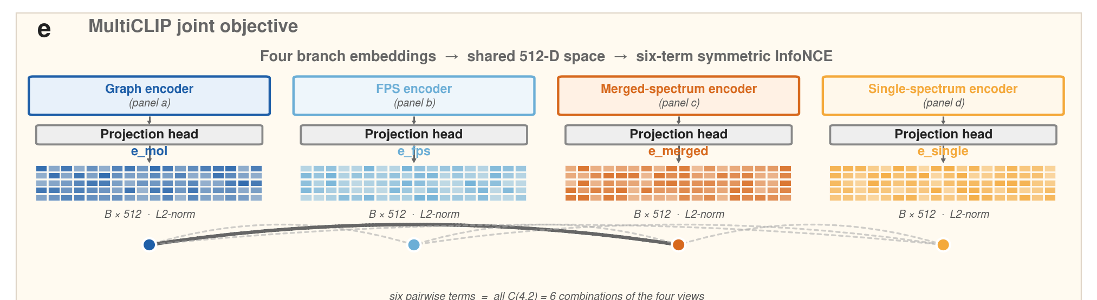
ACT 2 · OBJECTIVE
05:30–06:05
Every view is aligned with every other view
Four branches create six positive pairings per compound.
6 terms
Each pair pulls
the same compound together
and pushes others apart.
Why this matters
No branch can specialise
in evidence invisible
to the other three.
MultiCLIP | Ruiz-Botella, Sales-Pardo & Guimerà | URV · ComSCIAM · ICREA
08
Notes:
06:10–06:35 · SIX-TERM OBJECTIVE
On-slide clock: 05:30–06:05.
SAY
Four branches create six positive pairings per compound.
We train symmetric InfoNCE on all six. Each pair pulls the same compound together, and pushes other compounds apart.
[Pause 2 s]
Why this matters: no branch can specialise in evidence invisible to the other three.
Because every view is aligned with every other view, the embeddings are compatible at inference. They can be fused.
[Click]

Slide 18
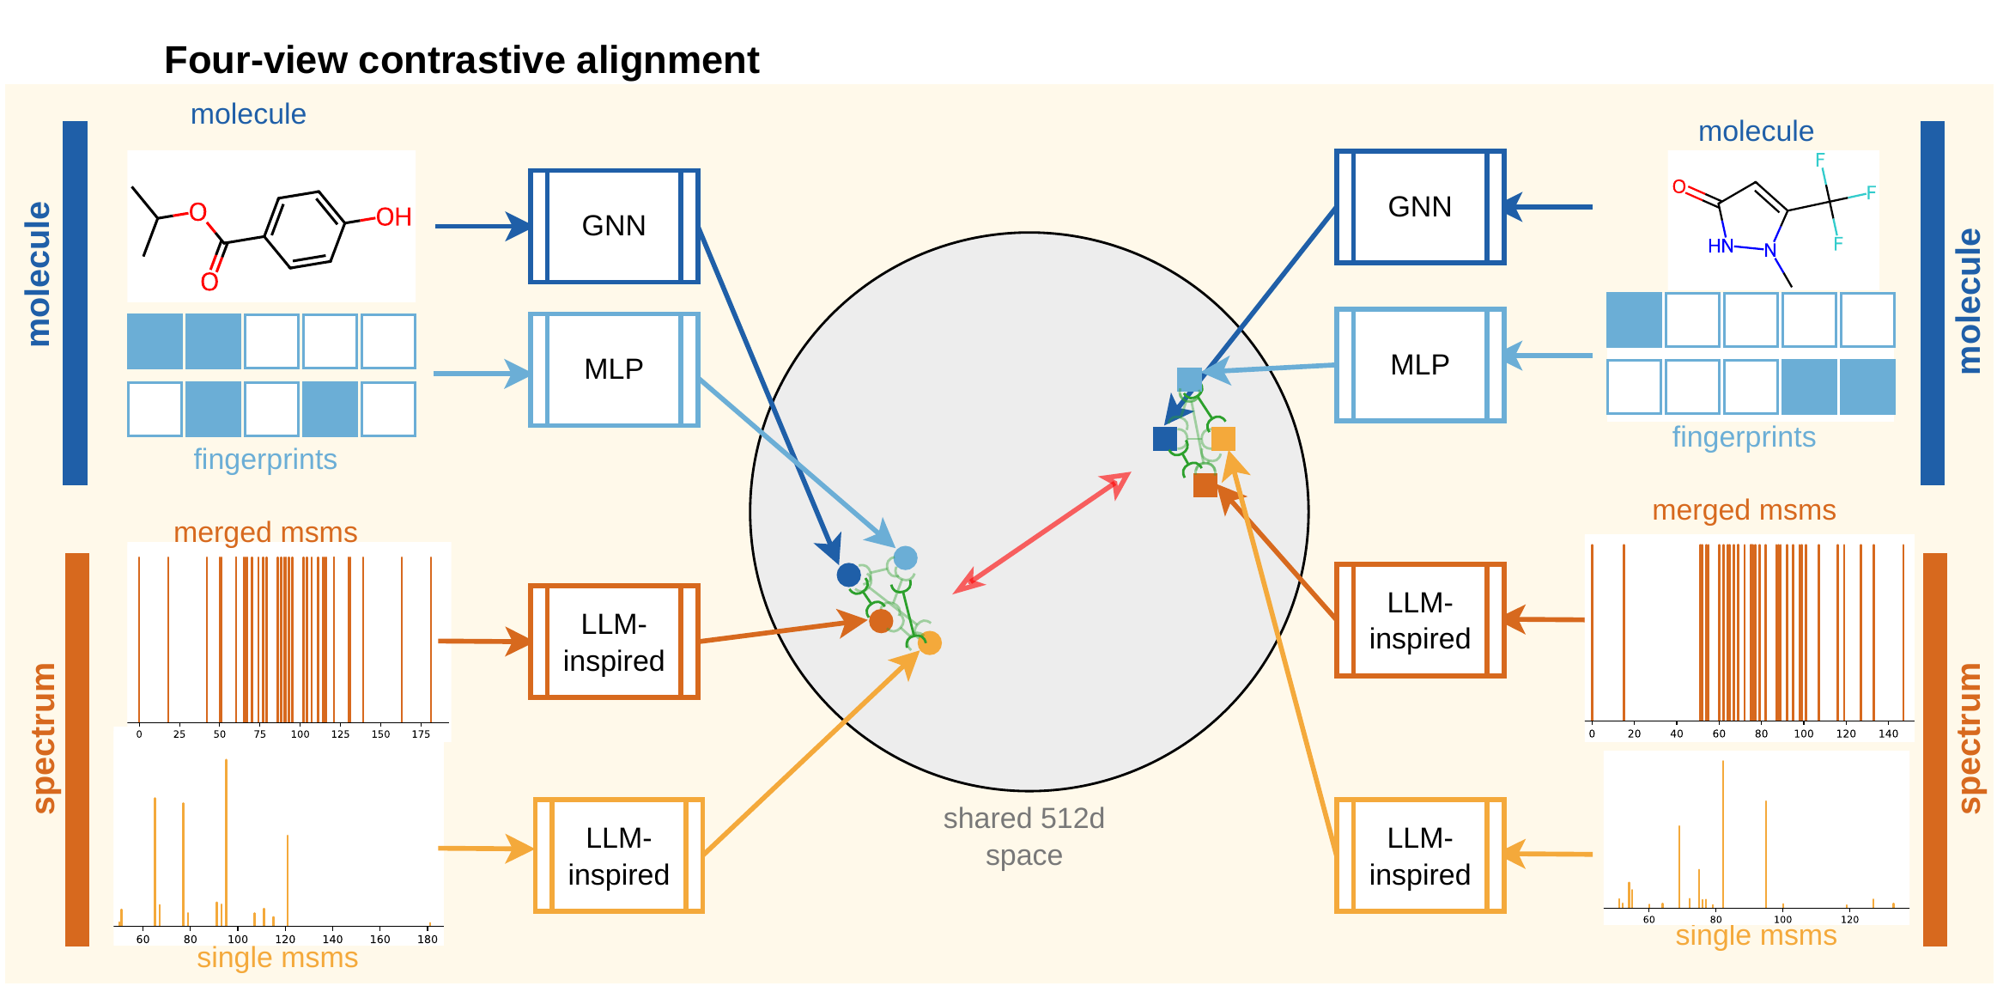
ACT 2 · ALIGNMENT
06:05–06:25
This is where the four views come together
Same-compound embeddings cluster. Other compounds are pushed apart.
Each coloured cluster is one compound. The red arrow is the InfoNCE push between compounds.
MultiCLIP | Ruiz-Botella, Sales-Pardo & Guimerà | URV · ComSCIAM · ICREA
08
Notes:
06:35–06:50 · ALIGNMENT, DRAWN
On-slide clock: 06:05–06:25.
SAY
This is where the four views come together.
Left and right are two different molecules. Each sends graph, fingerprint, merged spectrum and single spectrum into the shared space.
Views of the same compound form a tight cluster. The red arrow pushes the two compounds apart.
That is the six-term objective, drawn.
[Click]

Slide 19
THE PROBLEM
Coming back: How do we find the correct candidate?
MultiCLIP | Ruiz-Botella, Sales-Pardo & Guimerà | URV · ComSCIAM · ICREA
02
Notes:
06:50–07:05 · CALLBACK TO THE GRID
SAY
Coming back to the problem we opened with.
This spectrum was produced by one of these molecules. Same mass. Same formula.
We now have four aligned views. Next: how we use them to rank.
[Click]

Slide 20
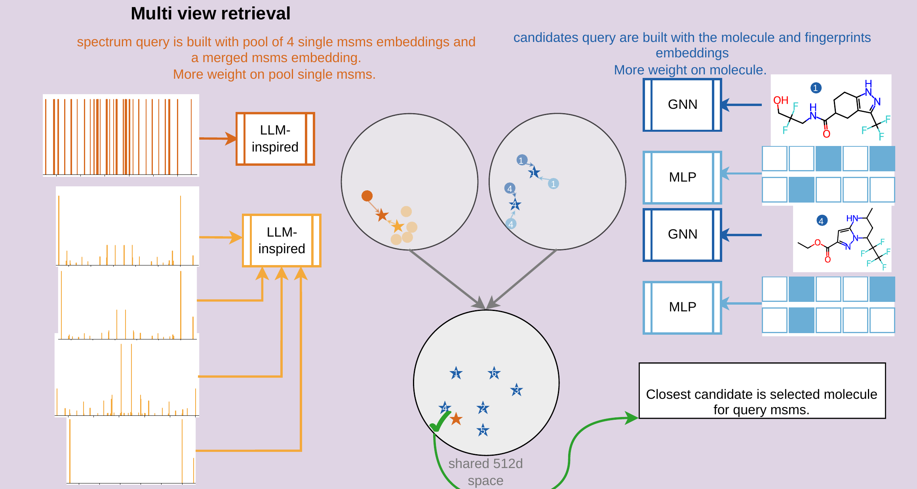
ACT 2 · RETRIEVAL
06:25–07:20
At inference: 1. we combine the spectrum embeddings
Query from merged + pooled singles
MultiCLIP | Ruiz-Botella, Sales-Pardo & Guimerà | URV · ComSCIAM · ICREA
09
Notes:
07:05–07:50 · RETRIEVAL
On-slide clock: 06:25–07:20. Slides 21–22 are hidden, so go from here to the leaderboard.
SAY
At inference we fuse the four views, then rank.
The query is a blend of the merged consensus and pooled single spectra.
Each candidate is a blend of the graph and the fingerprint.
Cosine similarity in 512-D picks the closest structure.
[If 21 and 22 stay hidden — they are hidden in this deck — add this, then go to the leaderboard:]
The fusion is asymmetric: more weight on the graph for candidates, more weight on pooled singles for the query. Operating points chosen on validation, not on test. One view is not enough. Combining them is what beats the published methods. The numbers are next.
[Click]

Slide 21
ACT 2 · RETRIEVAL
06:25–07:20
At inference: 2. we obtain the embeddings for each candidate
Each candidate from graph + fingerprint.
MultiCLIP | Ruiz-Botella, Sales-Pardo & Guimerà | URV · ComSCIAM · ICREA
09
Notes:
07:05–07:50 · RETRIEVAL
On-slide clock: 06:25–07:20. Slides 21–22 are hidden, so go from here to the leaderboard.
SAY
At inference we fuse the four views, then rank.
The query is a blend of the merged consensus and pooled single spectra.
Each candidate is a blend of the graph and the fingerprint.
Cosine similarity in 512-D picks the closest structure.
[If 21 and 22 stay hidden — they are hidden in this deck — add this, then go to the leaderboard:]
The fusion is asymmetric: more weight on the graph for candidates, more weight on pooled singles for the query. Operating points chosen on validation, not on test. One view is not enough. Combining them is what beats the published methods. The numbers are next.
[Click]

Slide 22
ACT 2 · RETRIEVAL
06:25–07:20
At inference: 3. we calculate the cosine distance from the query embedding to each candidate.
MultiCLIP | Ruiz-Botella, Sales-Pardo & Guimerà | URV · ComSCIAM · ICREA
09
Notes:
07:05–07:50 · RETRIEVAL
On-slide clock: 06:25–07:20. Slides 21–22 are hidden, so go from here to the leaderboard.
SAY
At inference we fuse the four views, then rank.
The query is a blend of the merged consensus and pooled single spectra.
Each candidate is a blend of the graph and the fingerprint.
Cosine similarity in 512-D picks the closest structure.
[If 21 and 22 stay hidden — they are hidden in this deck — add this, then go to the leaderboard:]
The fusion is asymmetric: more weight on the graph for candidates, more weight on pooled singles for the query. Operating points chosen on validation, not on test. One view is not enough. Combining them is what beats the published methods. The numbers are next.
[Click]

Slide 23
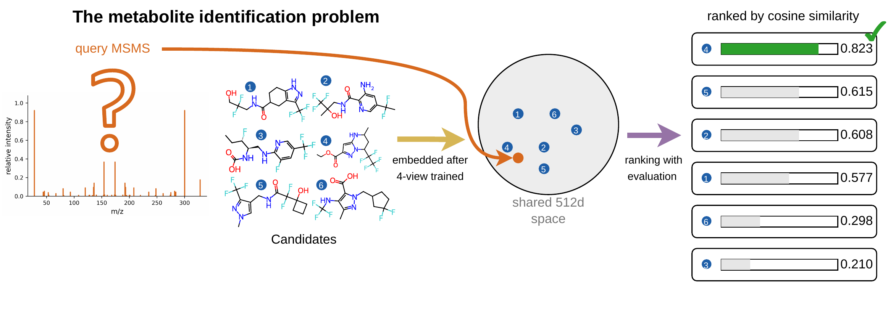
THE PROBLEM
12:55–13:20
The problem, solved.
Same query · four-view embedding · the right isomer ranks first.
MultiCLIP | Ruiz-Botella, Sales-Pardo & Guimerà | URV · ComSCIAM · ICREA
17
Notes:
11:50–12:15 · THE PROBLEM, SOLVED
On-slide clock: 12:55–13:20.
SAY
We opened with this query and this candidate list.
After four-view training, the spectrum and the molecules sit in the same 512-D space.
Cosine ranking puts candidate 4 first — the true isomer.
[Pause 2 s]
That is the identification.
[Click]

Slide 24
ACT 2 · FUSION
07:10–08:05
Training aligns the views. Inference combines them.
Candidate and query fusion are asymmetric because they solve different problems.
CANDIDATE STRUCTURE
SPECTRAL QUERY
2D graph
60%
Morgan FPS
40%
merged
20%
mean pool K = 16
single spectra · 80%
+
+
↓
↓
one candidate embedding
one query embedding
Cosine similarity ranks each formula-matched candidate against the fused query.
MultiCLIP | Ruiz-Botella, Sales-Pardo & Guimerà | URV · ComSCIAM · ICREA
10
Notes:
HIDDEN SLIDE — skip unless you unhide it.
Clock on slide: 07:10–08:05 · FUSION WEIGHTS
SAY
Training aligns the views. Inference combines them.
Candidate side: 60% graph, 40% fingerprint. One candidate embedding.
Query side: 20% merged, 80% mean of sixteen single spectra. One query embedding.
Asymmetric because they solve different problems: connectivity plus substructure on the candidate; a stable signature plus replicate variability on the query.
Cosine similarity then ranks each formula-matched candidate against the fused query.
[Click]

Slide 25
ACT 2 · EVIDENCE
07:20–09:15
One view loses. Combining views wins.
Recall@1 on held-out test. α, β and K selected on validation.
25.9
23.6
FLARE 22.66%
21.5
17.8
16.6
Merged
Single
DualSpec
Pool K=16
Fused
DualSpec clears FLARE. Pooling replicate evidence reaches 25.9%.
MultiCLIP | Ruiz-Botella, Sales-Pardo & Guimerà | URV · ComSCIAM · ICREA
11
Notes:
HIDDEN SLIDE — skip unless you unhide it.
Clock on slide: 07:20–09:15 · INCREMENTAL EVIDENCE
SAY
Here is the evidence, on held-out test. Alpha, beta and K were chosen on validation.
Merged-only: 17.8% Recall@1. Single-only: 16.6%. Both sit below FLARE at 22.66%.
DualSpec — combining the molecular views with the spectral views — 23.6%. Already above FLARE.
Pooling sixteen replicates alone: 21.5%. Fusing everything: 25.9%.
[Pause 3 s]
One view loses. Combining views wins.
[Click]

Slide 26
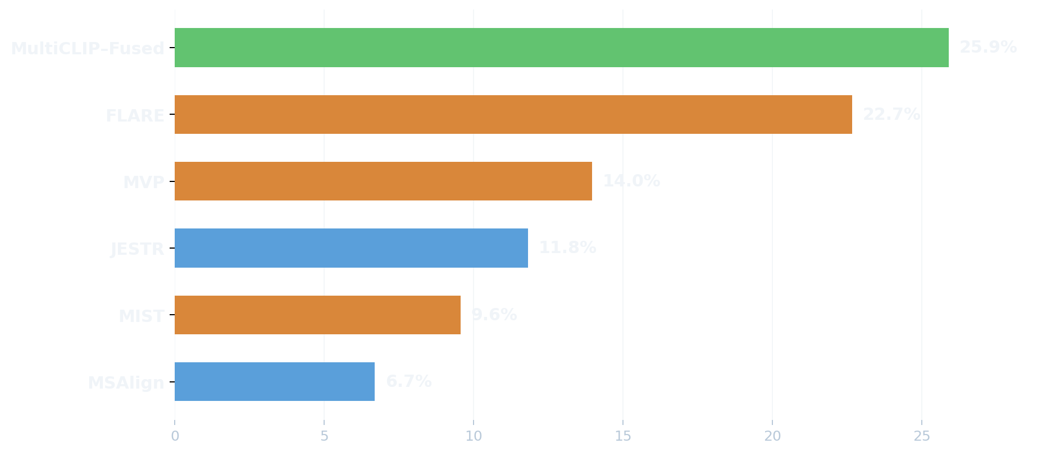
ACT 2 · RESULT
09:15–10:15
Best published Recall@1 — with formula-free spectrum encoding
MassSpecGym formula-known track · up to 256 isomers per query
MULTICLIP–FUSED
25.9%
Recall@1
53.8%
Recall@5
78.4%
Recall@20
Candidate list: formula-constrained
Spectrum encoder: formula-free
formula-free encoder
precursor formula required
MultiCLIP–Fused
MultiCLIP | Ruiz-Botella, Sales-Pardo & Guimerà | URV · ComSCIAM · ICREA
12
Notes:
07:50–09:00 · LEADERBOARD
On-slide clock: 09:15–10:15. You arrive early because 21–22 are hidden. Use the extra minute. Do not rush this slide.
SAY
MassSpecGym, formula-known track, up to 256 isomers per query.
MultiCLIP–Fused: 25.9% Recall@1. 53.8% at 5. 78.4% at 20 — about eight in ten metabolites land in a list a chemist can review.
That is the best published Recall@1, with a formula-free spectrum encoder.
FLARE is the strongest prior method, but it needs precursor-dependent subformula tokens. We do not.
[Pause 2 s]
One distinction, because it is easy to mix: the benchmark formula defines the candidate list. It is not an input to our spectrum encoder.
[Pause 3 s. Look at the centre of the room.]
Aligning four views of a metabolite helps to identify the isomer from several candidates.
[Click]

Slide 27
THE IDEA
10:15–10:30
What does the embedding space actually look like?
01
INPUT
02
ENGINE
03
HORIZON
Tokenise m/z directly
Align and fuse four views
Understand the latent geometry
MultiCLIP | Ruiz-Botella, Sales-Pardo & Guimerà | URV · ComSCIAM · ICREA
·
Notes:
09:00–09:15 · ACT 3 BEGINS
On-slide clock: 10:15–10:30.
SAY
The retrieval number is the result.
The remaining question is geometric: what does the embedding space actually look like?
[Pause 2 s. Point at card 03.]
That is Act 3.
[Click]

Slide 28
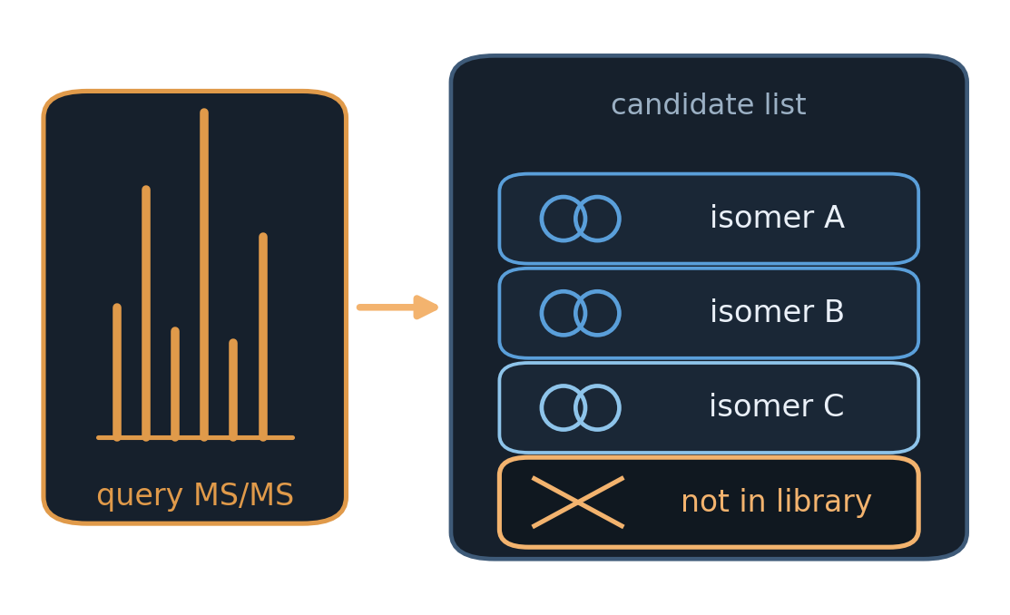
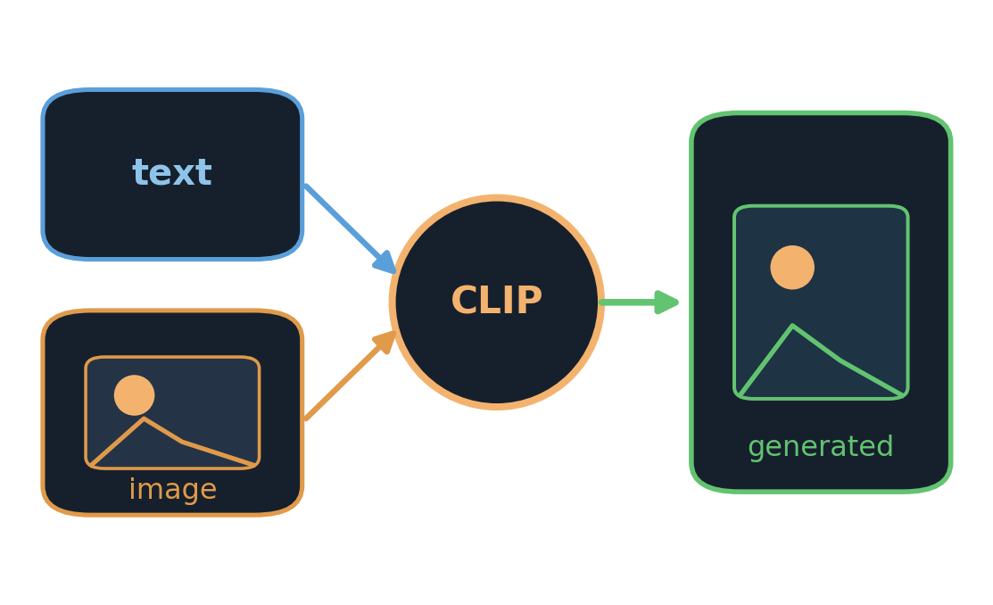
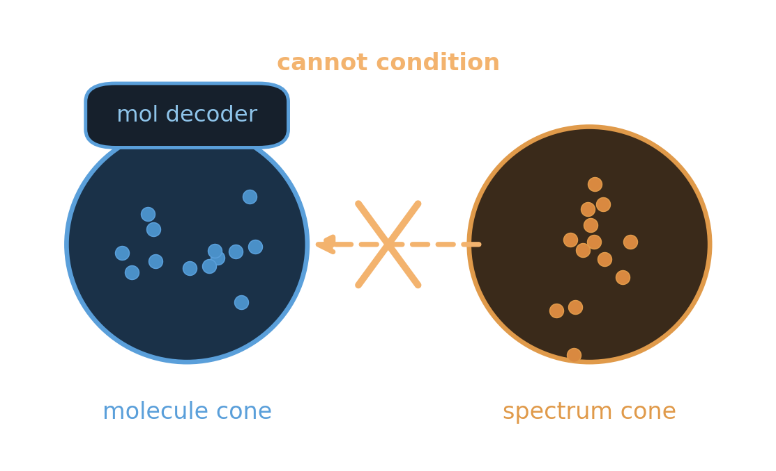
ACT 3 · WHY
11:05–11:25
Motivation for understanding the geometry.
Retrieval ranks existing candidates, the future is generating new molecules with guiding embedding.
01 · DATABASE CEILING
02 · OTHER CLIP DOMAINS
03 · THE OBSTACLE
Retrieval has a hard wall
Vision–language already generates
A decoder would see a shift
A novel metabolite is not in the list.
Ranking cannot invent it.
unCLIP and DALL·E 2 already decode
from contrastive latents.
A graph decoder fed a spectral vector
is out of distribution.
No method has yet generated structures from contrastive MS/MS embeddings. The missing piece is geometric.
MultiCLIP | Ruiz-Botella, Sales-Pardo & Guimerà | URV · ComSCIAM · ICREA
13
Notes:
09:15–09:45 · WHY THE GEOMETRY
On-slide clock: 11:05–11:25. Say this before the UMAPs.
SAY
Why does this geometry matter?
One. Retrieval has a hard wall. A novel metabolite is not in the list. Ranking cannot invent it.
Two. Vision–language CLIP already generates from contrastive latents. unCLIP and DALL·E 2 already decode from that space.
Three. A graph decoder fed a spectral vector would be out of distribution. That is the modality gap.
[Pause 2 s]
No method has yet generated structures from contrastive MS/MS embeddings. The missing piece is geometric.
[Click]

Slide 29
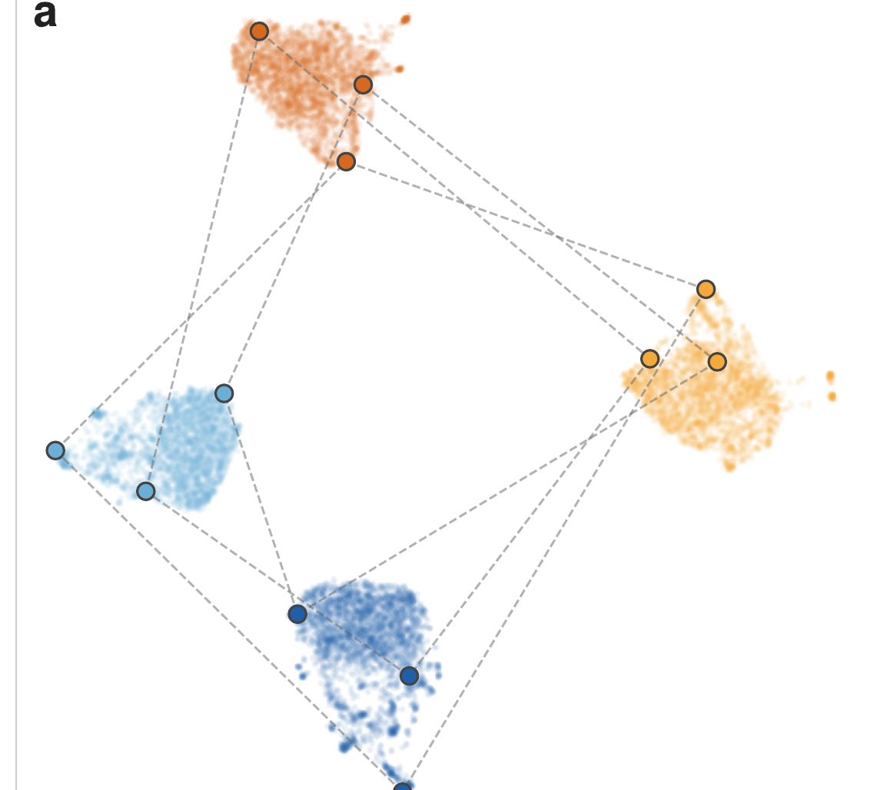
ACT 3 · GEOMETRY
10:30–11:05
Contrastive alignment does not make the modalities overlap
In the raw 512-D space, the four representations occupy separate regions.
Graph
FPS
Merged
Single
The modality gap
Same compound.
Four embeddings.
Four separated cones.
But note the pattern:
the displacement is systematic,
not arbitrary scatter.
MultiCLIP | Ruiz-Botella, Sales-Pardo & Guimerà | URV · ComSCIAM · ICREA
13
Notes:
09:45–10:15 · RAW MODALITY GAP
On-slide clock: 10:30–11:05.
SAY
Contrastive alignment does not make the modalities overlap.
InfoNCE aligns relative angles. It does not force the four encoders to occupy the same region.
In the raw 512-D space, graph, fingerprint, merged and single form separate cones.
Same compound: four embeddings, four separated cones.
[Pause 2 s]
But look at the pattern: the displacement is systematic, not arbitrary scatter.
[Click]

Slide 30
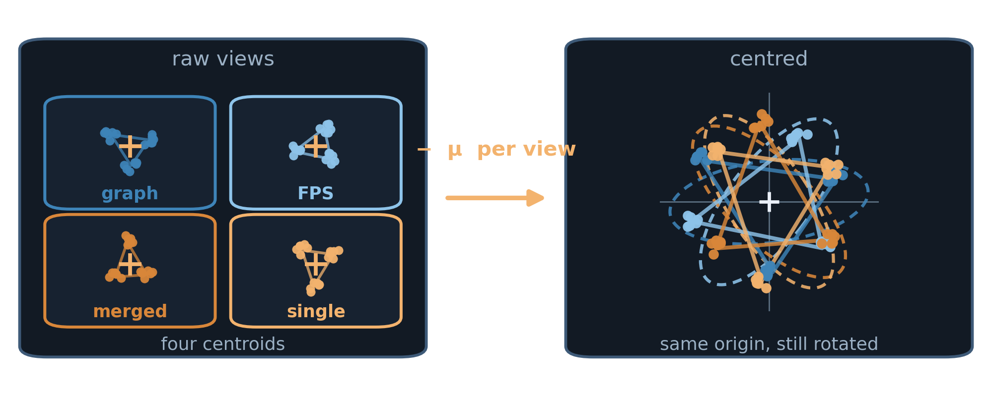
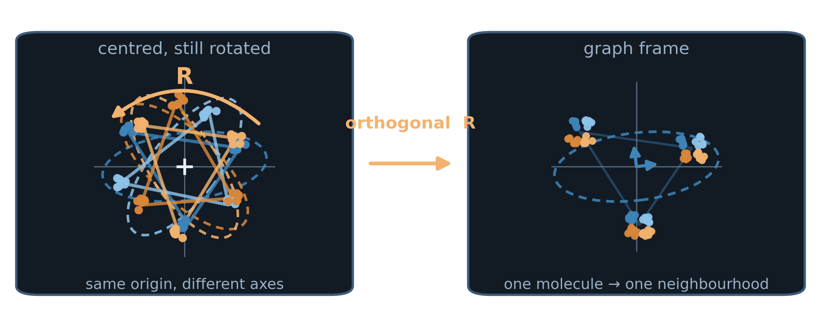
ACT 3 · ALIGN
11:15–11:35
Two deterministic steps. Nothing is retrained.
Centre each view, then rotate the others onto the graph frame.
01 · MEAN-CENTRE
02 · PROCRUSTES
Subtract the view mean
Rotate onto the graph frame
Each encoder has its own centroid.
We move every cloud to the origin.
Relative angles inside a view are unchanged.
An orthogonal R is fitted in 512-D.
Fingerprint, merged and single rotate onto graph.
Distances inside each view are preserved.
Affine, orthogonal, no extra training. Chemistry is preserved; only the coordinate frame moves.
MultiCLIP | Ruiz-Botella, Sales-Pardo & Guimerà | URV · ComSCIAM · ICREA
14
Notes:
10:15–10:40 · HOW WE ALIGN
On-slide clock: 11:15–11:35.
SAY
Two deterministic steps. Nothing is retrained.
First: subtract the mean of each view. Every cloud moves to the origin. Relative angles inside a view stay the same.
Second: an orthogonal Procrustes rotation maps fingerprint, merged and single onto the graph frame, in 512-D. Distances inside each view are preserved.
Affine, orthogonal, no extra training. Chemistry is preserved. Only the coordinate frame moves.
[Click]

Slide 31
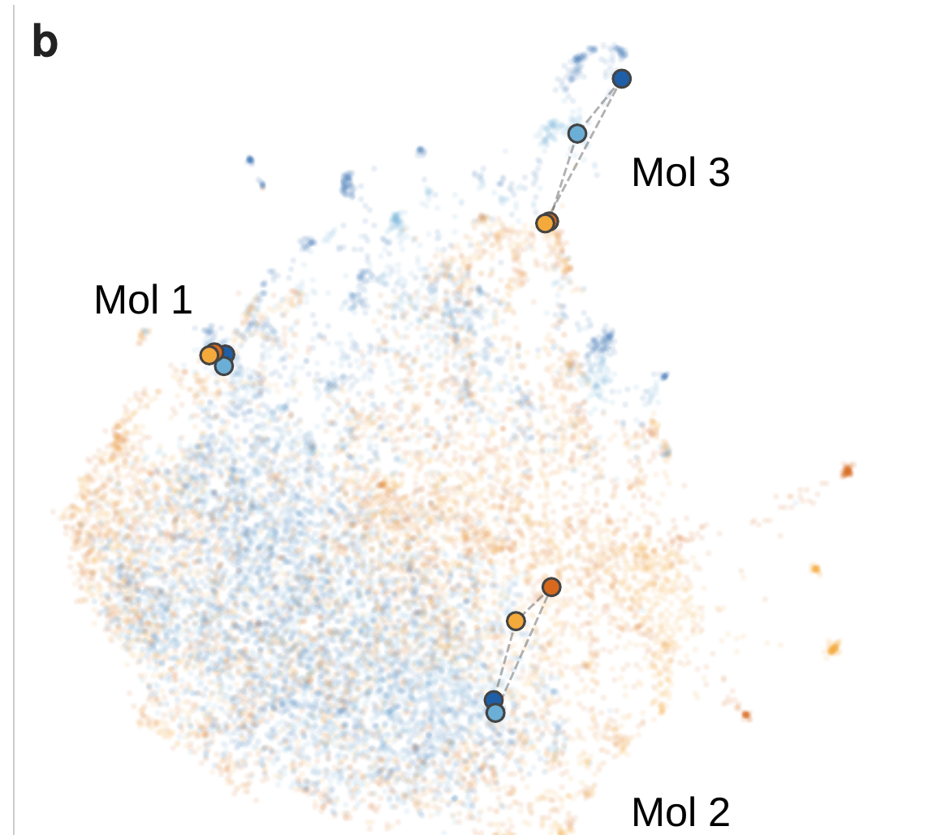
ACT 3 · GEOMETRY
11:35–12:05
A deterministic alignment closes the gap
Per-view mean-centering + paired orthogonal Procrustes rotation.
Merged
Single
Mol fused
No retraining
centre each view
+
rotate into one frame
Result
the four views overlap
without sacrificing
structural resolution.
MultiCLIP | Ruiz-Botella, Sales-Pardo & Guimerà | URV · ComSCIAM · ICREA
15
Notes:
10:40–11:10 · THE GAP CLOSES
On-slide clock: 11:35–12:05.
SAY
After that transform, the four views overlap.
The modality gap collapses, and structural resolution is kept: distinct molecules stay apart.
The gap was an affine displacement, not noise.
That is what makes a spectral embedding usable as a continuous condition — not only as a retrieval key.
[Click]

Slide 32
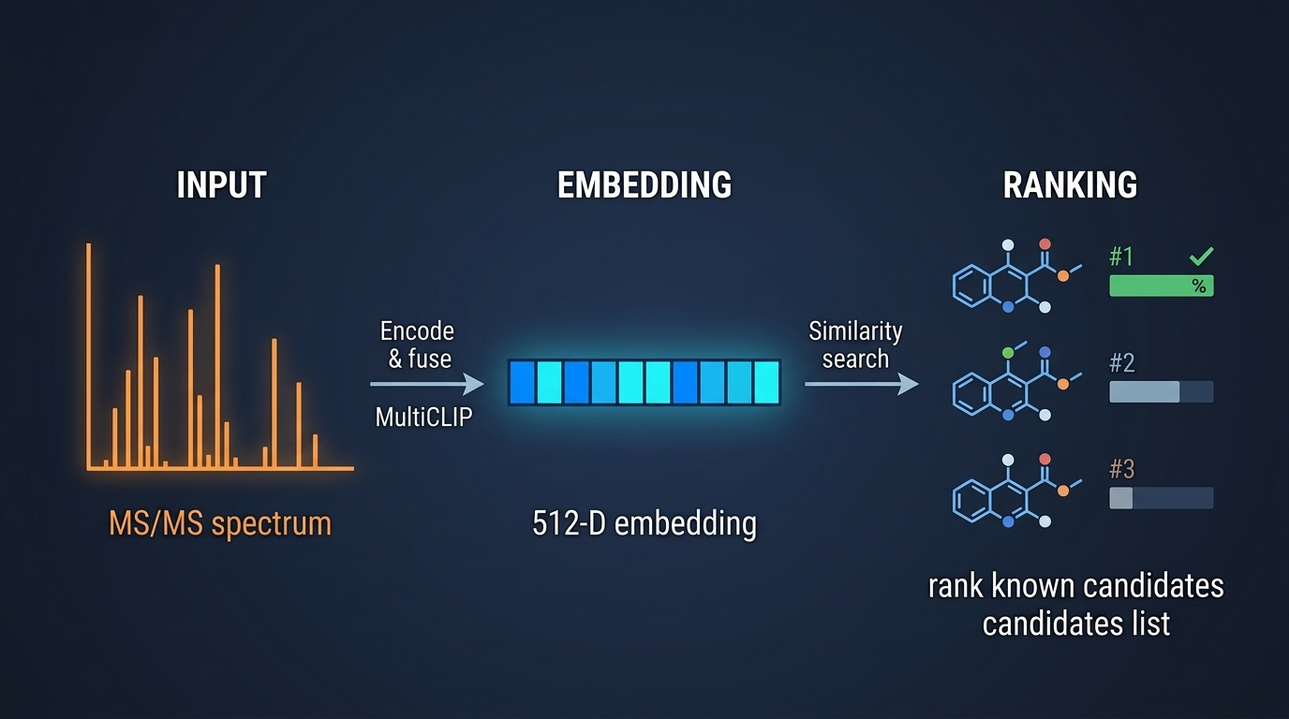
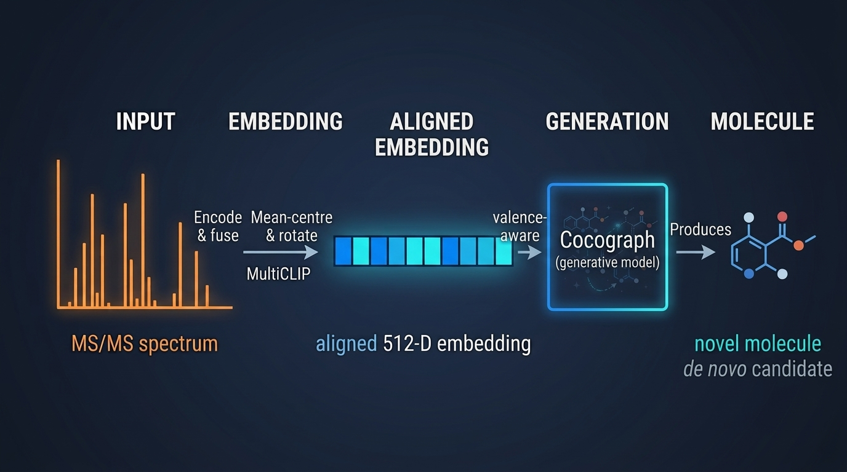
ACT 3 · HORIZON
12:05–12:55
Retrieval is today’s result. Generation is the next experiment.
No de novo claim: the aligned spectral embedding is a testable conditioning signal.
TODAY · RETRIEVAL
NEXT · GENERATION
The benchmark result is retrieval.
The geometric result removes a known obstacle to continuous conditioning.
MultiCLIP | Ruiz-Botella, Sales-Pardo & Guimerà | URV · ComSCIAM · ICREA
16
Notes:
11:10–11:50 · HORIZON
On-slide clock: 12:05–12:55. Keep this under 40 seconds.
SAY
Retrieval is today’s result. Generation is the next experiment.
Today: spectrum, to a 512-D embedding, to ranking known candidates.
Next: spectrum, to an aligned embedding, to a valence-aware graph generator.
I am not showing generated molecules. I am showing the space that makes that experiment possible.
The geometric result removes a known obstacle to continuous conditioning.
[Click]

Slide 33
CLOSE
13:20–13:50
We identify the isomer this way.
01 · WITHOUT THE FORMULA
02 · BY FUSING FOUR VIEWS
03 · WITH SOTA RESULTS
m/z tokens. No precursor formula.
Graph, fingerprint, merged, single.
25.9% Recall@1 · 53.8% @5
The peaks go in as they are measured.
Align them, then fuse at inference.
Best published, formula-free encoding.
THIS OPENS A NEW WAY TO RECONSTRUCT
The aligned embedding is not only a key for retrieval.
It is a continuous condition for generating molecules that are not in any library.
MultiCLIP | Ruiz-Botella, Sales-Pardo & Guimerà | URV · ComSCIAM · ICREA
18
Notes:
12:15–13:20 · CLOSE
On-slide clock: 13:20–13:50. Land before 13:30. Extra time is cushion, not more content.
SAY
We identify the isomer this way.
Without the precursor formula: m/z tokens. The peaks go in as they are measured.
By fusing four views: graph, fingerprint, merged, single. Align them, then fuse at inference.
With the best published Recall@1 on MassSpecGym: 25.9%, formula-free encoding.
[Pause 2 s]
That retrieval still has a ceiling: if the molecule is not in the list, ranking cannot invent it. The aligned embedding is a continuous condition for generating molecules that are not in any library.
[Pause 2 s]
So: aligning four views of a metabolite helps to identify the isomer from several candidates.
[Pause 3 s. Do not say “in conclusion”.]
If you work with spectra without a formula, I am happy to talk after this.
Thank you.
[Do not move until the applause.]

