Slide 1
Helping NYC’s underserved kids gain access to the highest quality of education
August 7, 2018
Final Project
Manoranjan Kumar
Gary Sepulveda
UTSA – MSDA – Data Analytics Applications &
Data Driven Decision Making & Design
Summer 2018

Slide 2
Problem Description
Black & Latino Students are significantly underrepresented in NYC Specialized High Schools.
NYC Black & Latino K-12 Population









How can we establish a predictive relationship between environmental & demographic factors leading to educational opportunities for PK - 8.
  Identify more granular success factors
  Apply insights to underperforming Schools
  Ultimately provide underserved with opportunity to succeed

70% of Total Enrollment
◻
◻
◻
◻
◻
◻
◻
◻
◻
◻
41% SHSAT Takers










8% Acceptance to Specialized High Schools
Notes:
PASSNYC aims to identify talented underserved students within New York City’s underperforming school districts in order to increase the diversity of students taking the Specialized High School Admissions Test (SHSAT).
PASSNYC aims to have a greater impact with a more objective approach to identifying the need for providing a better outreach at a given school. As of now they depend on some identified indicators such as number of English Language Learners, Students with Disabilities, Students on Free/Reduced Lunch, and Students with Temporary Housing.
Identify a KPI (response variable) for ranking all schools from the available open data such as overall academic score and/or Weighted Academic scores based on diversity enrollment.
Assess the needs of students by using publicly available data to quantify the challenges they face in taking the SHSAT.

Slide 3
Modeling Approach
Determine Topic & Acquire Data Sources
Determine Response & Predictors Variables
Data Cleaning & Preprocessing
Feature Engineering
Model Tuning
Generate Multiple Models
Model Comparison
Model Selection
Final Model
Conclusion

Slide 4
Data Sources
PASSNYC (Promoting Access to Specialized Schools in New York City)
  2016 School Explorer
NYC Dept of Education
  District 5 Specialized HS Test
City of New York/Social Services
  After School Programs
  Affordable Housing
US Dept of Commerce/Census Bureau Geography
  Census R & Tidy Census packages use API to source data

Slide 5
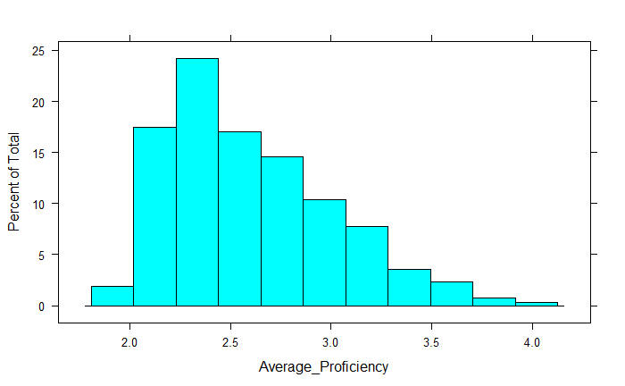
Predictors & Response Variables
Continuous Response Variable
Average_Proficiency (Math & English Scores)
Model Predictors
Original Predictors (159)
Removed Redundancy(50)
Remove Dup & ID (25)e
Multicollinearity Reduction(18)y
Variable Clustering(10)
2.6 mean
Correlation cut off point 0.80;
No degenerate variables found

Slide 6
Data Cleaning and Preprocessing
Sourced data from 4 datasets.
  Final number of observations – 1,217
  Reduced 55 missing response variables
Imputed with KNN for missing NA’s (394 of 1,272) or 31%
Box-Cox transformation applied
No degenerate variables found (near zero var)
PCA 90% variance explained by 10 of 19 components
Checked & removed highly correlated predictor variables
Evaluated and reduced predictors using Variable Clustering as a second approach

Slide 7
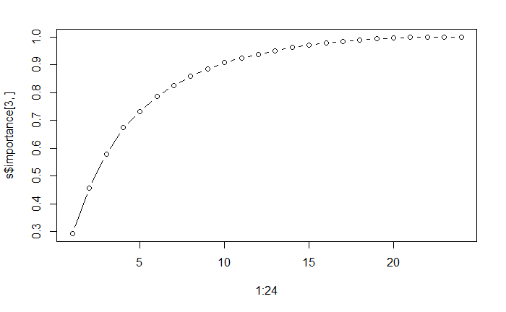
PCA – 90% equals 10 PCs

Slide 8
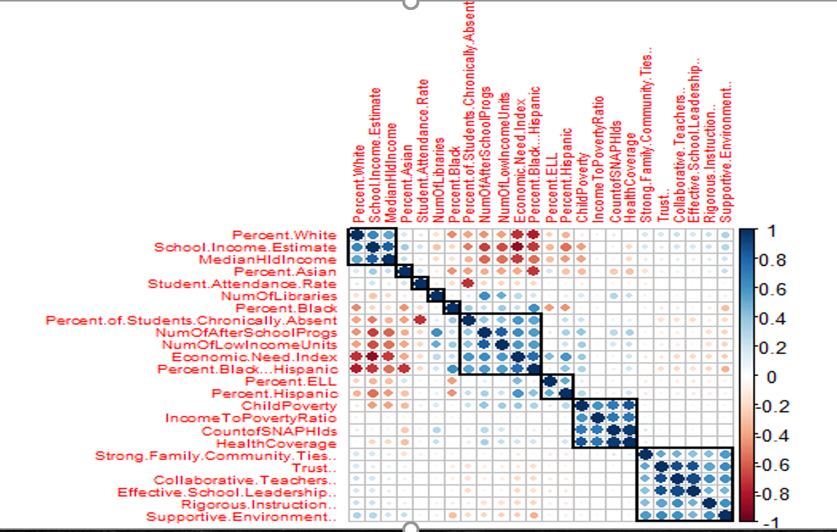
Predictor Correlation Matrix
7 Variables removed (cutoff @ 0.8)
Economic Need Index
School Income Estimate
# of After School Progs
Child Poverty
Collaborative Teachers
Trust
Count of SNAP Hlds

Slide 9
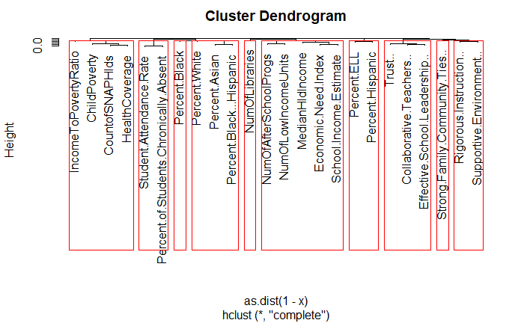
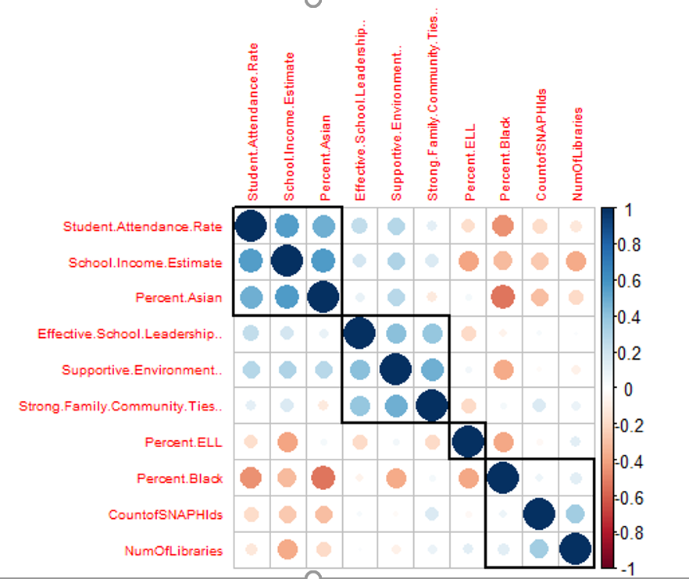
Variable Clustering (Dimensionality Reduction)
Reduced 14 Predictors by lowest RSQ ratio

Slide 10
Feature Engineering
1 Mile Radius from Each School
  Libraries
  After School Programs
  Low and Extremely Subsidized Housing
Census Tract Data (geoID)
    Median HH Income
    Ratio of Income to Poverty
    Child Poverty (under 18 Yrs old)
    # of HH with Food stamps
    # of HH with Health Coverage

Slide 11
Model Tuning
Achieved a 85 training/15 test split
  # or rows
  1030/181
Used repeated 10-fold cross validation to tune models

Slide 12
Generation of Multiple Models
Started with simple Linear Model, them built 6 more complex models including unsupervised models (i.e. RF & SVM)
Comparison of RMSE & R² was comparable across all models except PCR.
Best results using CV trained data was RF at mtry = 9
Found that LM and PLS models performed well compared to unsupervised models.
Notes:
Mtry = number of variables randomly sampled at each split
Default regression selects 18/3 P by 3

Slide 13
Model Comparison
Model | R² |  | RMSE
 | Test | Train | Test | Train
LM | 79.1% | 81.9% | 0.187 | 0.175
PLS | 79.0% | 81.6% | 0.188 | 0.175
PCR | 60.0% | 70.4% | 0.259 | 0.223
RF | 78.6% | 97.2% | 0.190 | 0.072
SVM | 79.1% | 81.6% | 0.188 | 0.176
Ridge | 79.1% | 81.9% | 0.187 | 0.175
LASSO | 79.2% | 81.9% | 0.187 | 0.175
LASSO (best test results)
  PCR (Not so good)
All test models performed well except PCR
Random Forest is significantly overfitted

Slide 14
Model Selection
Goal: Select the simplest model that performs well and can be easily understood and adapted as circumstances change.
  Final model is PLS
    Comparable performance
    Variable Importance
  BONUS – We compared our final model using an alternative tuning method (i.e. Variable Clusters)

Slide 15
Final Model – PLS
Model | R² | RMSE | Key Variables
PLS (reduced multicollinearity) | 79.0% | 0.188 | % of Students Chronically Absent Median HH Income # of Low Income Units Supportive Environment % ELL
PLS w / Variable Clustering | 63.4% | 0.247 | School Income Estimate Supportive Environment % ELL Community Schools Effective Leadership

Slide 16
Conclusion & Final Thoughts
Selected PLS Model
  Prediction performance good @ 79.0% R² / 0.188 RMSE
  Feature Engineered variables impacted model prediction (good insight)
Simple linear models did well compared to unsupervised ones
PCR with PCA tuning did not perform well
Further research and refinement needed:
  Consider predictor variables that impact the total educational pipeline
  Portable model - Can be applied to other school districts/geographies
  Assess impact of controllable variables impacting educational success

Slide 17

DATA
Thank You!

Slide 18
Appendix
Bonus Slides

Slide 19
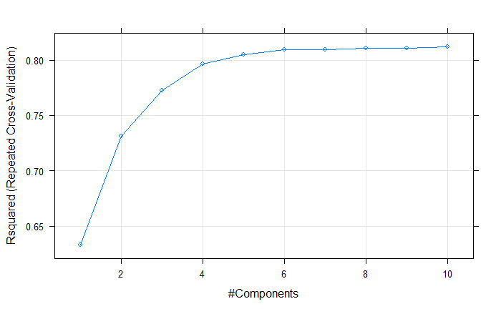
PLS Model - # of Components & R²

Slide 20
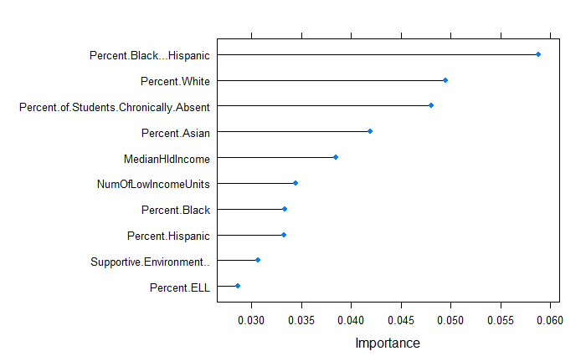
PLS Model – Top 10 Variables of Importance

Slide 21
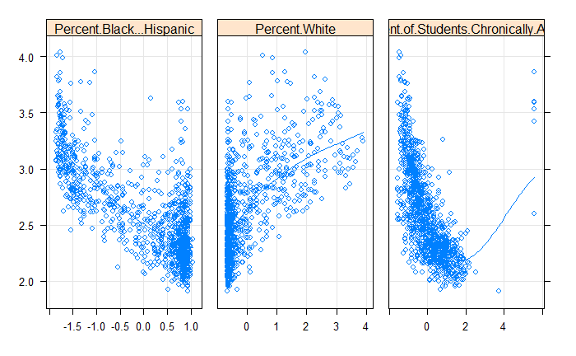
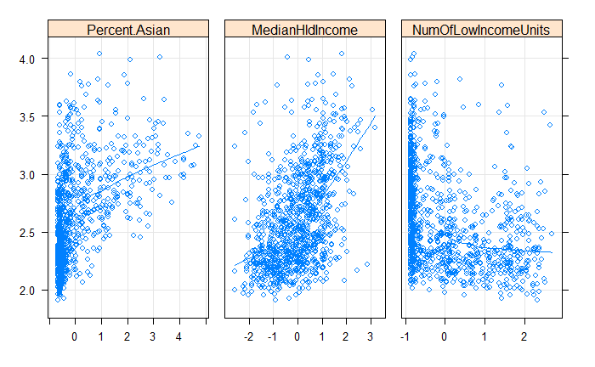
PLS Model – Scatterplots with Response Variable

Slide 22
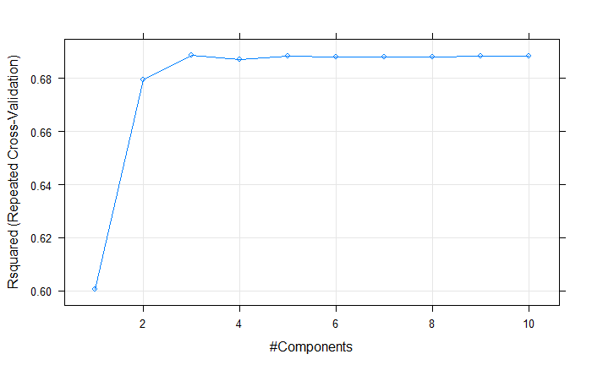
PLS Model w/Var Clst - # of Components & R²

Slide 23
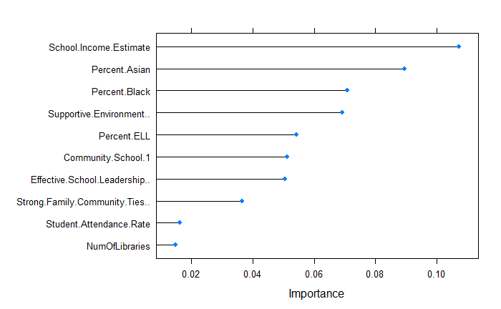
PLS Model w/Var Clst – Top 10 Variables of Importance

Slide 24
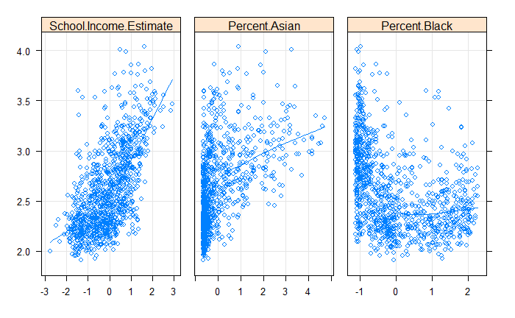
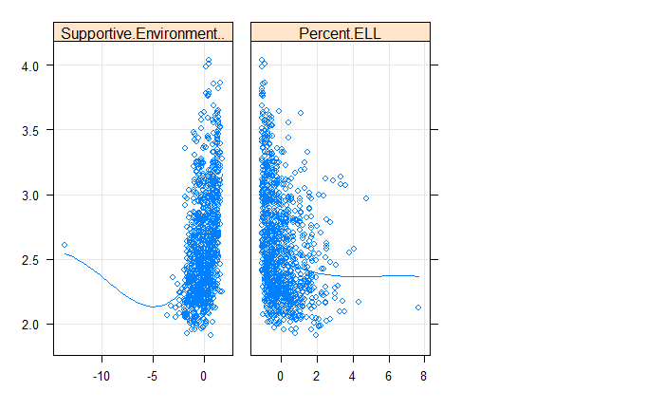
PLS Model w/Var Clst – Scatterplots with Response Variable

