Slide 1

IT244 Software Group Project -1
MAZE SOLVER
Project members –
Manush Parikh – 17I7061
Deep Desai – 17IT018
Guide – Ms.Nehal patel

Slide 2
Introduction -
A project on maze solver where the machine will be finding the shortest path to be out of the maze. Concepts of “Q-learning” will be applied for solving the maze. Main applications of such automated maze solving robots are, automated crate moving within a warehouse, military applications may involve, robots traversing unknown terrain while avoiding or moving obstacles out of the way and in rescue or emergency scenarios whereby robots are required to go into hazardous situation.

Slide 3
Problem and Solution Statement -
The problem is solving a maze and finding the shortest path to achieve the result is difficult and time consuming which in turn uses a lot of resources and man power and understanding. Thus, all these consequences that we face can be solve by intending the machine to find the shortest path from the maze by applying the basic knowledge of machine learning specifically reinforcement learning.

Slide 4
Implementation Strategy -
The workflow will start with learning the basic concepts of machine learning, reinforcement learning and “Q-learning”. Further on we will apply our learned concepts GUI based maze and find the shortest path for it. Then we will try to combine our concepts and prepared GUI solution to the machine.

Slide 5
Apparatus Required -
2 Micro Gear Motors
Pair of Motor Brackets
Pair of Wheels
Ball Caster
Analog Reflectance Sensor Array
Arduino Uno
Motor Driver IC
4AAA Battery Holder
4 Rechargeable AAA Batteries

Slide 6
Tools and Technology -
Arduino and circuit elements –
Q-learning -

Slide 7
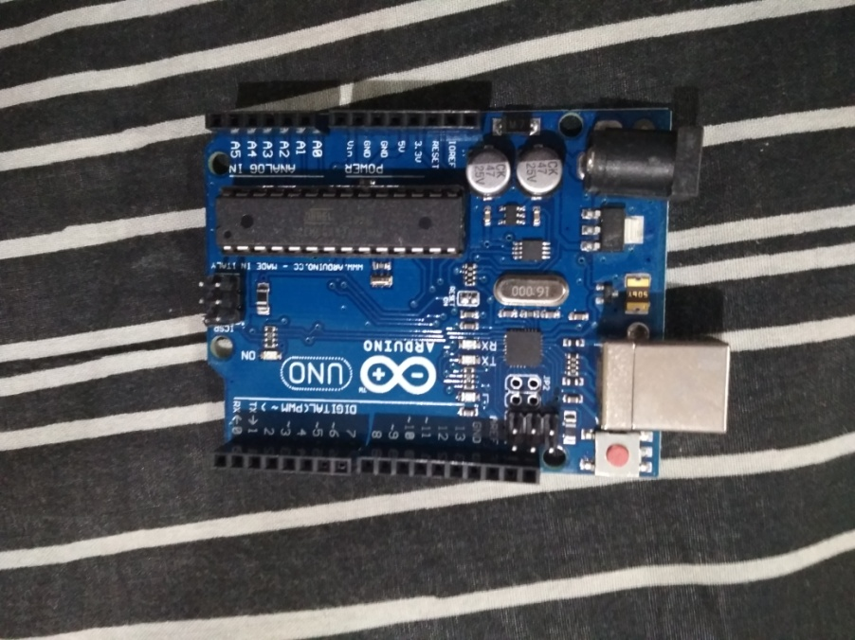
1.Arduino And Circuit elements – Arduino Uno -
- The Arduino UNO is a widely used open-source microcontroller board.
The board features 14 Digital pins and 6 Analog pins.
It can be powered by a USB cable or by an external 9 volt battery, though it accepts voltages between 7 and 20 volts.
Why Arduino Uno rather than other Arduino boards –
Most standard board available and best for beginners.
Dual purpose of USB cable to supply voltage and to act as serial port
The Uno features 14 Digital I/O pins and 6 Analog I/O pins.
Lot of extra Add-on hardware is built for Uno. Special hardware is available for Internet, Bluetooth, Motor control etc.

Slide 8
Arduino pins -
Pin Category | Pin Name | Details
Power | Vin, 3.3V, 5V, GND | Vin: Input voltage to Arduino when using an external power source. 5V: Regulated power supply used to power microcontroller and other components on the board. 3.3V: 3.3V supply generated by on-board voltage regulator. Maximum current draw is 50mA. GND: ground pins.
Reset | Reset | Resets the microcontroller.
Analog Pins | A0 – A5 | Used to provide analog input in the range of 0-5V
Input/Output Pins | Digital Pins 0 - 13 | Can be used as input or output pins.
Serial | 0(Rx), 1(Tx) | Used to receive and transmit TTL serial data.
External Interrupts | 2, 3 | To trigger an interrupt.
PWM | 3, 5, 6, 9, 11 | Provides 8-bit PWM output.
SPI | 10 (SS), 11 (MOSI), 12 (MISO) and 13 (SCK) | Used for SPI communication.
Inbuilt LED | 13 | To turn on the inbuilt LED.
TWI | A4 (SDA), A5 (SCA) | Used for TWI communication.
AREF | AREF | To provide reference voltage for input voltage.

Slide 9
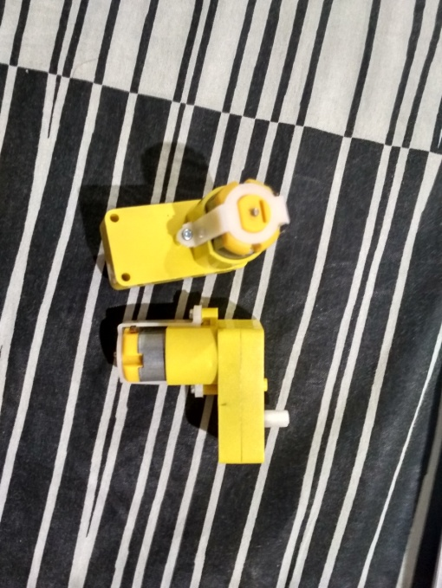
Micro Motor Gears -
DC Motors with gears and 5v power supply requirement will be used to run the wheels and the Machine in the maze.

Slide 10
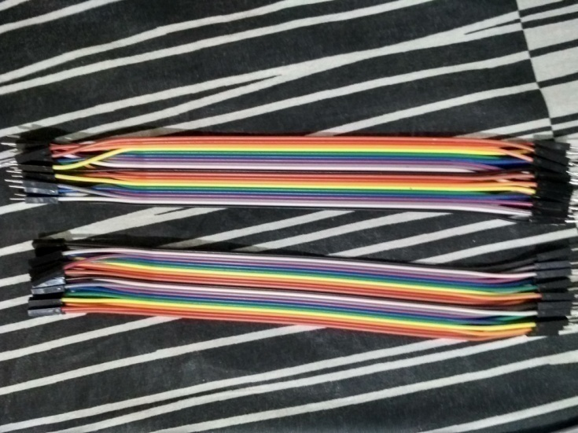
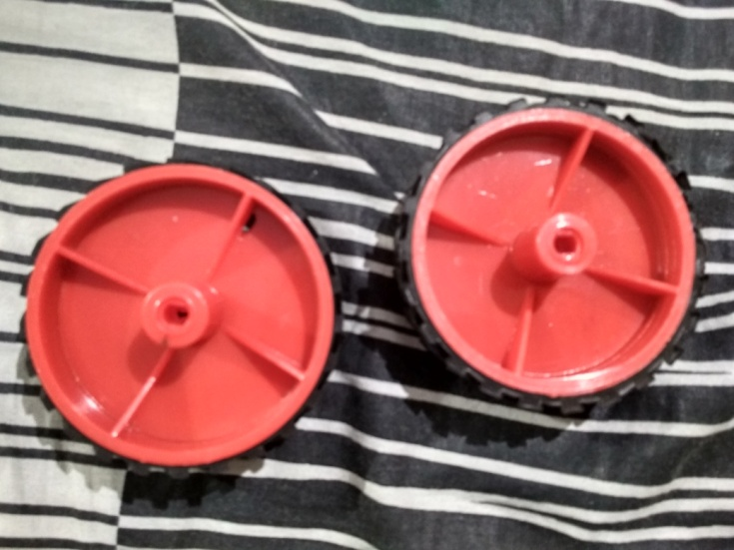
Pair of Wheels and Wires -
Wheels will be used for the movement of the robot and wires to connect the connections.

Slide 11
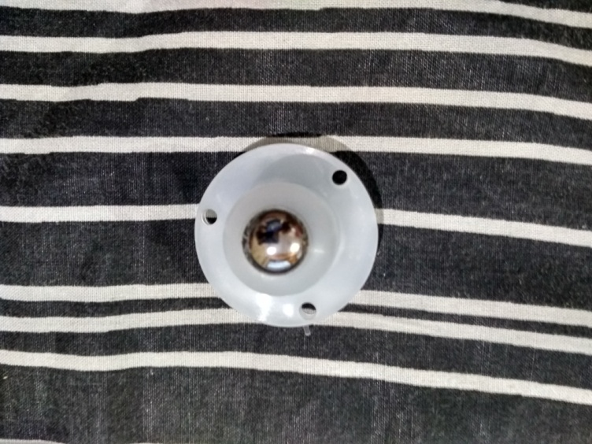
Ball Caster -
Ball casters are a type of caster that features a spherical-shaped roller ball wheel, to provide specific maneuvering abilities.

Slide 12
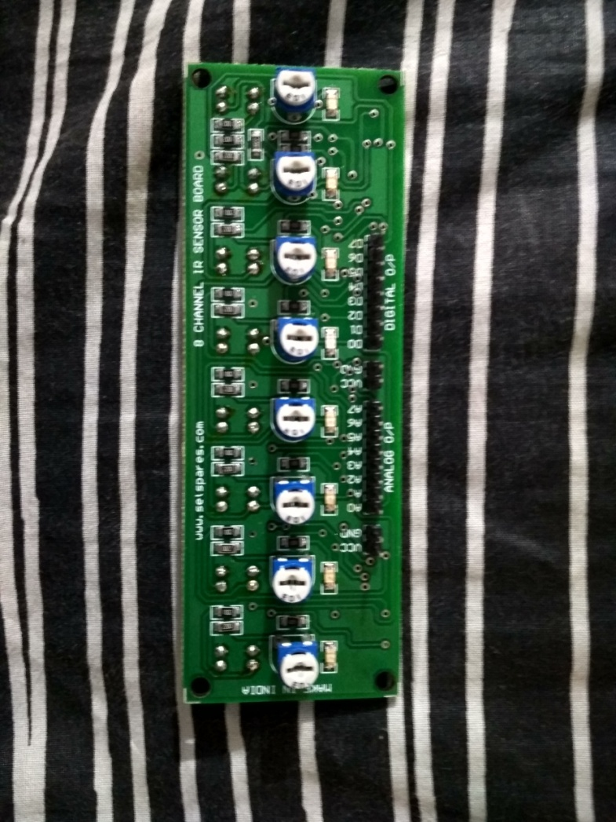
Analog Reflectance Sensor Array -
The QTR-8A reflectance sensor array is intended as a line sensor, but it can be used as a general-purpose proximity or reflectance sensor. The module is a convenient carrier for eight IR emitter and receiver (phototransistor) pairs evenly spaced at intervals of 0.375" (9.525 mm).

Slide 13
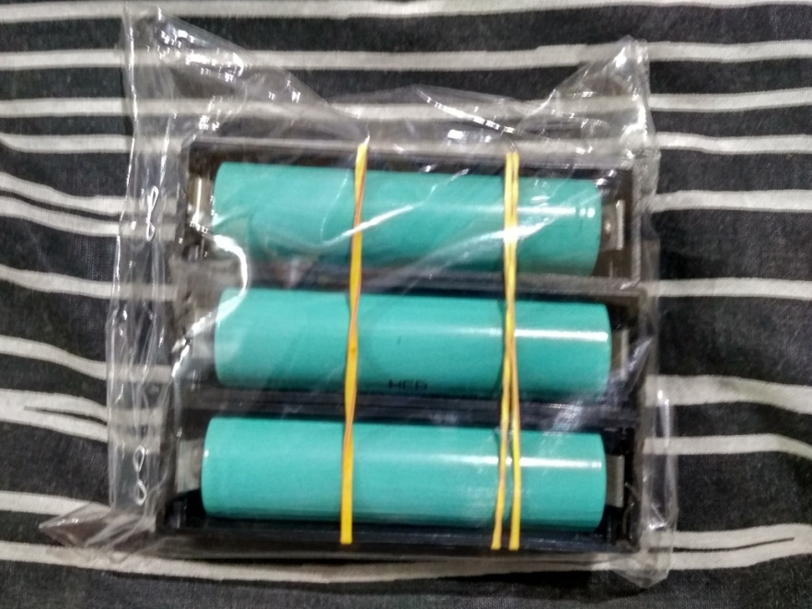
4 Rechargeable AAA Batteries And 4AAA Battery Holder -
This will be the power supply for the circuit to function. The cells are rechargeable and thus can be used times. The battery holder holds the batteries and thus makes it simple.

Slide 14
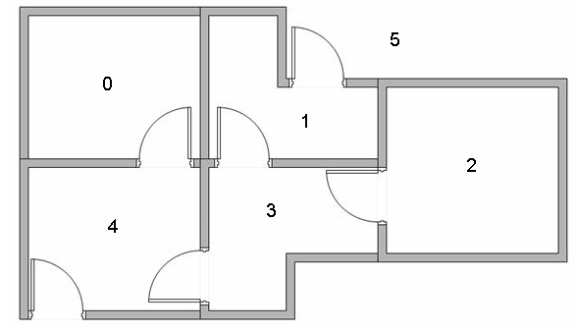
2.Q-learning -
Problem:

Slide 15
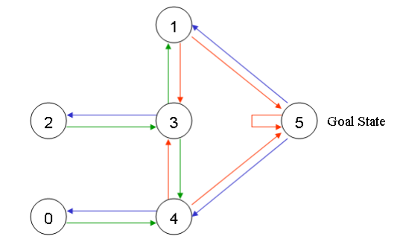
Graphical representation of the problem:

Slide 16
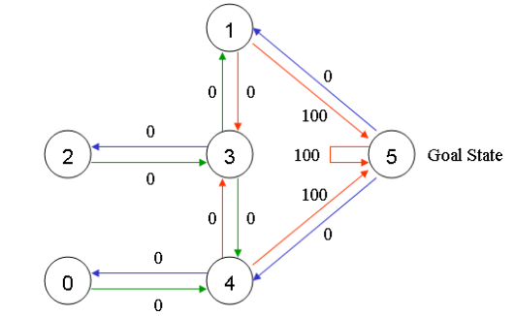
Weighted Graph:

Slide 17
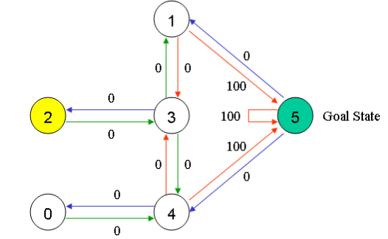
Starting the development of r matrix:

Slide 18
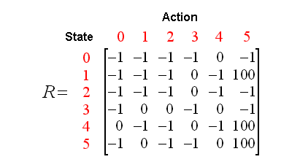
Matrix based on 2 as initial stage:

Slide 19
Formula for Q-Matrix
Q(state, action) = R(state, action) + Gamma * Max[Q(next state, all actions)]

Slide 20
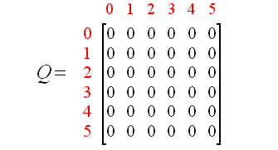
Q- Matrix
Initialize matrix to zero:

Slide 21
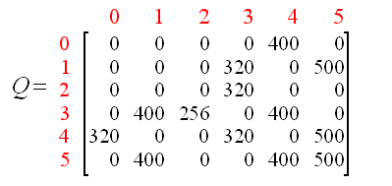
Developed Matrix

Slide 22
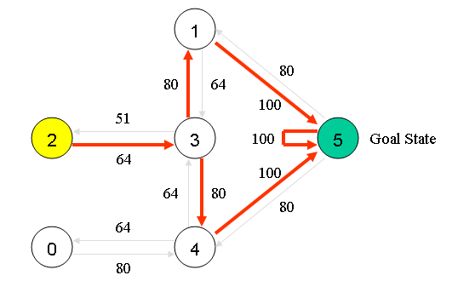
Solution

Slide 23
Bibliography
https://www.instructables.com/id/Maze-Solving-Robot/
http://patrickmccabemakes.com/hardware/Maze_Solving_Robot_V3/
http://mnemstudio.org/path-finding-q-learning-tutorial.html

Slide 24


