Slide 1

EchoNote AI Meeting Transcriber • Nepali & English

Slide 2



INTRODUCTION
AI records and transcribes meetings.
Creates summaries and minutes automatically.
Detects both Nepali and English speech.
Works for physical and online meetings

Slide 3
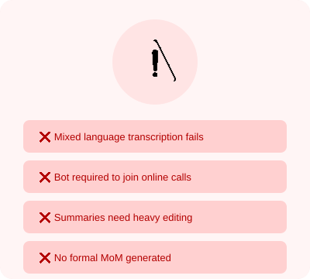
PROBLEMS

Slide 4
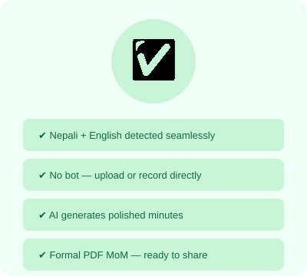
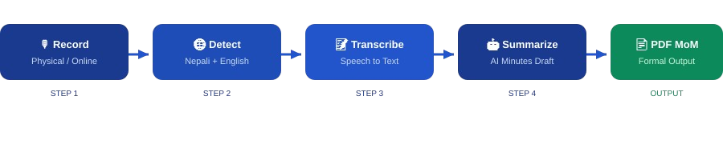
PROJECT GOALS

Slide 5
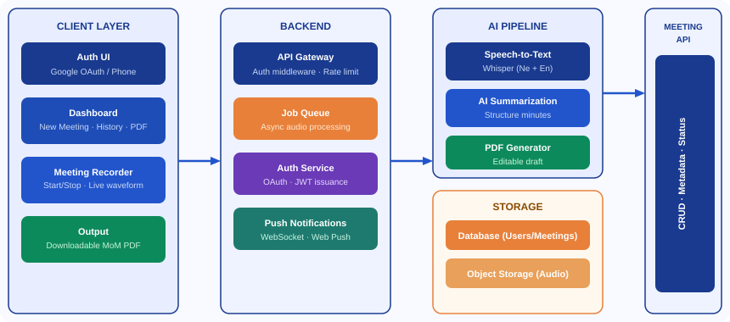
SYSTEM ARCHITECTURE

Slide 6
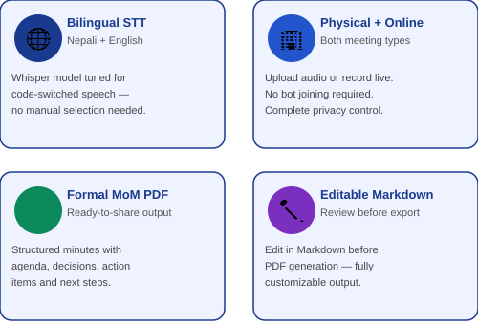
KEY FEATURES

Slide 7
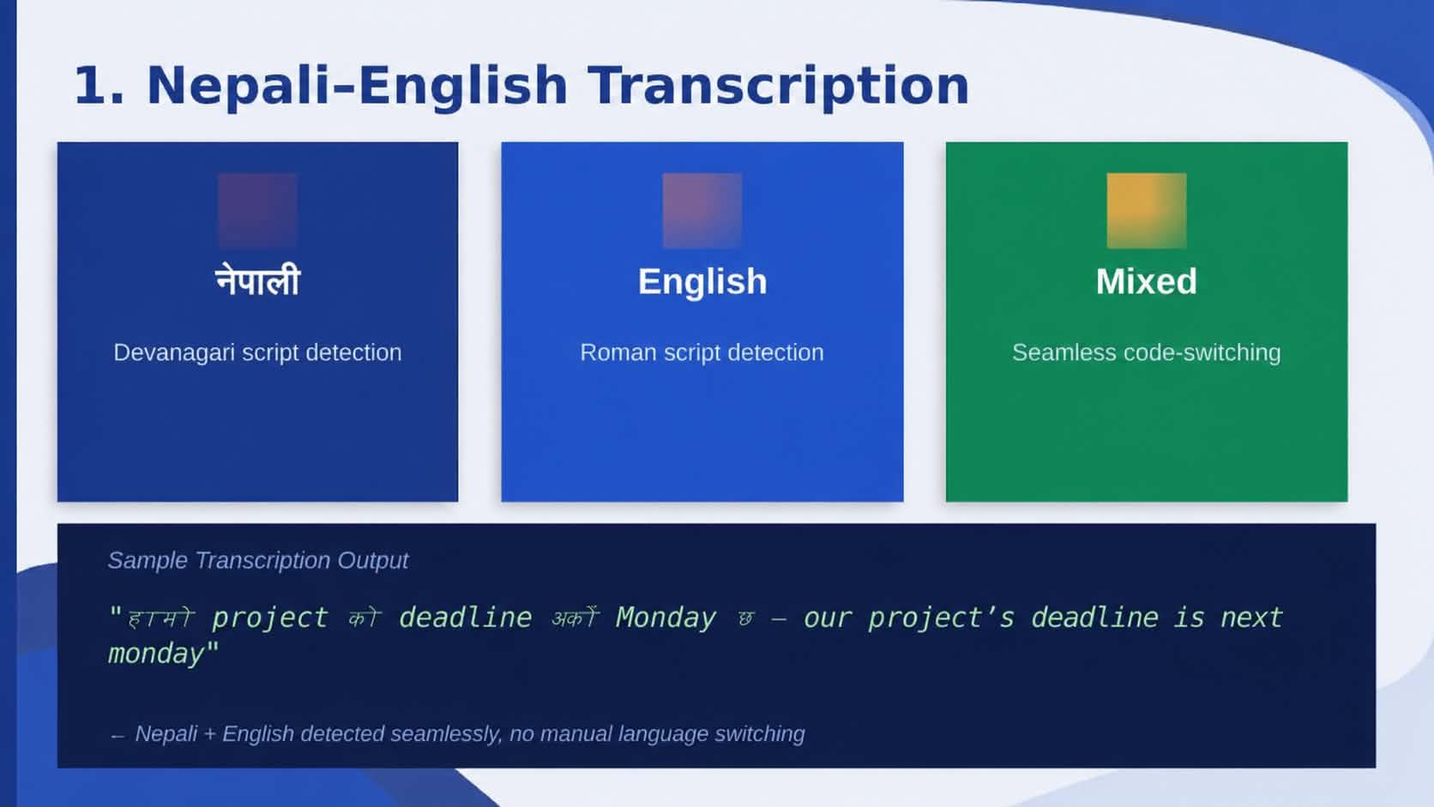



Slide 8
2. Physical & Online Meeting Support
🏢Physical Meeting
Open the app, press Record, speak. AI captures everything in the room — no extra hardware needed.
💻 Online Meeting
Download the audio from Zoom/Meet/Teams and upload it. Processed instantly — no bot joins your call.

Slide 9
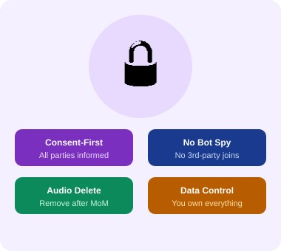
3. NO BOT DEPENDENCY

Slide 10



4. Privacy First
Consent-First Design
Zero Bot Intrusion
Your Data, Your Control

Slide 11

5.Why Formal MoM?
Professionalism
Standardization
Clarity
Documentation
Flexibility

Slide 12
THANK YOU

