Slide 1
Smile Detection App
By Manushi
Notes:
Hi, I’m Manushi. I’ll walk you through what Smile Detection App does, how it works, and some things I learned along the way.

Slide 2
Smile Detection App
Real-time Smile Detection using React & Python (FastAPI + OpenCV)
Full-stack app: React frontend, FastAPI backend
Real-time smile detection from webcam (OpenCV Haar cascades)
Detection events and images logged to SQLite and disk
Robust error handling, configuration via environment variables
Well-tested (Jest + Pytest)
Notes:
It’s a full-stack project: the frontend is built in React, the backend is Python with FastAPI and OpenCV. Basically, it takes camera frames and detects if you’re smiling in real time. If it finds a smile, it draws a bonding box on the image and saves both the image and the info about the smile into a database.
The app features error handling, with all configuration handled via environment variables for easy deployment. Both frontend and backend are well-tested

Slide 3
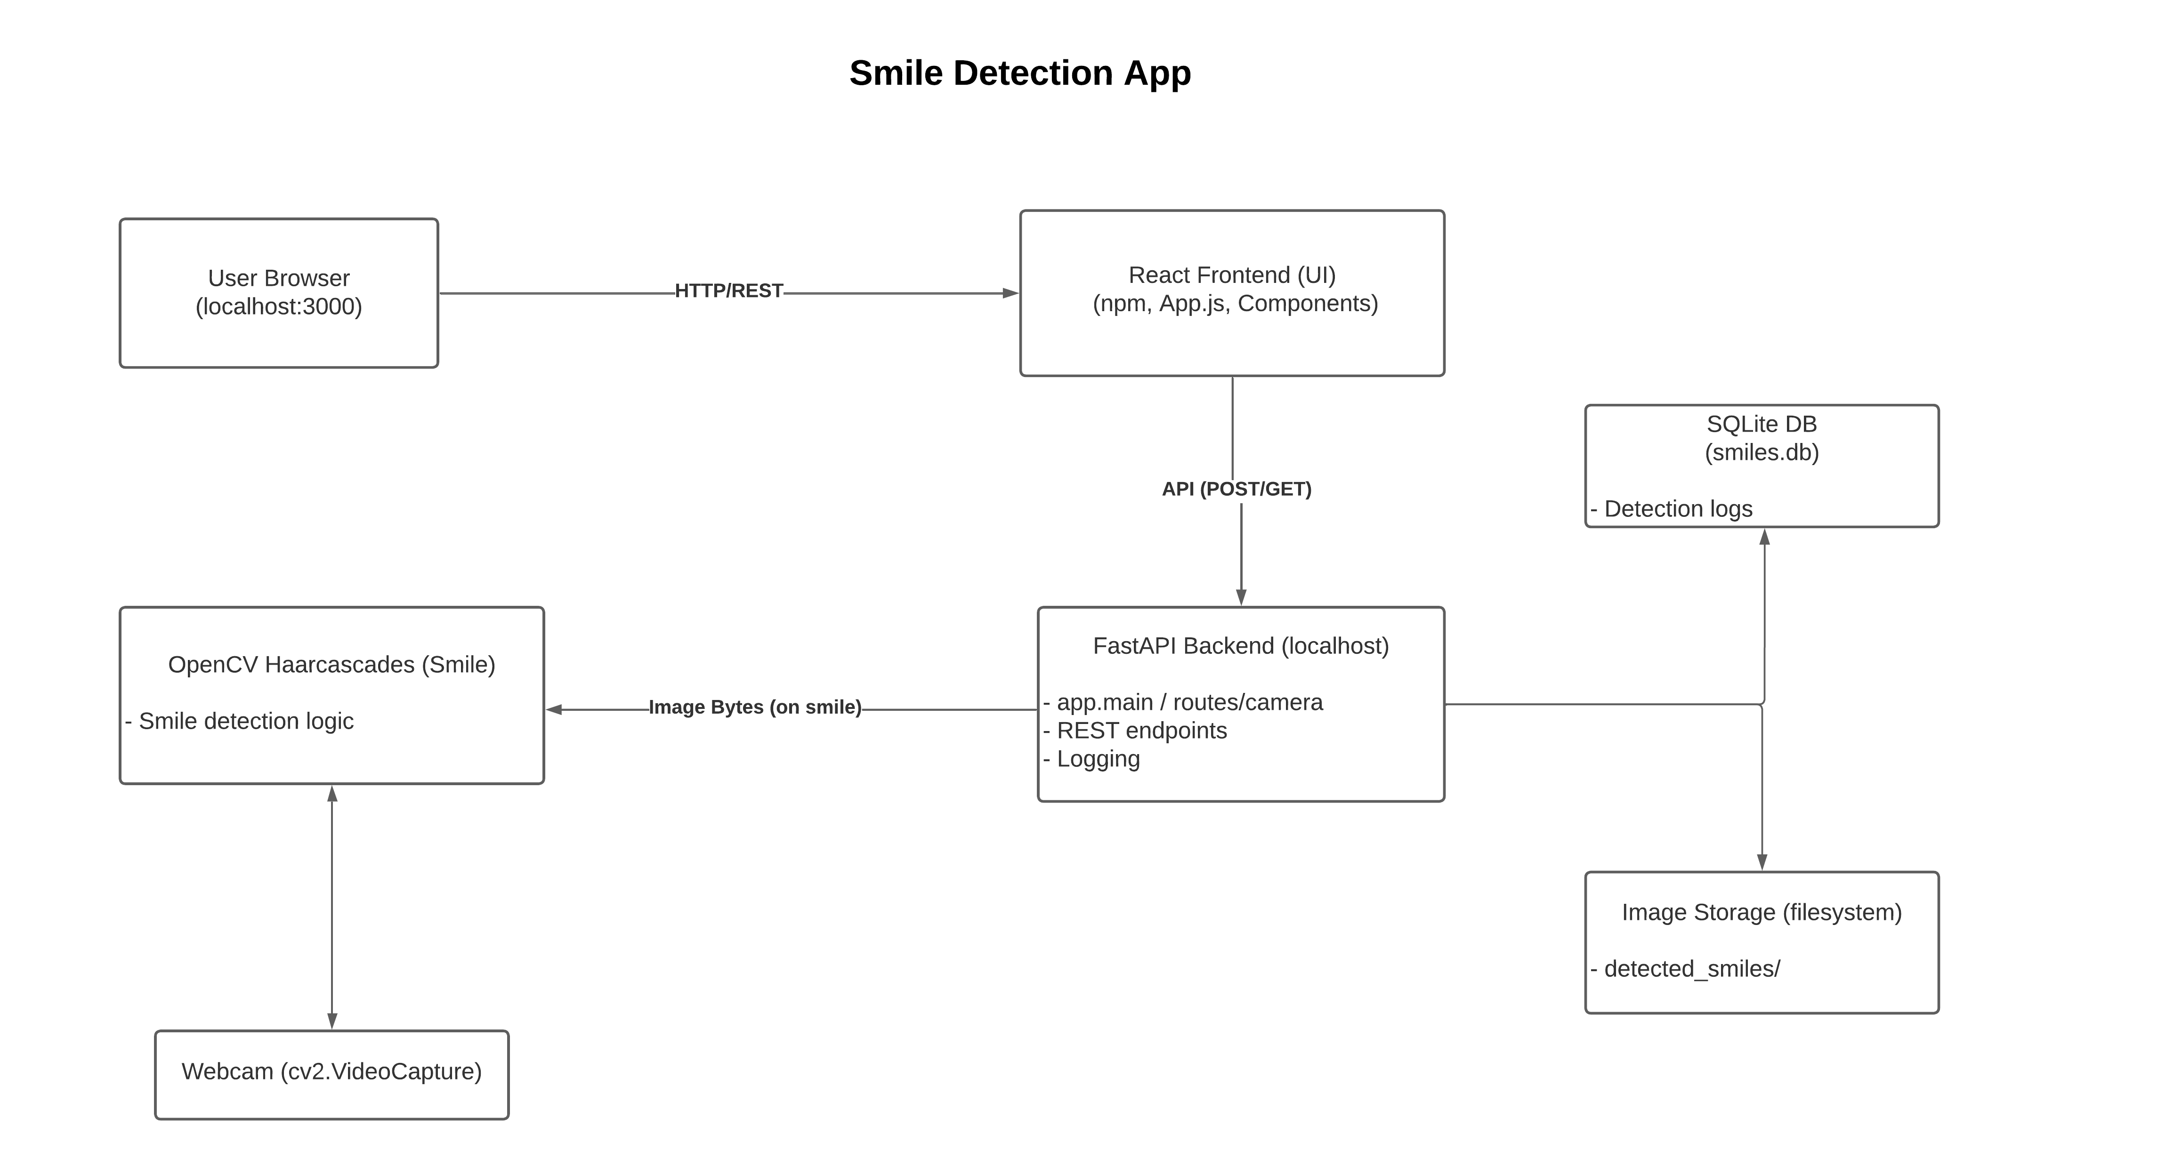
System Architecture
High-level system architecture: End-to-end data flow from browser to backend and persistence.
Notes:
Here’s a high-level architecture diagram. The user interacts with the React app in the browser. That interacts with the Python backend using simple API calls. The backend handles the camera management, runs the smile detection, and sends only the smile detected image and coordinates data back to the frontend. Anytime a smile is found, it logs that in the database and saves the picture. This setup keeps everything organized and easy to manage.

Slide 4
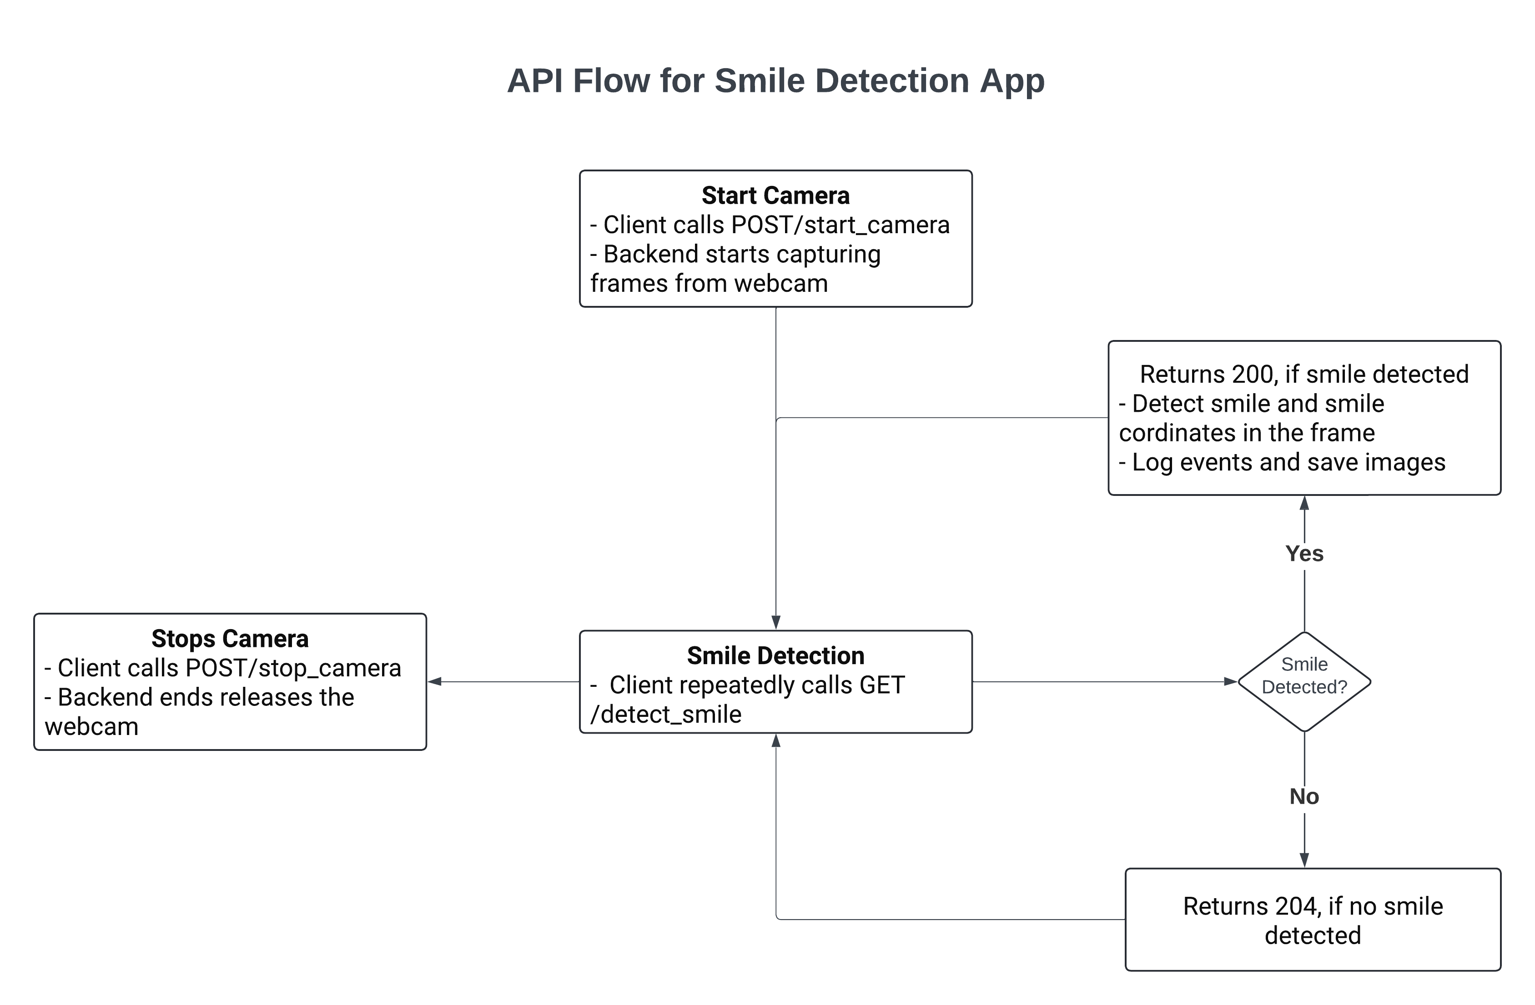
API Flow: Start, Detect, Stop
Step-by-step REST API flow for camera session, real-time detection, and teardown.
Notes:
This API flow diagram shows the typical user journey: First, the frontend sends a request to start the camera. While the camera session is running, the app requests the backend every second to check for smiles in the video feed. If a smile is detected, the backend responds with an image and metadata; if not, it returns a status message. When finished, the frontend stops the camera and the backend releases all resources. All errors, such as trying to detect a smile when the camera isn’t running, are handled gracefully and reported to the user.

Slide 5
Key Implementation Patterns
Singleton Pattern:
Ensures a single camera instance (prevents conflicts, resource leaks)
Dependency Injection:
Enables mocking classifiers & encoders for unit tests
Separation of Concerns:
camera_manager.py: Handles webcam lifecycle
smile_detector.py: Detection logic, easily testable
detection_event.py: Logging to DB and file system
Environment-Based Config:
Paths and DB can be changed without code edits
Notes:
A few things I want to highlight in the code:
I use the singleton pattern for camera management, guaranteeing only one camera instance is ever active. This avoids resource conflicts and leaks.
Dependency injection is used in the detection logic, making it easy to mock OpenCV components for unit testing.
Each module has a clear responsibility: camera management, smile detection, and event logging are all separated.
And finally, all paths—like database or image directories—can be set via environment variables, so the app is portable and easy to configure

Slide 6
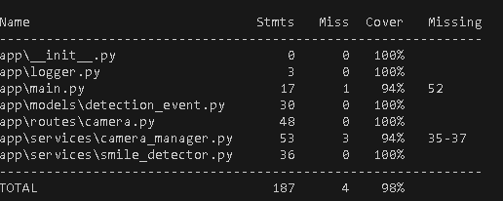
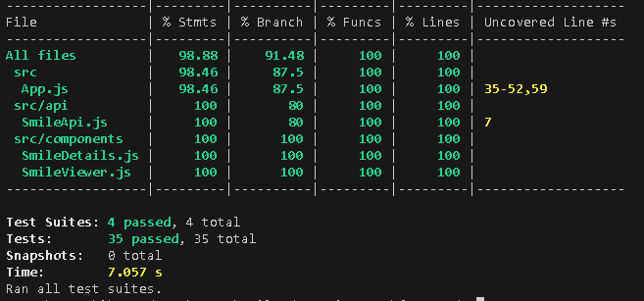
Testing & Reliability
Frontend:
~90% test coverage (Jest/React Testing Library)
Major UI flows tested (start/stop, error handling, image rendering)
Backend:
Pytest for unit/integration (camera, detection, routes, DB)
Mocking for consistent, isolated tests
Continuous Integration Ready:
All tests runnable in CI
Linting and code formatting (PEP8, Prettier, etc.)
Notes:
I’ve focused a lot on testing to ensure reliability:
On the frontend, I have over 90% test coverage using Jest and React Testing Library. All main UI flows—like starting, stopping, error handling, and image rendering—are covered.
On the backend, I use Pytest with mocking to test all components in isolation, including camera logic, detection, routes, and database handling.
The project is CI-ready, so tests and linting run automatically to maintain code quality.

Slide 7
Detections Table Schema
Column | Type | Description
id | INTEGER | Primary Key (autoincrement)
timestamp | TEXT | ISO8601 timestamp
coords | TEXT | JSON-encoded coordinates
Notes:
Here’s the SQLite table schema for detection events.
Every record has an ID, the timestamp, and the smile coordinates saved as JSON.

Slide 8
Challenges & Lessons Learned
Haar cascade sensitivity to lighting, angle, glasses, and facial hair
Ensuring thread-safe camera management
Reliable test isolation (mocks for OpenCV and DB)
Balancing real-time performance with testability
Notes:
Some quick lessons:
Haar cascades are very sensitive — not just to lighting and face angle, but also to anything that might “confuse” the detector, like glasses, mustaches, or even heavy beards. Sometimes the app thinks a mustache is a smile, or it just misses a smile if you’re wearing glasses and there’s glare.
Managing the camera safely across threads required careful use of locks and singleton patterns.
For reliable testing, I had to mock both the OpenCV components and the database to keep tests isolated and repeatable.
And finally, balancing real-time performance with maintainable, testable code was a key focus throughout.

Slide 9
Future Enhancements
Ideas:
Use MediaPipe or Dlib for improved accuracy
Dockerize for easy deployment
Allow image upload or video file detection
Notes:
A few things I’d add next:
Swap out Haar cascades for something more accurate, like MediaPipe or Dlib
Package everything up in Docker so it’s easier to deploy
Add the ability to upload photos or run smile detection on a video file

Slide 10
Thank You!
Thanks for reviewing this project!
For questions, feedback, or code walkthrough:
GitHub
LinkedIn
Notes:
That’s it! Thanks so much for taking a look at my project. If you have any questions, just reach out on GitHub or LinkedIn.

