Slide 1
Smile Detection App
By Manushi

Slide 2
Smile Detection App
Real-time Smile Detection using React & Python (FastAPI + OpenCV)
Full-stack app: React frontend, FastAPI backend
Real-time smile detection from webcam (OpenCV Haar cascades)
Detection events and images logged to SQLite and disk
Robust error handling, configuration via environment variables
Well-tested (Jest + Pytest)

Slide 3
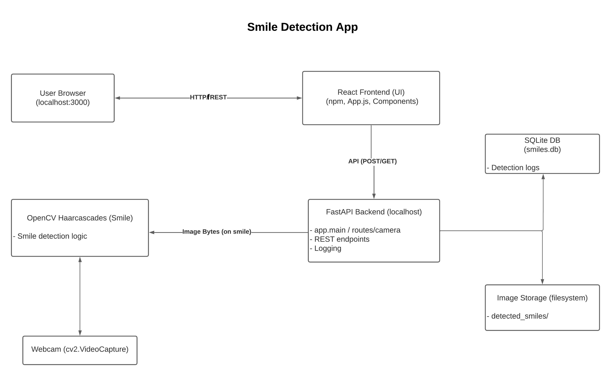
System Architecture
High-level system architecture: End-to-end data flow from browser to backend and persistence.

Slide 4
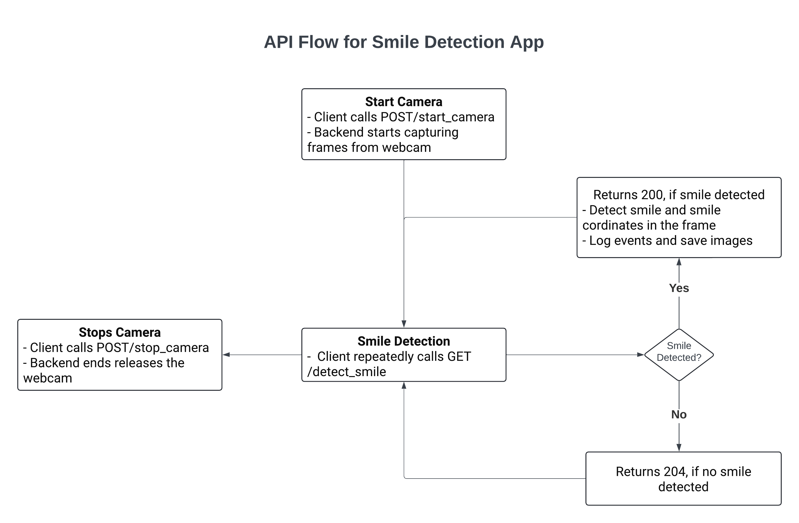
API Flow: Start, Detect, Stop
Step-by-step REST API flow for camera session, real-time detection, and teardown.

Slide 5
Key Implementation Patterns
Singleton Pattern:
Ensures a single camera instance (prevents conflicts, resource leaks)
Dependency Injection:
Enables mocking classifiers & encoders for unit tests
Separation of Concerns:
camera_manager.py: Handles webcam lifecycle
smile_detector.py: Detection logic, easily testable
detection_event.py: Logging to DB and file system
Environment-Based Config:
Paths and DB can be changed without code edits

Slide 6
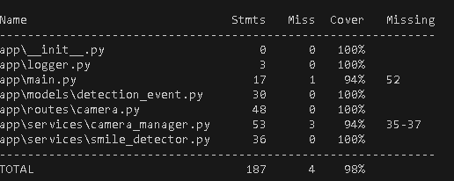
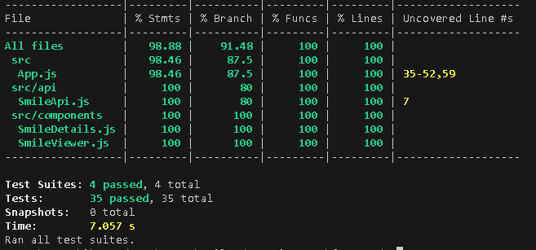
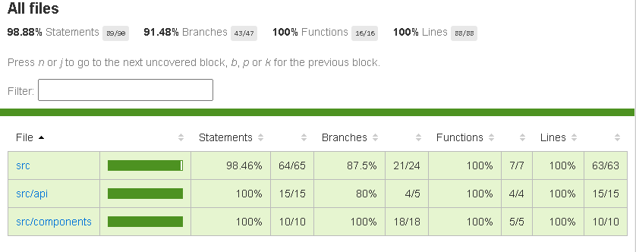
Testing & Reliability
Frontend:
~90% test coverage (Jest/React Testing Library)
Major UI flows tested (start/stop, error handling, image rendering)
Backend:
Pytest for unit/integration (camera, detection, routes, DB)
Mocking for consistent, isolated tests
Continuous Integration Ready:
All tests runnable in CI
Linting and code formatting (PEP8, Prettier, etc.)

Slide 7
Detections Table Schema
Column | Type | Description
id | INTEGER | Primary Key (autoincrement)
timestamp | TEXT | ISO8601 timestamp
coords | TEXT | JSON-encoded coordinates

Slide 8
Demo

Slide 9
Challenges & Lessons Learned
Haar cascade sensitivity to lighting and angle
Ensuring thread-safe camera management
Reliable test isolation (mocks for OpenCV and DB)
Balancing real-time performance with testability

Slide 10
Future Enhancements
Ideas:
Use MediaPipe or Dlib for improved accuracy
Dockerize for easy deployment
Allow image upload or video file detection

Slide 11
Thank You!
Thanks for reviewing this project!
For questions, feedback, or code walkthrough:
GitHub
LinkedIn

