Slide 1
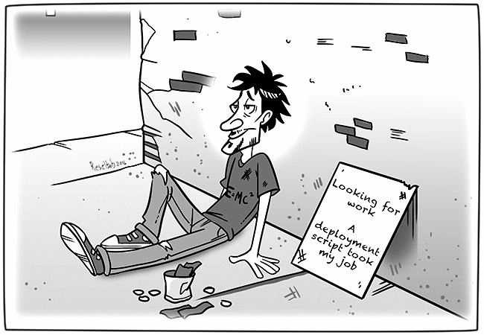
DevOps
Vishal Murugan (vmuruga)
Dinesh Prasanth (dmolugu)
Mukundram (mmurali5)
Manushri (manush)

Slide 2
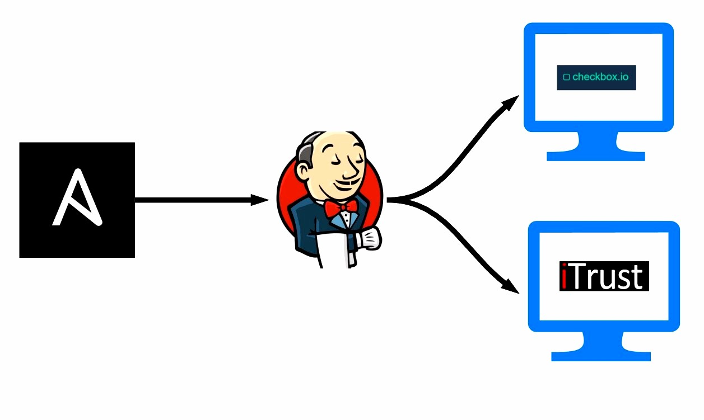
Milestone 1
Provisioning the Jenkins server
Deploying instance of checkbox.io Using Virtual Machine
Deploying instance of iTrust Using Virtual Machine

Slide 3
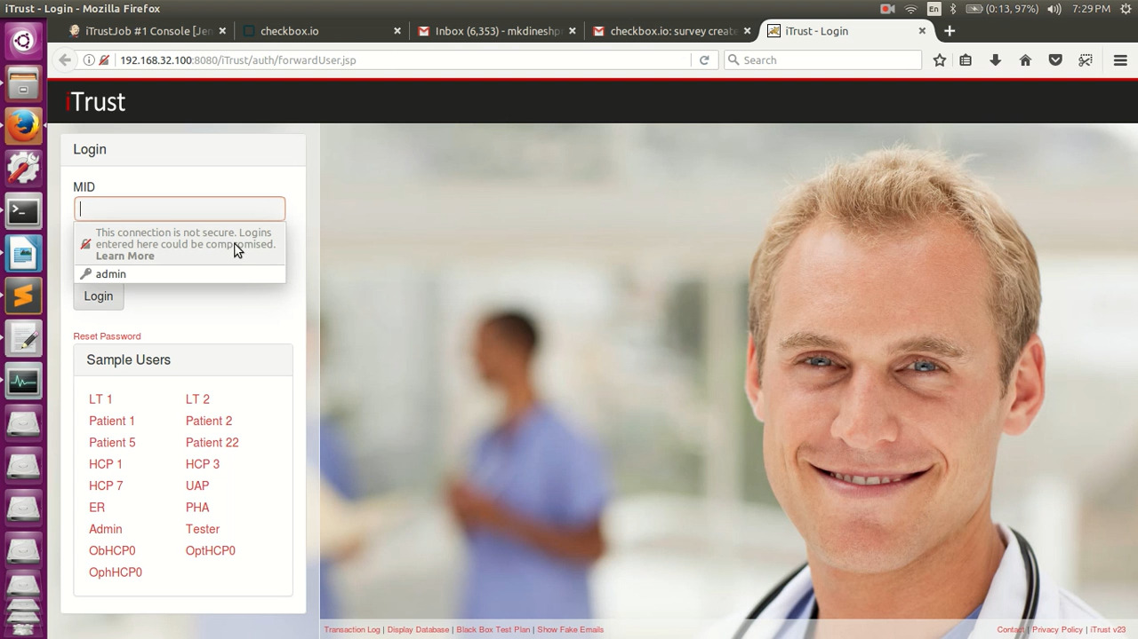
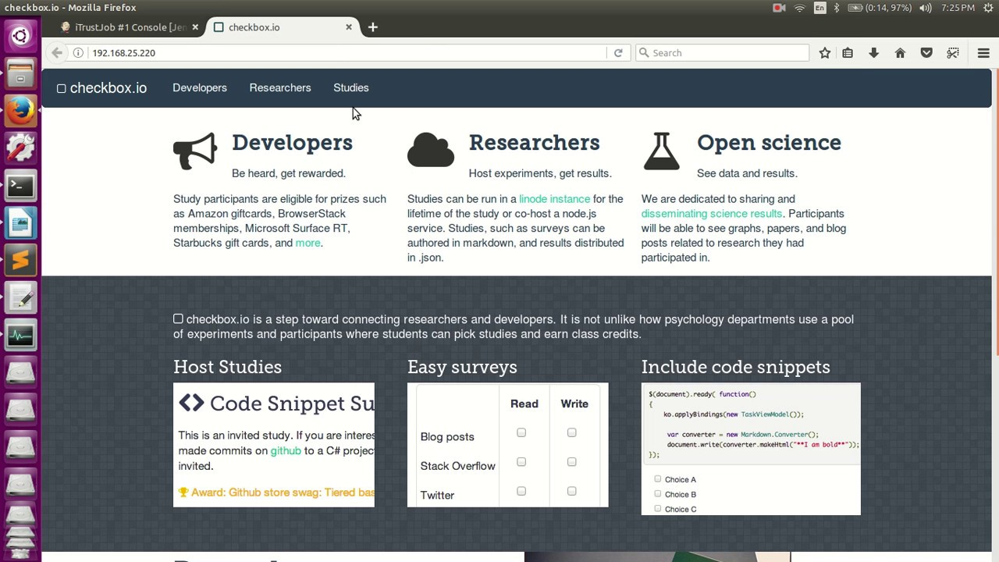
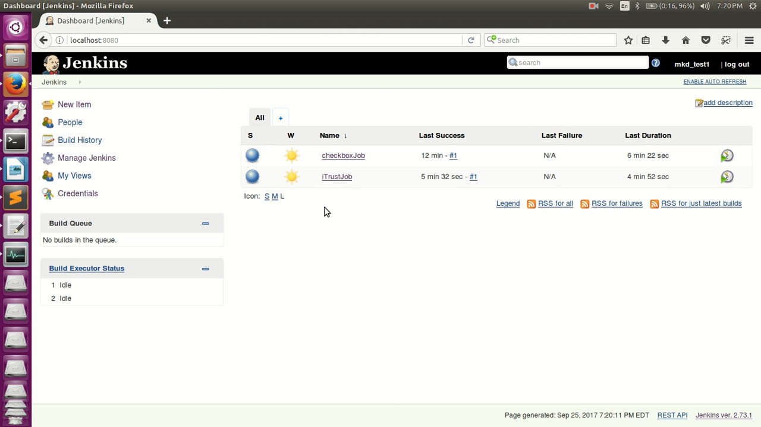
Milestone 1 - Screens

Slide 4
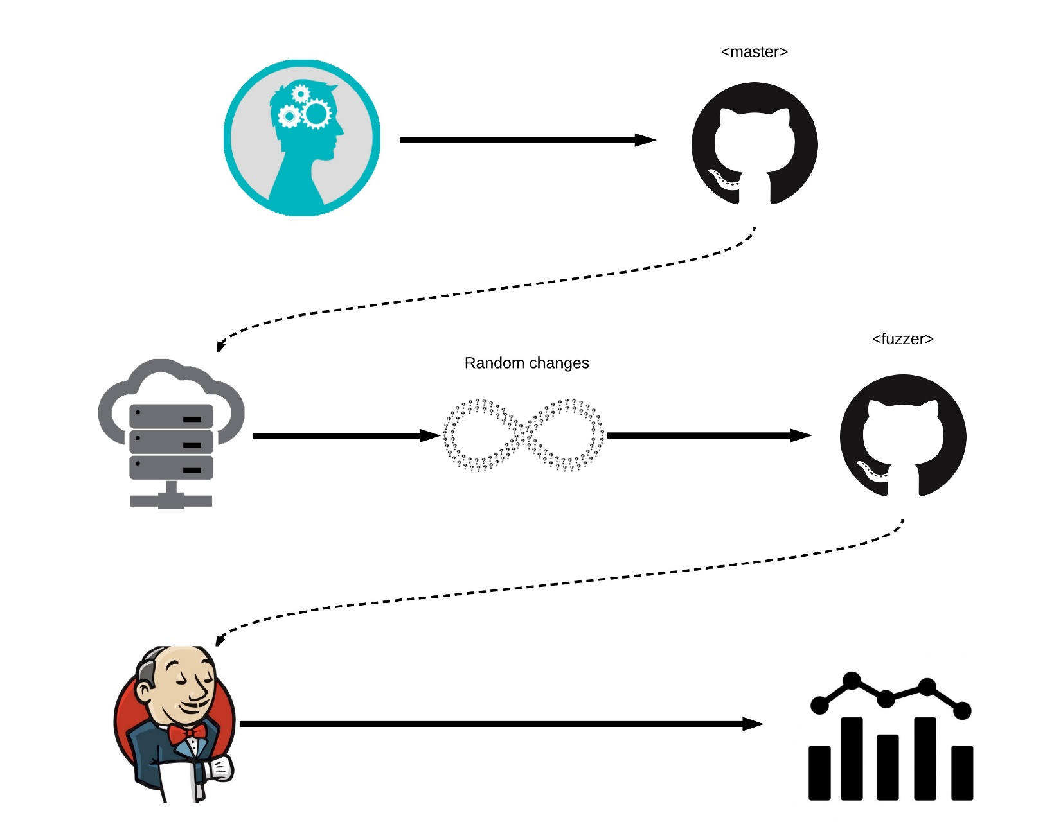
Milestone 2
Commit Fuzzer Testing upon random changes Eliminate useless tests
Analysis Long methods & message chains Sync calls Complex functions > O(n³)
Reject build on failure

Slide 5
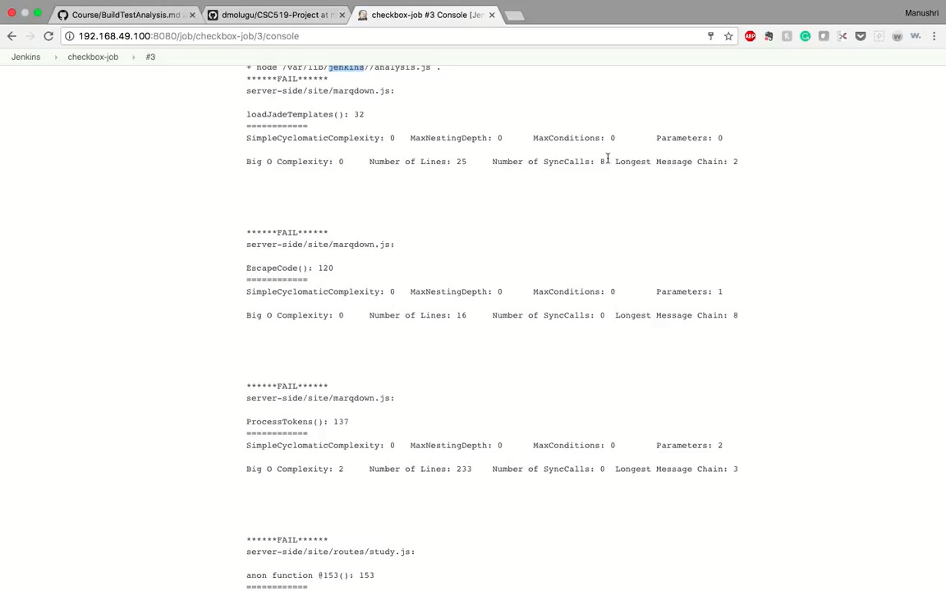
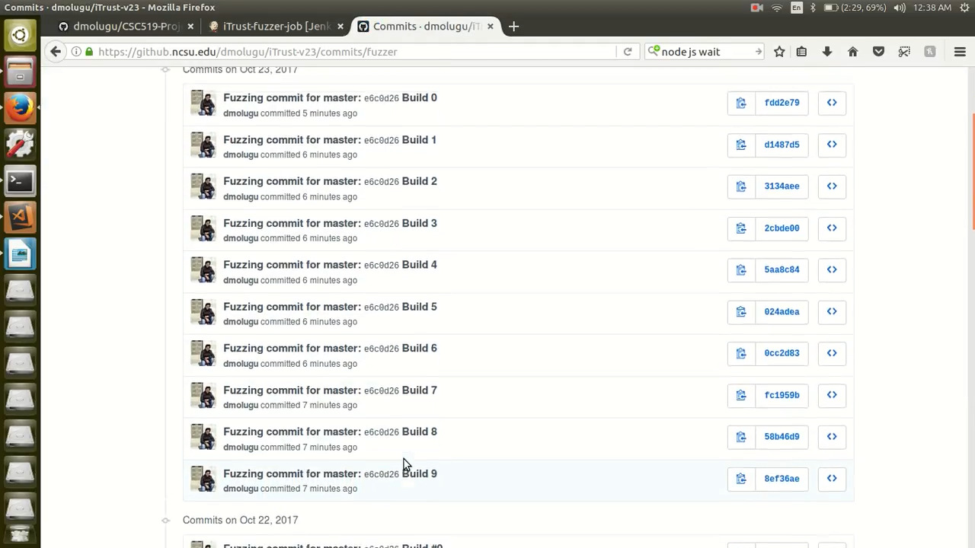
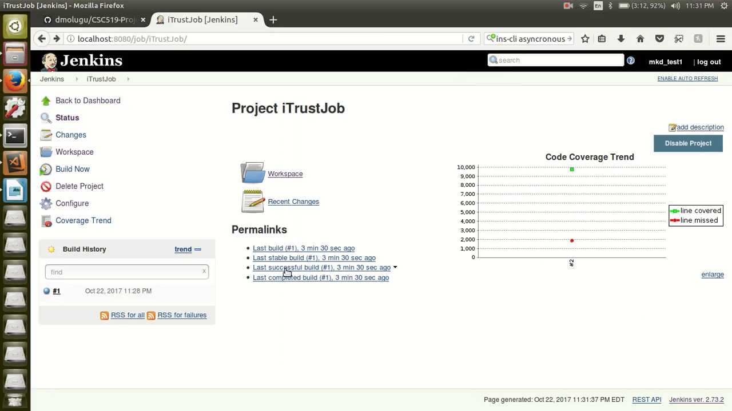
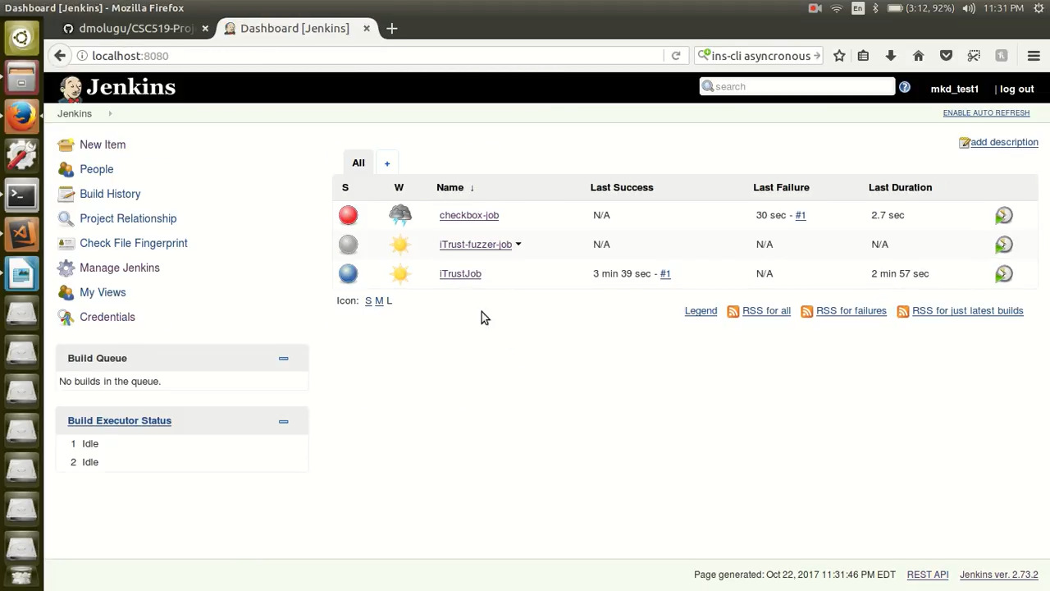
Milestone 2 - Screens

Slide 6
Milestone 3
Deployment Use AWS EC2 instance Deploy checkbox.io Deploy iTrust
Infrastructure Upgrade Uninterrupted update using Nomad Redis Feature Server
Canary Release Load Balancer Ignore Canary upon error
Rolling Update Deploy updates with continuity

Slide 7
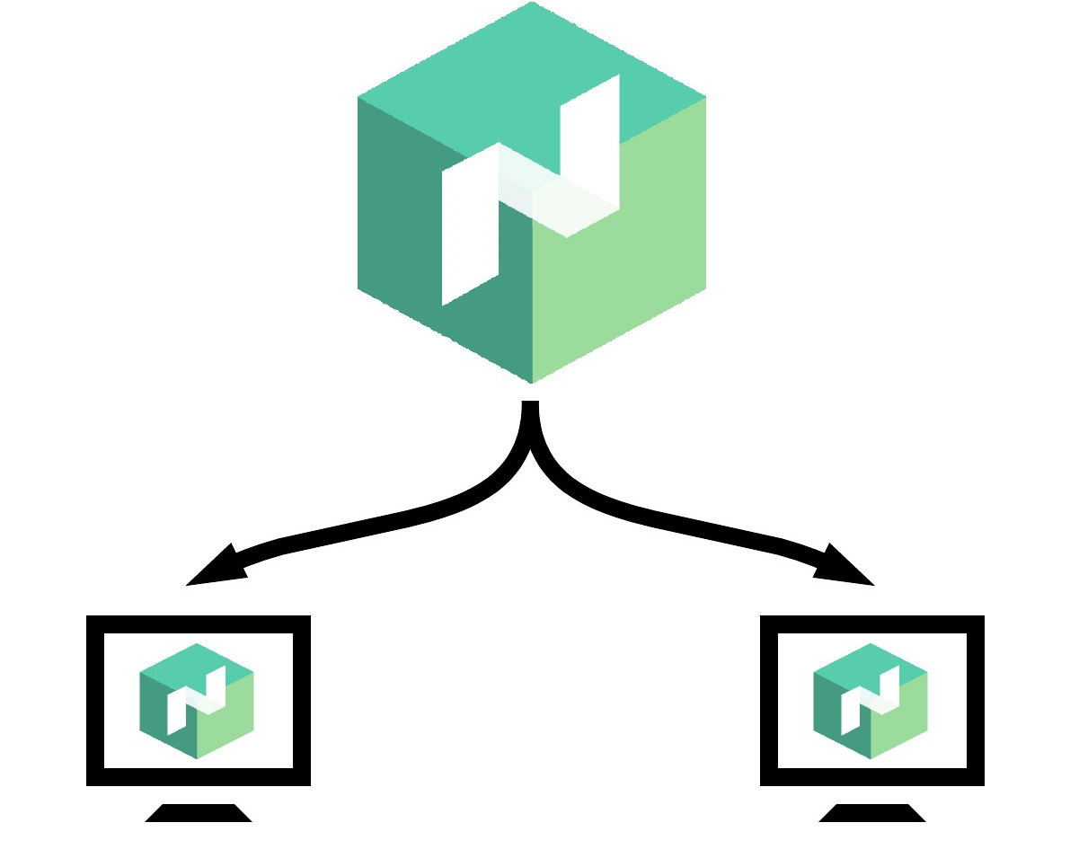
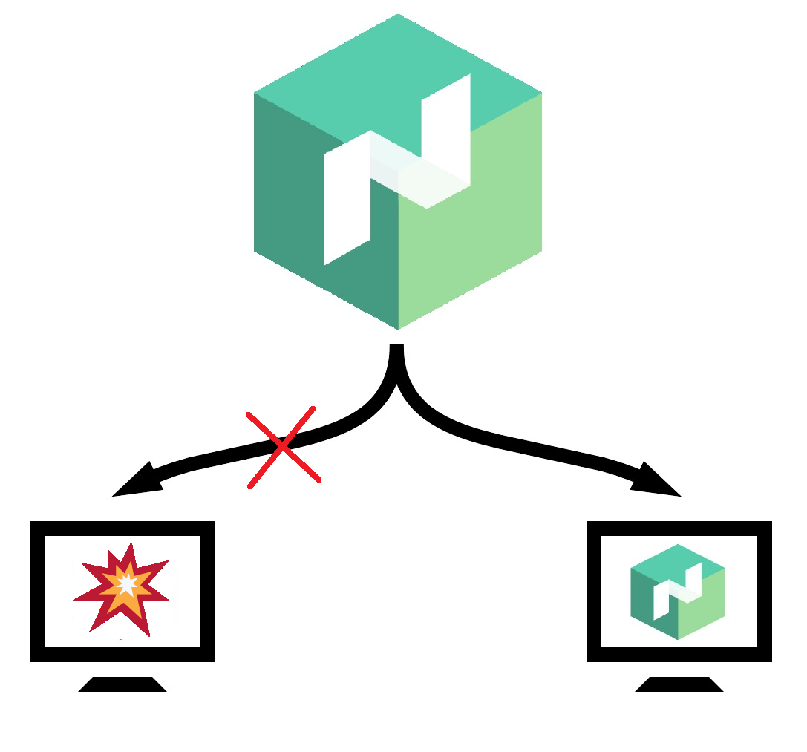
Milestone 3

Slide 8
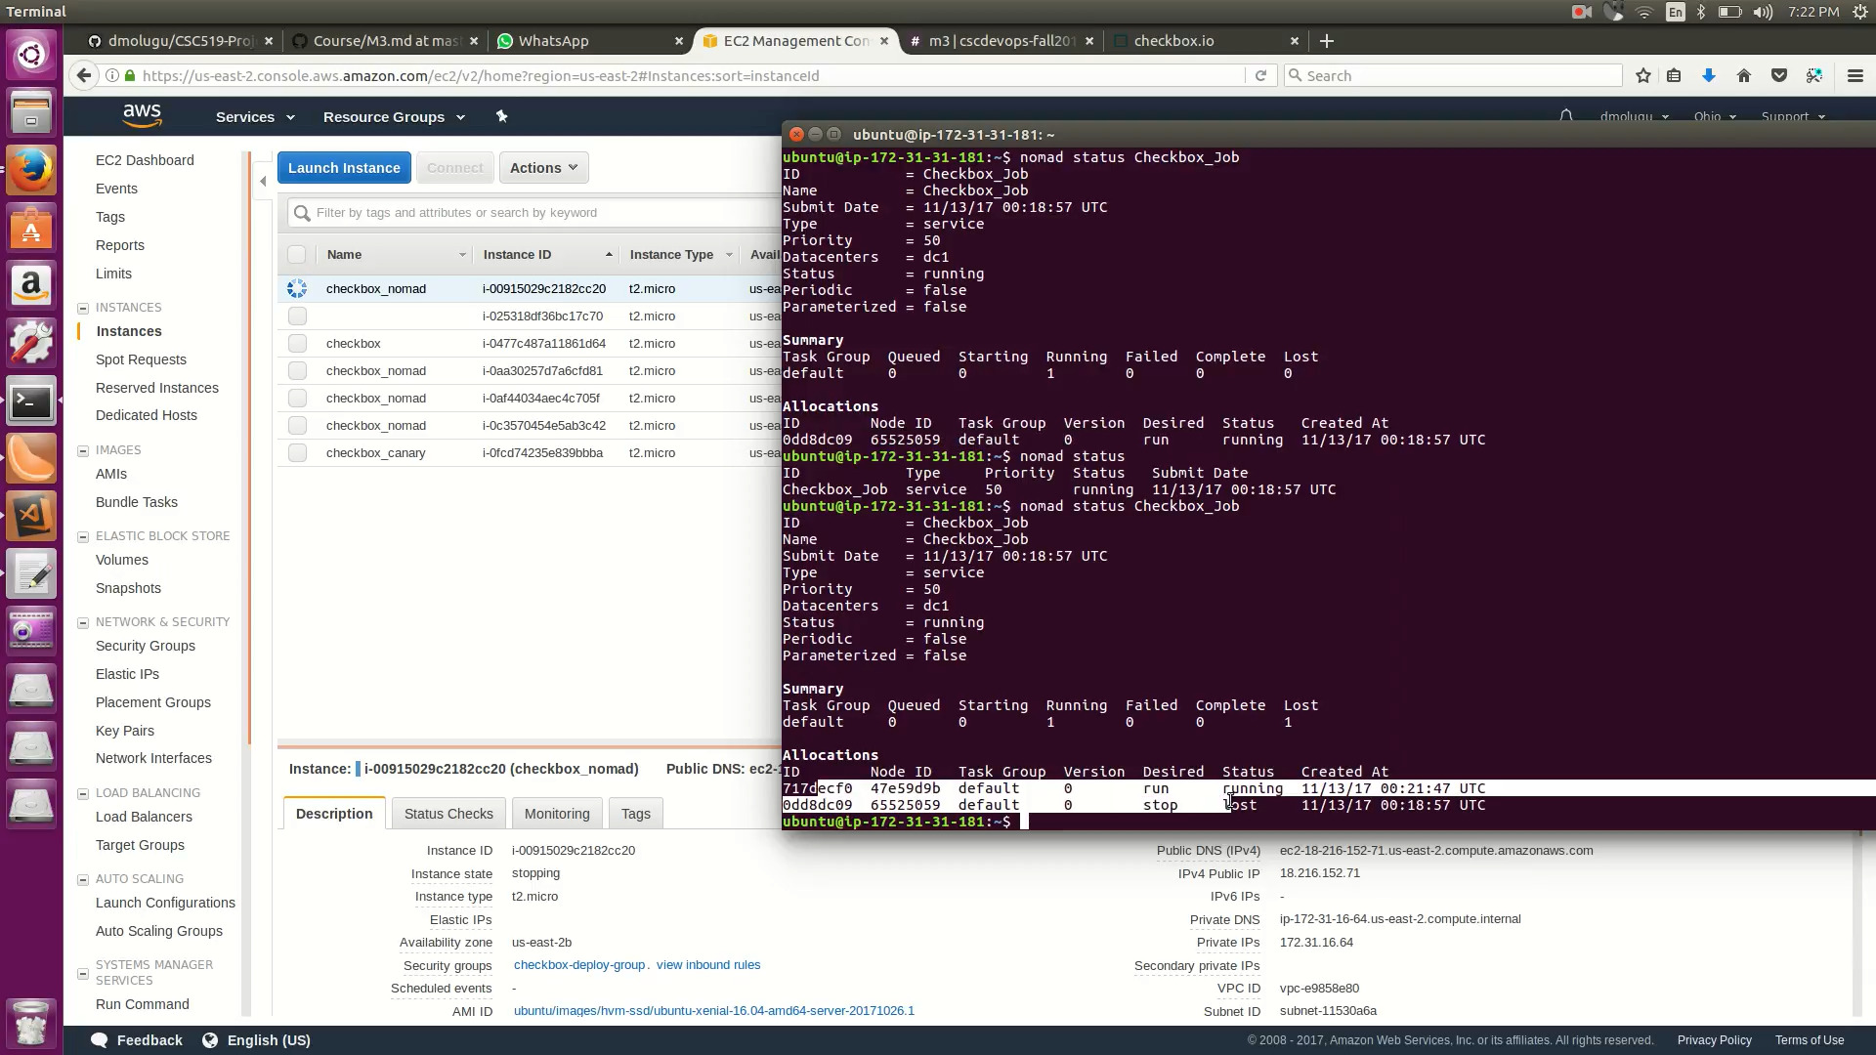
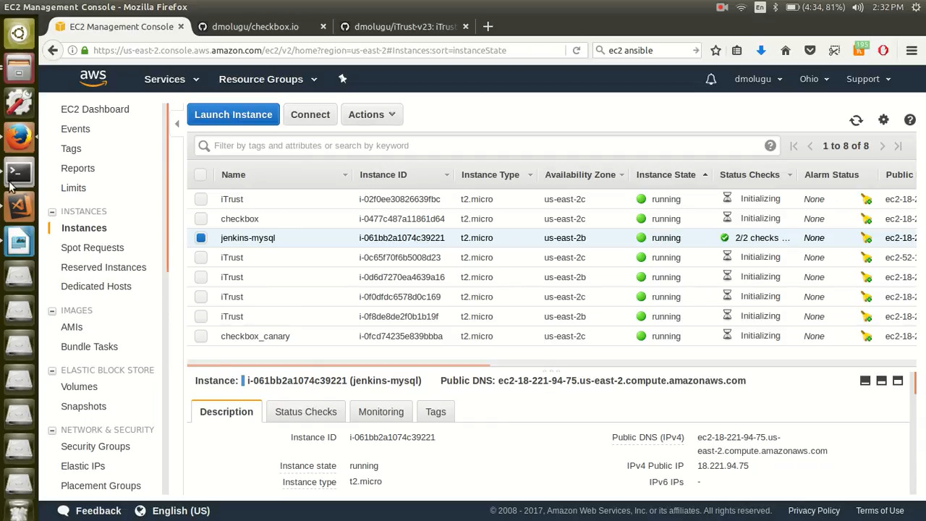
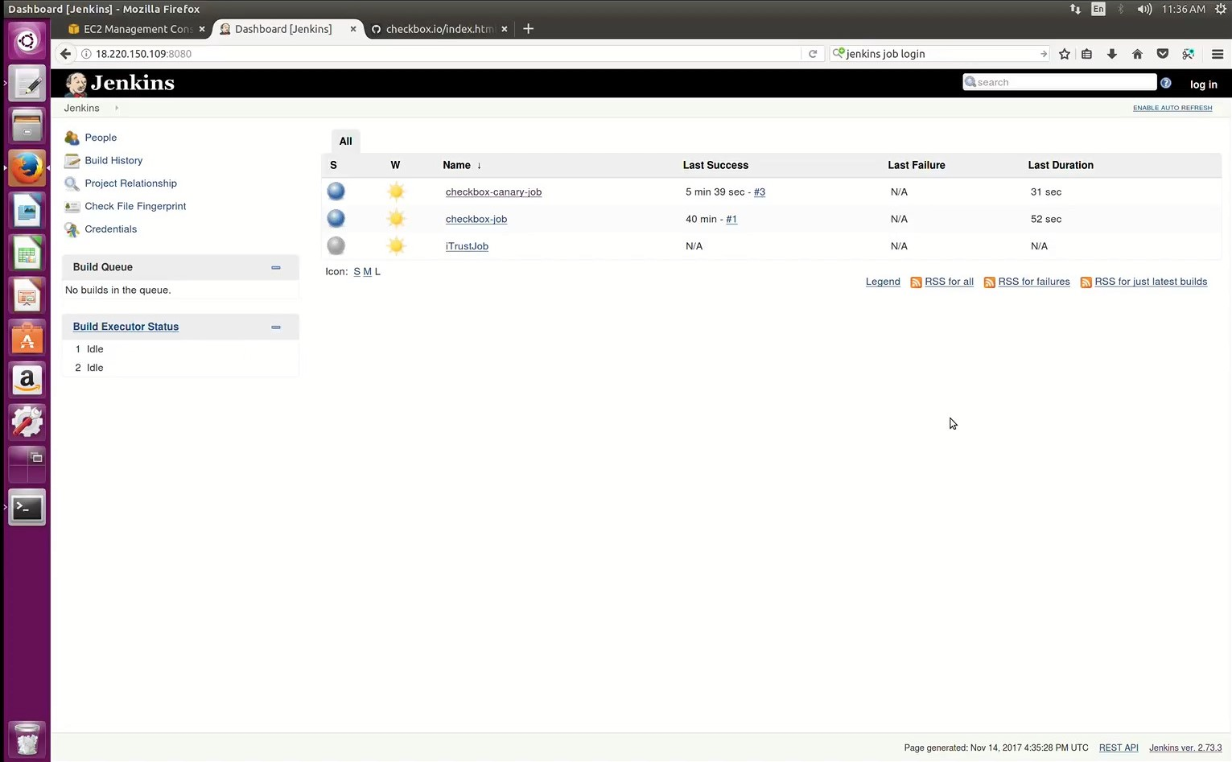
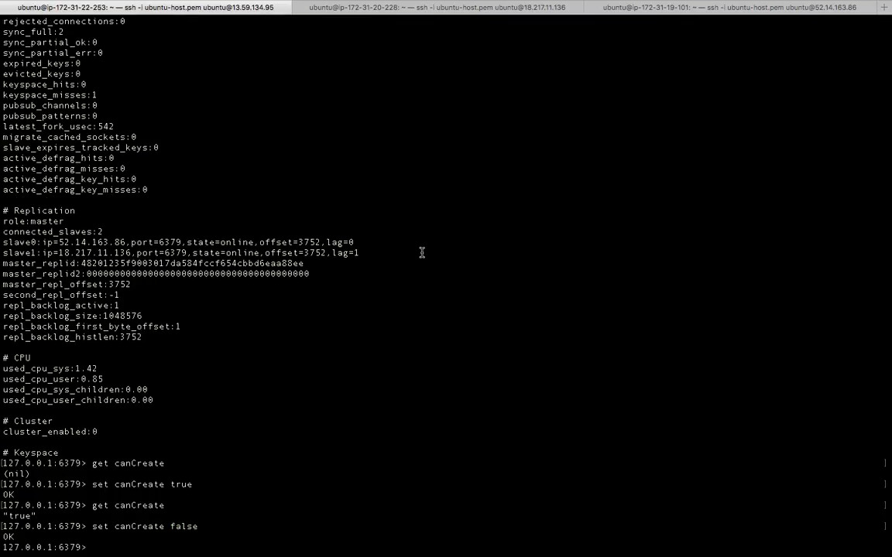
Milestone 3 - Screens

Slide 9
Special Milestone
Facilitate automated code review request GerritHub Incorporate code review into pipeline
Push to GitHub upon code review Pushes to master branch on merge Hook in master branch for deployment

Slide 10
Milestone 4 - Screens

