Slide 1
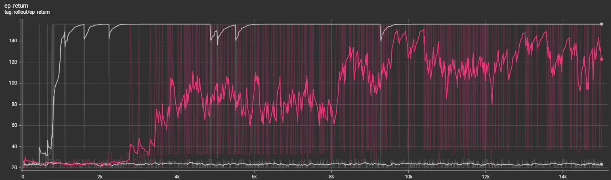
Train without Augmentation on different configurations
1
2
3
Two configurations: (30, 10), (28, 10)
Seven configurations: (30, 10), (28, 10), (32, 10), (26, 10), (34, 10), (30, 14), (28, 14)
Nine configurations: (30, 10), (28, 10), (32, 10), (26, 10), (34, 10), (30, 14), (28, 14), (32, 14), (26, 14)

Slide 2
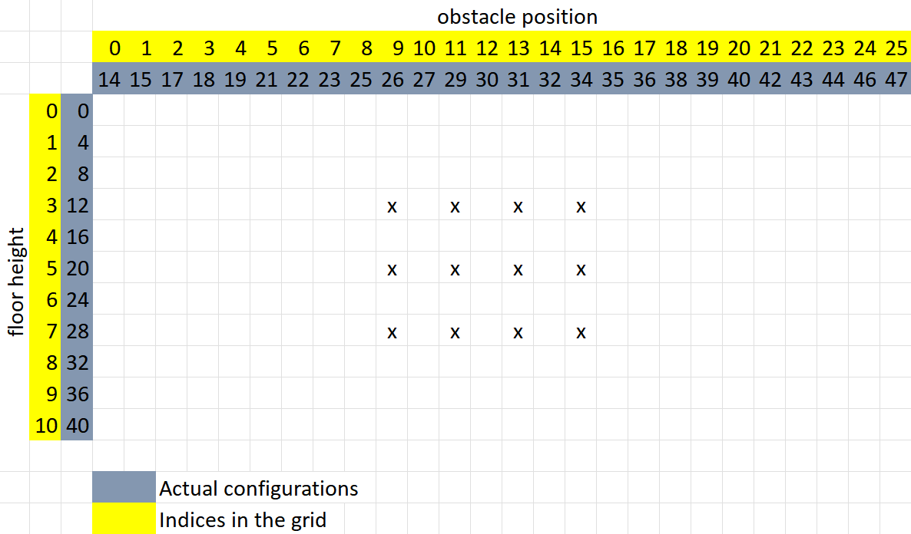
Narrow grid

Slide 3
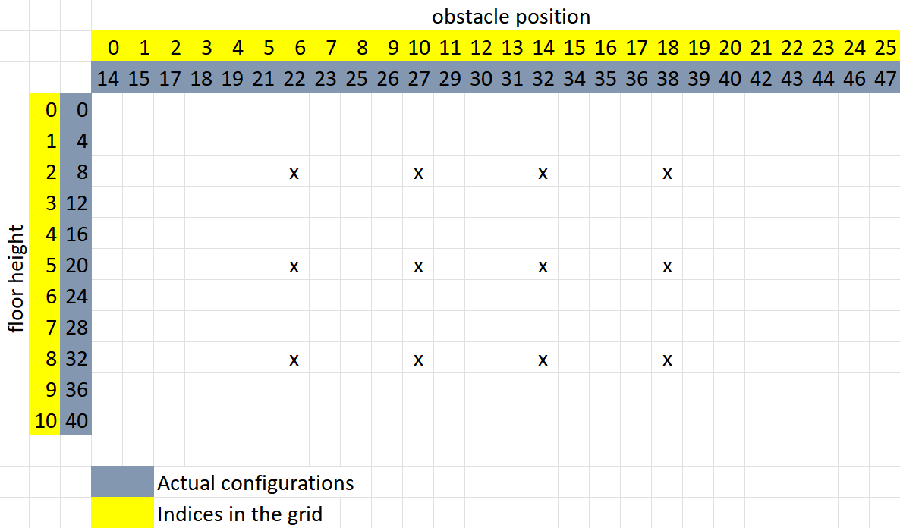
wide grid

Slide 4
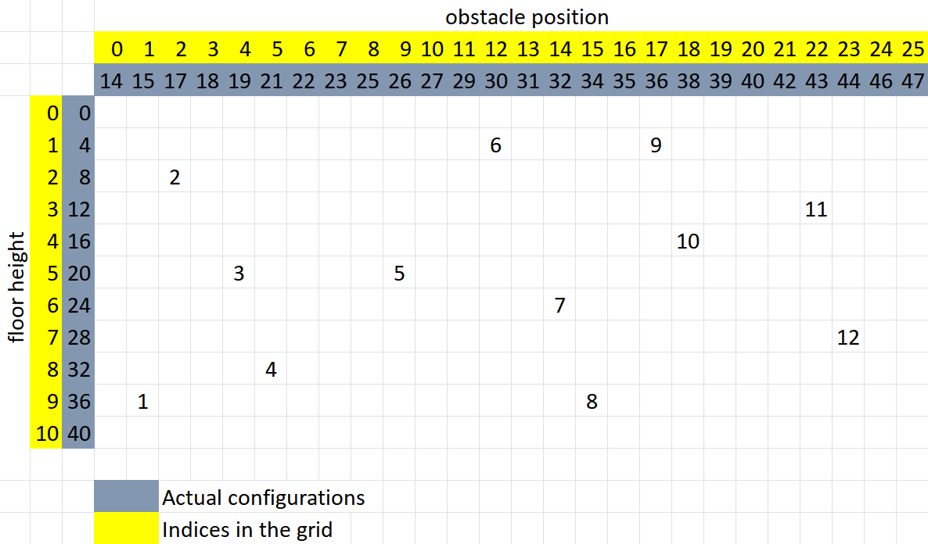
random grid

