Slide 1
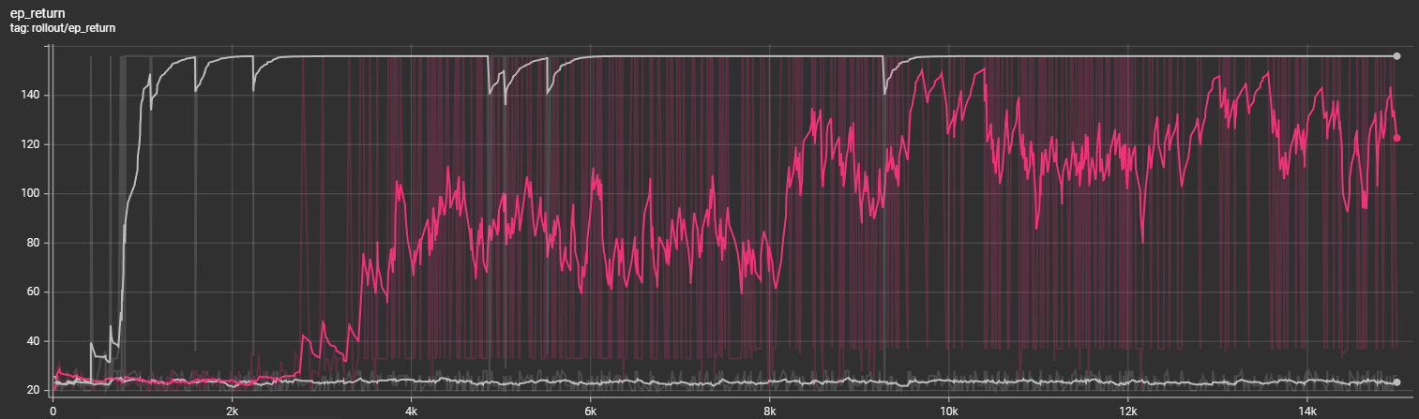
Train without Augmentation on different configurations
1
2
3
Two configurations: (30, 10), (28, 10)
Seven configurations: (30, 10), (28, 10), (32, 10), (26, 10), (34, 10), (30, 14), (28, 14)
Nine configurations: (30, 10), (28, 10), (32, 10), (26, 10), (34, 10), (30, 14), (28, 14), (32, 14), (26, 14)

Slide 2
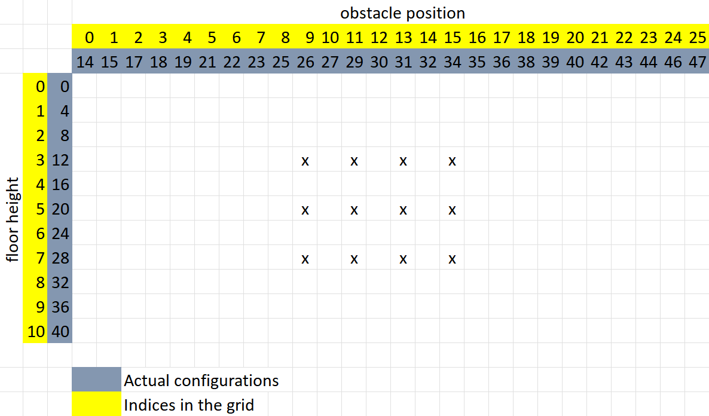
Narrow grid

Slide 3
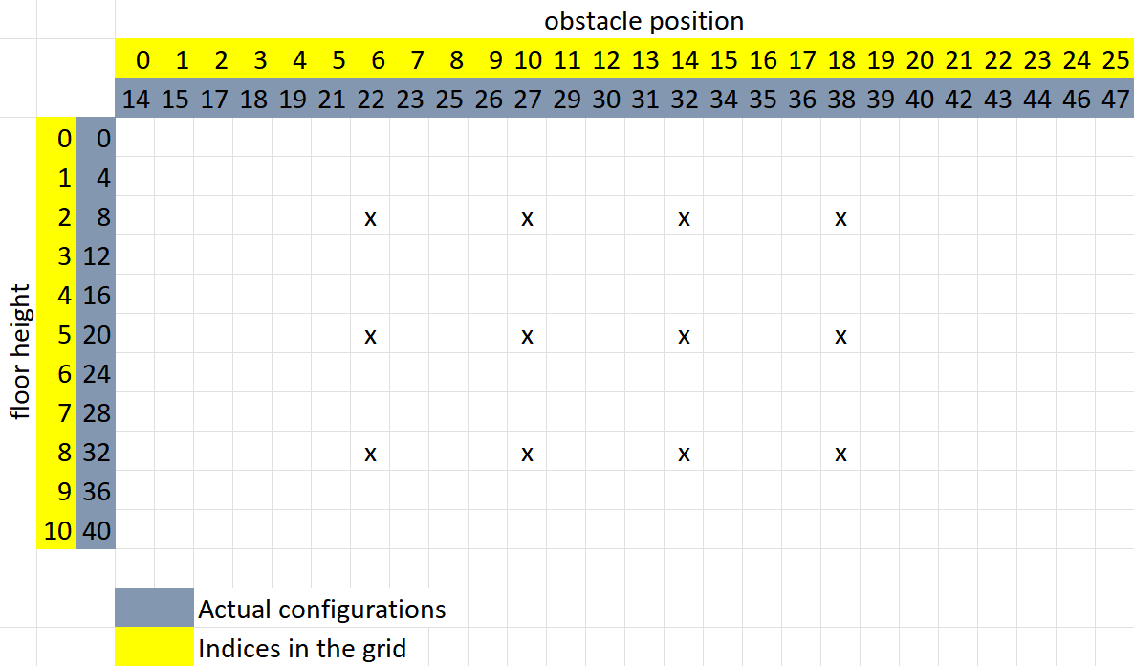
wide grid

Slide 4
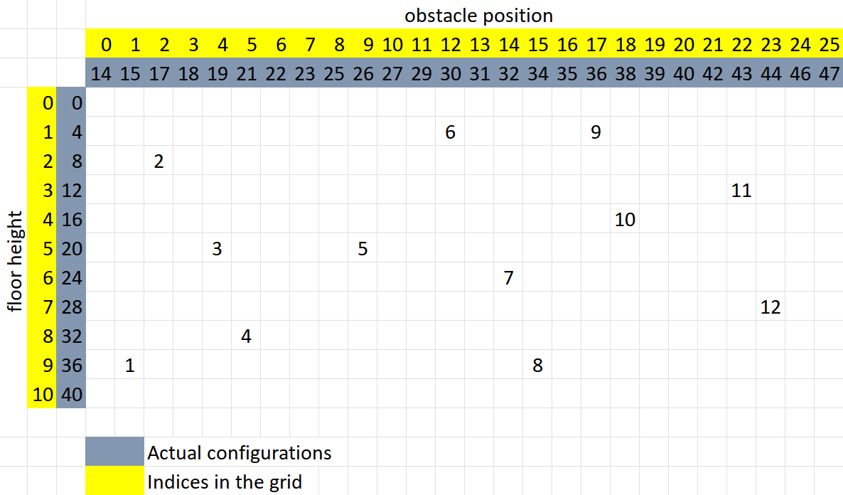
random grid

Slide 5
The following tests were done without any augmentation

Slide 6
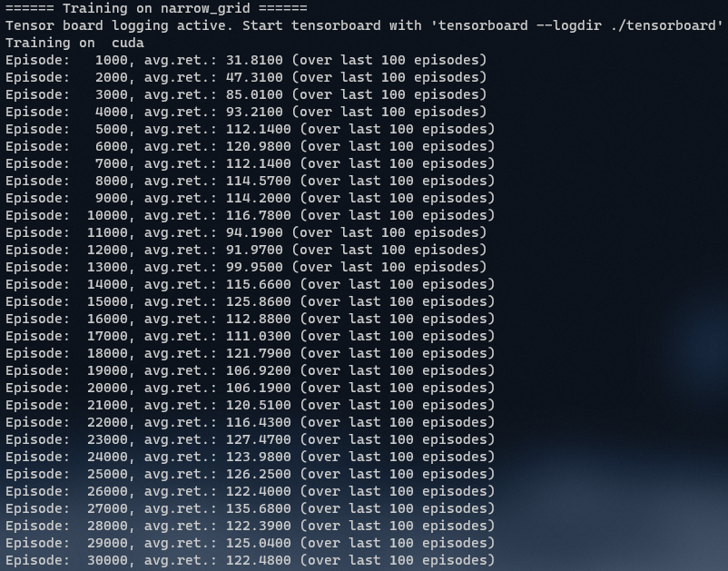
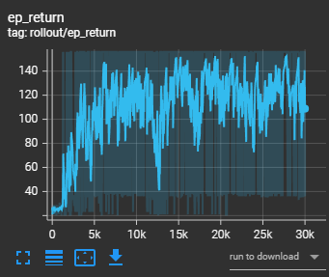
Smoothing 0.8

Slide 7
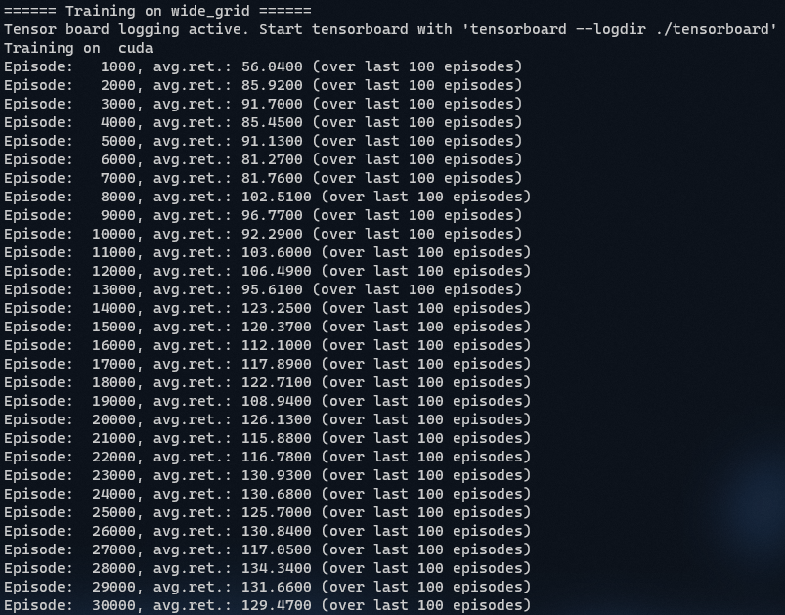
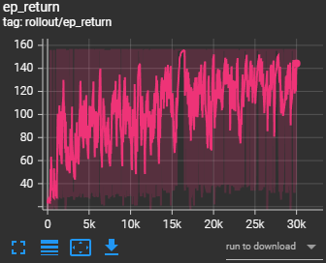
Smoothing 0.8

Slide 8
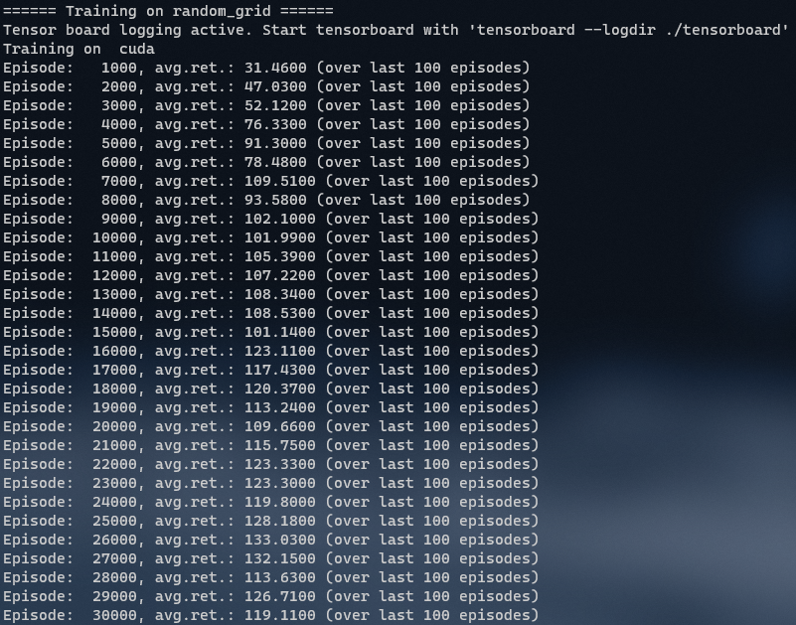
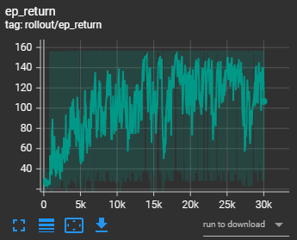
Smoothing 0.8

Slide 9
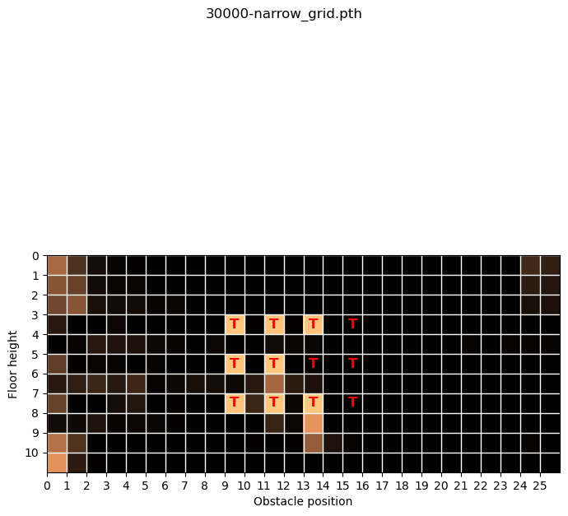

Slide 10
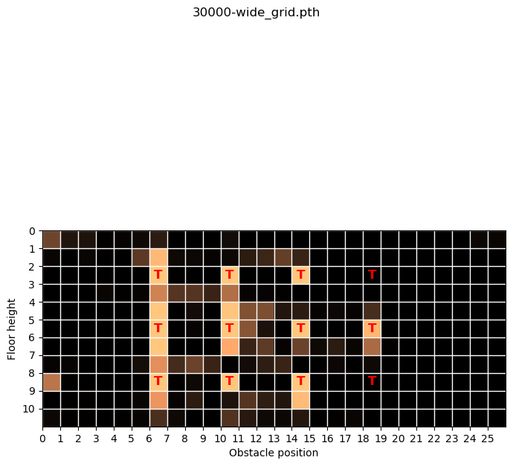

Slide 11
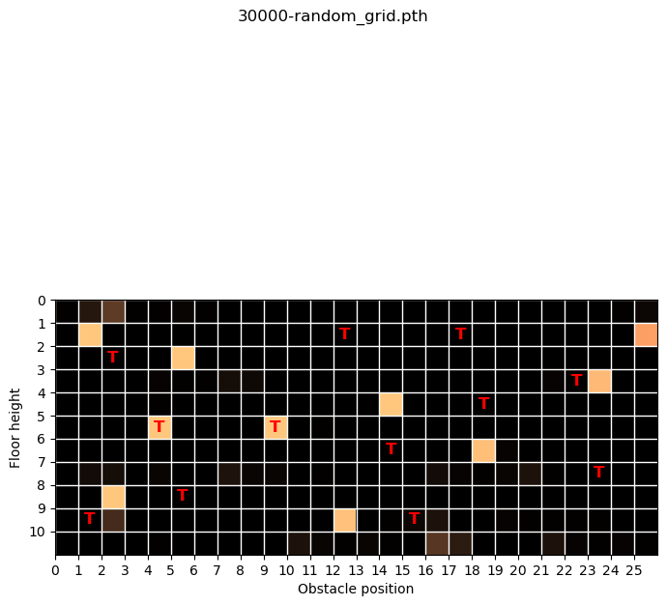

Slide 12
The following tests were done with random augmentation which changes at every step()

Slide 13
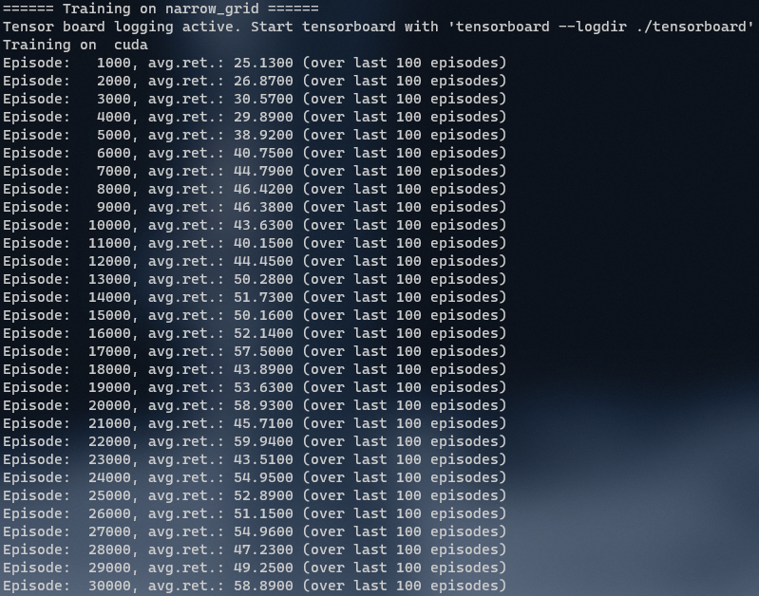
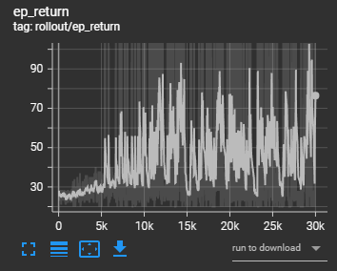
Smoothing 0.8

Slide 14
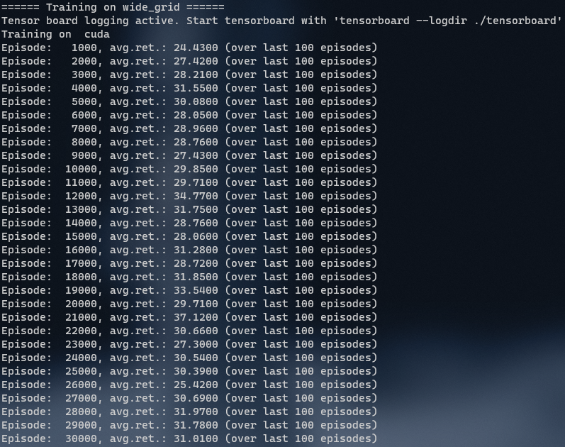
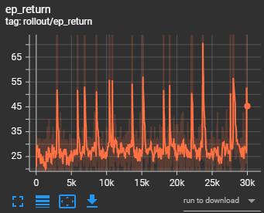
Smoothing 0.8

Slide 15
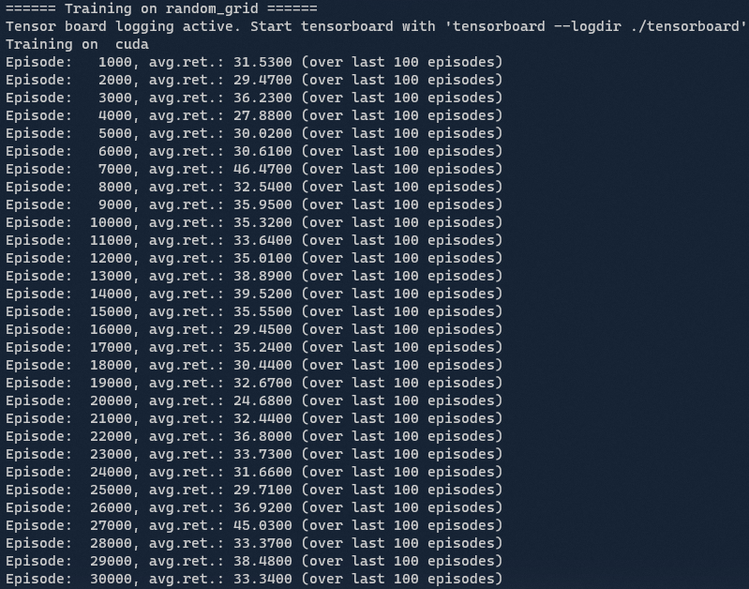
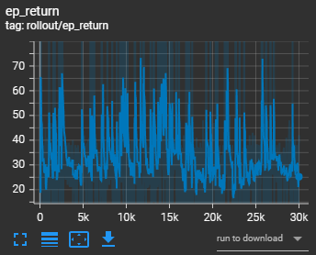
Smoothing 0.8

Slide 16
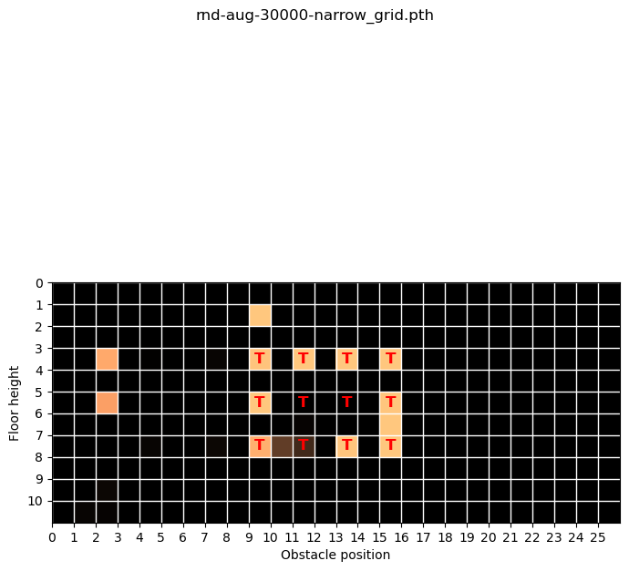

Slide 17
Questions
When to choose the augmentation? At every step? Or for every episode and keep the augmentation for the entire episode?
gym.vector.SyncVectorEnv for speed up?

