Slide 1



HACKMERIDIAN 2026 · LISBON
PLATFORM 01 / 09
SPLIT BILLS WITH FRIENDS · ON STELLAR
LUMENSPLIT
SETTLE IN SECONDS
October 2026
#HackMeridian26
© 2026 HackMeridian · Lisbon

Slide 2
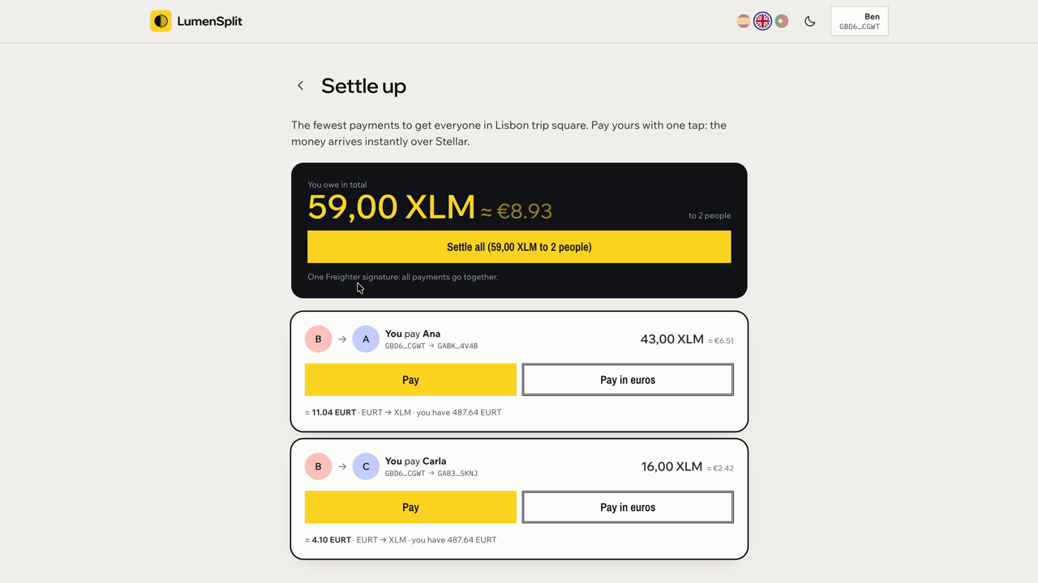

PLATFORM 02 / 09
HACKMERIDIAN 2026 · LISBON
NEXT ▸ KEY FEATURES
PITCH STEP 01 / 04
THE SOLUTION
Tracking and paying, in the same place.
A Soroban contract keeps the ledger and finds the fewest payments.
Settle all: every debt, one signature, one atomic transaction.
Money arrives in about 5 seconds, for a fraction of a cent.
No crypto jargon: names, amounts and a “Pay” button.
👉 Why it wins: the payment is inside the app, not an IOU.
© 2026 HackMeridian · Lisbon · #HackMeridian26

Slide 3
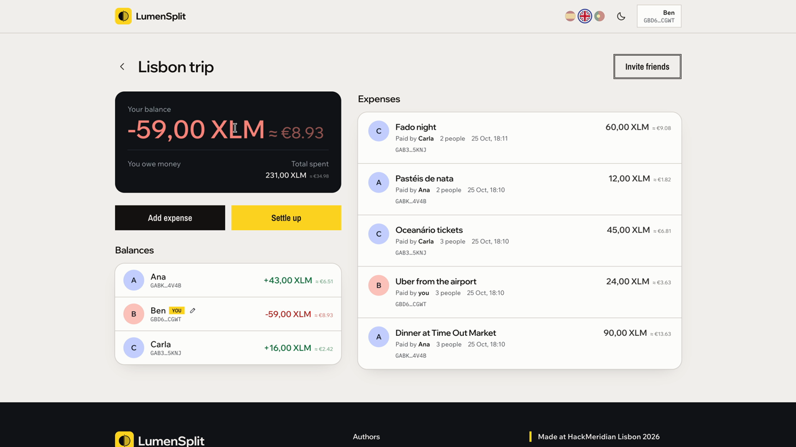
PLATFORM 03 / 09
HACKMERIDIAN 2026 · LISBON
NEXT ▸ PMF
PITCH STEP 01 / 04
KEY FEATURES
Built for paying back, not just keeping score.
Pay in euros: Stellar’s AMM converts; your friend gets the exact amount.
Join by link or QR; only the invite’s hash is stored on-chain.
Equal or custom splits; the ledger always sums to zero.
Overpay protection: pay only what you owe, to who is owed.
👉 Also: English, Spanish, Portuguese · light and dark mode · installable PWA.
© 2026 HackMeridian · Lisbon · #HackMeridian26

Slide 4
PLATFORM 04 / 09
HACKMERIDIAN 2026 · LISBON
NEXT ▸ GO-TO-MARKET
PITCH STEP 02 / 04
PMF
Splitting is easy to track and annoying to pay.
Splitwise and Tricount keep the score; the money moves elsewhere, or never.
Small debts linger, and asking a friend for 12 € feels awkward.
Across borders, slow transfers and fees can be bigger than the debt.
International students and travel groups feel it most.
👉 Who cares: anyone who has waited weeks for a friend abroad to pay them back.
© 2026 HackMeridian · Lisbon · #HackMeridian26

Slide 5
PLATFORM 05 / 09
HACKMERIDIAN 2026 · LISBON
NEXT ▸ WHY STELLAR
PITCH STEP 02 / 04
GO-TO-MARKET
Start where paying back hurts most.
Entry wedge: international students and Erasmus flatmates.
Next: travel groups and digital nomads; then shared flats.
Revenue: small fee on cross-currency settlements; premium groups.
Roadmap: EURC/USDC, cash-out via anchors (SEP-24), mainnet, mobile.
👉 Built so far: groups, splits, settle all, invites, pay in euros, passkeys.
© 2026 HackMeridian · Lisbon · #HackMeridian26

Slide 6
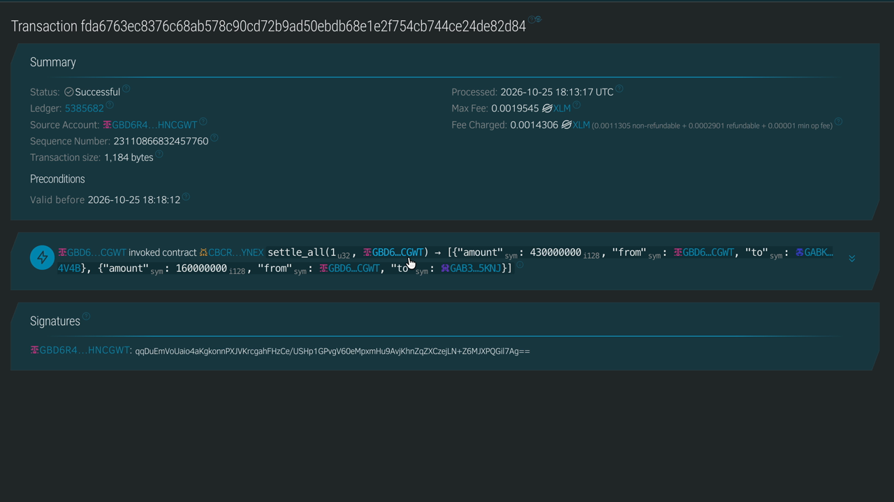
PLATFORM 06 / 09
HACKMERIDIAN 2026 · LISBON
NEXT ▸ TECHNICAL WORKFLOW
PITCH STEP 03 / 04
WHY STELLAR
Paying back 3 € finally makes sense.
~5 s finality and fees far below a cent per settlement.
Native path payments + AMM: pay in one currency, receive another.
Stellar Asset Contracts: Soroban moves real XLM, no wrapping.
Anchors (next): cash out to a bank account in your own currency.
👉 Only on Stellar: payments, FX and smart contracts in one network.
© 2026 HackMeridian · Lisbon · #HackMeridian26

Slide 7
PLATFORM 07 / 09
HACKMERIDIAN 2026 · LISBON
NEXT ▸ PASSKEYS
PITCH STEP 03 / 04
TECHNICAL WORKFLOW
Web app → wallet → Soroban contract → Stellar payment.
React PWA (ES · EN · PT) on Vercel; Freighter or a Nido passkey signs.
Contract: groups, custom splits, fewest payments, settle_all, invites.
XLM moves via its Asset Contract; euros via a path payment on the AMM.
Live on testnet, contract tests passing, receipts on stellar.expert.
👉 Feasible today: everything in the demo runs on Stellar testnet.
© 2026 HackMeridian · Lisbon · #HackMeridian26

Slide 8
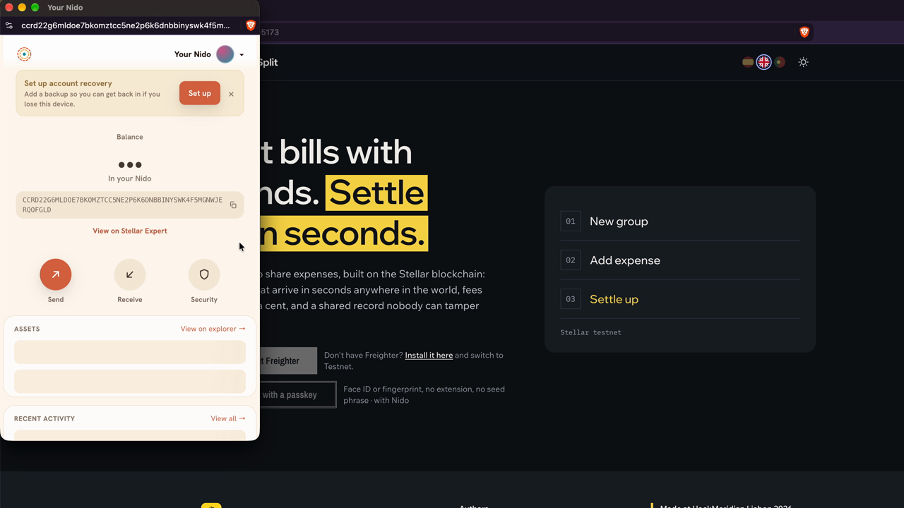
PLATFORM 08 / 09
HACKMERIDIAN 2026 · LISBON
NEXT ▸ THE TEAM
PITCH STEP 03 / 04
PASSKEYS
No extension. No seed phrase.
Nido by The Aha Company (HackMeridian partner): wallet with Touch ID.
The wallet is a Soroban smart account (C… address).
Authorize LumenSplit once: 7 days, daily XLM cap enforced on-chain.
Then friends join and pay without signing every time.
👉 Why it matters: onboarding is the biggest barrier to paying with crypto.
© 2026 HackMeridian · Lisbon · #HackMeridian26

Slide 9
PLATFORM 09 / 09
HACKMERIDIAN 2026 · LISBON
FINAL STOP
PITCH STEP 04 / 04
THE TEAM
Three builders, 28 hours, one working product.
Manuel Villegas · Soroban contract, deployment and integration.
Gregorio Torres · Frontend: the React app and its UX.
Alejandro Teva · Design, brand, pitch and demo video.
👉 Try it: lumensplit.vercel.app · youtu.be/u57OSypg87w · github.com/manuuvllgs/LumenSplit
© 2026 HackMeridian · Lisbon · #HackMeridian26

