Slide 1
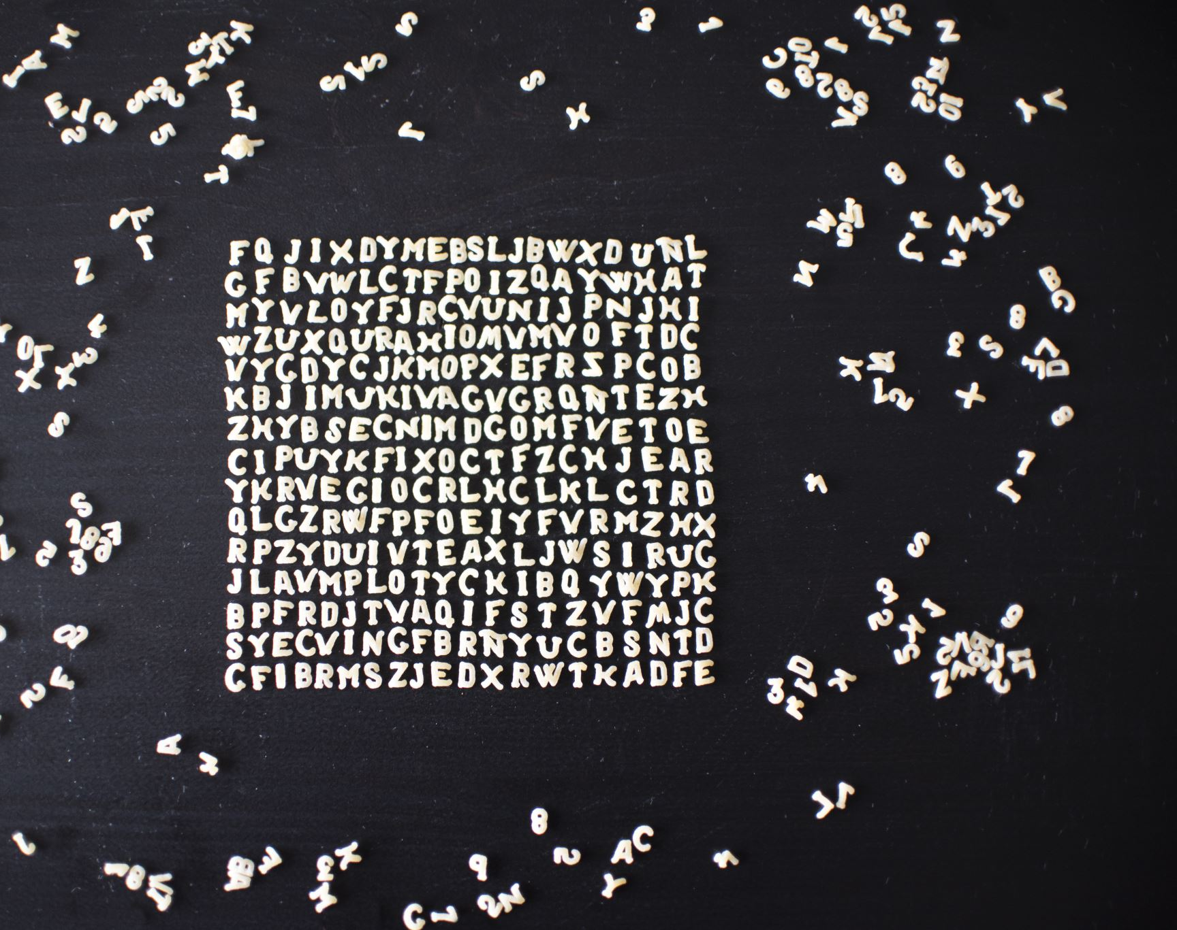
Analysis of Neural networks
With and without convolutional layers
Manu Vats

Slide 2
INTRODUCTION
This project demonstrates difference between the models with and without the convolutional layers. There are 3 sets of experiments performed in each of which two datasets are used. One with binary classes and other with multiple classes in their dependent variables.
In one experiment, a sample model is already given.
In 2nd experiment we change the model by adding dense layers but no convolutional layers and see the difference and impact on both the datasets.
In 3rd experiment we change the model by adding convolutional layers instead of dense layers and using techniques like data augmentation and regularization and see the difference and impact on both the datasets.
All notebook links are given in the next slides (The notebooks have description of all the parameters used and layers chosen).

Slide 3
Datasets used
MedMNIST2D | Data Modality | Tasks (# Classes/Labels) | # Samples | # Training / Validation / Test
PneumoniaMNIST | Chest X-Ray | Binary-Class (2) | 5,856 | 4,708 / 524 / 624
BloodMNIST | Blood Cell Microscope | Multi-Class (8) | 17,092 | 11,959 / 1,712 / 3,421

Slide 4
Google Colab Notebook Links
Original Model
Dense Network
Convolution + Dense Network
Binary dataset
Multi-class dataset
Binary dataset
Multi-class dataset
Binary dataset
Multi-class dataset
*To view a notebook, CTRL+Click on the link.

Slide 5
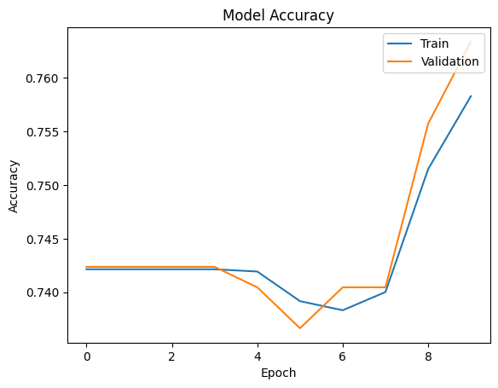
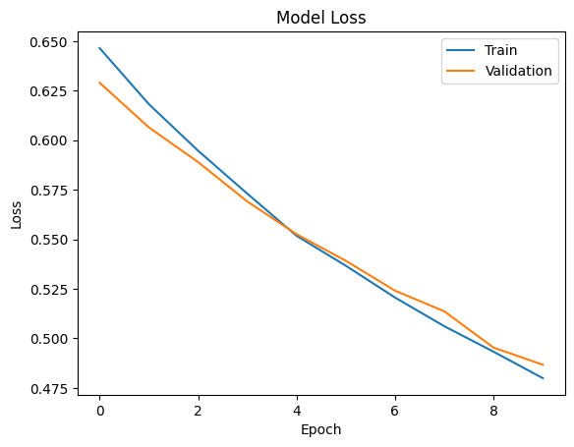
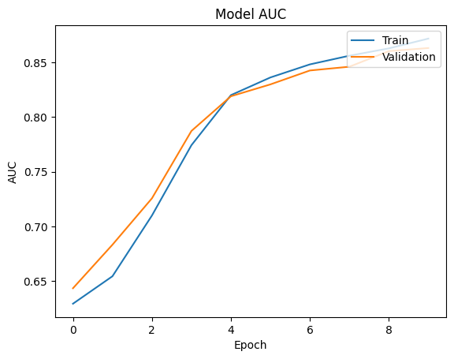

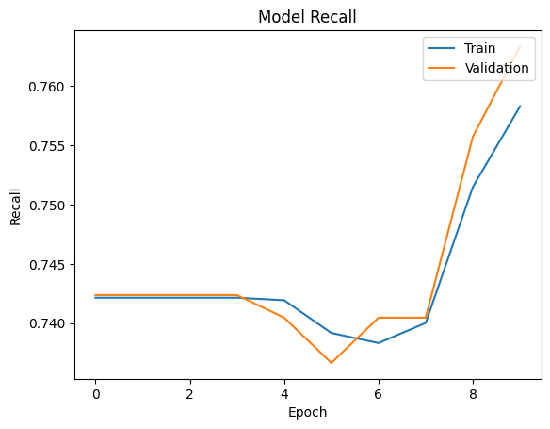
Original Model (Binary Dataset)

Slide 6
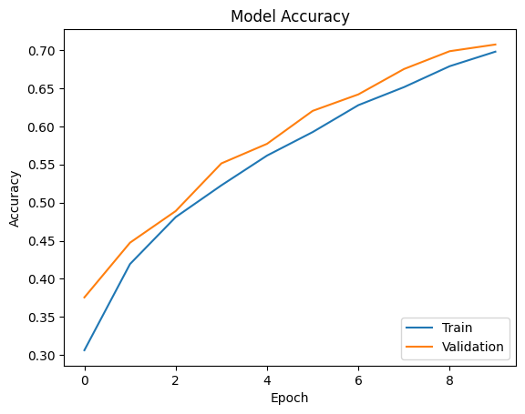
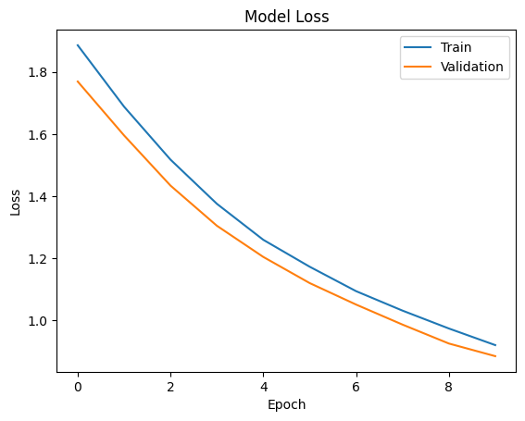
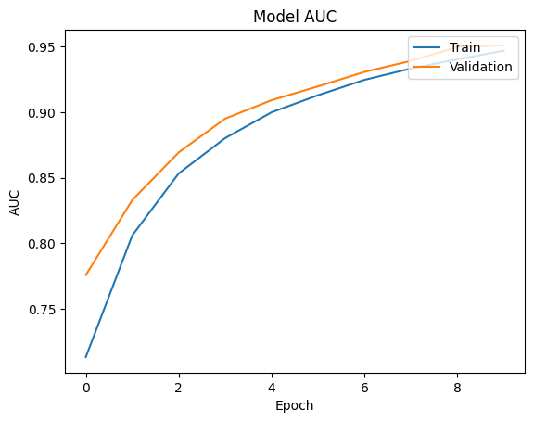
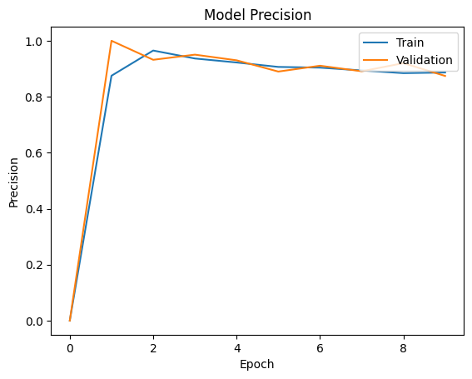
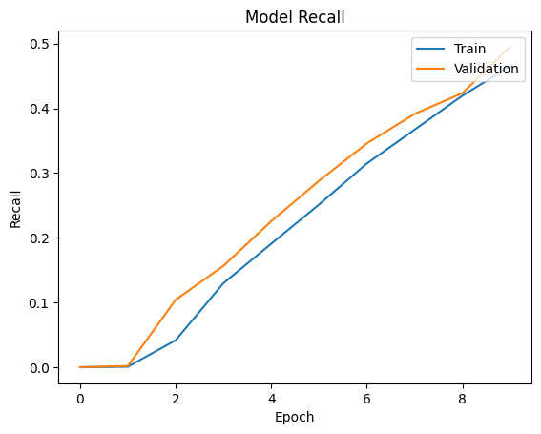
Original Model (Multi-class Dataset)

Slide 7
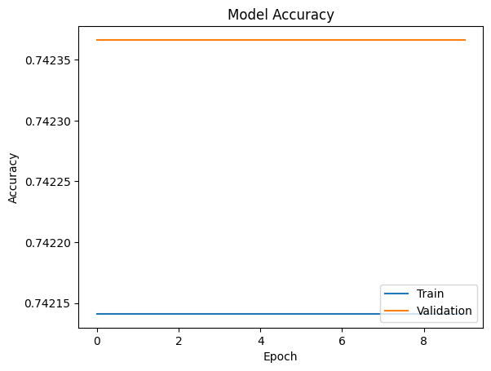
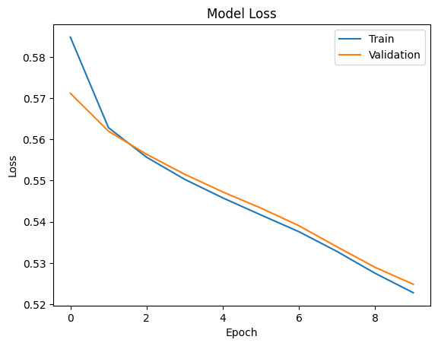
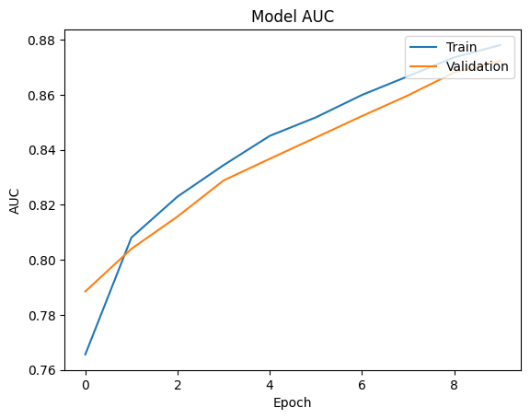
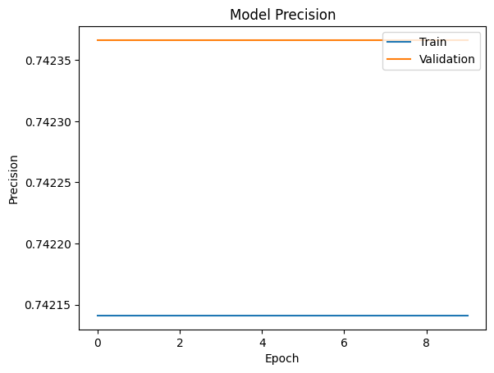
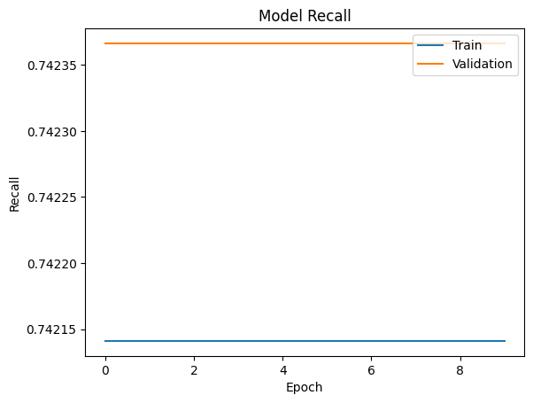
Dense Network (Binary Dataset)

Slide 8
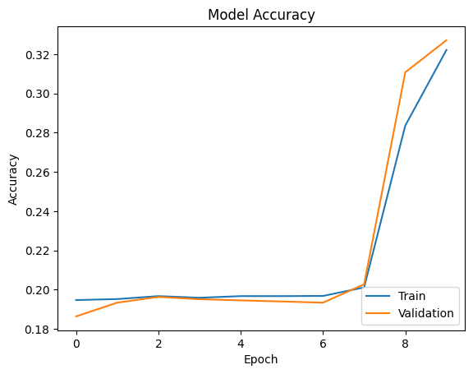
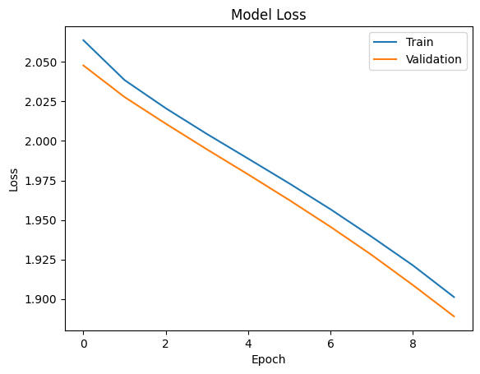
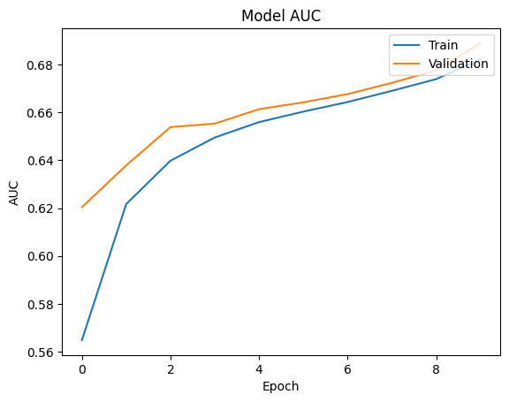
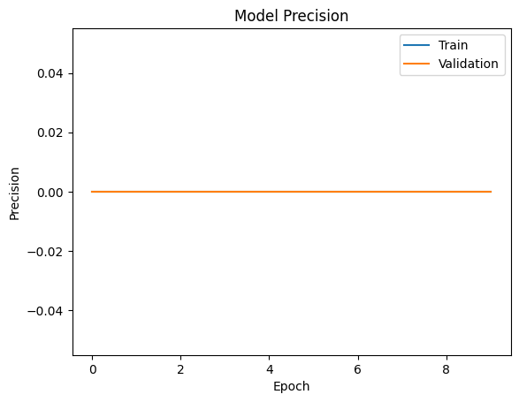
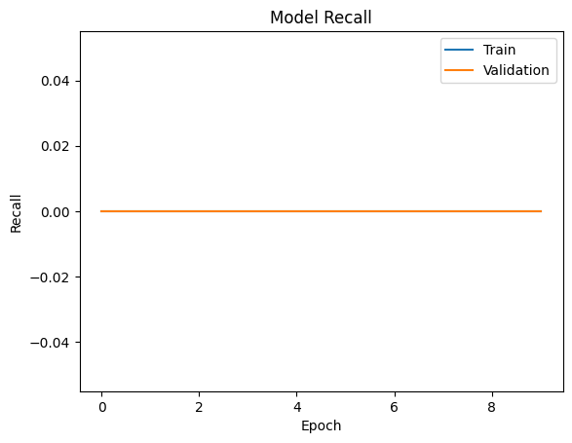
Dense Network (Multi-class Dataset)

Slide 9
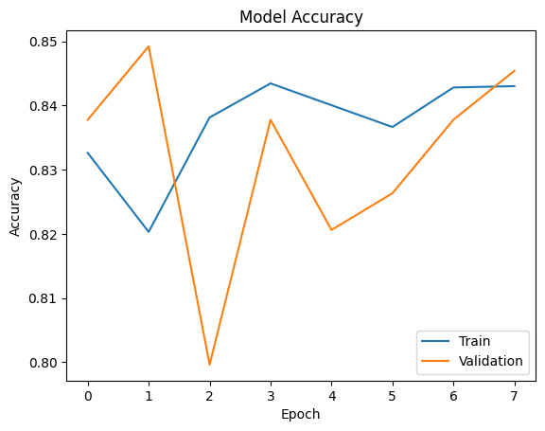
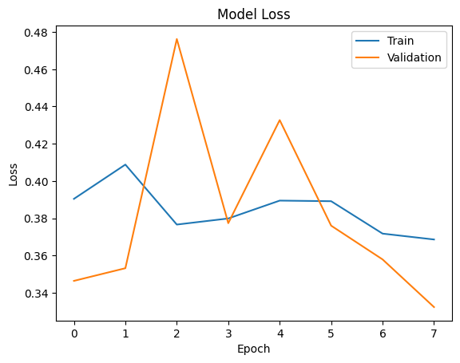
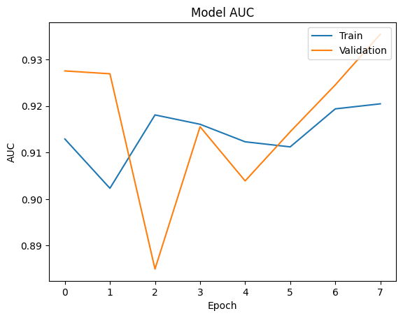
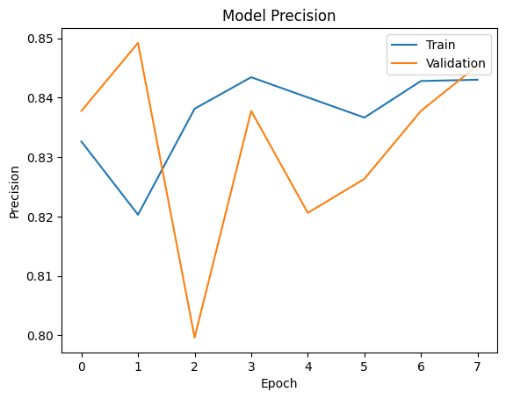
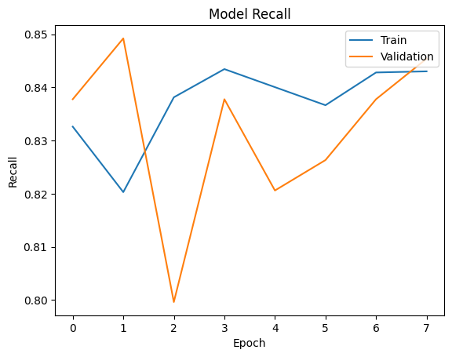
Convolution + Dense Network (Binary Dataset)

Slide 10
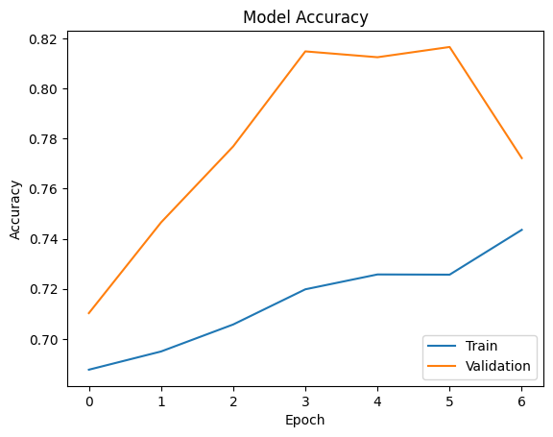
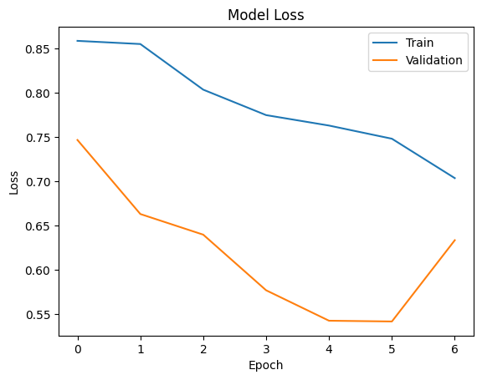
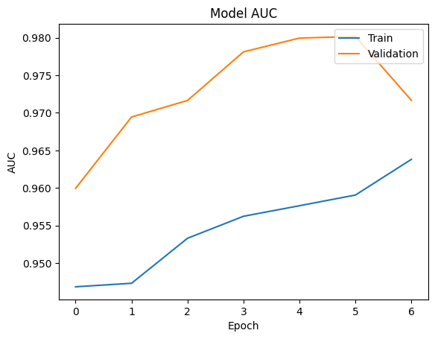
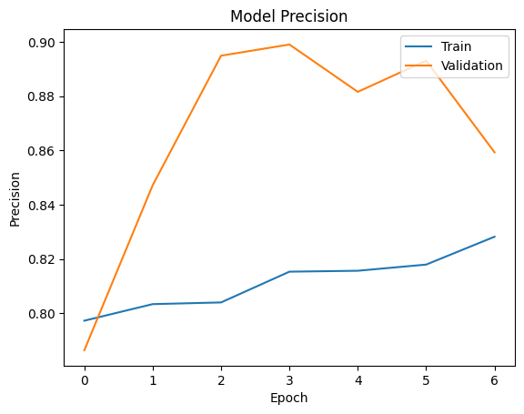
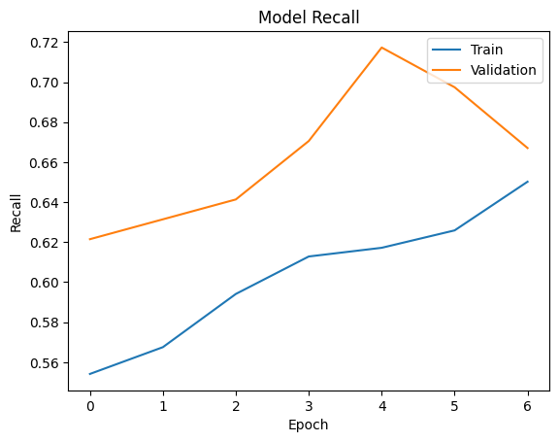
Convolution + Dense Network (Multi-class Dataset)

Slide 11
All models’ Test Metrics
Model | Binary/Multi-label | Accuracy | Loss | AUC | Precision | Recall
Original | Binary | 0.65 | 0.61 | 0.74 | 0.65 | 0.65
 | Multi-label | 0.70 | 0.91 | 0.95 | 0.88 | 0.48
Dense Networks | Binary | 0.63 | 0.65 | 0.77 | 0.63 | 0.63
 | Multi-label | 0.33 | 1.89 | 0.69 | 0.00 | 0.00
Convolutional + Dense Network (Augmented Data) | Binary | 0.78 | 0.50 | 0.86 | 0.78 | 0.78
 | Multi-label | 0.77 | 0.66 | 0.97 | 0.86 | 0.67

Slide 12
SUMMARY
There is not much of a difference among the different models on a binary dataset. This may be because, the PneumoniaMNIST dataset has only two classes and enough samples that are representative of the problem space.
But that difference is quite significant in case of multi-class dataset. It can be observed that Convolution networks perform much better than Dense networks. This is because Dense networks work on all the features of an image which include a lot of the redundant features. But convolution networks work on essential features which enhances model performance.
The 3rd model seems the best based on the metrics. The reason being the feature maps go deeper in the 2nd convolution layer whereas the original model has same depth in its convolution layers. Also 3rd model has one extra dense layer as compared to the original model which increases the number of parameters in the model and enhances the performance.
It should also be noted that data augmentation plays a big role in the model performance. The augmented data should not be much different from the original data as otherwise the augmented images only add noise to the model and significantly reduce the model performance.

