Slide 1
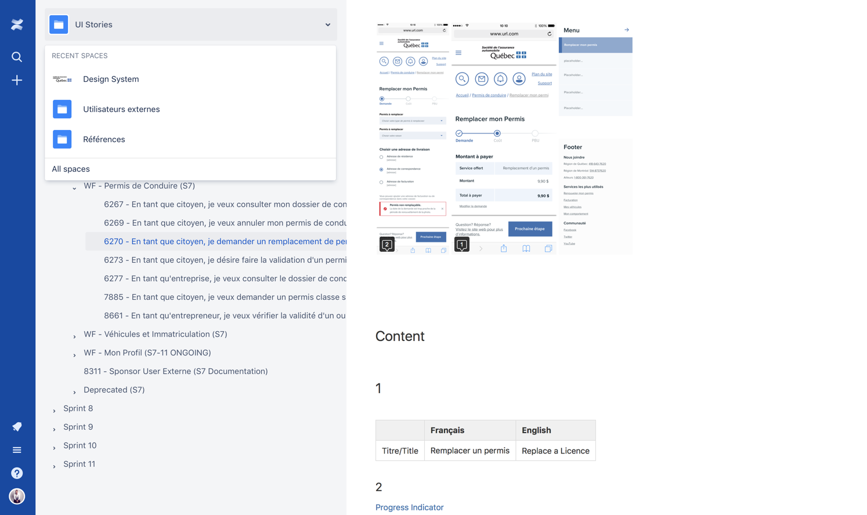

SAAQ
IBM Design Stories
A new government portal for citizen and employees
DIGITAL STRATEGY & VISION

