Slide 1
recap
Mario Leonini & Manuel Wittmer

Slide 2
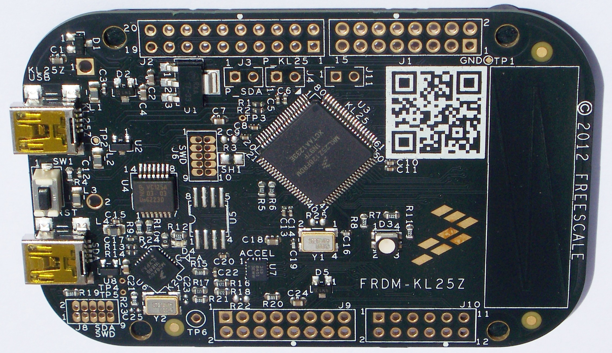
ARM
ARM:
Advanced RISC Machine
RISC:
Reduced Instruction Set Computer

Slide 3
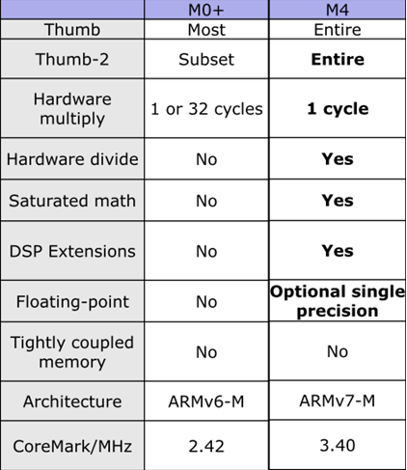
Cortex-M
Notes:
There are some differences between the two processors we are using in this module. On the FRDM we are using the ARM Cortex M0+ and on the Robo we use the ARM Cortex M4.
Here you see the differences. As you can see the M0+ is not supporting hardware divied and floating-point arithmetic. So we need to pay attention if we are writing software on those uControllers. An other thing is, that the M0+ needs more cycles for a multiplication. So it takes more time for a multiplication.
So why sould we use an M0+ instead of an M4?
blablabla

Slide 4
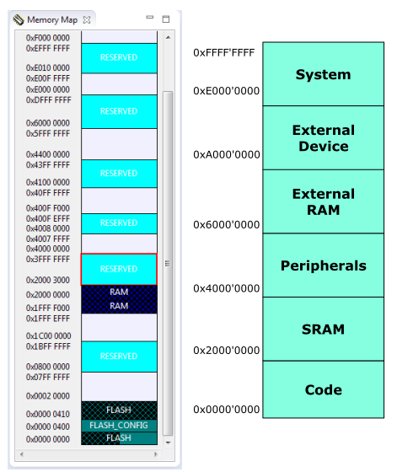
Memory Map

Slide 5
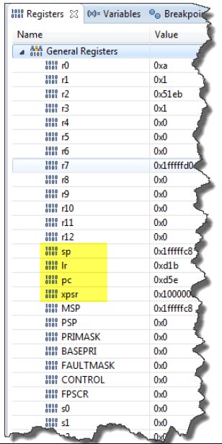
CPU Registers
General Purpose Register (GPR)
Stack Pointer
Link Register
Program Counter
Processor Status Register
Notes:
An ARM CPU has several registers. We can check and change the values in those registers while we are debugging.. Which can make it easier to find bugs and helps us to unterstand, what the microcontroller does in the background.
The general purpose registers R0 to R12 are working registers, which are used to store variables during operations.
Stack Pointer
Link Register: stores the return-addres to jump back to the code after a interrupt
Processor Status Register
PRIMASK and BASEPRI

Slide 6
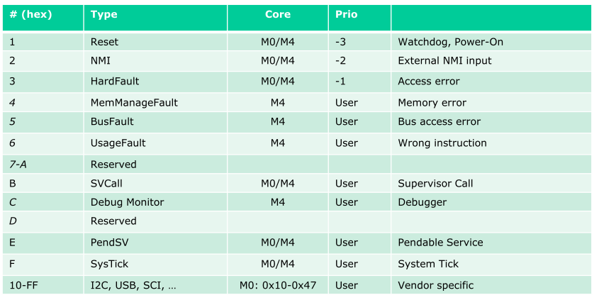
Exception Types

Slide 7
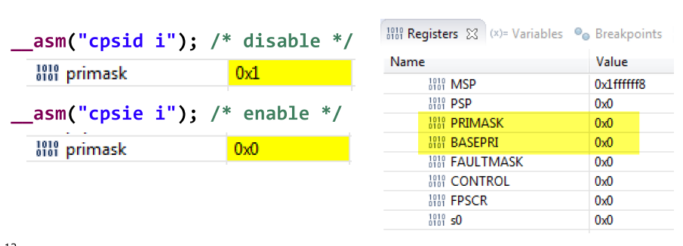
PRIMASK

Slide 8

Fault Exception

Slide 9
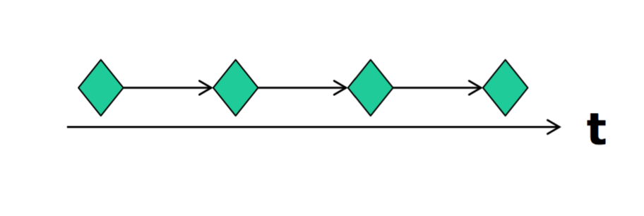
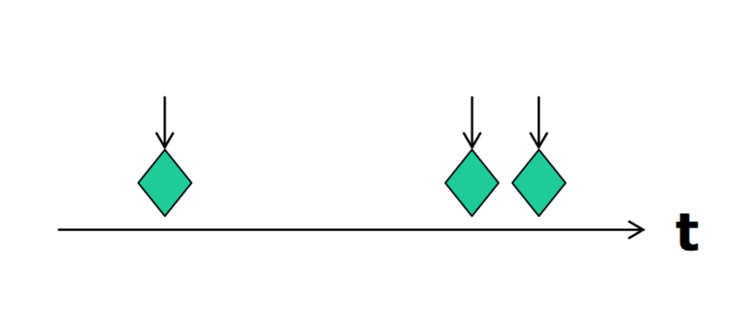
Events
Synchronous Events ( Timer interrupt)
Asynchronous Events ( Button pressed)

Slide 10
Interupt Execution Speed

Slide 11
Interrupt and Events

Slide 12
Storing Events

Slide 13
Event handle

Slide 14
Questions

