Slide 1
recap
Mario Leonini & Manuel Wittmer

Slide 2
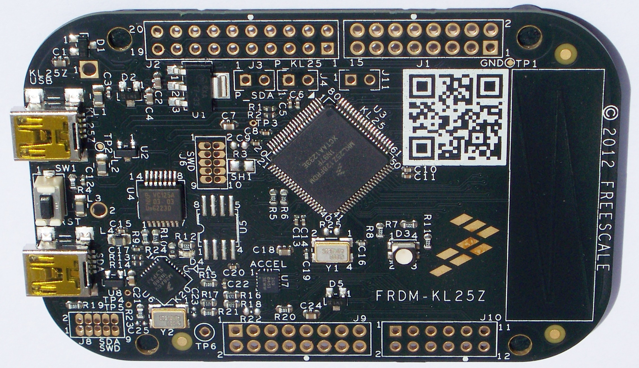
ARM
ARM:
Advanced RISC Machine
RISC:
Reduced Instruction Set Computer

Slide 3
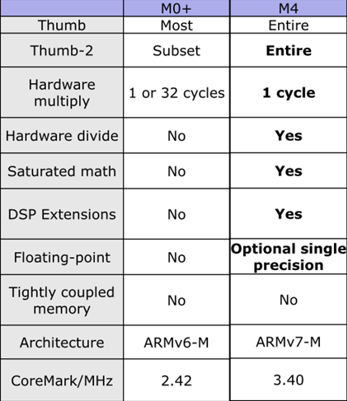
Cortex-M

Slide 4
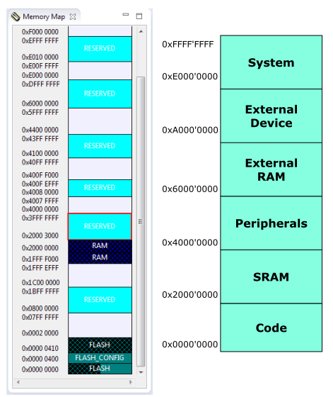
Memory Map

Slide 5
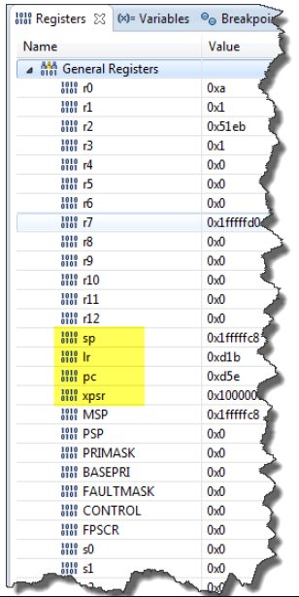
CPU Registers

Slide 6
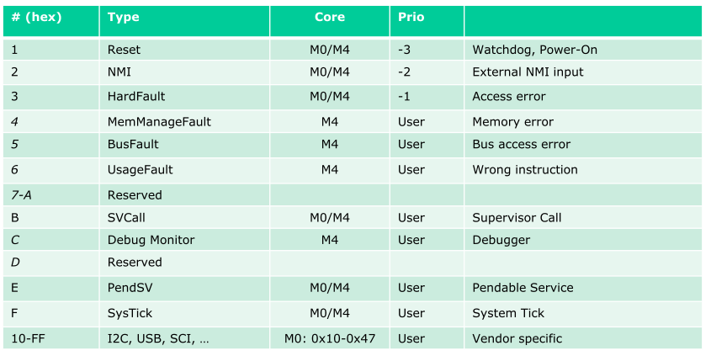
Exception Types

Slide 7
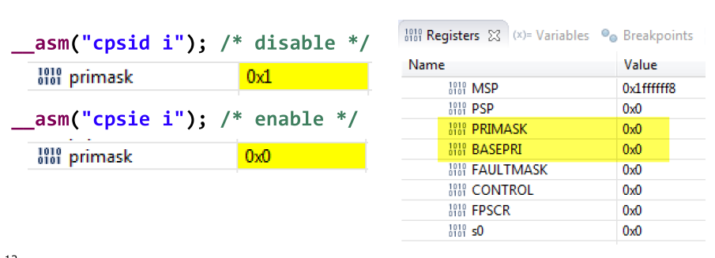
PRIMASK

Slide 8

Fault Exception

Slide 9
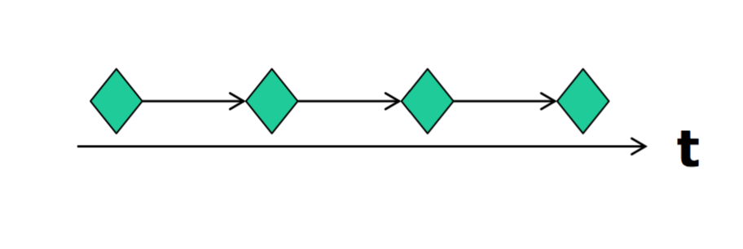
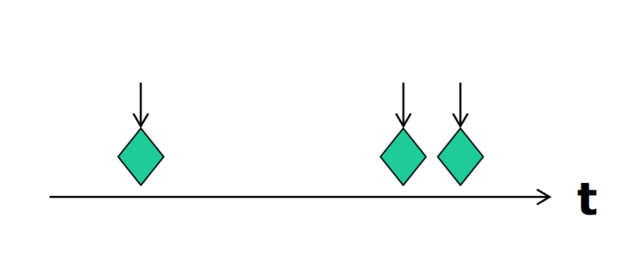
Events
Synchronous Events ( Timer interrupt)
Asynchronous Events ( Button pressed)

Slide 10
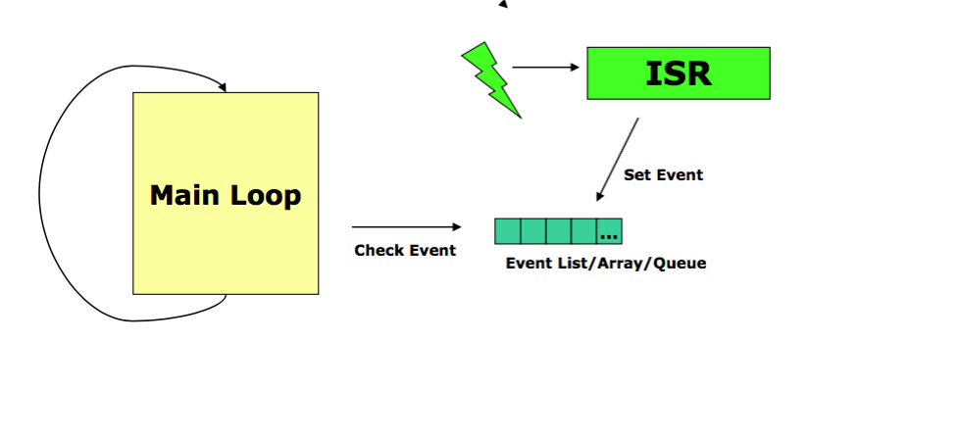
Interupt Execution Speed

Slide 11
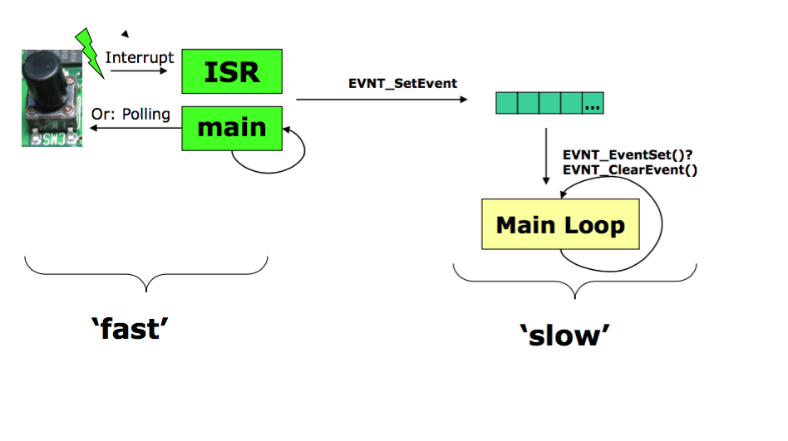
Interrupt and Events

Slide 12
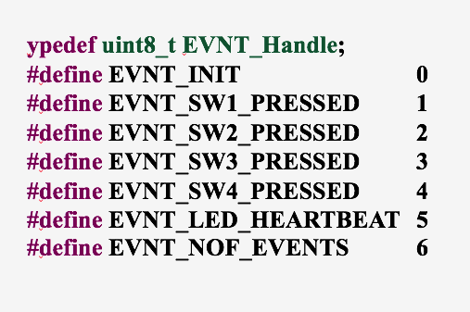
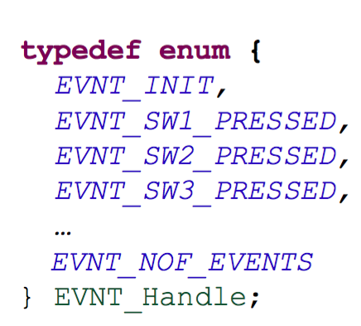
Storing Events
Define
Enum

Slide 13
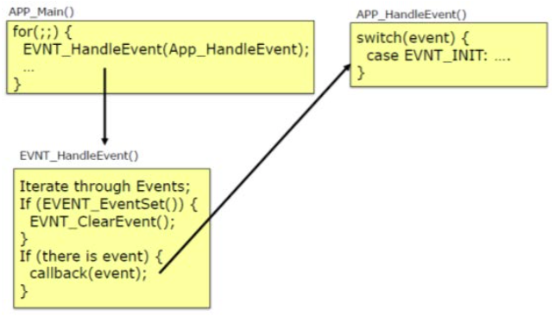
Event handle

Slide 14
Questions
What types of events we have?
Why we have events and processing separate?
Which memory types we have?

