Slide 1
recap
Mario Leonini & Manuel Wittmer

Slide 2
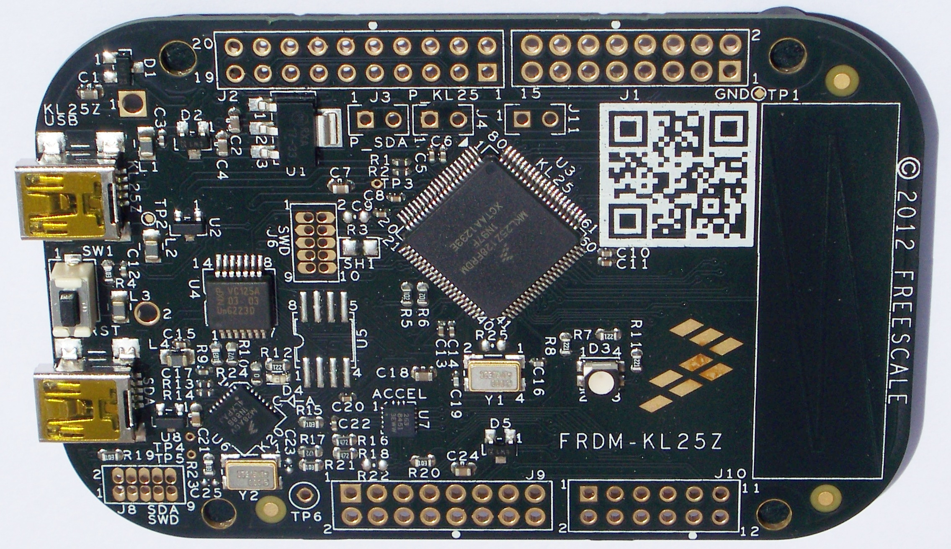
ARM
ARM:
Advanced RISC Machine
RISC:
Reduced Instruction Set Computer

Slide 3
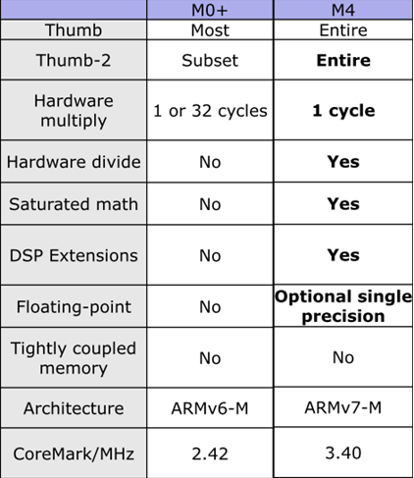
Cortex-M

Slide 4
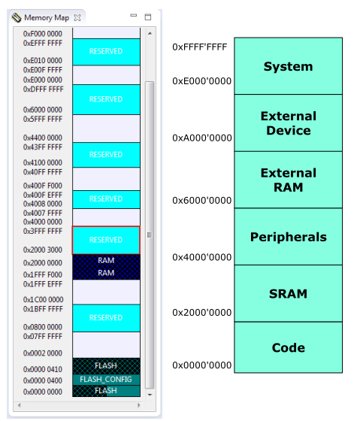
Memory Map

Slide 5
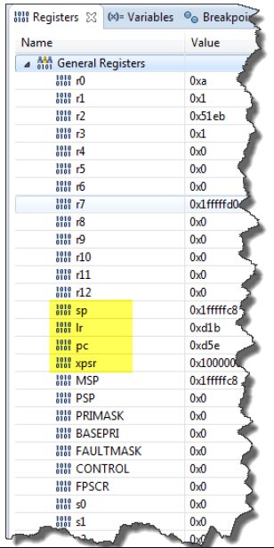
CPU Registers

Slide 6
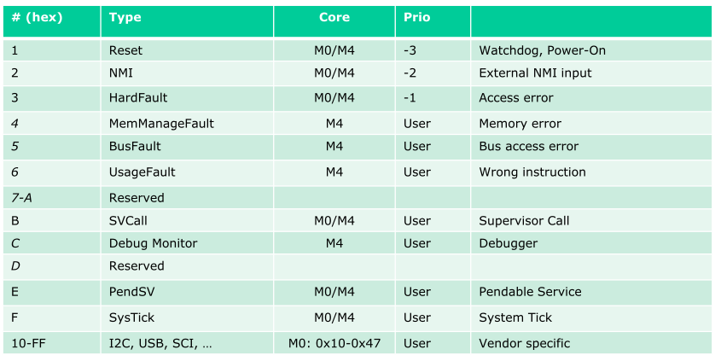
Exception Types

Slide 7
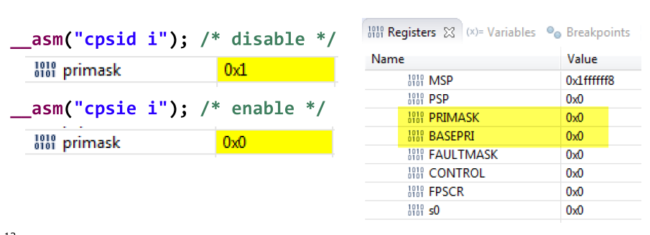
PRIMASK

Slide 8

Fault Exception

Slide 9
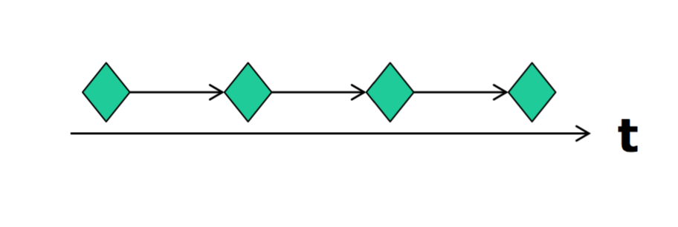
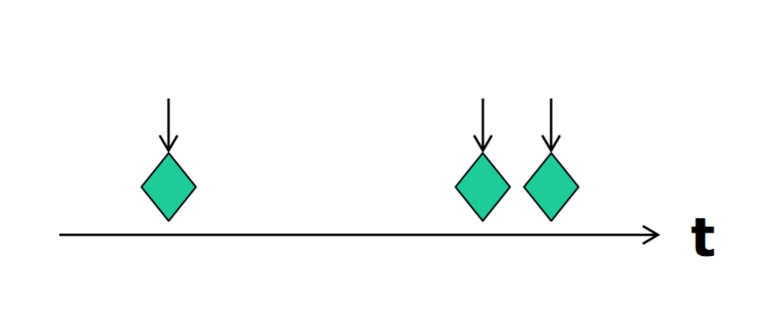
Events
Synchronous Events ( Timer interrupt)
Asynchronous Events ( Button pressed)

Slide 10
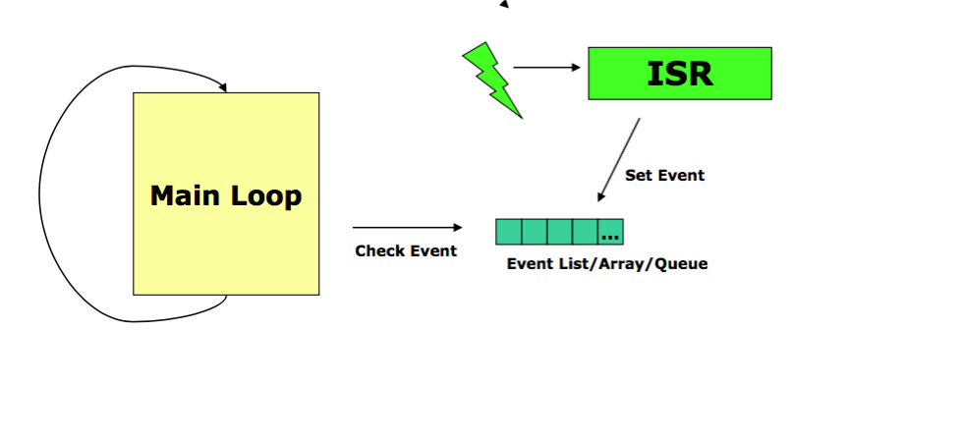
Interupt Execution Speed

Slide 11
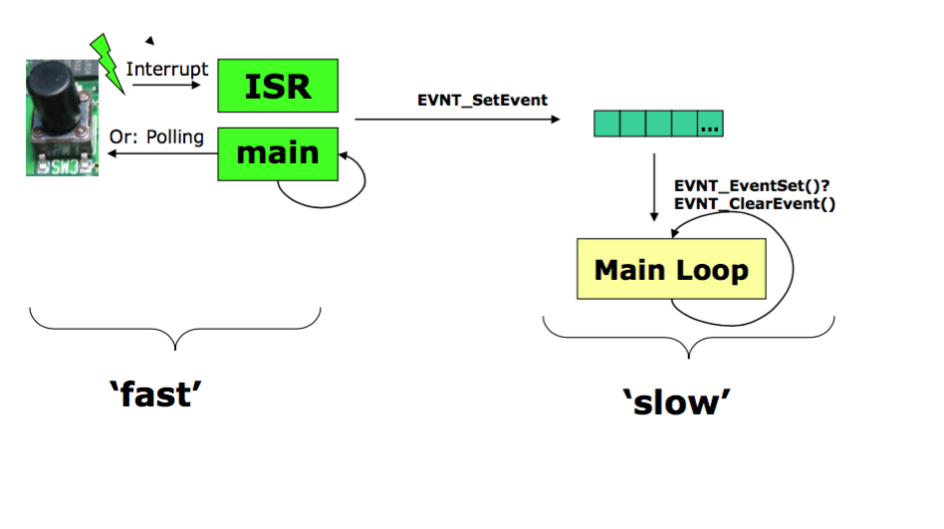
Interrupt and Events

Slide 12
Storing Events

Slide 13
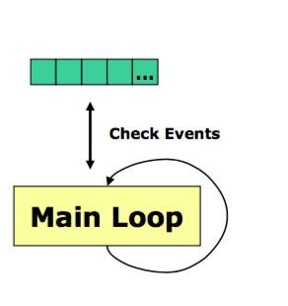
Event handle

Slide 14
Questions
What types of events we have?

