Slide 1
recap
Mario Leonini & Manuel Wittmer

Slide 2
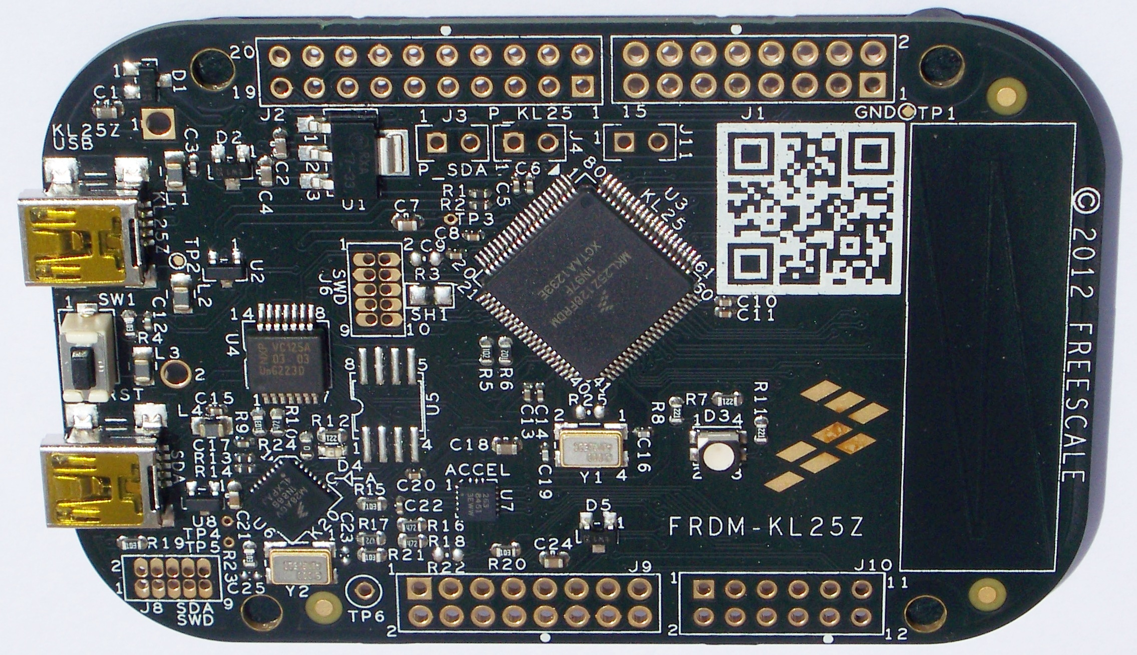
ARM
ARM:
Advanced RISC Machine
RISC:
Reduced Instruction Set Computer
FRDM => Cortex-M0+
Robo => Cortex-M4

Slide 3
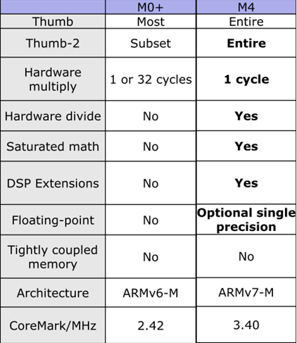
Cortex-M
Hardware multiply
cycles
Hardware divide
price
30% less silicon
Floating-point
Clock frequency
Notes:
There are several differences between the two processors we are using. Important for us is the hardware multiply, which needs more cycles on the M0+ than on the M4. Then the M0 doesnt have a hardware divider, which makes the processor cheaper than the M4
As you can see the M0+ is not supporting hardware divied and floating-point arithmetic. So we need to pay attention if we are writing software on those uControllers. An other thing is, that the M0+ needs more cycles for a multiplication. So it takes more time for a multiplication.
So why sould we use an M0+ instead of an M4?
blablabla

Slide 4
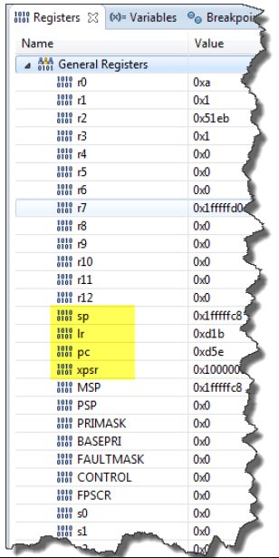
CPU Registers
General Purpose Register (GPR)
Stack Pointer
Link Register
Program Counter
Processor Status Register
Notes:
An ARM CPU has several registers. We can check and change the values in those registers while we are debugging. Which can make it easier to find bugs and helps us to unterstand, what the microcontroller does in the background.
The general purpose registers R0 to R12 are working registers, which are used to store variables during operations.
For example to save the program context before jumping into an interrupt function or something like that.
Stack Pointer and program counter
Link Register: which stores the return-addres to jump back to the code after a interrupt
Processor Status Register
PRIMASK

Slide 5
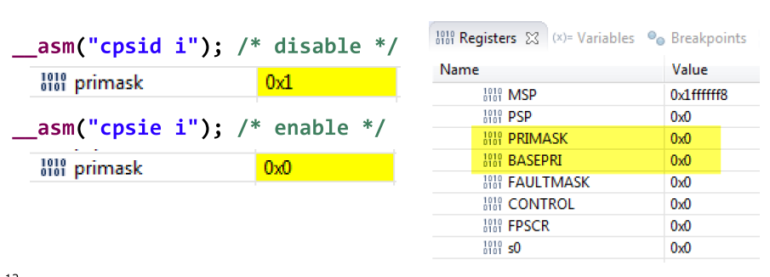
PRIMASK
Notes:
The PRIMASK bit is used to enable or disable interrupts

Slide 6
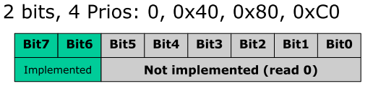
Priority Register
M0+ at least 4 priorities
M4 at least 8 priorities

Slide 7
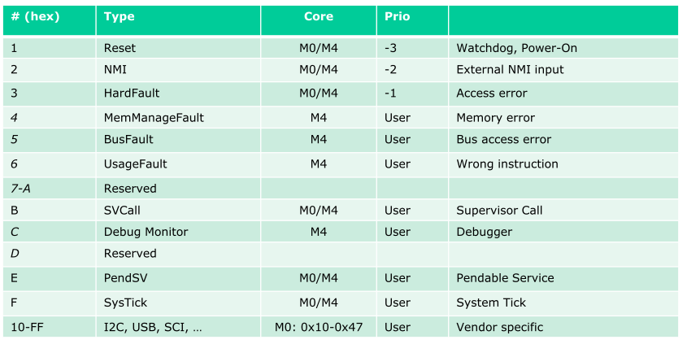
Exception Types
1-15: System Exception Types
> 15: External interrupts
The lower the number, the higher the priority!
1-3: negative priority

Slide 8

Hard Fault Handler
Processor Expert component
Link register & PC register

Slide 9
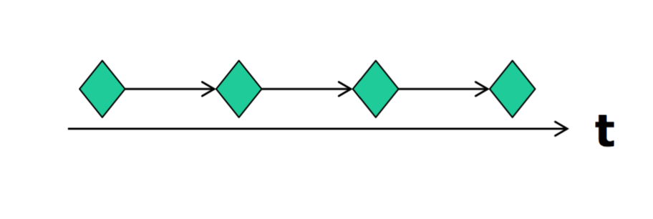
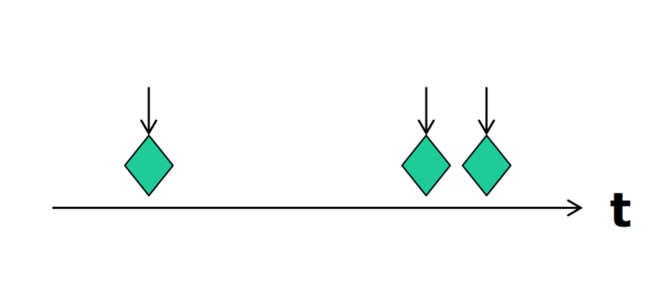
Events
Synchronous Events ( Timer interrupt)
Asynchronous Events ( Button pressed)

Slide 10
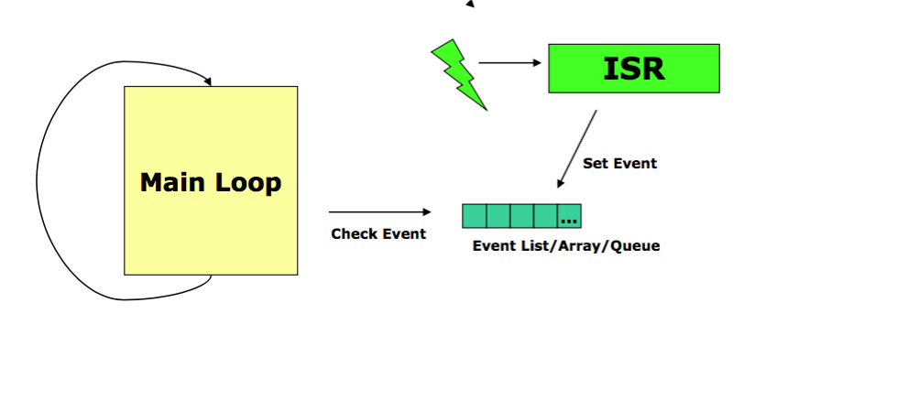
Interupt Execution Speed

Slide 11
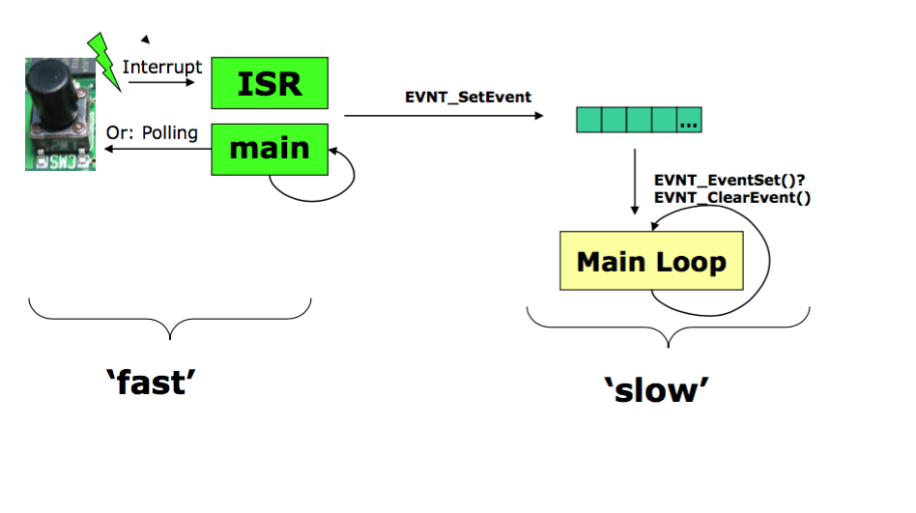
Interrupt and Events

Slide 12
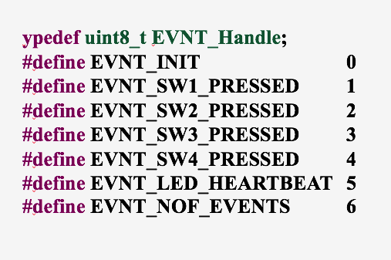
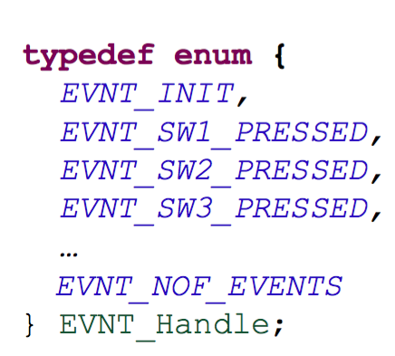
Storing Events
Define
Enum

Slide 13
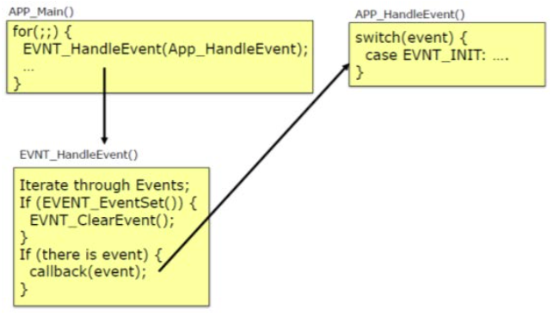
Event handling

Slide 14
Questions
What does ARM mean?
What does RISC mean?
Disadvantages of hardware division?
How long are the Memory Addresses?
What is the PRIMASK-Bit for?
What types of events we have?
Why we have events and processing separate?
Which memory types we have?

