Slide 1
recap
Mario Leonini & Manuel Wittmer

Slide 2
ARM

Slide 3
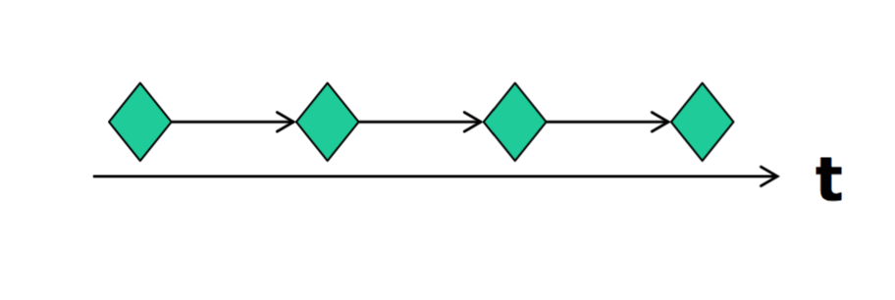
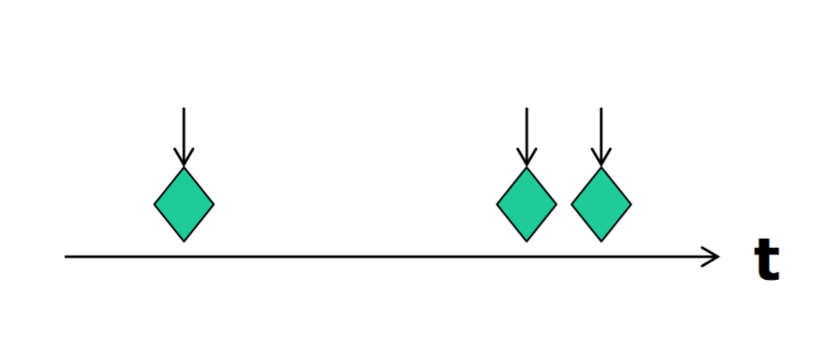
Events
Synchronous Events ( Timer interrupt)
Asynchronous Events ( Button pressed)

Slide 4
Interupt Execution Speed

Slide 5
Interrupt and Events

Slide 6
Storing Events

Slide 7
Event handle

Slide 8
Questions

