Slide 1
Executive Summary
Current Funnel State
The Primary Friction Point
The Delta
Strategic Verdict
Blended conversion rate stands at 0.50%. This is a deceptive average that masks a high-performing Mobile segment and a significantly under-indexed Desktop experience.
Mobile users convert at 4x the rate of Desktop users (1.0% vs. 0.25%).
Shift to a "Mobile-First" development priority. Realigning Desktop UX to match Mobile's efficiency and reallocating marketing spend will drive an immediate step-change in ROI.
The transition from Search to Payment is the "leakiest" part of the funnel, losing 86.7% of users. This represents the single largest opportunity for revenue unlock.

Slide 2




Full Funnel Performance & Attrition
Mid-Funnel Leakage Accounts for 90%+ of Total User Attrition
Home to Search (50% Retention)
Search to Payment (13.3% Retention)
Payment to Confirmation (7.5% Retention)
Initial user intent is strong and consistent across all platforms.
Critical Leakage Point. 6 out of 7 users drop off after searching, indicating issues with product relevance or "Add to Cart" visibility.
Final stage friction suggests technical payment errors, lack of guest checkout, or missing trust signals.
Bottom Line: For every 1,000 users who land on the Home Page, only 5 complete a purchase.

Slide 3
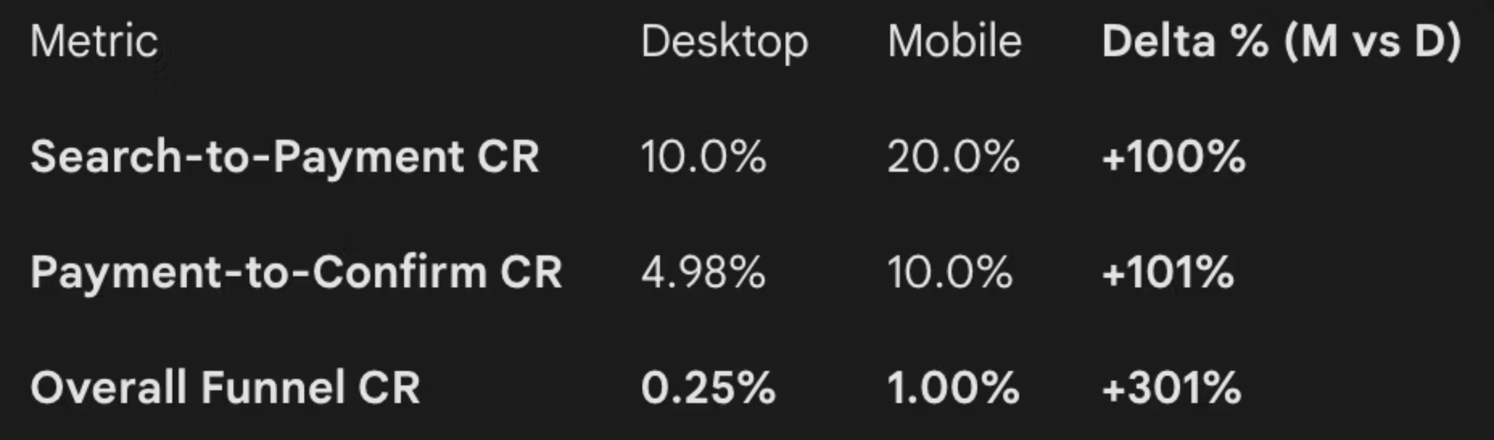
Platform Divergence (Mobile vs. Desktop)
Mobile Outperforms Desktop Across Every Node with a +301% Total Efficiency Gain
Platform Insight
Inference
Mobile users are 2x more likely to proceed to payment and 2x more likely to finalize a purchase once in the checkout flow.
The Mobile UI likely benefits from a simplified "linear" path, whereas Desktop may suffer from "information overload" or technical friction during checkout.

Slide 4
Key Behavioral Insights
Structural UX Barriers are Throttling Desktop Conversion and Final-Stage Checkout
Insight 1 (Search Relevance)
Insight 2 (Checkout Fatigue)
Insight 3 (Platform Intent)
The 92.5% drop-off at the Payment stage is a major red flag. On Desktop, this drop-off is nearly 95%, suggesting the Desktop payment form is likely too complex or prone to errors.
Mobile is functioning as a high-velocity transactional tool, while Desktop is currently functioning as a "window-shopping" platform with significant barriers to closing the sale.
The +100% Delta in Search-to-Payment suggests Mobile search results are either more relevant or the layout allows for faster product selection compared to Desktop.

Slide 5
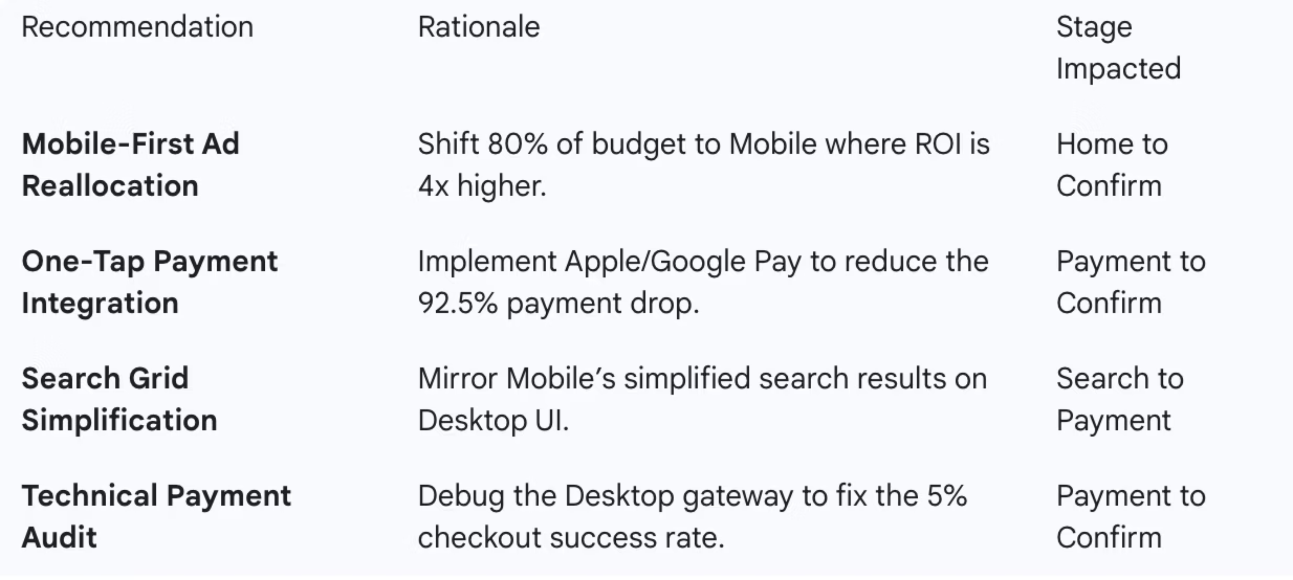
Strategic Recommendations
High-Impact Interventions to Triple Revenue

Slide 6
01
02
Immediate Technical Remediation
Mobile-First Resource Arbitrage
Conduct an urgent root-cause analysis and rollback of UI/API updates
Reallocate 80% of the marketing budget toward Mobile channels to capitalize on its 4x higher conversion efficiency compared to Desktop.
03
04
Search-to-Payment UX Optimization
Frictionless Checkout Integration
Simplify the search results interface and implement "Quick-Buy" buttons to address the massive 86.7% drop-off at the product discovery stage.
Deploy one-tap payment solutions to eliminate the final-stage friction that currently causes 92.5% of payment-ready users to abandon.

Slide 7
Risks & Next Steps
Immediate Deployment of UX Monitoring and Technical Root-Cause Analysis
Data Limitation
Technical Risk
Analysis assumes a single-session journey. We need cross-device tracking to ensure users aren't "Searching on Desktop" and "Buying on Mobile."
A technical audit is required to ensure the 95% Desktop payment drop isn't caused by a specific browser incompatibility

