Slide 1

Real Estate Market Analysis
2013 - 2023

Slide 2
Executive Summary
Market Activity Peak: Sales volume peaked in 2021, followed by a correction in 2022.
Price Resilience: Average prices remained stable ($700k-$800k) despite volume drops.
Geographic Dominance: NYC leads in volume; niche markets like North Hampton, NH lead in price.
Value Drivers: Strong positive correlation between Size/Bathrooms and Price.

Slide 3
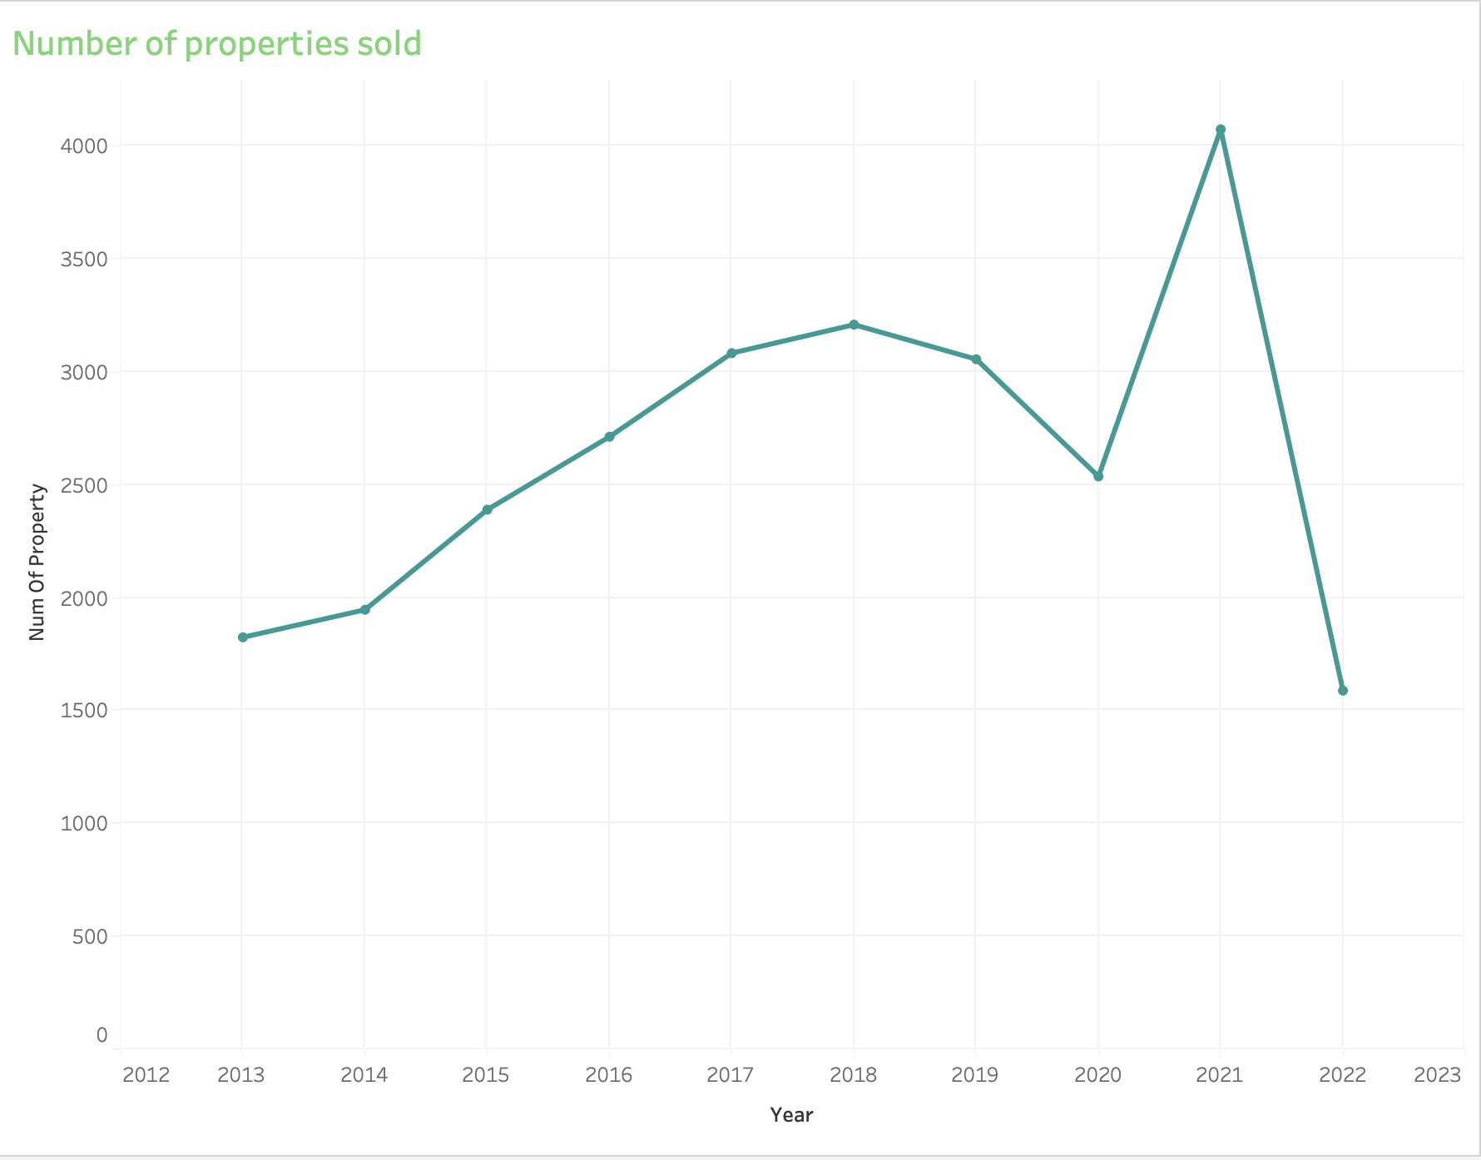
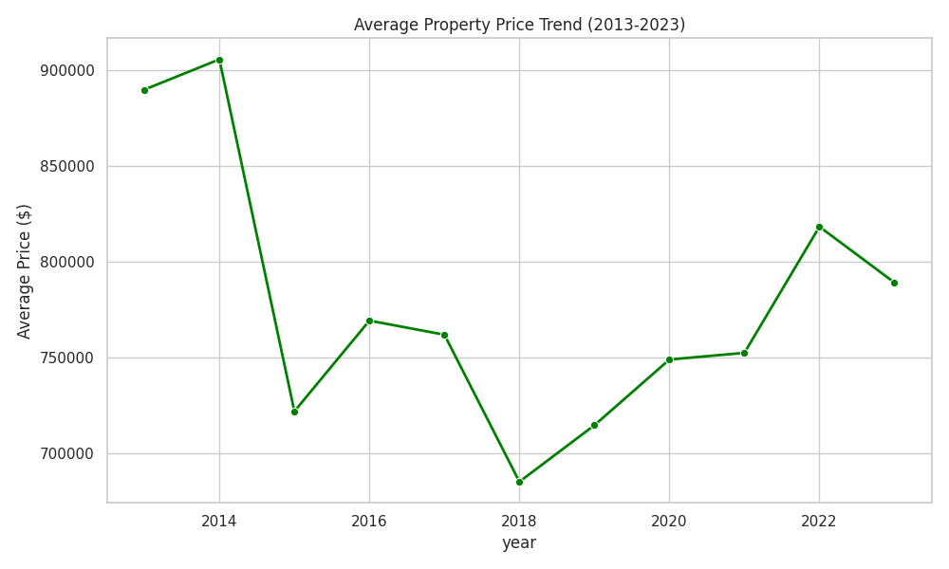
Market Trends: Volume & Price
Between 2020 and 2021, the real estate market experienced an unprecedented "surge" in transaction volume. This was driven by a combination of record-low interest rates, a shift toward remote work (the "Race for Space"), and pent-up demand from the initial pandemic lockdowns. However, by 2022, the market "cooled" significantly as interest rates rose and inventory levels remained historically low. Despite this drop in sales volume, average prices remained "sticky" (price inelasticity). This indicates a market where sellers are unwilling to lower prices even as buyer demand softens, primarily due to the limited supply of high-quality inventory.

Slide 4
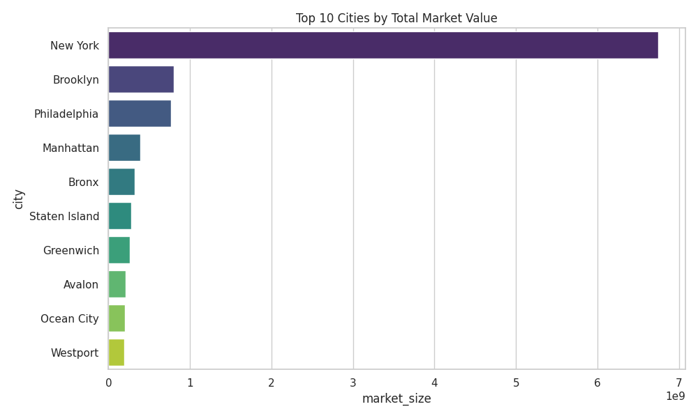
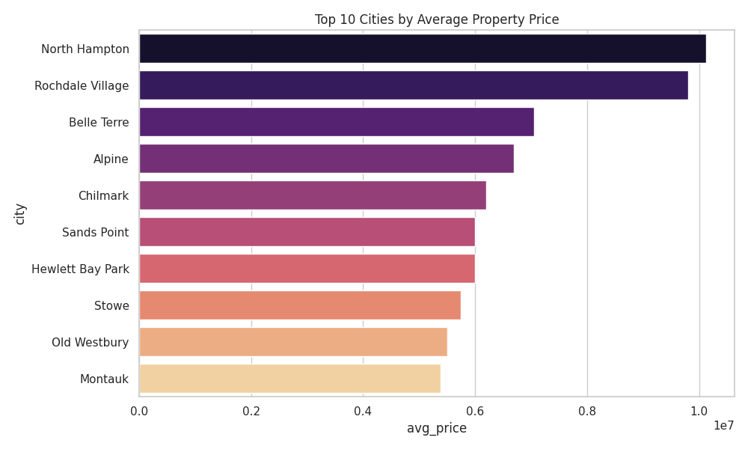
Geographic Performance
There is a clear divide between High-Volume and High-Value markets. New York City functions as the regional "Volume Engine," accounting for the largest share of total transactions and market liquidity. Its dominance is driven by high-density urban turnover. In contrast, the "Premium Value" is concentrated in exclusive, low-density luxury enclaves. Towns like North Hampton, NH and Belle Terre, NY show significantly higher average price points than major metropolitan centers. This reflects a market preference for "safe-haven" assets in prestigious locations where the scarcity of land and exclusivity of the community act as a hedge against broader market volatility.

Slide 5
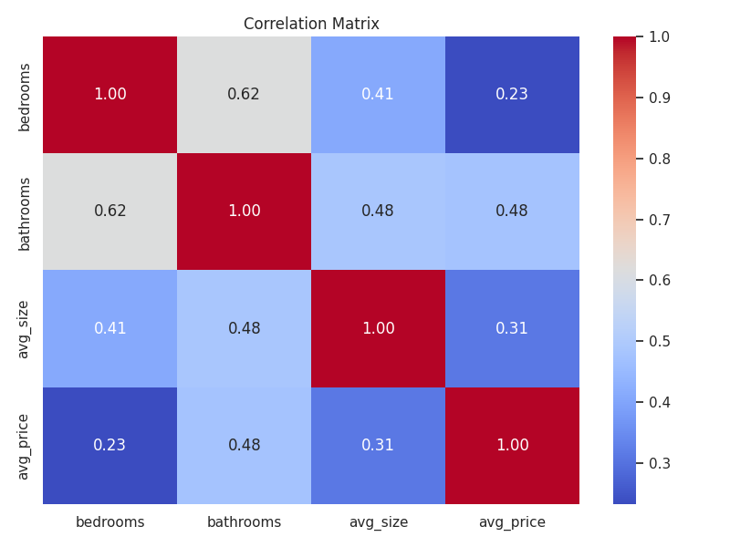
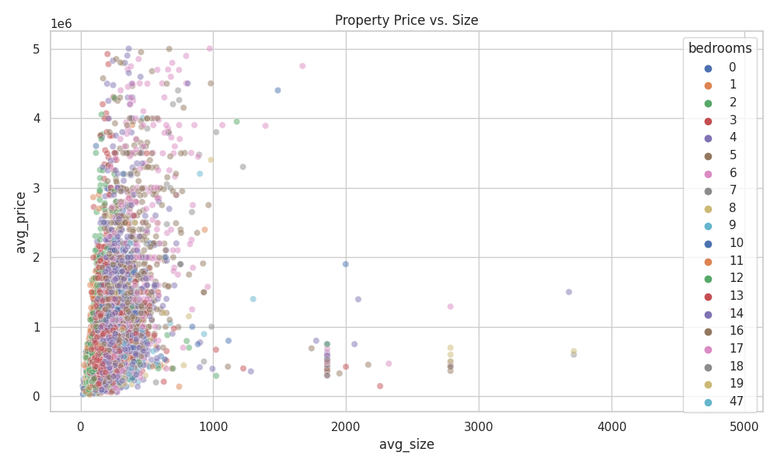
Price Drivers
The analysis shows that Bathrooms are a stronger indicator of a property's value than Bedrooms. This suggests that high-value buyers are prioritizing amenities and luxury finishings over just simple room count.
On average, every extra square foot adds about $2,240 to the price tag
The "Bedroom" Insight This is the most interesting part of the chart. You might expect that "More Bedrooms" (darker/different colored dots) would always be at the top right (most expensive/biggest). But they aren't always.
The "Cramped" Effect: Some properties with many bedrooms are actually lower on the price scale. These are likely smaller homes where developers squeezed in extra rooms, making them feel cramped rather than luxurious.
The "Luxury" Effect: Conversely, we see properties with fewer bedrooms (light colors) that are very large (far right). These represent "Grand" living spaces, huge master suites, open floor plans. These often command a premium because they signify luxury, not just utility.

