Slide 1
TRACK 2: PERSONAL AGENTS & DATA PRIVACY
AegisMCP 🛡️
Zero-Leakage Privacy Firewall & Clean-Room Broker for AI Agents
🔒 Zero PII in Context
LLMs never see raw credit cards, home addresses, or passports. All physical actions use single-use HMAC surrogate tokens.
⚡ Clean-Room Math
Differential privacy quantization bounds balance leakage. Answers 'can I afford this?' without revealing total net worth.
💳 Live Stripe Charges
Isolated daemon ('aegis-broker') holds sealed platform keys and completes live Stripe transactions out-of-band.

Slide 2
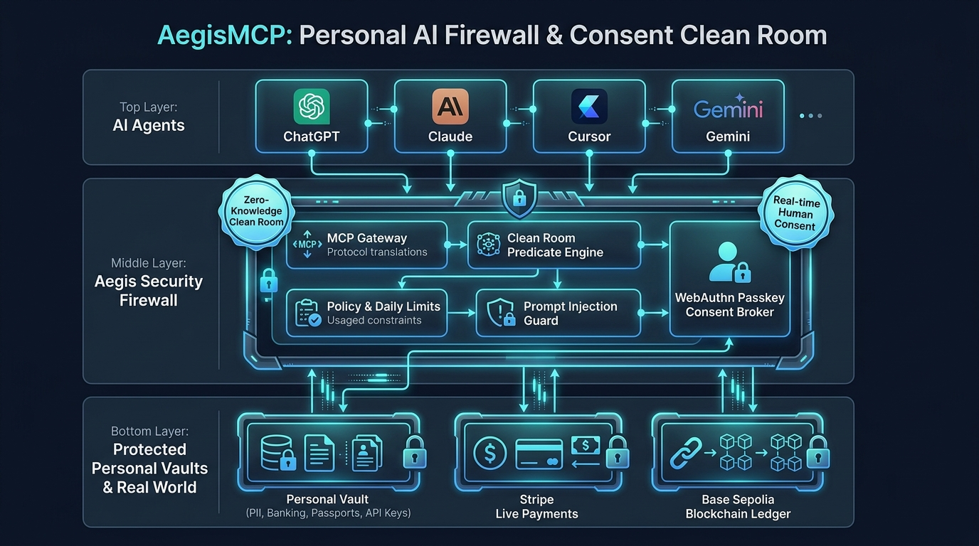
System Architecture & Request Pipeline
Real-time cryptographic interception between autonomous models and physical execution
1. Agent Tool Call
Cursor Agent or ChatGPT calls /mcp tool (e.g. order_item, book_flight, make_payment).
2. Policy & Risk Scoring
Aegis evaluates risk level (LOW/MED/HIGH/CRIT) and checks user daily spend caps.
3. Clean-Room & Surrogate Vault
Sensitive attributes tokenized (aegis_ship_..., aegis_pm_...). Differential privacy applied.
4. Human Consent Interception
Dashboard (/u/maya) halts execution with diff card and 60-second countdown.
5. Out-of-Band Broker Execution
aegis-broker unseals live Stripe/airline API keys out-of-band. 0% raw PII in LLM context.

Slide 3
Human-in-the-Loop: The 3 Approval Modes
Granular privacy control on every sensitive transaction diff card at /u/{subject}
1. Approve CLEAN ROOM
TOKENIZED SURROGATE (RECOMMENDED)
• Generates single-use opaque tokens (aegis_pm_..., aegis_ship_...)
• Dispatches real payment / shipping out-of-band directly to Stripe & merchants
• 0% raw PII in model context
• Ideal for fully autonomous agent workflows
2. Approve REDACTED
DISPLAY MASKING (WITH ASTERISKS)
• Replaces sensitive digits with asterisks (**** **** **** 4242)
• Retains human-readable city/state for verification
• Real payment processed via backend proxy
• Ideal when agent needs to show human summary confirmation
3. Allow RAW
PLAINTEXT OVERRIDE (DEV/OVERRIDE)
• Injects exact raw credentials into model context window
• HARD SAFETY LOCK: Regulated identifiers (SSN, Passport) permanently BLOCKED
• Triggers critical ledger audit warning
• Use case: Explicit manual debugging & developer tool overrides

Slide 4
Button 1: Approve CLEAN ROOM (Tokenized)
Autonomous Mode: Mutual Information I(X; Y) = 0 bits | Real Stripe transaction completed out-of-band
How it Works in Aegis:
1. Agent calls order_item or make_payment
2. Diff card appears on /u/maya. User clicks 'Approve CLEAN ROOM'
3. Aegis Vault generates cryptographic HMAC surrogate tokens:
- aegis_ship_d37a892b10ef
- aegis_pm_7f8a9b2c3d4e
4. aegis-broker contacts Stripe API directly over TLS, creating live PaymentIntent (pi_3UTVCd...)
5. The model receives confirmed tokenized response. Zero PII enters prompt memory.
EXACT JSON PAYLOAD RETURNED TO AGENT (LLM CONTEXT):
{
"status": "APPROVED_TOKENIZED",
"order_id": "aegis_ord_8f19c2e04",
"shipping": {
"recipient": "Maya Lin",
"delivery_token": "aegis_ship_d37a892b10ef",
"routing": "USPS_ZONE_4"
},
"payment": {
"surrogate_token": "aegis_pm_7f8a9b2c3d4e",
"live_stripe_charge": "pi_3UTVCdAM6XW2dK7l03VpX1rK",
"amount_billed_usd": 45.00
},
"privacy_guarantee": {
"raw_pii_exposed_to_model": false,
"leakage": "0 bits (surrogate isolated)"
}
}

Slide 5
Button 2: Approve REDACTED (Masked)
Display Redaction: Preserves high-level context (last 4 digits, city) without exposing raw secret PAN or street address
How it Works in Aegis:
1. Agent requests customer verification details
2. User clicks 'Approve REDACTED 60s'
3. Aegis PII Redactor parses sensitive AST nodes:
- Card number -> **** **** **** 4242
- Street address -> ********************
- City/State kept -> San Francisco, CA
4. Live Stripe payment is still authorized out-of-band
5. The agent can summarize confirmation to the user in chat without possessing the secret PAN or street number.
EXACT JSON PAYLOAD RETURNED TO AGENT (LLM CONTEXT):
{
"status": "APPROVED_REDACTED",
"order_id": "aegis_ord_8f19c2e04",
"shipping": {
"recipient": "M*** L**",
"street": "********************",
"city": "San Francisco",
"state": "CA",
"postal_code": "941**"
},
"payment": {
"card_brand": "Visa",
"card_last4": "4242",
"card_number": "**** **** **** 4242",
"live_stripe_charge": "pi_3UTVCdAM6XW2dK7l03VpX1rK",
"amount_billed_usd": 45.00
}
}

Slide 6
Button 3: Allow RAW (Plaintext Override)
Explicit Developer Override Mode | Regulated Identifiers (SSN, Passport) Protected by Hardware Lock
How it Works & Safety Locks:
1. Explicit override for developers testing models or non-regulated fields
2. Releases raw plaintext directly into model context
3. HARD-CODED SAFETY BARRIER:
If the request touches Regulated Identifiers:
- Social Security Number (SSN)
- Government Passport Number
-> 'Allow RAW' button is HARD DISABLED in UI.
4. Critical audit receipt logged to SHA-256 ledger.
EXACT JSON PAYLOAD RETURNED TO AGENT (LLM CONTEXT):
{
"status": "APPROVED_RAW_OVERRIDE",
"order_id": "aegis_ord_8f19c2e04",
"shipping": {
"recipient": "Maya Lin",
"street_address": "452 Tehama St, Apt 3B",
"city": "San Francisco",
"state": "CA",
"postal_code": "94103"
},
"payment": {
"cardholder": "Maya Lin",
"card_number": "4242424242424242",
"cvv": "921",
"exp_month": 12,
"exp_year": 2028,
"amount_billed_usd": 45.00
},
"privacy_warning": "CRITICAL: Raw credentials exposed."
}

Slide 7
Side-by-Side Comparison Matrix
What LLM sees vs what gets executed in the real world
Dimension | 1. Approve (Tokenized) | 2. Approve (Masked) | 3. Approve (Raw)
Physical Address | aegis_ship_d37a892b10ef | San Francisco, CA 941** | 452 Tehama St, Apt 3B
Payment Card | aegis_pm_7f8a9b2c3d4e | **** **** **** 4242 | 4242424242424242
Govt Passport / SSN | aegis_pass_shielded | USA ••••••710 | 🚫 BLOCKED BY POLICY
Stripe Execution | Out-of-band broker proxy | Out-of-band broker proxy | Model direct / broker
Mutual Information | I(X; Y) = 0 bits | Bounded leakage | Total leakage
Context Safety | ✅ 100% Zero Leakage | ⚠️ Partial / Summary | ❌ High Risk of Exfiltration

Slide 8
Live Agent Demos & Verified Tasks
Tested with ChatGPT and Cursor Agent over persistent Cloudflare tunnel
Autonomous E-Commerce Order
PROMPT: 'Find a desk fan under $25 and order it via Aegis'
• Agent calls order_item
• Diff card fires on /u/maya
• Maya clicks [Approve CLEAN ROOM]
• Live Stripe charge: pi_3UTVCd...
• Agent gets: aegis_ship_..., aegis_pm_...
• ZERO street address or card numbers leaked!
Differential Privacy Financials
PROMPT: 'Can I afford to purchase a $45 accessory?'
• Agent calls query_financials
• DP engine quantizes against $500 bucket
• Returns: can_afford: true, checked_against: 500.0
• Agent gets exact affordability answer without knowing total bank balance!
Delegated Shielded Flight Booking
PROMPT: 'Book United flight UA 1542 for Maya Lin'
• Agent calls book_flight
• Aegis contacts airline directly over TLS
• Injects passport & DOB from vault out-of-band
• Agent gets ticket reference: aegis_tkt_...
• Passport never enters LLM context window!

